Slide 1
Programming in R

Slide 2
Introduction
R is a programming language and software environment for statistical computing and graphics.
The R language is widely used among statisticians and data miners for developing statistical software and data analysis.
It compiles and runs on a wide variety of UNIX platforms, Windows and Mac OS.
R can be downloaded and installed from CRAN website , CRAN stands for Comprehensive R Archive Network.

Slide 3
Features
Open Source:
The source code of R program and the extensions could be examined line by line.
Integrating with other Programming Language:
R is an interpreting language, can be rather slow, but could integrate with high eﬃcient languages such as C, C++ or Fortran.
OS Independence:
UNIX, Linux, Windows, MacOS, FreeBSD...
Command line Driven

Slide 4
Basic Commands
• help() – help(demo)
• demo() – demo(is.things)
• q()
• ls()
• rm() – rm(x)

Slide 5
Basic Datastructures
• Factor
• Vector
• List
• Array
• Matrix
• Data Frame

Slide 6
1. Factors

Slide 7

FACTORS
Factor is a data structure used for fields that takes only predefined, finite number of values (categorical data).
For example, a data field such as marital status may contain only values from single, married, separated, divorced, or widowed.
Factor x has four elements and two levels.
We can check if a variable is a factor or not using class() function.
Levels of a factor can be checked using the levels() function.

Slide 8

Levels of a factor are inferred from the data if not provided.
We can change the levels of the factor if needed.
Eg:
x <- factor(c("single", "married", "married", "single"), levels = c("single", "married", "divorced"));
> x [1] single married married single
Levels: single married divorced
Structure of the factor:

Slide 9
Nominal categorical variables Vs Ordinal variables
They have no order.
Trying to compare two such factors returns NA
Eg:
We cant say that blood group A is > blood group B
Ordering is present.
Eg:
sf <- factor(c(“S”,”L”,”M”,”L”)levels= c(“S”,”L”,”M”), ordered=TRUE)
> sf
S L M L
levels = S<M<L

Slide 10
2. Vectors

Slide 11
Vectors
Vector is a basic data structure in R. It contains element of the same type.
The data types can be logical, integer, double, character, complex or raw.
A vector’s type can be checked with the typeof() .
Another important property of a vector is its length. This is the number of elements in the vector and can be checked with the function length().
A vector must have elements of the same type, this function will try and coerce elements to the same type, if they are different.
Coercion is from lower to higher types from logical to integer to double to character.

Slide 12
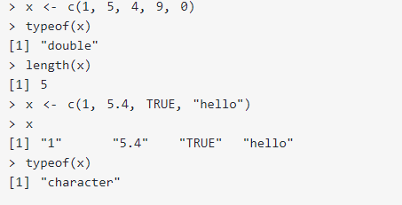
Creating Vectors

Slide 13
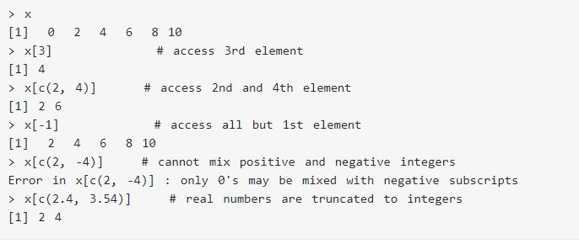
Accessing vectors

Slide 14
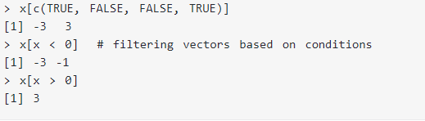
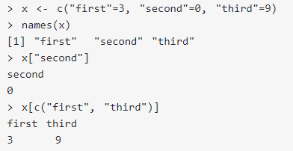
Using logical vector as index
Using character vector as index

Slide 15
3. Matrices

Slide 16
Matrices
Matrix is a two dimensional data structure in R programming.
Matrix is similar to vector but additionally contains the dimension attribute.
All attributes of an object can be checked with the attributes() function (dimension can be checked directly with the dim() function).
Matrix can be created using the matrix() function.
Dimension of the matrix can be defined by passing appropriate value for arguments nrow and ncol.
Providing value for both dimension is not necessary. If one of the dimension is provided, the other is inferred from length of the data.

Slide 17
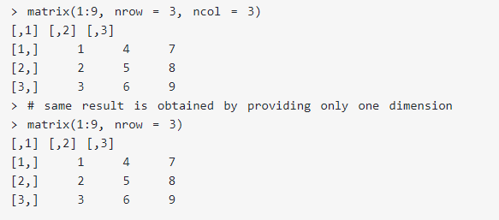
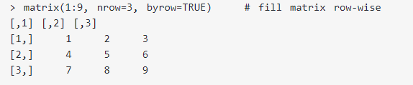
Creating Matrices

Slide 18
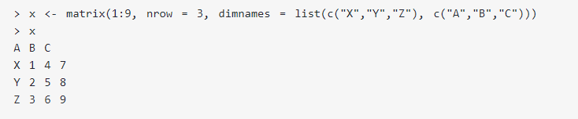
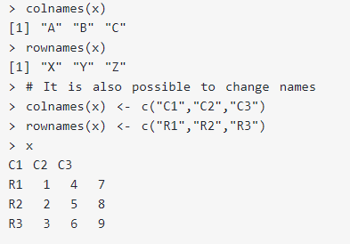
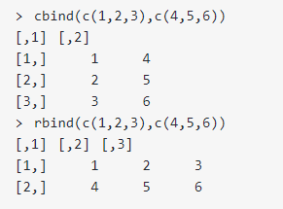

Slide 19
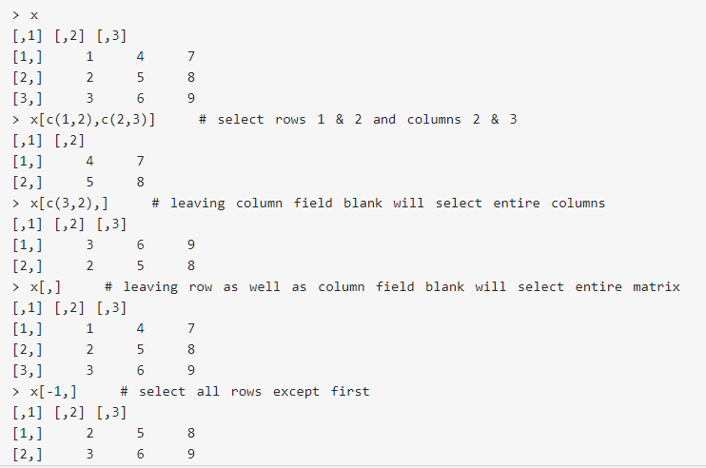
Accessing matrices

Slide 20
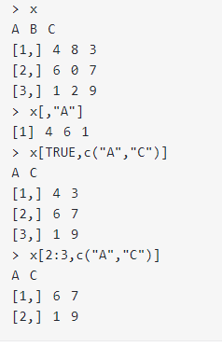

Slide 21
4. Lists

Slide 22
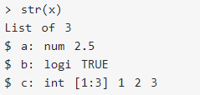
Lists
List is a data structure having components of mixed data types.
A vector having all elements of the same type is called atomic vector but a vector having elements of different type is called list.
List can be created using the list() function.
Its structure can be examined with the str() function.

Slide 23
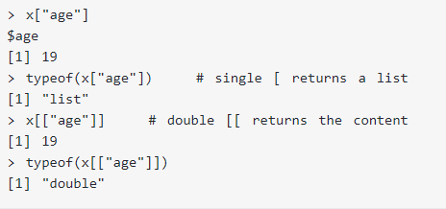
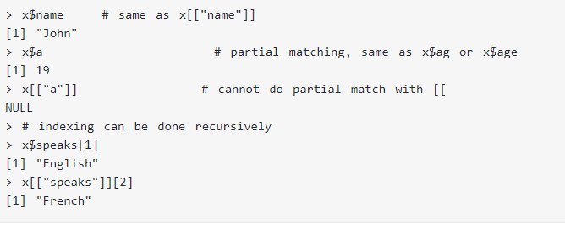
Accessing the list

Slide 24
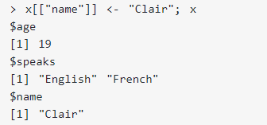
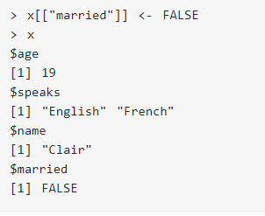
Modifying:
Adding:

Slide 25
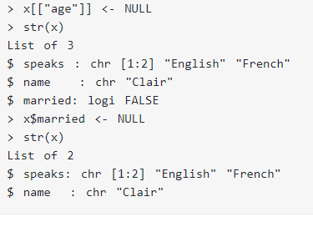
Deleting components

Slide 26
5. Dataframes

Slide 27
Data frame is a two dimensional data structure in R. It is a special case of a list which has each component of equal length.
Each component form the column and contents of the component form the rows.
We can create a data frame using the data.frame() function.
Built in datasets that are available can be listed with the command - library(help = "datasets").
Fix(dataset name) – Gives the table of values in the dataset
Summary(Dataset name) – gives summary of data (Min, lower hinge, median, upper hinge, max)

Slide 28
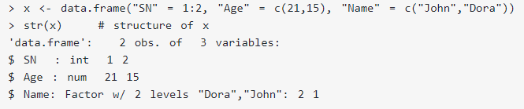
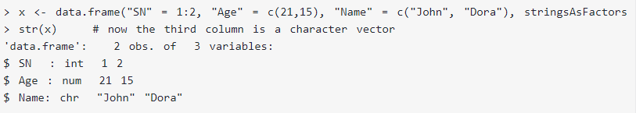
Creating data frames

Slide 29
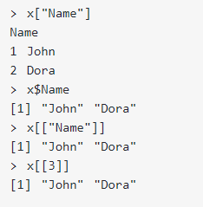
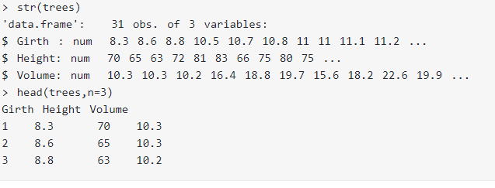
Accessing as list & matrices

Slide 30
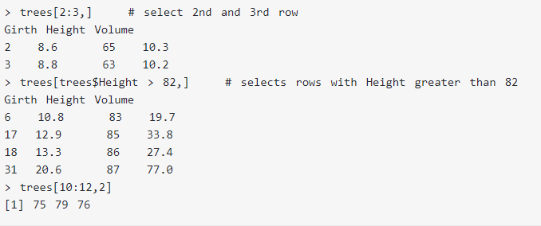
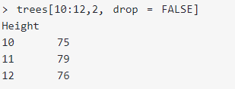

Slide 31
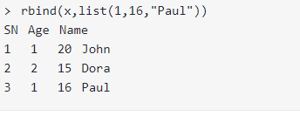
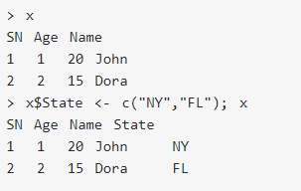
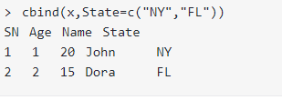
Adding components

Slide 32
Flow Control
ifelse(test_expression, x, y)
if (test_expression) { statement1 } else { statement2 }
for (val in sequence) { statement }
while (test_expression) { statement }
if (test_condition) { next }
if (test_expression) { break }

Slide 33
Functions in R
Syntax:
func_name <- function (argument) { statement }
Eg:
pow <- function(x, y) {
# function to print x raised to the power y
result <- x^y
print(paste(x,"raised to the power", y, "is", result))
}
Calling the function:
>pow(8, 2)
[1] "8 raised to the power 2 is 64"

Slide 34
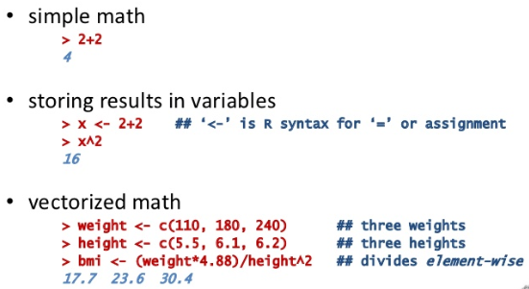
Other mathematical functions:

Slide 35
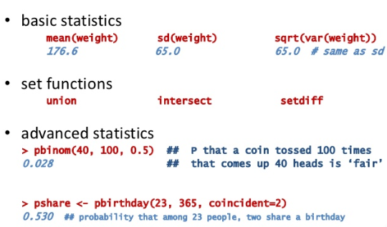
Other mathematical functions:

Slide 36
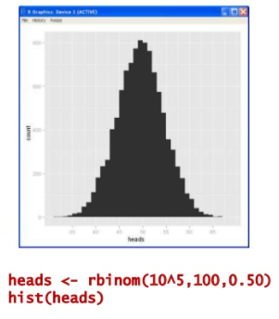
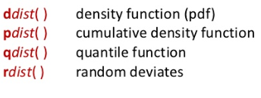
Functions for Probability distributions

Slide 37
THANKYOU!

