Slide 1
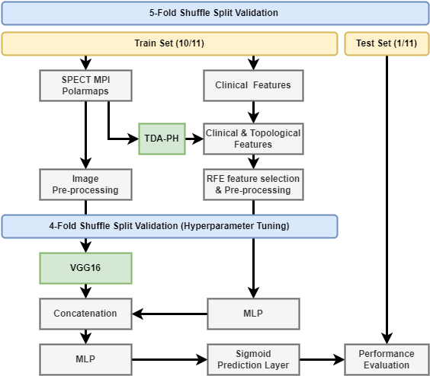
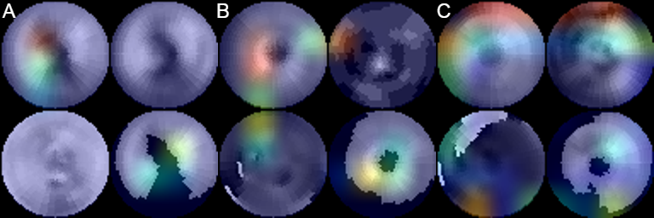
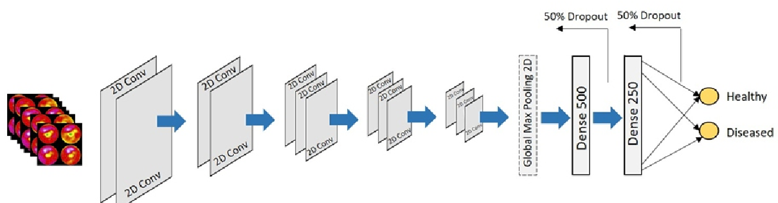
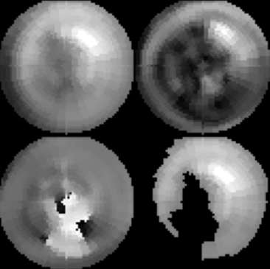



An Explainable Deep Learning Model Integrating SPECT-MPI Polarmaps with Clinical and Derived Topological Features for Cardiac Resynchronization Therapy Decision Support
Kristoffer Larsenª, Zhuo He^{b}, Chen Zhao^{b}, Qiuying Shaª, Weihua Zhou^{b}
a. Department of Mathematical Sciences, MTU b. Applied Computing, MTU
Summary
methods
Discussion
Cardiac Resynchronization Therapy (CRT) remains as the last resort for late-stage heart failure (HF) despite the significant proportion (30-40%) of patients that do not receive any benefit, i.e., CRT response¹.
Machine Learning (ML) using clinical variables has shown to outperform current CRT guidelines for admission² , deep learning using clinical variables and Single Photon Emission Computerized Tomograph Myocardial Perfusion Imaging (SPECT MPI) is shown here to out-perform both CRT guidelines and ML for CRT response.
This is a post hoc analysis combining a non-randomized, multinational, multicenter prospective cohort study: “Value of intraventricular synchronism assessment by gated-SPECT myocardial perfusion imagining in the management of HF patients submitted to CRT” (IAEA VISION-CRT) and a randomized, multicenter, controlled study: “SPECT Guided LV Lead Placement for Incremental Benefits to CRT Efficacy” (GUIDE-CRT).
Grad-Cam
Grad-Cam was utilized to provided predictions with interpretability: a jet colormap of the activations was applied and overlayed on the polarmap images.
In patient A, the apex region (“center”) and Right Coronary Artery region (“center bottom”) of the perfusion polarmap has a perfusion defect which the deep learning model detects and contributes towards the non-response prediction.
Similarly, in patient B, the classifier places importance on the perfusion defect in the apex region. Moreover, in the wall thickening polarmap the Left Anterior Descending Artery Region (“upper left”) is highlighted indicating contractility abnormalities corresponding to CRT non-response.
In patient C, low values in systolic dyssynchrony polarmap are highlighted along the Anterior regions (“top side”) unlike the non-response cases (A & B) with the wall thickening polarmap highlighted in the septal region (“left side”) where there is a lack of thickening.
Limitations
Limitations included the small sample size (218) which impede the generalization capabilities of the CNN component, especially for extracted features from polarmaps which do not necessary qualify as significant biomarkers.
background
HF is on the rise, between 2009 and 2012 roughly 5.7 million people had HF. Moreover, it is expected to increase by 46% from 2012 to 2030, which means more than eight million people ≥18 years of³.
The multi-faceted causes of late-staged HF make predicting patient response to CRT complex as the biventricular pacemaker stimulates the heart’s chambers only through coordinate electric impulses.
ML has been previously applied to the task of classifying CRT response using a Prediction Analysis of Microarrays (PAM) model against guideline recommendations with AUC (0.80 vs 0.71) and Accuracy (0.80 vs. 0.62), respectively.
A supervised deep learning method has yet to be applied to CRT response using convolutional neural network architectures, previously such as Apostolopoulos (2020)⁴ have applied a VGG16 transfer learning model solely using SPECT MPI polarmaps for coronary artery disease prediction without the inclusion of clinical parameters.
Figure 5. Grad-Cam for three patients from the best test fold: A. Correctly predicted non-response with CRT class 1 B. Correctly predicted non-response with CRT class 2A1 C. Correctly predicted response with CRT class 1
Figure 1. Deep Learning Model for CAD Prediction
Figure 3. Deep Learning Transfer Model
Patients were classified for ground truth using normal-response guidelines as “responders” or “non-responders” if they had an increase of Left Ventricle Ejection Fraction (LVEF) ≥ 5%.
The deep learning model was trained with a nested validation structure using Bayesian hyperparameter optimization due to small sample size (218) to gain robustness in performance metrics evaluation.
Pre-processing for images included centering for the VGG16 ImageNet dataset while for the tabular data including centering, scaling, and spatial sign transformation.
For comparison, three ML models were trained using the same validation structure and tabular features, namely AdaBoost Elastic Net (ADA-ENET), Support Vector Machine Ensemble (SVM-ENS), and Random Forest (RF).
conclusions
Data
Despite the small sample size, it is possible to classify CRT response using SPECT MPI alongside clinical and generated topological variables. Moreover, the prediction process is incredible fast allowing for timely and improved clinical decision-making support.
Even with the addition of SPECT MPI, the performance metrics still have a lot of room for growth indicating there are more unseen factors at play in determining CRT response beyond what feature engineering can accomplish.
Including more nuanced information, such as regional locations by using a transformer-based model with attention/self-attention may provided additional predictive ability to CRT response as CNN’s are position invariant.
Tabular
Twelve Clinical Variables, such as patient characteristics, disease history, medication, and medical treatment were considered.
Parameters from SPECT MPI which characterize mechanical dyssynchrony and parameters from Electrocardiogram (ECG) which quantify electrical dyssynchrony were used.
Topological Data Analysis using Persistent Homology (TDA-PH) was applied to the polarmap images with radial, binary, gray-scale, and density filters to quantify connected components and holes (“texture analysis”).
results
Deep Learning is shown to out-perform both ML and CRT guideline recommendations using the 5-fold average.
The only instance of challenge is between the sensitivity of the deep learning versus the ADA-ENET and SVM-ENS models (0.78 vs. 0.87, 0.82), respectively. But note the ML models respective lower specificity.
References & Funding
Images
Perfusion, wall thickening, systolic dyssynchrony, and a modified perfusion polarmap (excluding pixels ≤ 50%) were concatenated to form the image input.
The modified perfusion polarmap was done to reduce redundant information with the hypothesis that including only regions of high perfusion may present different informative patterns and maintain square dimensions.
[1] Auricchio A, Prinzen FW. Non-responders to cardiac resynchronization therapy: the magnitude of the problem and the issues. Circ J. 2011;75(3):521–7.
[2] Fernandes F et al., (2022). A new method using machine learning to integrate ECG and gated SPECT MPI for Cardiac Resynchronization Therapy Decision Support on behalf of the VISION-CRT. arXiv e-prints, arXiv:2211.07472.
[3] Benjamin EJ, Paul Muntner C, Chair Alvaro Alonso V, Marcio Bittencourt FS, Clifton Callaway MW, April Carson FP, et al. Heart disease and stroke statistics – 2019 update. Circulation. 2019;139:56–528.
[4] Apostolopoulos, I.D., Papathanasiou, N.D., Spyridonidis, T., & Apostolopoulos, D.J. (2020). Automatic characterization of myocardial perfusion imaging polar maps employing deep learning and data augmentation. Hellenic journal of nuclear medicine.
 | Accuracy | AUC | Sensitivity | Specificity
Deep Learning | 0.77 | 0.79 | 0.78 | 0.69
ADA-ENET | 0.68 | 0.78 | 0.87 | 0.44
RF | 0.67 | 0.72 | 0.75 | 0.58
SVM-ENS | 0.75 | 0.77 | 0.82 | 0.67
Guideline | 0.53 | NA | 0.75 | 0.26
Figure 2. Polarmap Image Input for VGG16
Figure 4. Table of evaluation metrics
Notes:
To change this poster, replace our sample content with your own. Or, if you'd rather start from a clean slate, use the New Slide button on the Home tab to insert a new page, then enter your text and content in the empty placeholders. If you need more placeholders for titles, subtitles or body text, copy any of the existing placeholders, then drag the new one into place.

