Slide 1
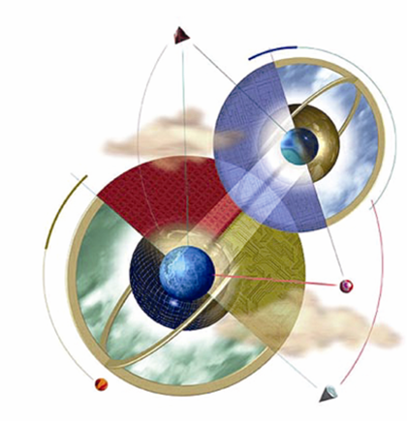
Chapter 1:
Introduction to Expert Systems
Expert Systems: Principles and Programming, Fourth Edition
Original by Course Technology
Modified by Ramin Halavati (halavati@ce.sharif.edu)

Slide 2
Objectives
Learn the meaning of an expert system
Understand the problem domain and knowledge domain
Learn the advantages of an expert system
Understand the stages in the development of an expert system
Examine the general characteristics of an expert system

Slide 3
Objectives
Examine earlier expert systems which have given rise to today’s knowledge-based systems
Explore the applications of expert systems in use today
Examine the structure of a rule-based expert system
Learn the difference between procedural and nonprocedural paradigms
What are the characteristics of artificial neural systems

Slide 4
What is an expert system?
“An expert system is a computer system that emulates, or acts in all respects, with the decision-making capabilities of a human expert.”
Professor Edward Feigenbaum
Stanford University

Slide 5
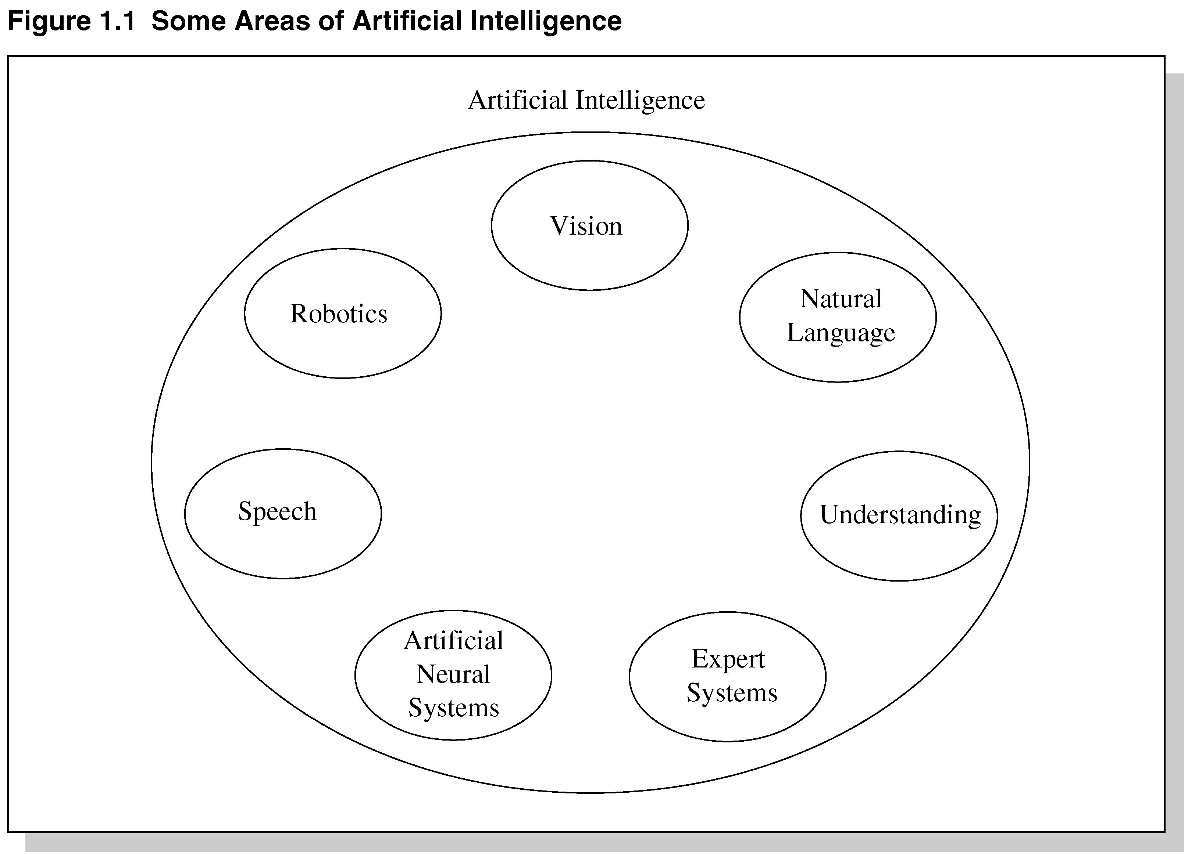
Fig 1.1 Areas of Artificial Intelligence

Slide 6
Expert system technology may include:
Special expert system languages – CLIPS
Programs
Hardware designed to facilitate the implementation of those systems

Slide 7
Expert System Main Components
Knowledge base – obtainable from books, magazines, knowledgeable persons, etc.
Inference engine – draws conclusions from the knowledge base

Slide 8
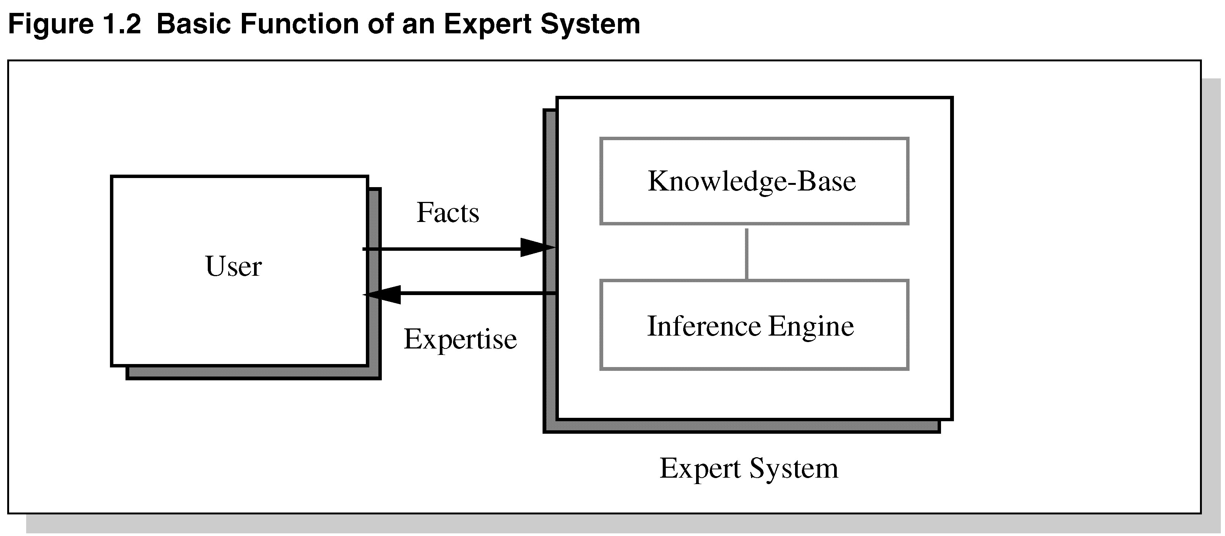
Figure 1.2 Basic Functions of Expert Systems

Slide 9
Problem Domain vs. Knowledge Domain
An expert’s knowledge is specific to one problem domain – medicine, finance, science, engineering, etc.
The expert’s knowledge about solving specific problems is called the knowledge domain.
The problem domain is always a superset of the knowledge domain.

Slide 10
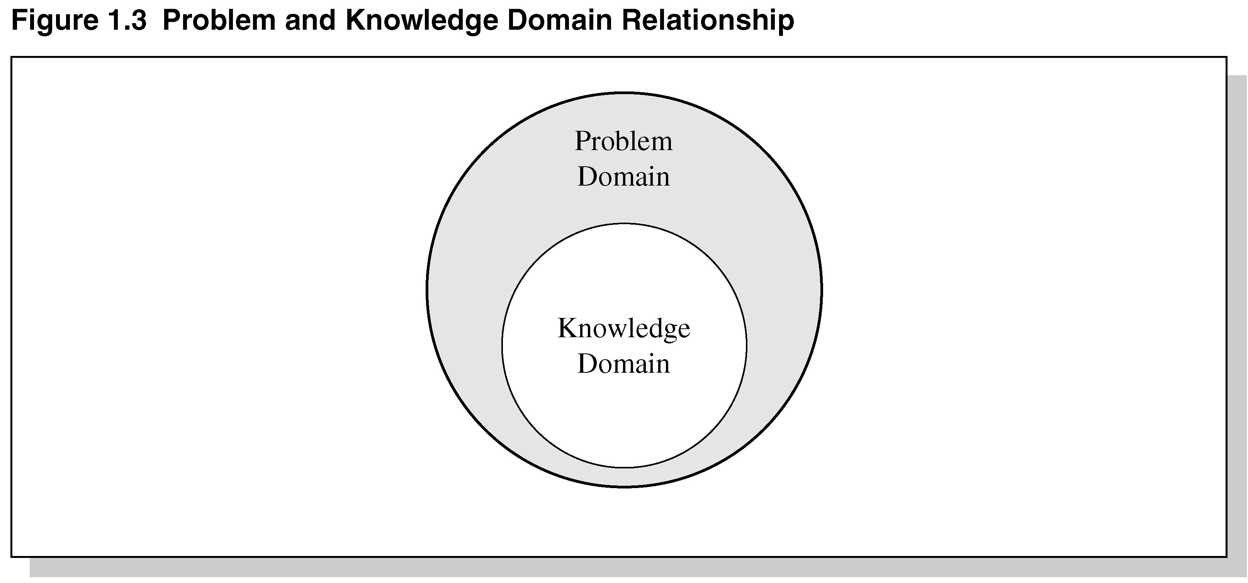
Figure 1.3 Problem and Knowledge Domain Relationship

Slide 11
Advantages of Expert Systems
Increased availability
Reduced cost
Reduced danger
Performance
Multiple expertise
Increased reliability

Slide 12
Advantages Continued
Explanation
Fast response
Steady, unemotional, and complete responses at all times
Intelligent tutor
Intelligent database

Slide 13
Representing the Knowledge
The knowledge of an expert system can be represented in a number of ways, including IF-THEN rules:
IF you are hungry THEN eat

Slide 14
Knowledge Engineering
The process of building an expert system:
The knowledge engineer establishes a dialog with the human expert to elicit knowledge.
The knowledge engineer codes the knowledge explicitly in the knowledge base.
The expert evaluates the expert system and gives a critique to the knowledge engineer.

Slide 15
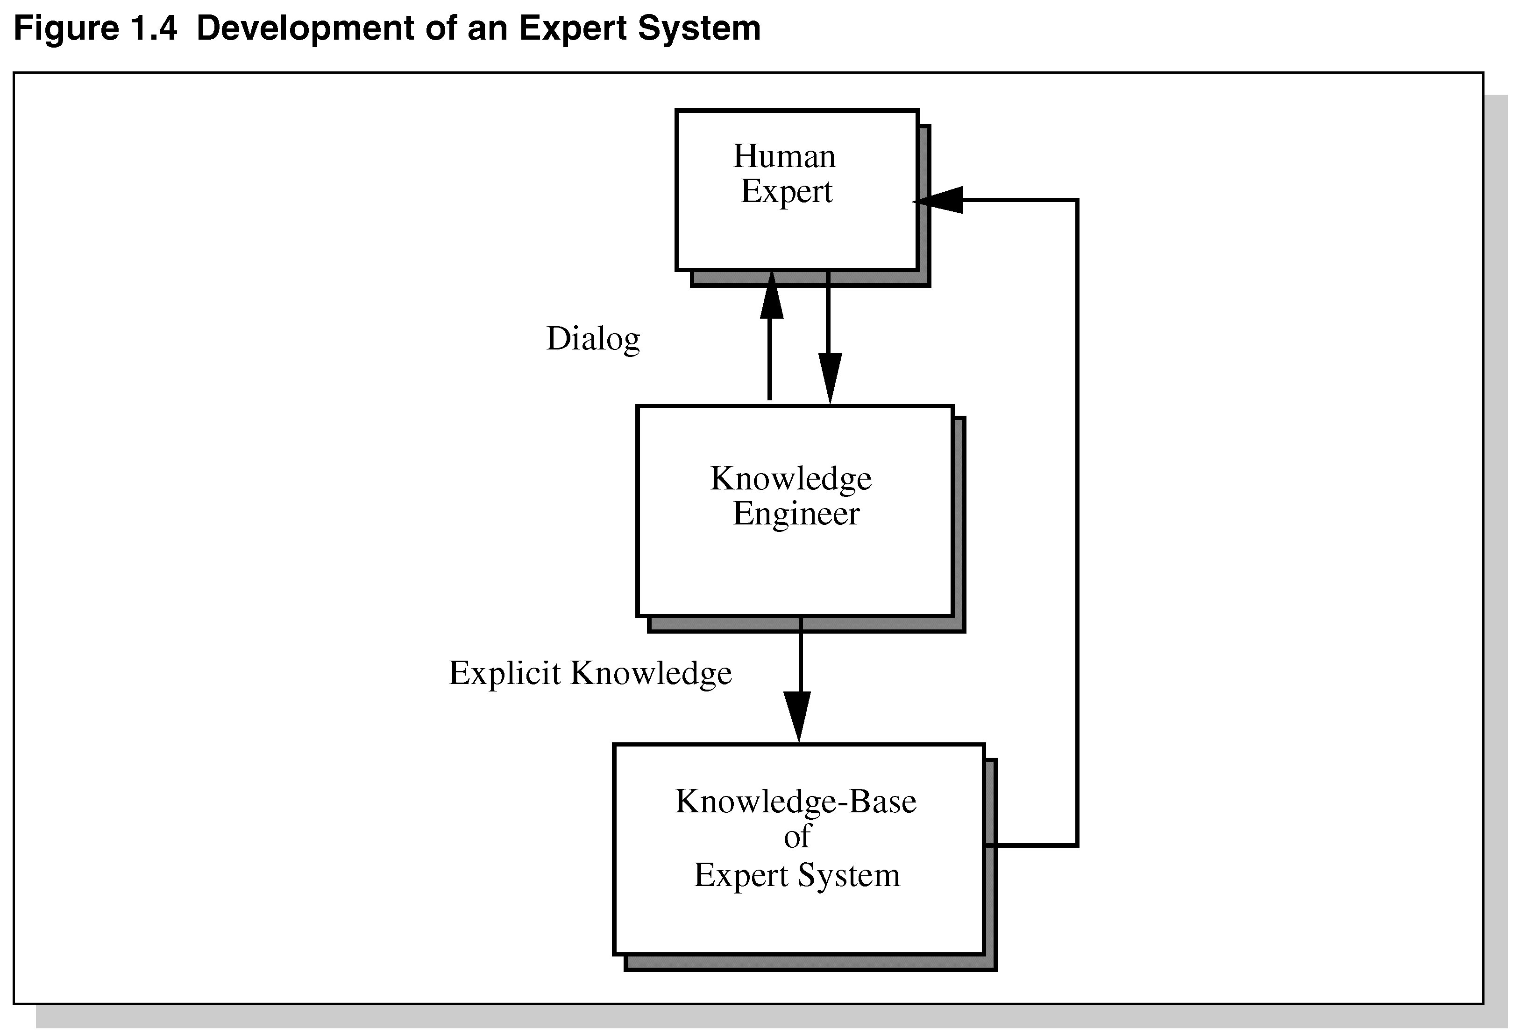
Development of an Expert System

Slide 16
The Role of AI
An algorithm is an ideal solution guaranteed to yield a solution in a finite amount of time.
When an algorithm is not available or is insufficient, we rely on artificial intelligence (AI).
Expert system relies on inference – we accept a “reasonable solution.”

Slide 17
Uncertainty
Both human experts and expert systems must be able to deal with uncertainty.
It is easier to program expert systems with shallow knowledge than with deep knowledge.
Shallow knowledge – based on empirical and heuristic knowledge.
Deep knowledge – based on basic structure, function, and behavior of objects.

Slide 18
Limitations of Expert Systems
Typical expert systems cannot generalize through analogy to reason about new situations in the way people can.
A knowledge acquisition bottleneck results from the time-consuming and labor intensive task of building an expert system.

Slide 19
Development of Expert Systems
Rooted from Cognitive Studies:
  How does human process information
Newell/Simon Model (GPS)
  Long Term Memory: IF-Then Rules
  Short Term Memory: Current Facts
  Inference Engine/Conflict Resolution

Slide 20
Rule Examples
IF the car doesn’t run and the fuel gauge reads empty THEN fill the gas tank.
IF there is flame, THEN there is a fire.
IF there is smoke, THEN there may be a fire.
IF there is a siren, THEN there may be a fire.

Slide 21
Expert Knowledge
Base Knowledge / Expert Knowledge
  Book Rules / Heuristics and Experiences (secrets!)
    Experts usually score almost similar to novices in brand new problems.
  Chess Rules / Chess Master Patterns

Slide 22
Early Expert Systems
DENDRAL – used in chemical mass spectroscopy to identify chemical constituents
MYCIN – medical diagnosis of illness
DIPMETER – geological data analysis for oil
PROSPECTOR – geological data analysis for minerals
XCON/R1 – configuring computer systems

Slide 23
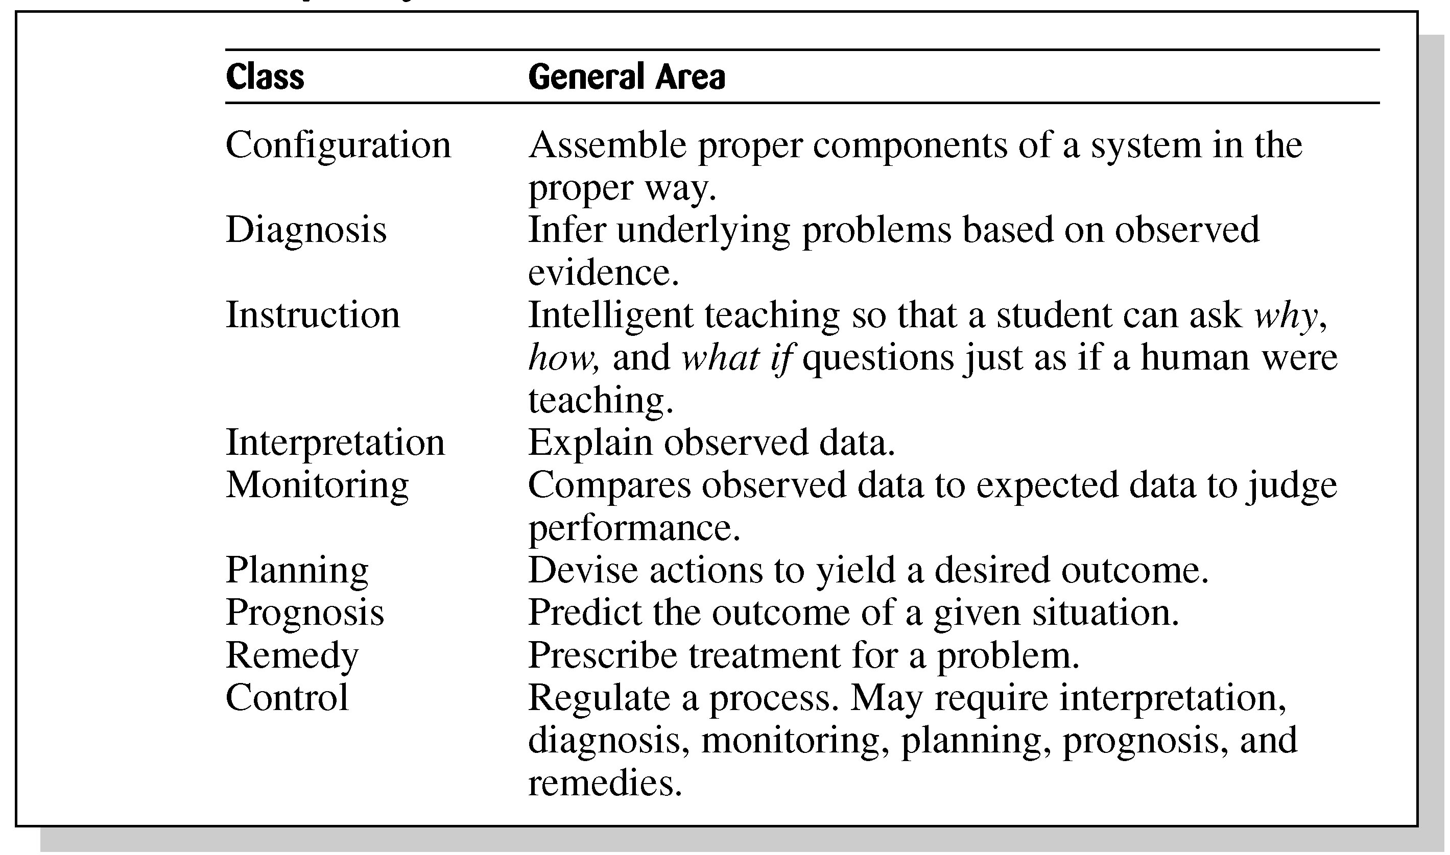
Expert Systems
Applications and Domains

Slide 24
Considerations for Building Expert Systems
Can the problem be solved effectively by conventional programming?
  Ill-Structured Problems / Rigid Control
Is the domain well bound?
  Headache: Neurochemistry, biochemistry, chemistry, molecular biology, physics, yoga, exercise, stress management, psychiatry, …
Is there a need and a desire for an expert system?
  The Traffic Light Example

Slide 25
Considerations for Building Expert Systems
Is there at least one human expert who is willing to cooperate?
  Their faults may b revealed.
  Their secrets are revealed.
  They have different ideas.
Can the expert explain the knowledge to the knowledge engineer can understand it.
  How do you move your finger?
  Medicine
Is the problem-solving knowledge mainly heuristic and uncertain?
  If not, why expert system?

Slide 26
Expert Systems
Languages, Shells, and Tools
Conventional computer programs generally solve problems having algorithmic solutions.
Tight interweaving of data and knowledge results in rigid control flow control.
More advance languages limit the usage, but are easier for the limited area.

Slide 27
Languages, Shells, and Tools
Expert system languages are post-third generation.
Procedural languages (e.g., C) focus on techniques to represent data.
More modern languages (e.g., Java) focus on data abstraction.
Expert system languages (e.g. CLIPS) focus on ways to represent knowledge.

Slide 28
Elements of an Expert System
User interface – mechanism by which user and system communicate.
Exploration facility – explains reasoning of expert system to user.
Working memory – global database of facts used by rules.
Inference engine – makes inferences deciding which rules are satisfied and prioritizing.

Slide 29
Elements Continued
Agenda – a prioritized list of rules created by the inference engine, whose patterns are satisfied by facts or objects in working memory.
Knowledge acquisition facility – automatic way for the user to enter knowledge in the system bypassing the explicit coding by knowledge engineer.
Knowledge Base!

Slide 30
Production Rules
Knowledge base is also called production memory.
Production rules can be expressed in IF-THEN pseudocode format.
In rule-based systems, the inference engine determines which rule antecedents are satisfied by the facts.

Slide 31
An Example from MYCIN
IF
  The site of the culture is blood and
  The identity of the organism is not known with certainty, and
  The stain of the organism is gramnegm and
  The morphology of the organism is rod, and
  The patient is seriously burned.
THEN
  There is a weakly suggestive evidence (.4) that the identity of the organism is pesudomonas.

Slide 32
An Example from XCON/R1
IF
  The current context is assigning devices to Unibus modules, and
  There is an unassigned dual-port disk drive, and
  The type of controller it requires is known, and
  There are two such controllers, neither of which has any devices assigned to it, and
  The number of devices that these controllers can support is known,
THEN
  Assign the disk drive to each of the controllers, and
  Note that the two controllers have been associated and each supports one drive.

Slide 33
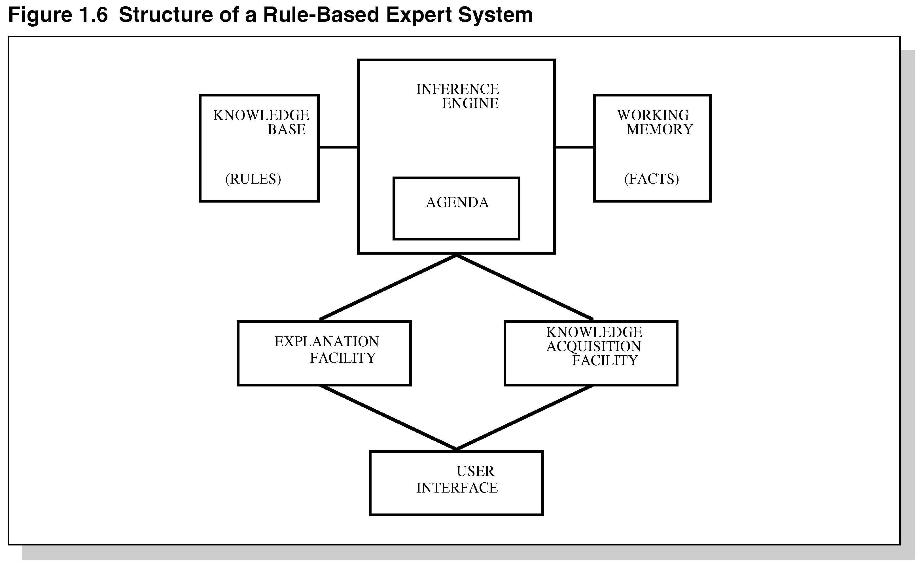
Structure of a
Rule-Based Expert System

Slide 34
General Methods of Inferencing
Forward chaining – reasoning from facts to the conclusions resulting from those facts – best for prognosis, monitoring, and control.
  primarily data-driven
Backward chaining – reasoning in reverse from a hypothesis, a potential conclusion to be proved to the facts that support the hypothesis – best for diagnosis problems.
  primarily goal driven

Slide 35
Main Inference Engine Cycle
While Not DONE
  If there are active rules, Conflict Resolution. Else DONE.
  Act
  Match
  Check for Halt
End of While
Accept a new user command.

Slide 36
Mathematical Roots of Rule Based Systems
Post Production Systems
Markov Algorithm
Rete Algorithm

Slide 37
Post Production System
Basic idea – any mathematical / logical system is simply a set of rules specifying how to change one string of symbols into another string of symbols.
Basic limitation – lack of control mechanism to guide the application of the rules.

Slide 38
Markov Algorithm
An ordered group of productions applied in order or priority to an input string.
If the highest priority rule is not applicable, we apply the next, and so on.
An efficient algorithm for systems with many rules.

Slide 39
Rete Algorithm
Functions like a net – holding a lot of information.
Much faster response times and rule firings can occur compared to a large group of IF-THEN rules which would have to be checked one-by-one in conventional program.
Takes advantage of temporal redundancy and structural similarity.
Drawback is high memory space requirements.

Slide 40
Programming Paradigms
Procedural (sequential)
  Functional/Imperative
None Procedural

Slide 41
Procedural Paradigms
Algorithm – method of solving a problem in a finite number of steps.
Procedural programs are also called sequential programs.
The programmer specifies exactly how a problem solution must be coded.

Slide 42
Imperative Programming
Focuses on the concept of modifiable store – variables and assignments.
During execution, program makes transition from the initial state to the final state by passing through series of intermediate states.
Provide for top-down-design.
Not efficient for directly implementing expert systems.

Slide 43
Nonprocedural Paradigms
Do not depend on the programmer giving exact details how the program is to be solved.
Declarative programming – goal is separated from the method to achieve it.
Object-oriented programming – partly imperative and partly declarative – uses objects and methods that act on those objects.
Inheritance – (OOP) subclasses derived from parent classes.

Slide 44
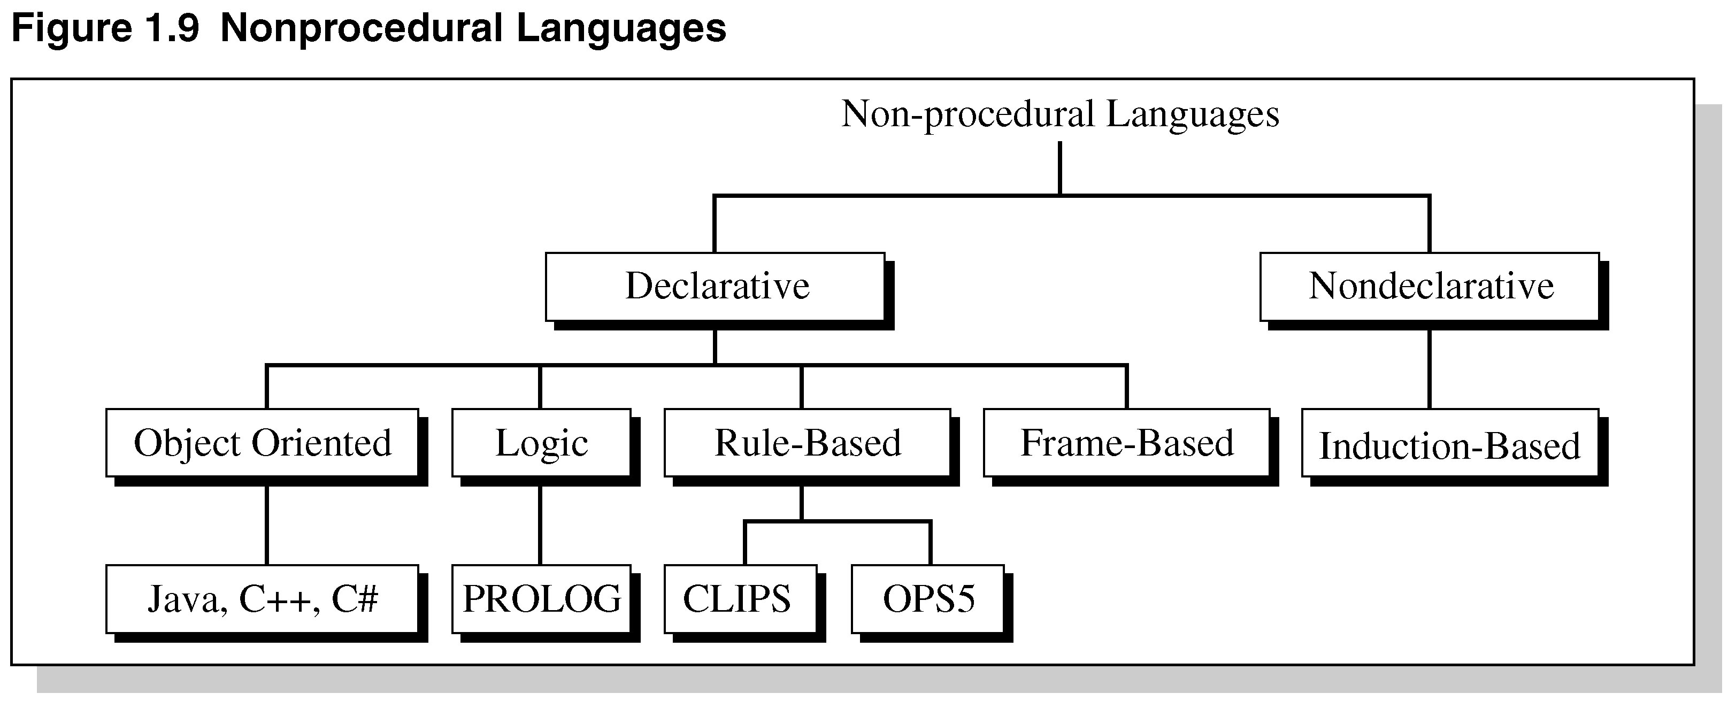
Nonprocedural Languages

Slide 45
Artificial Neural Systems
In the 1980s, a new development in programming paradigms appeared called artificial neural systems (ANS).
Based on the way the brain processes information.
Models solutions by training simulated neurons connected in a network.
ANS are found in face recognition, medical diagnosis, games, and speech recognition.

Slide 46
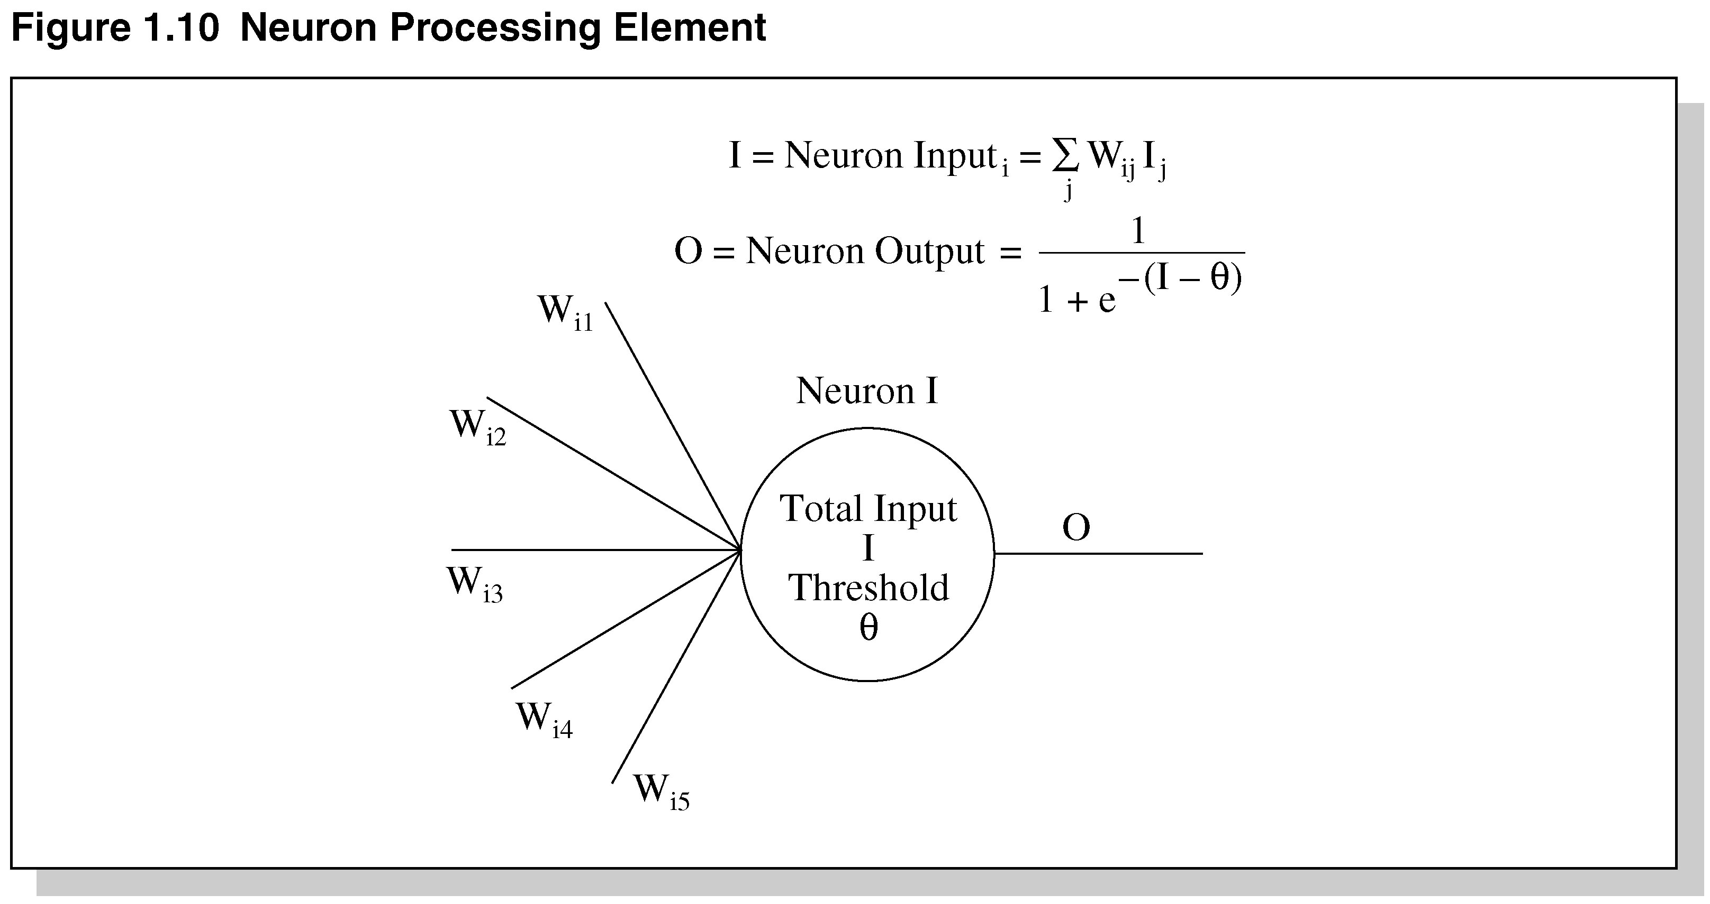
Neuron
Processing Element

Slide 47
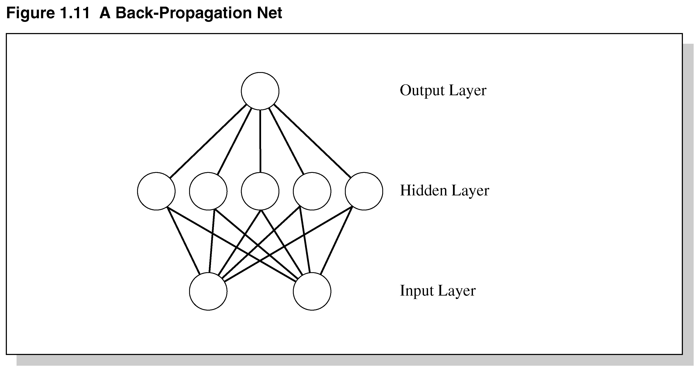
A
Back-Propagation Net

Slide 48
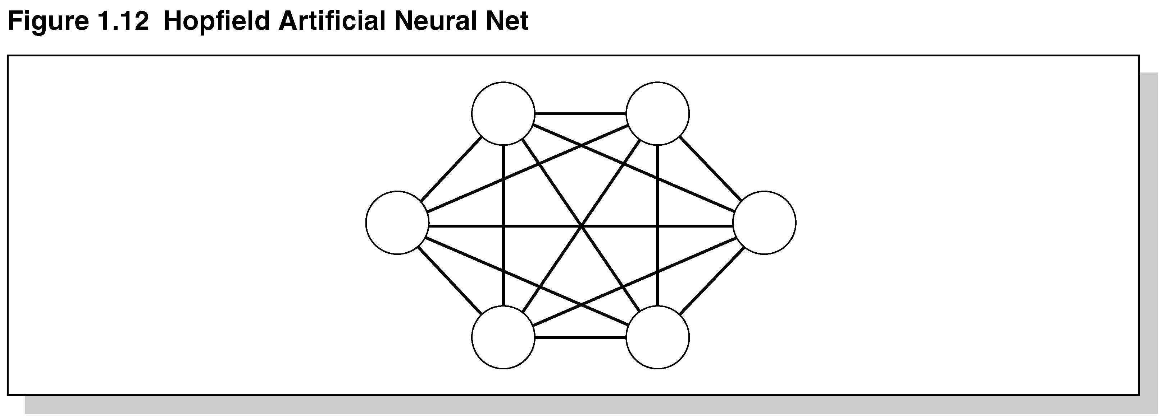
Figure 1.12 Hopfield
Artificial Neural Net

Slide 49
ANS Characteristics
ANS is similar to an analog computer using simple processing elements connected in a highly parallel manner.
Processing elements perform Boolean / arithmetic functions in the inputs
Key feature is associating weights w/each element.

Slide 50
Advantages of ANS
Storage is fault tolerant
Quality of stored image degrades gracefully in proportion to the amount of net removed.
Nets can extrapolate and interpolate from their stored information.
Nets have plasticity.
Excellent when functionality is needed long-term w/o repair in hostile environment – low maintenance.

Slide 51
Disadvantage of ANS
No Explanation Facility.
Requires a lot of examples for training.
The training result can not be (easily) analyzed.

Slide 52
MACIE
An inference engine called MACIE (Matrix Controlled Inference Engine) uses ANS knowledge base.
Designed to classify disease from symptoms into one of the known diseases the system has been trained on.
MACIE uses forward chaining to make inferences and backward chaining to query user for additional data to reach conclusions.

Slide 53
Summary
During the 20th Century various definitions of AI were proposed.
In the 1960s, a special type of AI called expert systems dealt with complex problems in a narrow domain, e.g., medical disease diagnosis.
Today, expert systems are used in a variety of fields.
Expert systems solve problems for which there are no known algorithms.

Slide 54
Summary Continued
Expert systems are knowledge-based – effective for solving real-world problems.
Expert systems are not suited for all applications.
Future advances in expert systems will hinge on the new quantum computers and those with massive computational abilities in conjunction with computers on the Internet.

