Slide 1


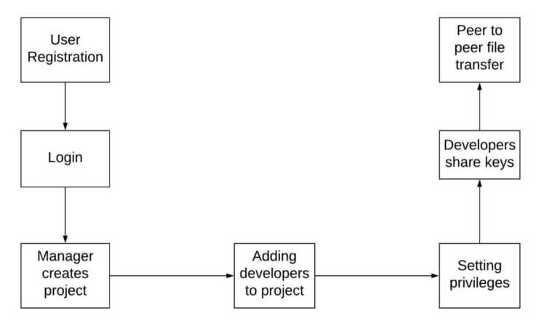
G H Patel College of Engineering and Technology
Department of Information Technology
Distributed Code Editor
Viraj Chavda | Lak Hinsu | Prakshal Trivedi
160110116005 | 160110116013 |160110116055
Abstract Requirements
Our product allows developers, managers and team leaders to share and edit code in real time making the software development life cycle easier. Unlike GitHub and Gitlab, our product does not require central server and push - pull mechanisms. It uses peer to peer file sharing with the help of a central server only used for key sharing and authentication.
Description
Version control and code sharing platforms like GitHub, GitLab etc. has made lives of programmers and software developers much easier , but there is still some room to improve. GitHub and GitLab uses push-pull mechanism which means code shared will not be in real time. In our application we overcome this limitation by removing central server and directly sharing code using peer to peer networking and distributed file system. Developers can use our application along with Git tools to further improve development process. Git work flow of the software development process won't change for a project but improvement will be that all the team members will have better communication and code sharing experience.
Software requirements
Node modules
Firebase API
Codemirror API
File manager API
Hardware requirements
PC
Laptop
Central Server
Functionalities
System allows Managers to create project and add team members. Then a key for the project is generated for each developer and stored in central server. Then developers from the same team uses the keys to share project code in a distributed manner between the peers.
Applications
This system can be used by Developers, Managers, and team leaders to create projects, teams, share and edit code. System can also be used along with existing version control systems.
Technologies
Electron JS
React JS
Dat JS
Firebase
System Flow
Future Enhancements
File sharing performance can be improved. Network overhead can be reduced by minimizing the amount of information shared between the peers.
Guided By
Dr. Nikhil Gondaliya
Professor & Head
nikhilgondaliya@gcet.ac.in
Department of Information Technology
G H Patel College of Engineering and Technology

