Slide 2
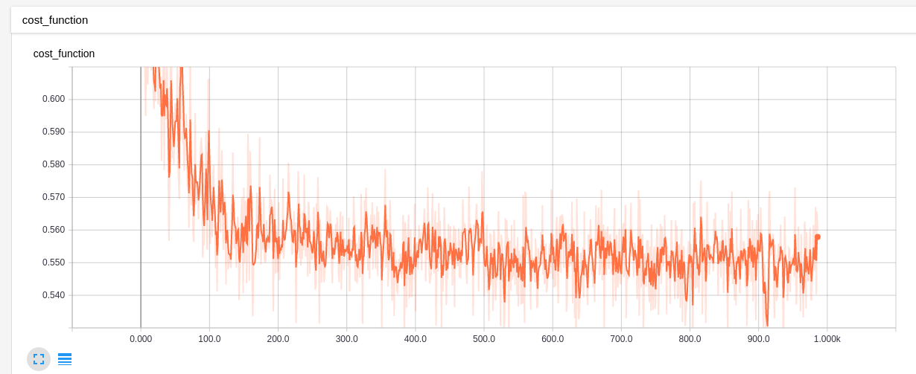

Slide 3
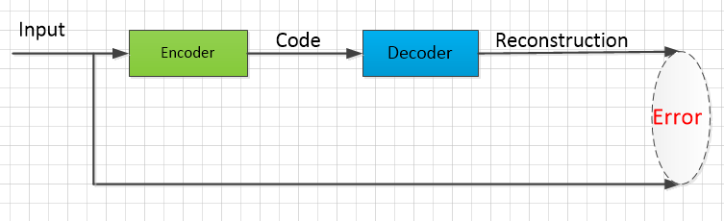
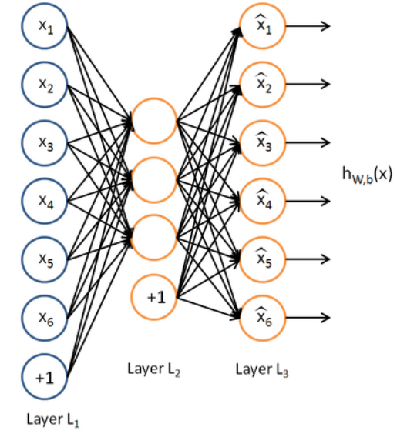

Slide 4
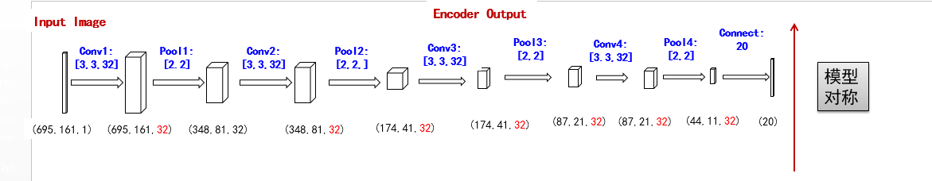
Input Image
Encoder Output
Conv1:
[5,5,1,64]
Pool1:
[1,2,2,1]
Conv2:
[5,5,1,64]
Pool2:
[1,2,2,1]
Conv3:
[5,5,1,32]
Pool2:
[1,2,2,1]
模型
对称
(28,28,1)
(28,28,64)
(14,14,64)
(14,14,64)
(7,7,64)
(7,7,32)
(4,4,32)

