Slide 1
Herbrand Models
Logic Lecture 2

Slide 2
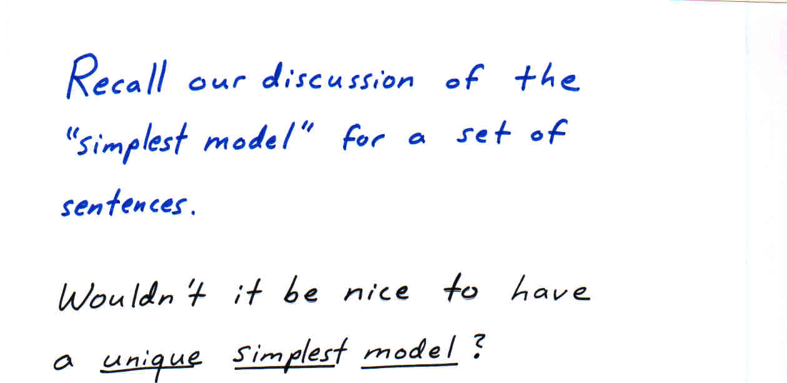

Slide 3
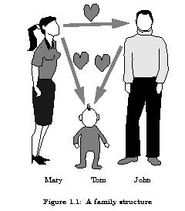
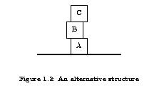
Example: Models
∀X(∀Y((mother(X) ∧ child_of(Y,X)) → loves(X,Y)))
mother(mary)
child_of(tom,mary)

Slide 4
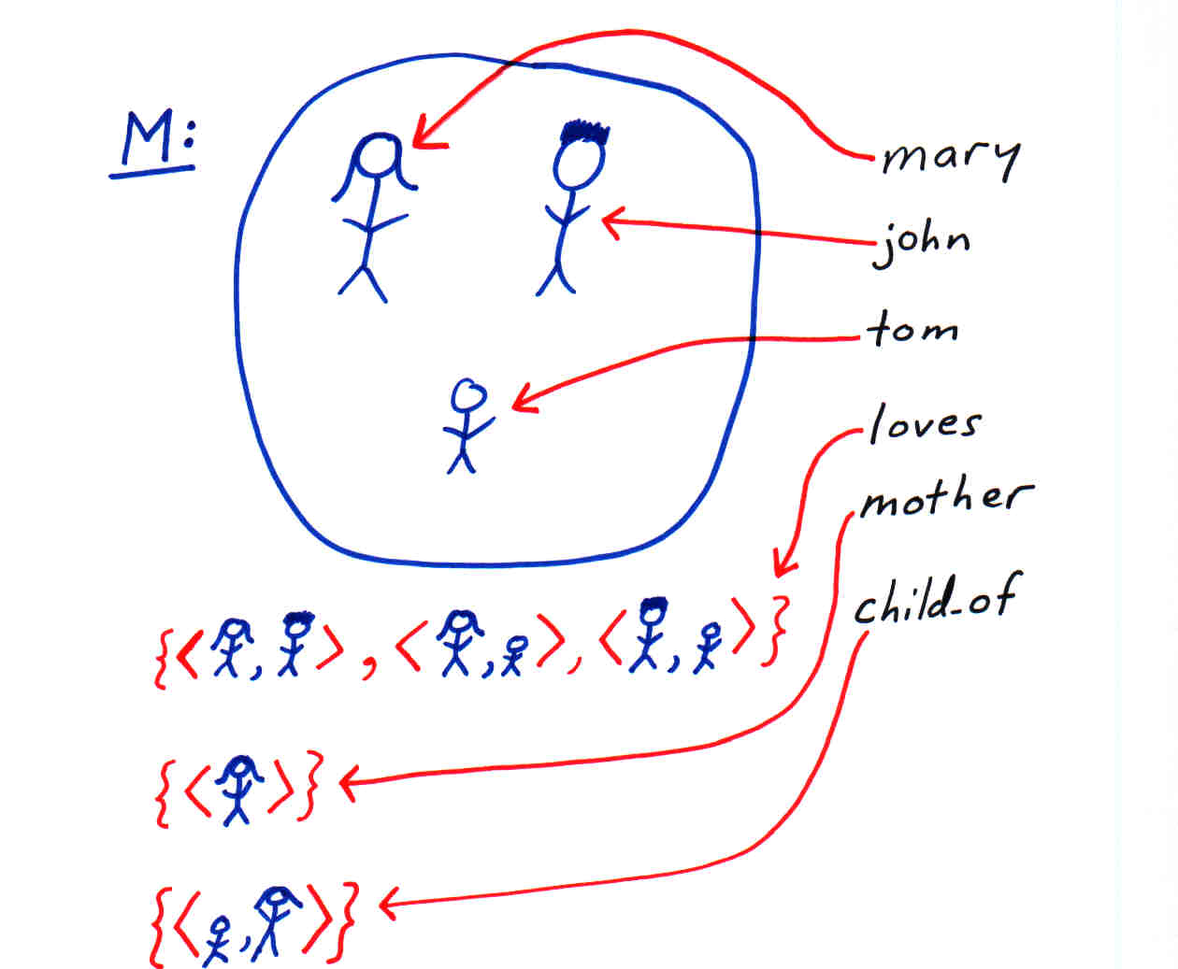

Slide 5
Problem…
Difficult to compare two interpretations with different domains… e.g., one domain consists of apples and the other of oranges.
Could map one domain to another. Can be tricky to define… most domains are infinite.
Idea: for a given alphabet, pick a canonical domain and mapping. But how?

Slide 6
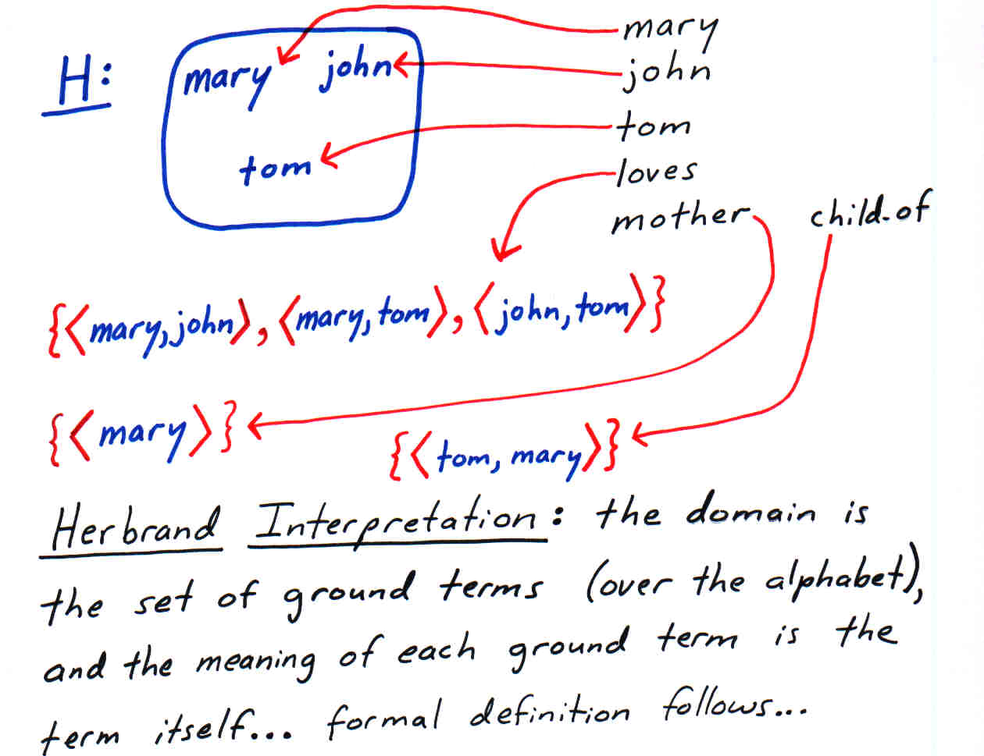

Slide 7
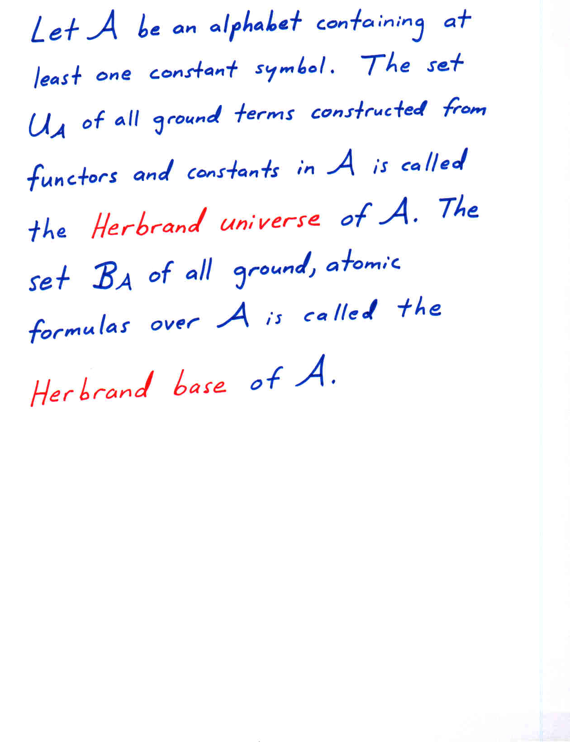

Slide 8
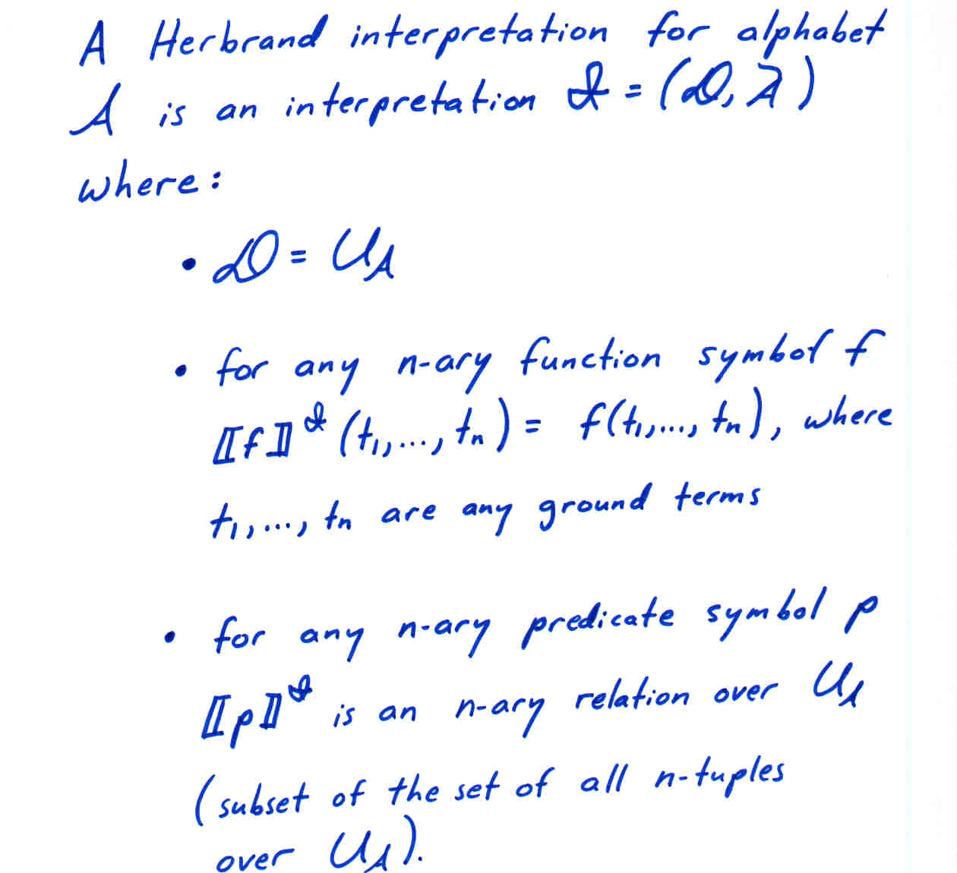

Slide 9
Some Notes
Typically, we are given a theory (set of sentences) T and wish to speak of Herbrand interpretations relative to T.
In this case we take the alphabet A to be the symbols in T.
If T has no constants, we introduce one.

Slide 10
Notes (continued)
Valuations with respect to a Herbrand interpretation may be thought of as grounding substitutions.
We’d like know it’s sufficient to consider only Herbrand interpretations… just ignore all others…

Slide 11
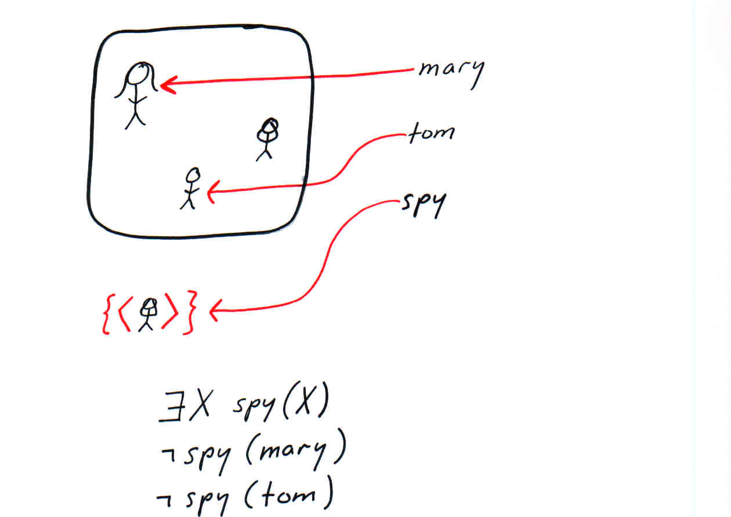

Slide 12
Herbrand Model Lemma
Let T be a theory (set of sentences) in Skolem Normal Form.
T has a model iff it has a Herbrand model.

Slide 13
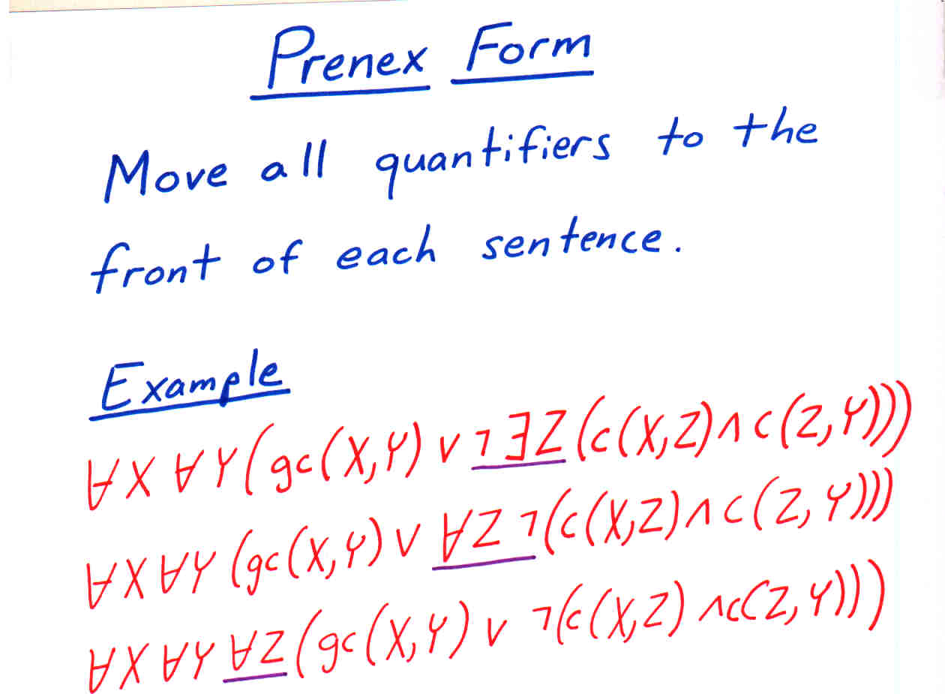

Slide 14
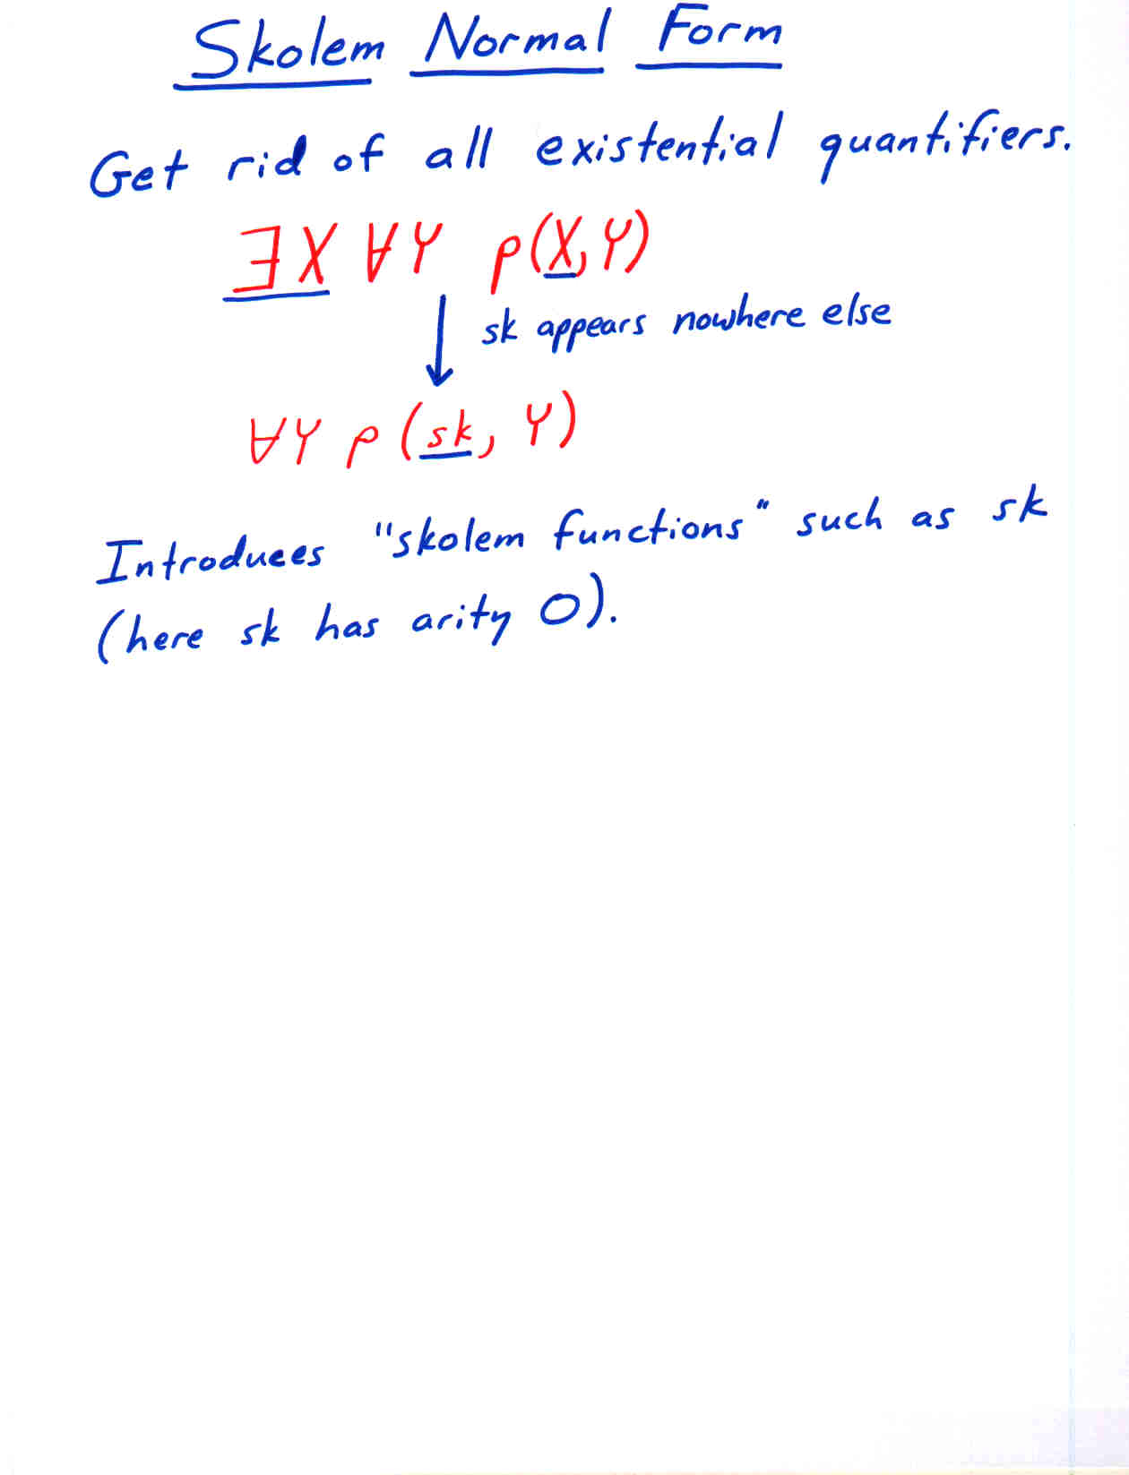

Slide 15
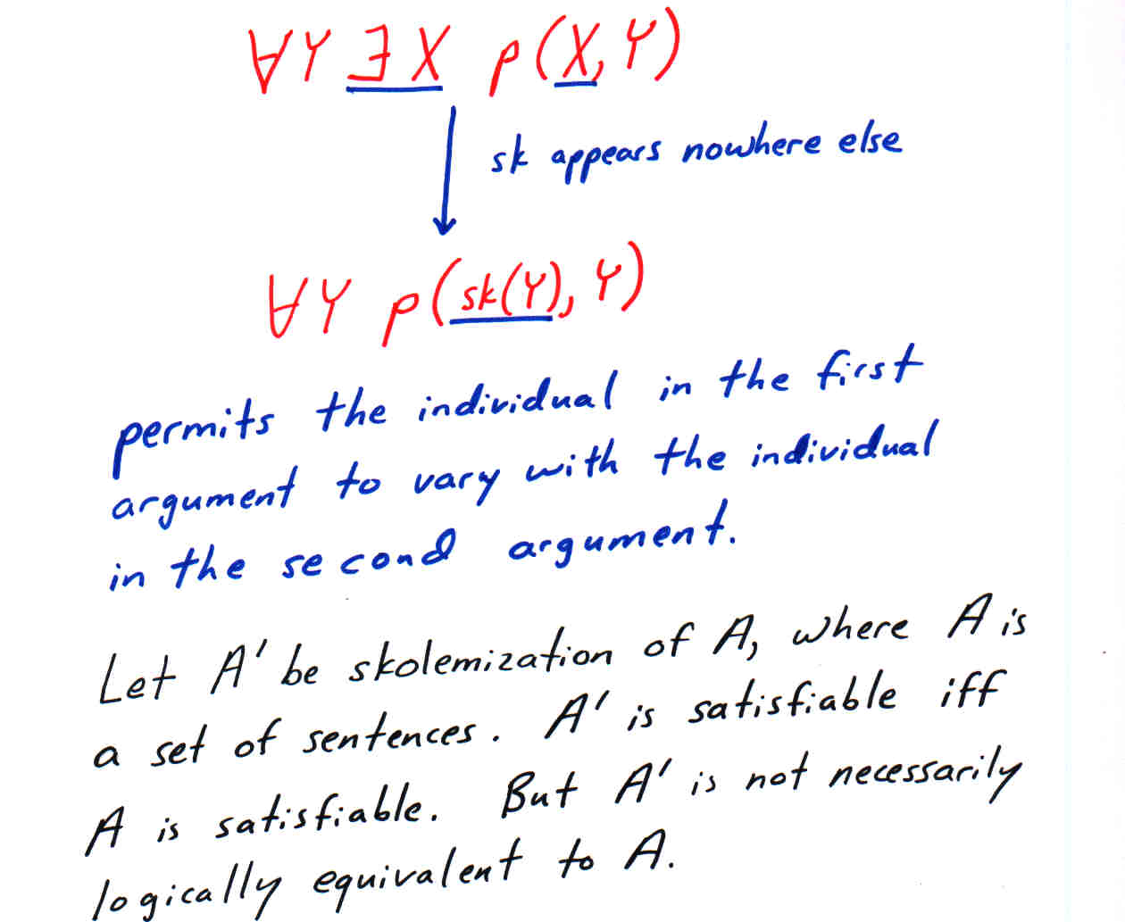

Slide 16
Skolemization
Process is applied to one sentence at a time and applied only to the entire sentence (so outermost quantifier first). Each sentence initially has empty vector of free variables.
Replace ∀X A(X) with A(X), and add X to vector of free variables.
Replace ∃X A(X) with A(x(V)) where x is a new function symbol and V is the current vector of free variables.

Slide 17
Herbrand Model Lemma
Let T be a theory (set of sentences) in Skolem Normal Form.
T has a model iff it has a Herbrand model.
Now recall our goal of identifying a unique simplest model.

Slide 18
Example: Models
∀X(∀Y((mother(X) ∧ child_of(Y,X)) → loves(X,Y)))
mother(mary)
child_of(tom,mary)

Slide 20
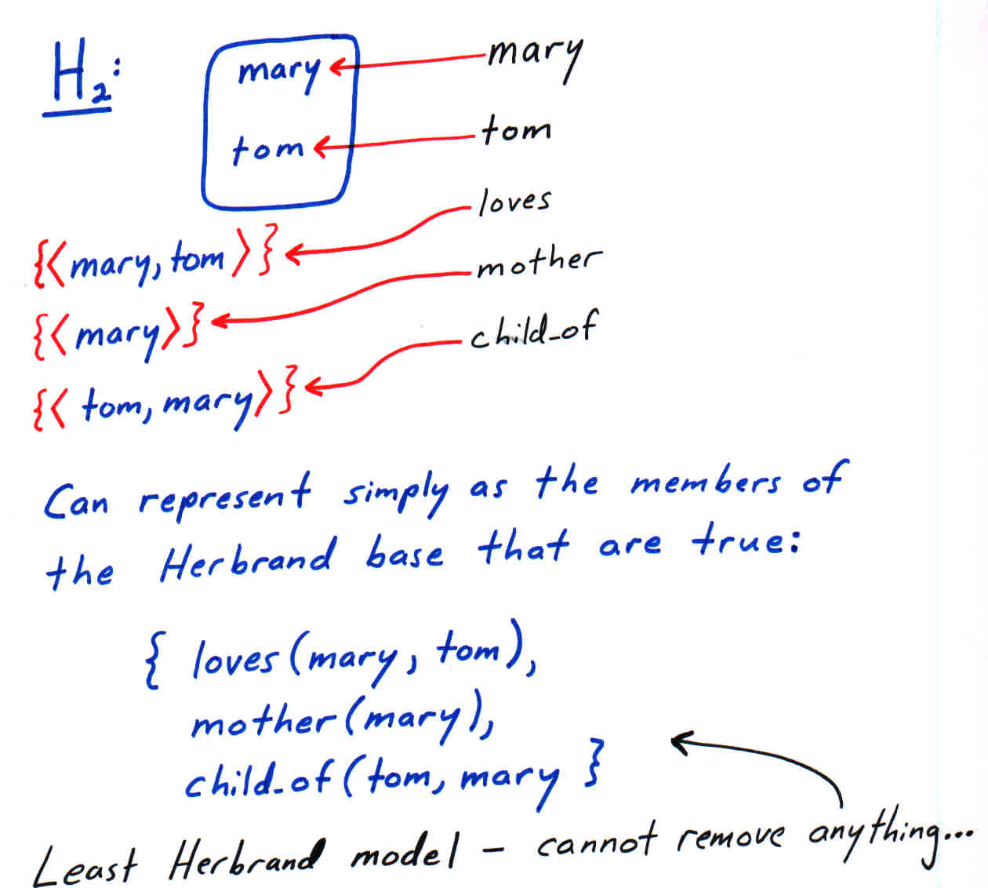

Slide 21
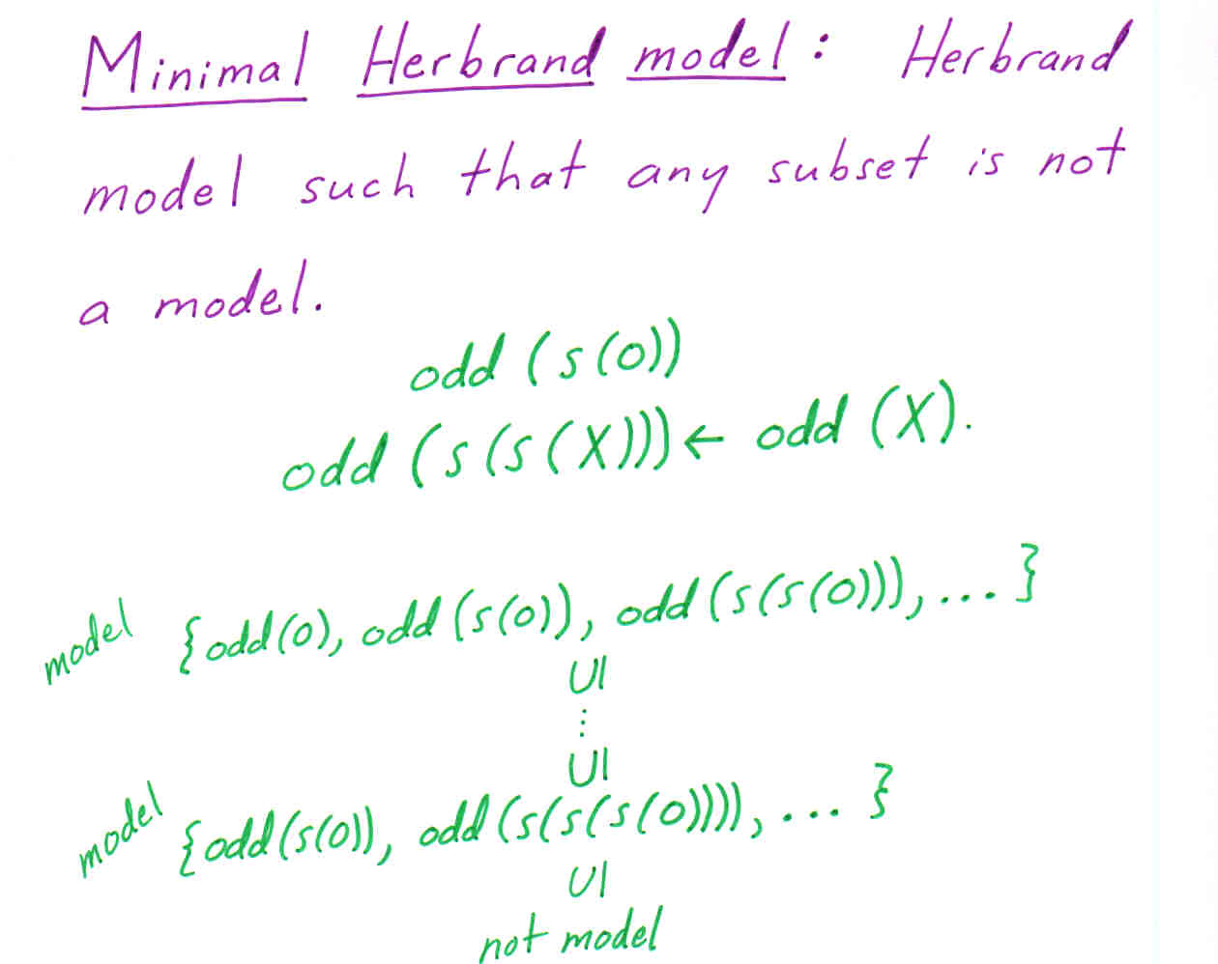

Slide 22
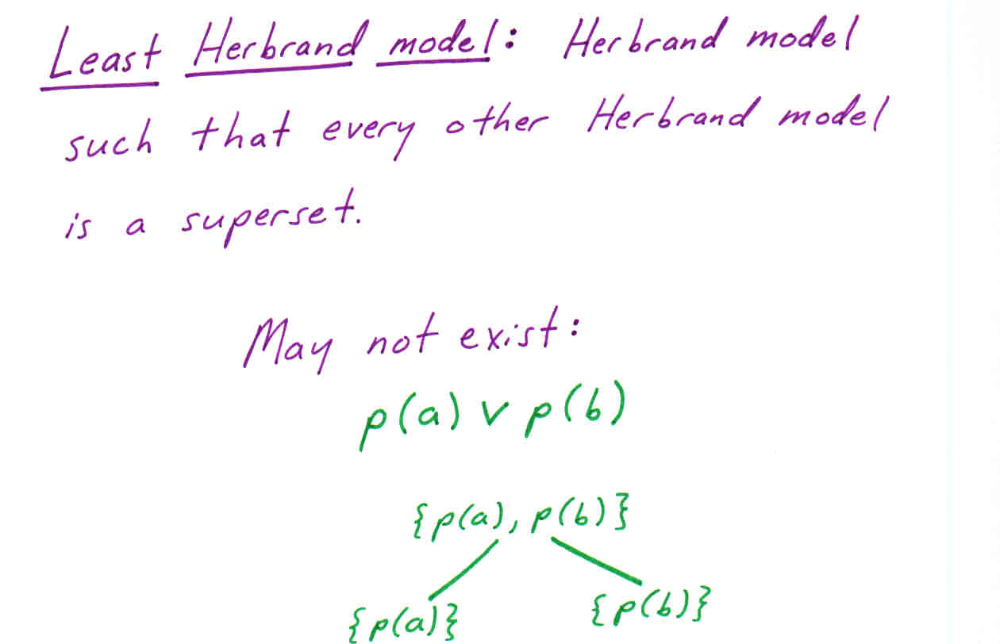

Slide 23
Why no least Herbrand model?
Disjunctive “positive” information… creates uncertainty. We can satisfy the disjunction by satisfying either disjunct – a choice.
This is somewhat analogous to the uncertainty created by existential quantifiers.
This uncertainty also causes inefficiencies in deduction (recall prop. SAT is NP-complete but SAT for Horn CNFs is linear-time solvable).

Slide 24
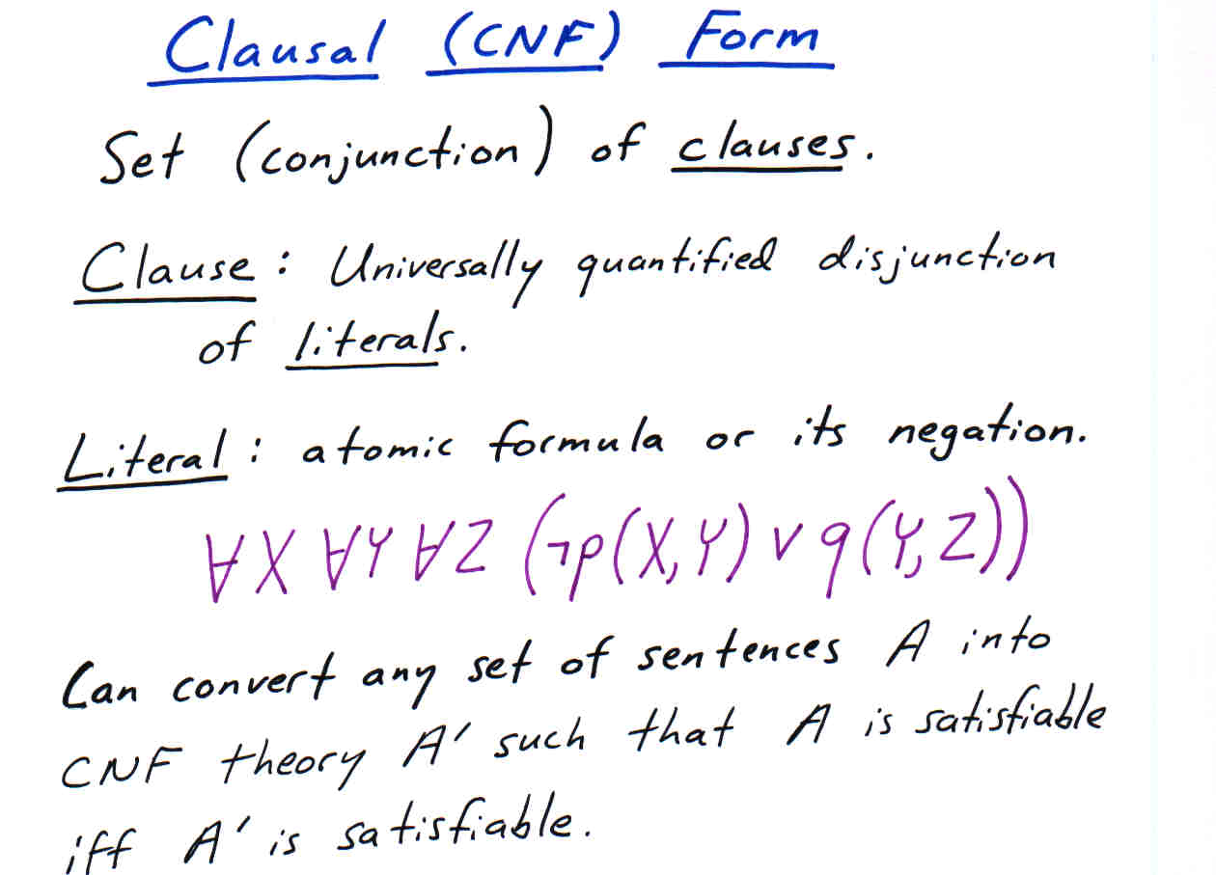

Slide 25
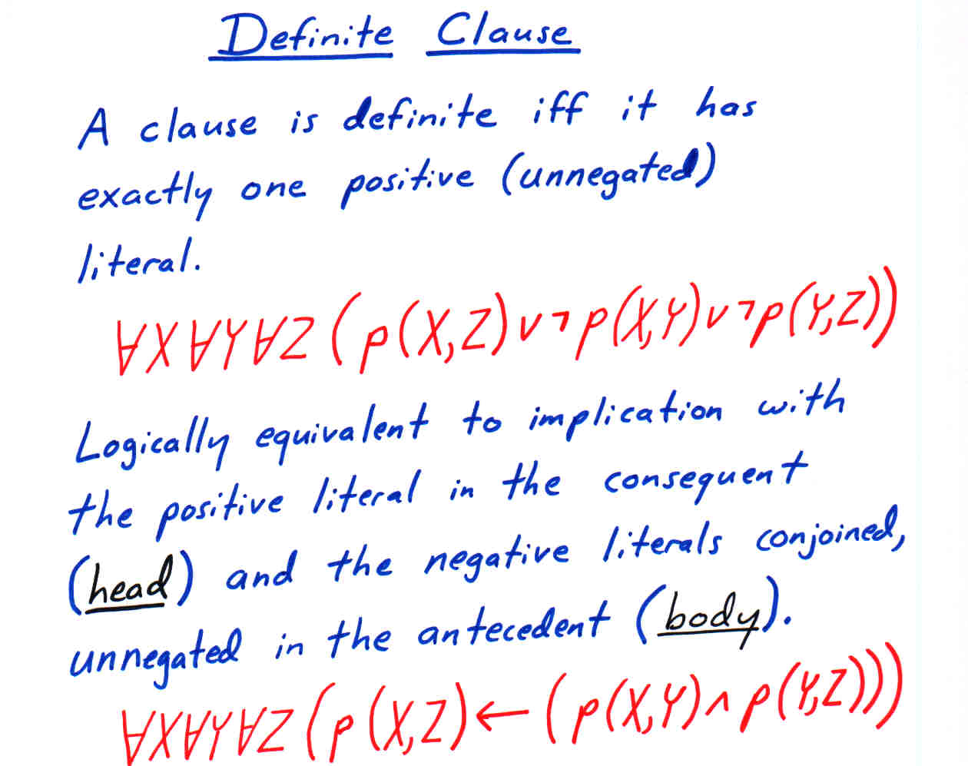

Slide 26
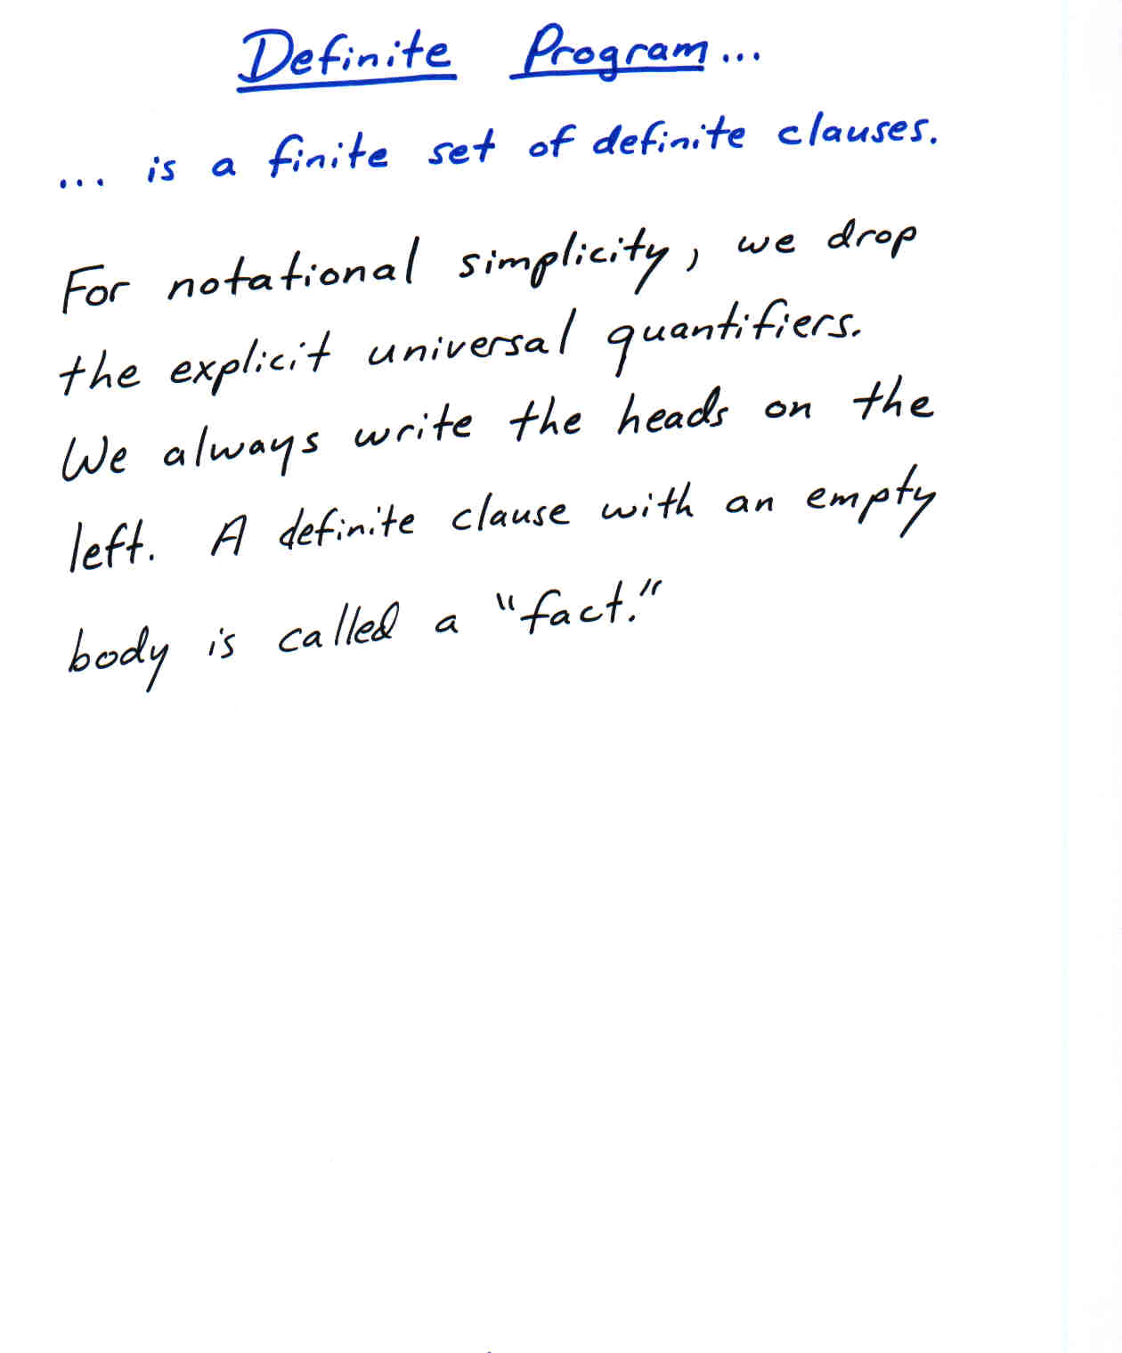

Slide 27
Examples of Definite Programs
mother(mary)
child_of(tom,mary)
loves(X,Y) mother(x) ∧ child_of(X,Y)
odd(s(0))
odd(s(s(X)) odd(X)

Slide 28
Prolog Notation
mother(mary).
child_of(tom,mary).
loves(X,Y):- mother(x), child_of(X,Y).
odd(s(0)).
odd(s(s(X)):- odd(X).

Slide 29
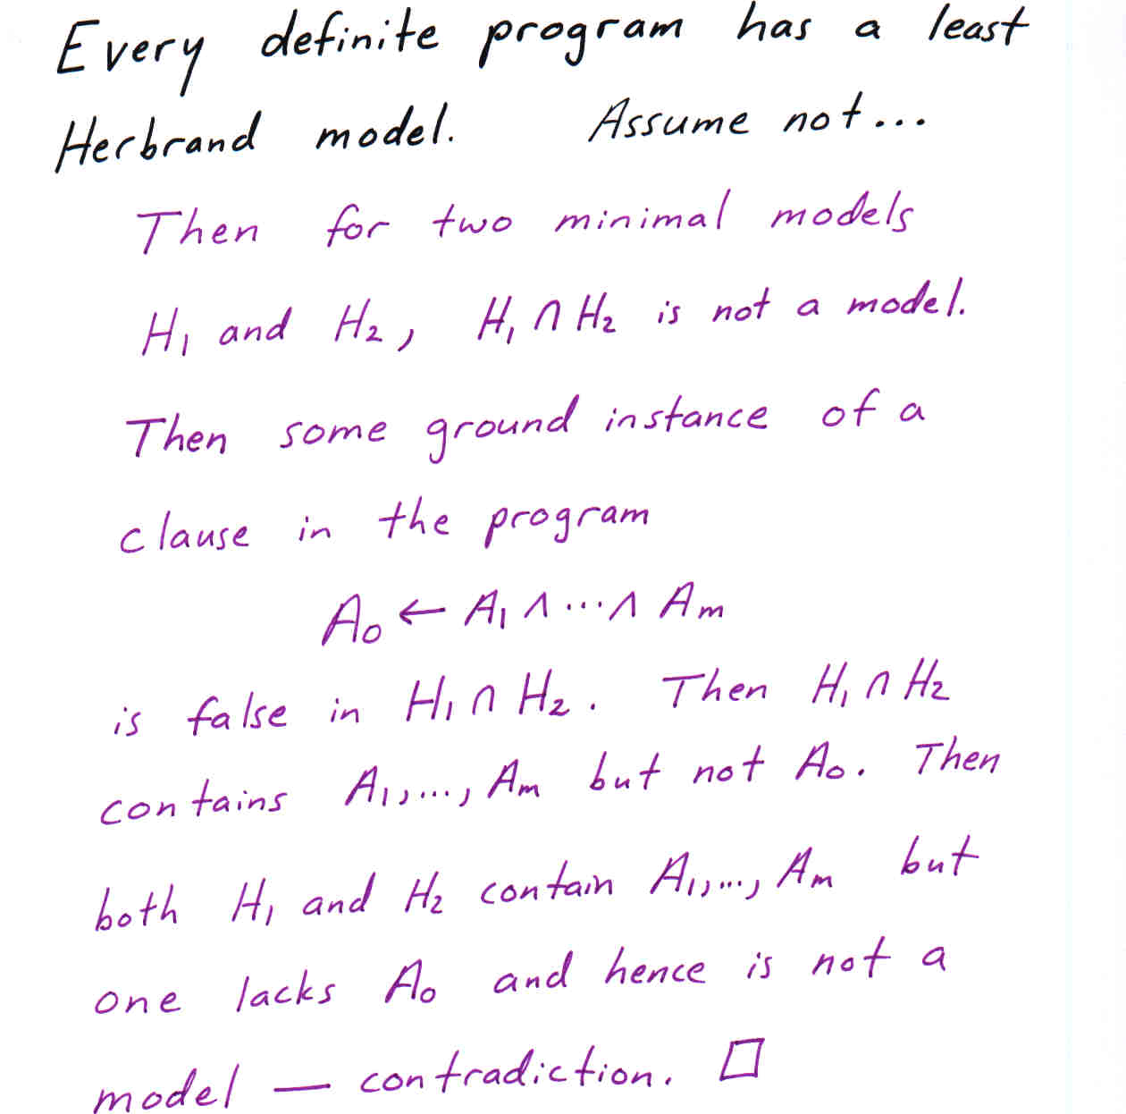

Slide 30
About Least Herbrand Models
The least Herbrand model M_{P} of a program P is the set of all ground atomic logical consequences of the program.
In general it is undecidable whether a ground atomic formula is in the least Herbrand model of a program (logically follows from the program). But if it follows, it can be eventually shown…

Slide 31
Alternative Characterization of Least Herbrand Model
Let P be a definite program. T_{P} is a function on Herbrand interpretations defined as follows:
  T_{P}(I) = {A₀ | A₀←A₁,…,A_{m} ∈ P_{gr} and {A₁,…,A_{m}} ⊆ I}
The least interpretation I such that T_{P}(I) = I is the least Herbrand model of P.

Slide 32
Contruction/Approximation of Least Herbrand Model
T_{P} ↑ 0 = ∅
T_{P} ↑ (i+1) = T_{P}(T_{P} ↑ i)
T_{P} ↑ ω is the union of T_{P} ↑ i for all i from 0 to ∞
The least Herbrand model M_{P} of P is the least fixpoint of T_{P}: the least Herbrand interpretation such that T_{P}(M_{P}) = M_{P}.
M_{P} = T_{P} ↑ ω.

Slide 33
Example
odd(s(0)).
odd(s(s(X)) ← odd(X).
T_{P} ↑ 0 = ∅
T_{P} ↑ 1 = {odd(s)}
T_{P} ↑ 2 = {odd(s(s(s(0))), odd(s)}
T_{P} ↑ ω = {odd(s^{n}(0)) | n ∈ {1,3,5,…}}

