Slide 1
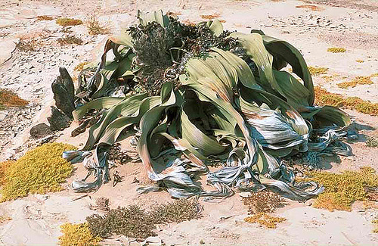
The plant of the day
Welwitschia mirabilis
Notes:
Welwitschia is a monotypic gymnosperm genus
Only genus of the family Welwitschiaceae and order Welwitschiales, in the division Gnetophyta – relative of pines
Endemic to the Namib desert within Namibia and Angola.
dioecious, with separate male and female plants.
Plants long-lived > 1000 years
Live in dry area – adapted to obtaining moisture from fog, but they occur on ephemeral water courses, and have roots, which suggest that they also obtain some ground water

Slide 2
Questions
What is evolution?
How does evolution occur?

Slide 3
Think – Pair - Share
Think of an example where understanding evolution is beneficial.
Write down 1-2 sentences.
Discuss with a neighbour.
Report back to class.

Slide 4
MECHANISMS OF EVOLUTION (a review)
Biological Evolution: the change over time in the genotypic
composition of populations
Microevolution: changes that occur over a small number of generations
Macroevolution: changes that happen over many generations
Population: a group of organisms of the same species occupying a particular geographic region.
Genotype: the genetic make-up of an organism.
Phenotype: the physical expression of an individual’s genotype. (selection acts on phenotype not genotype)

Slide 5
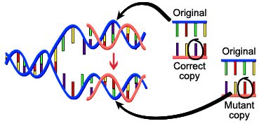
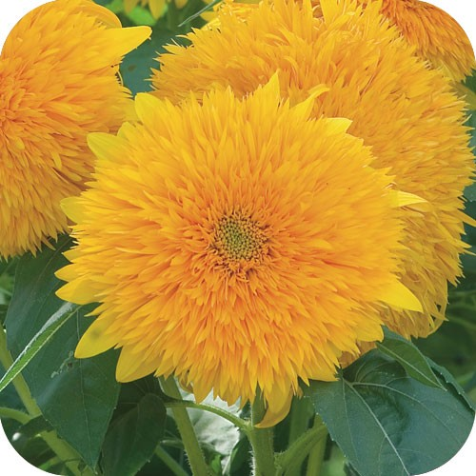

CHANGING THE GENOTYPIC COMPOSITION OF POPULATIONS
Evolutionary agents: forces that change allele and genotypic frequencies in populations: mutation, gene flow, genetic drift, and natural selection.
Mutation: random changes in genetic material. Mutation is ultimate source of all genetic variation. Mutation rates are low (one in a million per generation in typical genes).
DNA fails to copy accurately
Exposure to chemicals or radiation
http://evolution.berkeley.edu/evolibrary/article

Slide 6
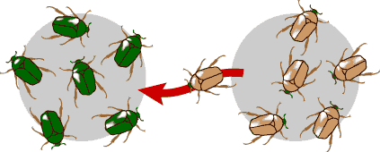
Gene Flow: migration of individuals followed by breeding produces gene flow. Gene flow adds new alleles to populations or changes the frequency of alleles already present.
http://evolution.berkeley.edu/evolibrary/article

Slide 7
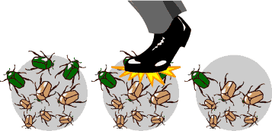
Genetic drift: In each generation, some individuals may, just by chance, leave behind a few more descendents (and genes, of course!) than other individuals.
http://evolution.berkeley.edu/evolibrary/article

Slide 8
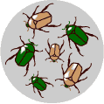
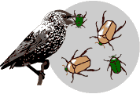
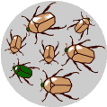
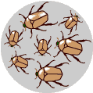
CHANGING THE GENOTYPIC COMPOSITION OF POPULATIONS
Natural selection: Individuals vary in traits that lead to differential reproduction.
Beetles vary in color
Green beetles are eaten by birds and
so survive to reproduce less often
The surviving brown beetles have
brown baby beetles because this trait
has a genetic basis.
The more advantageous trait, brown
coloration, which allows the beetle
to have more offspring, becomes more
common in the population.
http://evolution.berkeley.edu/evolibrary/article

Slide 9
Definitions (to aid with the reading for next week):
Effective population size: the number of breeding individuals in an idealized population
Inbreeding depression: reduced fitness as a result of breeding of related individuals.
Outbreeding depression: reduced fitness as a result of breeding of distantly related individuals.

Slide 10
Unanswered Questions
What is the relative importance of the different evolutionary agents?
Do these evolutionary agents vary in importance in different organismal groups?
If so, what ecological and demographic factors account for this variation?

