Slide 1
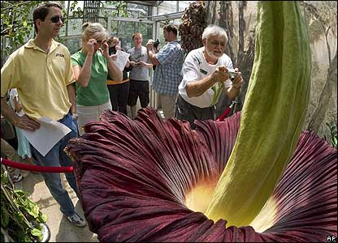
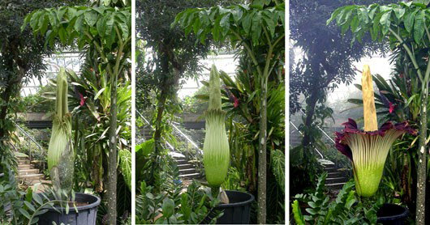
Spathe or leaf-like bract
Amorphophallus titanum
Largest unbranched inflorescence in the world
Monecious and protogynous
Carrion flower (fly/beetle pollinated)
Indigenous
to the forests
of Sumatra
Spadix

Slide 2
Questions
How is genetic variation distributed in time and space?
What factors account for the spatial and temporal distribution of genetic lineages?

Slide 3
Phylogeography: Outline
What is phylogeography?
The benefits of phylogeography
  i.e. understanding genetic structure
How do we do it?
  From historical to current approaches

Slide 4
Phylogeography: Introduction
What is phylogeography?
“A field of study concerned with the principles and processes governing the geographic distribution of genealogical lineages, especially those within and among closely related species.”
Avise 2000
PHYLOGENETICS + BIOGEOGRAPHY
Notes:
Relatively new field of study, coming of age with the development of better molecular and statistical tools.

Slide 5
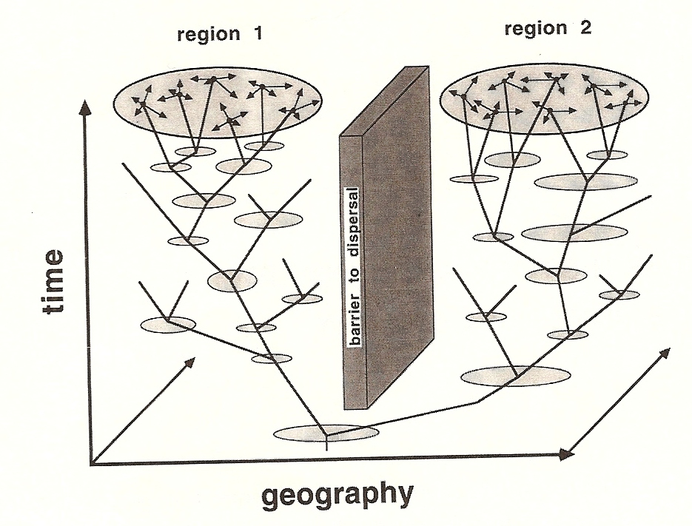
Phylogeography: Introduction
Gene genealogies of interest are mapped in space and time.
Avise 2000

Slide 6
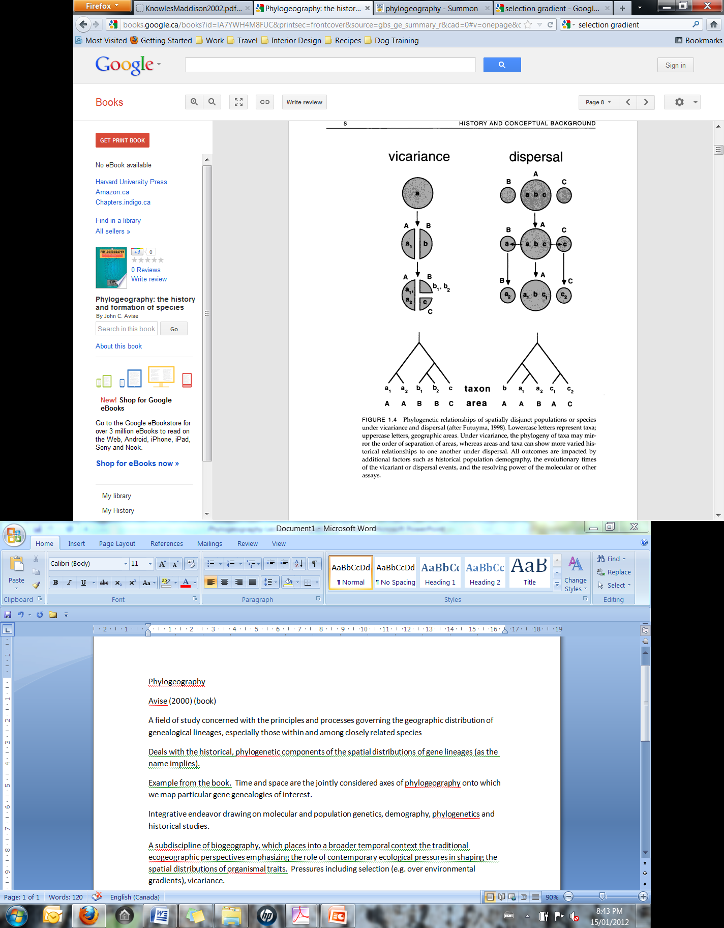
Phylogeography: Introduction
Goal: To understand the factors contributing to the formation of population (or species-level) genetic structure.
Can evaluate alternative historical scenarios that account for current spatial patterns.
Notes:
For example, vicariance and dispersal are two competing possibilities often invoked to account for the origins of spatially disjunct taxa. Phylogeographic analysis may be able to weigh these 2 possibilities. Under vicariance, the phylogeny of taxa may mirror the order of separation of areas, whereas areas and taxa can show more varied historical relationships under dispersal.

Slide 7
Determinants of Genetic Structure
Historical relationships and contemporary gene flow influence spatial patterns of genetic variation.
Similarity due to gene flow
Similarity due to historical relationships
Notes:
Gene flow levels are influenced by breeding system (e.g. oaks with no reproductive barriers and dandelions with apomixis) and dispersal mechanisms. Ancestry contributes to the genetic structure of all plant species to some extent… If genetic exchange is held constant, populations with more recent common ancestry will be more similar than those that are more distantly related.

Slide 8
Understanding
Genetic Structure
Traditionally:
  Within species, genetic exchange has been emphasized as the cause of similarity.
    Caveat: when estimating Nm, we assume an equilibrium between genetic drift and gene flow.
  Among species, historical relationship has been emphasized as the cause of similarity.
    Caveat: cladistics assumes non-reticulation.

Slide 9
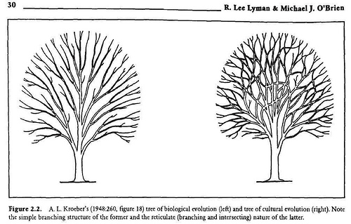
What is Reticulation?
Plant species boundaries are often porous (interspecific hybridization and introgression is common).
Populations form reticulating lineages (i.e. networks)
Notes:
So we know that neither of these two assumptions are appropriate… but these are fundamental to the application of population genetics and phylogenetics, respectively. How can we accurately tease the contribution of these two forces apart?

Slide 10
Understanding
Genetic Structure
“Phylogeographic methods provide a means of examining the history of genetic exchange among populations, with the potential to distinguish biogeographic patterns of genetic variation caused by gene flow from those caused by common ancestry.” - Schaal 1998
We can tease apart contemporary forces of genetic exchange from historical relationships

Slide 11
Understanding
Genetic Structure
Phylogeography uses principles from population genetics and phylogenetics.
However…
Does not assume an equilibrium between drift and gene flow
2) Does not assume non reticulation
Relying on the use of gene genealogies, from non-recombining segments of DNA (e.g. mtDNA, cpDNA), phylogeographic methods provide historical information that individuals or populations cannot.

Slide 12
Step 1: the search for genetic variation
We need significant genetic variation at the appropriate level (i.e. among the populations or taxonomic units under investigation)
Mitochondrial DNA
-great for animals
-low rates of molecular evolution in plants, intramolecular recombination
Chloroplast DNA
-faster rates of molecular evolution but still low (and variable among species)
-no recombination
-chloroplast capture can occur (e.g. in oaks, sunflowers, poplar)
Organelle genomes are essentially a single locus - inferences based on multiple loci give more accurate estimations of the population history of a species
Nuclear DNA
-problems of intra-allelic recombination, heterozygosity and gene families
Notes:
Recombination can complicate the analyses, since we are essentially trying to follow haplotypes over time in gene genealogies. Haplotypes = particular combination of alleles (over multiple markers) on a single chromosome.
Nuclear DNA potentially has all the variation we need but…

Slide 13
Phylogeography: the early years
Phylogeography was essentially descriptive:
Plot haplotypes on map
Classify pattern of phylogeographic structure
Consider historical explanations
Look for concordance among different species (comparative phylogeography)

Slide 14
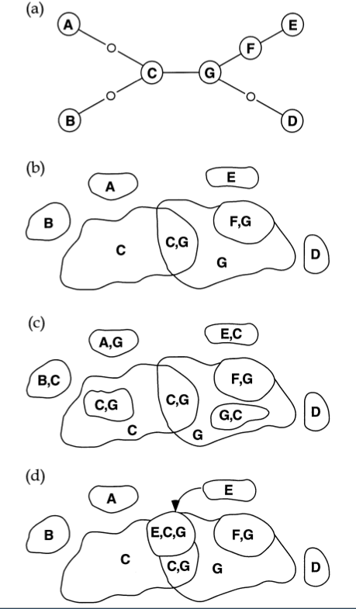
Phylogeography: patterns and process (Ex 1)
Phylogeographic analysis relies on interpreting patterns of congruence or lack of congruence between geographical distribution of haplotypes and their genealogical relationships. (Schaal et al 1998)
Notes:
Let’s look at how this works… with a couple of examples.

Slide 15
Phylogeography: patterns and process (Ex 1)
Clades of closely related haplotypes are geographically restricted and occur in proximity to each other.
CONGRUENCE
Long-standing pattern of highly restricted gene flow.
Oldest haplotypes at centre of gene tree and geographically widespread, whereas younger haplotypes at tree tips and geographically restricted.

Slide 16
Phylogeography: patterns and process (Ex 1)
NOT CONGRUENT
Persisting polymorphisms were differentially sorted, following population divergence (incomplete lineage sorting)

Slide 17
Phylogeography: patterns and process (Ex 1)
NOT CONGRUENT
Inter-population gene flow
(if gene-flow not from ‘tip’-haplotypes, difficult to distinguish from incomplete lineage sorting)

Slide 18
Phylogeography: patterns and process (Ex 2)
Spatial pattern of haplotypes
E
A
F
Region 1
Region 2
C
G
ABC
DEFG
B
D
Deep gene tree with major lineages allopatric
What is the likely demographic process?
Fragmentation (long term barriers to gene flow)

Slide 19
Phylogeography: patterns and process (Ex 2)
Spatial pattern of haplotypes
E
A
F
Region 1
Region 2
C
G
ABCD
EFG
ABCD
EFGG
B
D
Deep gene tree with major lineages sympatric
What is the likely demographic process?
Long term barriers to gene flow but more recent admixture among populations/species

Slide 20
Phylogeography: patterns and process (Ex 2)
Spatial pattern of haplotypes
A
B
C
Region 1
Region 2
Region 3
A
B
C
Shallow gene tree (haplotypes closely related) with lineages allopatric
What is the likely demographic process?
Recent colonization followed by restricted gene flow

Slide 21
New Approach: Coalescent theory
How do we do it?
Phylogeography makes use of coalescent theory
Is a statistical framework for the analysis of genetic polymorphism data
Is an extension of classical population genetics theory
It is used to estimate time (number of generations) since lineages coalesced
Many applications

Slide 22
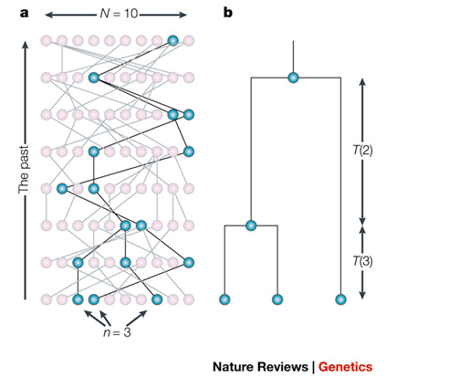
Coalescent theory
We go backwards in time from the present
Lineages can randomly “pick” their parents as we go back in time (no selection)
When two lineages pick the same parent they coalesce
All lineages will eventually coalesce to the MRCA of the sample
The rate that lineages coalesce depends on the number of lineages (more lineages the faster the rate) and the size of the population (the more parents to pick from, the slower the rate)
Recombination, gene flow and selection can be incorporated into the model
N number of alleles in the population
n number of lineages sampled
T time between coalescent events
Rosenberg & Nordborg 2002

Slide 23
Conceptual distinctions
Classical population genetics
-based on allele frequencies
-alleles are either the same or different, no degrees of similarity
Phylogeography
-based on gene genealogies
-both the frequencies of sequence haplotypes and their relationship is considered
Coalescent Theory
-a mathematical approach to solving population genetic problems
-explicitly considers genealogical processes, even if the data are allele frequencies

Slide 24
Phylogeography: new methods
Model based statistical phylogeographic inference:
Statistical approached based on coalescent models for parameter estimation (e.g. m, Ne) and hypothesis testing
Uses coalescent theory to build statistical models for hypothesis testing under a Baysian/Likelihood based stratagem
Fit the data to each model and compare to other models
Relies on the development of alternative models from external data (e.g. palynological data)

Slide 25
Phylogeography: summary
Phylogeography's objective is to understand the processes underlying the spatial and temporal dimensions of genetic variation
Statistical phylogeography, relying of coalescent models, provides a rigorous statistical method to assess demographic hypotheses
Gene genealogies from multiple unlinked nuclear loci are required to provide a better historical record for species

Slide 26
Unanswered questions
How much cryptic diversity exists in nature?
What is the phylogeographic history of ecological communities?

