Slide 1
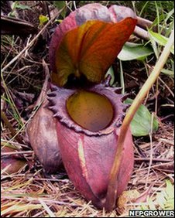
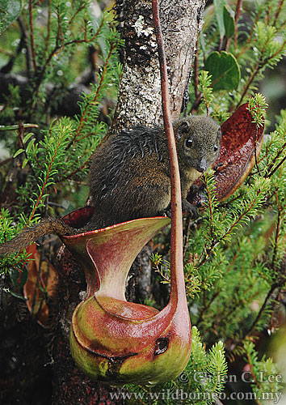
Plant of the day!
Nepenthes rajah, the largest meat-eating plant in the world, growing pitchers that can hold two litres of water if filled to the brim.
It is dioecious
Pitchers have evolved 3 times in 3 independent groups, the Sarraceniaceae (the Americas), the Nepenthaceae (Asia), and the Cephalotaceae (Australia).
Carnivorous plants have evolved 6 times independently (~630 species)
Such species attract, trap and digest insects etc.. and derive nutrients from them (live in nutrient poor environments like bogs)

Slide 2
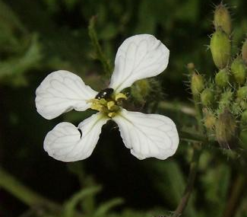
Adaptation
What is adaptation and local adaptation?
Why do we study local adaptation and how does it arise?
Can we measure selection in nature?
How do we assess quantitative genetic variation and why is it important?
How do we study local adaptation in nature?

Slide 3


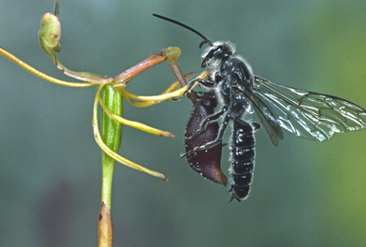
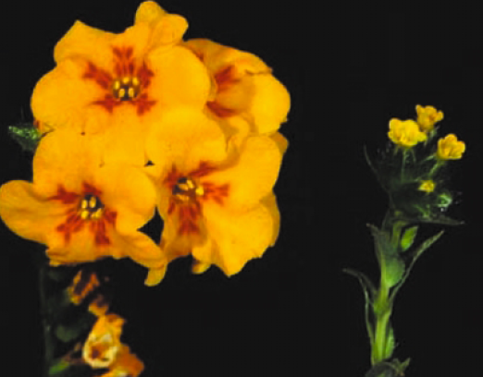
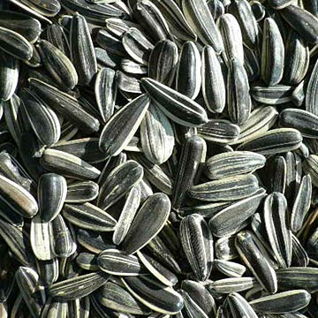
Adaptation
A feature of an organism that has been favoured by natural selection because of that feature's positive effect on relative fitness

Slide 4
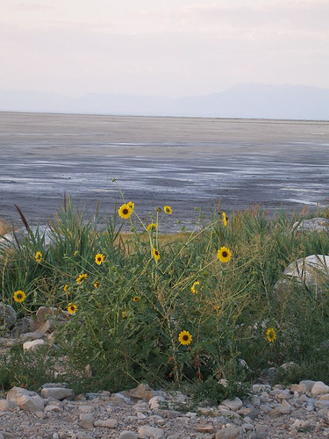
Local adaptation
What is local adaptation?
Evolution, through divergent natural selection, of traits that have high fitness in the environmental conditions specific to a population.
e.g. populations of sunflowers around the Great Salt Lake are highly salt tolerant there, but not elsewhere.
These adaptations are local in that they are NOT found throughout the whole species, having evolved through natural selection because they have high fitness in the specific environments of only certain populations of the species.

Slide 5
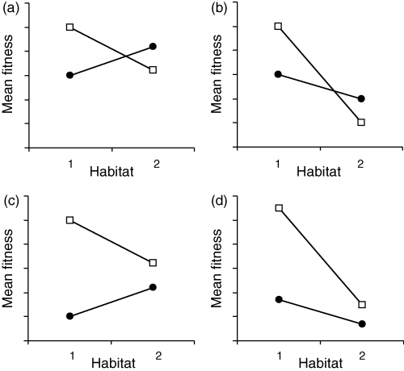
Which of these shows local adaptation?
Local
Local
Local
Local
Local
Local
Local
Local
“local” genotypes do better than “immigrant” at each site
Annual Reviews

Slide 6
Why study local adaptation?
Many adaptations are ancient, making it difficult to understand the selection pressures that led to their origins.
Local adaptation should be due to current or recent selection related to differences in environmental conditions experienced by different populations
- Can infer rate of adaptive evolution
-Is a mechanism that maintains genetic variation
-Can be crucial for initiating speciation

Slide 7
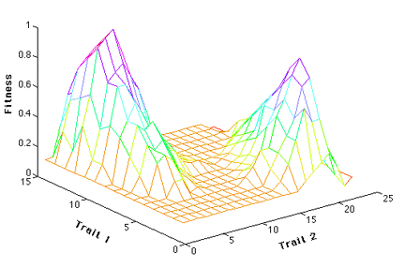
What might prevent local adaptation?
Weak/no divergent selection
Gene flow can prevent divergence due to selection (e.g. dge center to edge)
Temporarily varying selection may lead to a “generalist” strategy
Drift can oppose selection
Alternative adaptive peaks
Lack of genetic variation

Slide 8
Natural selection
Natural selection: Individuals vary in traits that lead to differential fitness.
Fitness: An individual’s contribution to the next generation. Determined by the probability of survival to reproduction and the number of offspring an individual produces. It is often expressed as a relative measure.
How can we measure fitness?
-difficult to measure in the field (especially for perennial and outcrossing plants)
Selection coefficient: A measure of the reduction in fitness compared with the best genotype in the population

Slide 9
Natural Selection
Natural selection:
More offspring are produced than can survive
Phenotypic variation in a trait
Differential fitness among phenotypes
What else is required for a response to selection?
Genetic variation
-if these traits are heritable certain genotypes will produce more offspring leading to evolutionary change

Slide 10
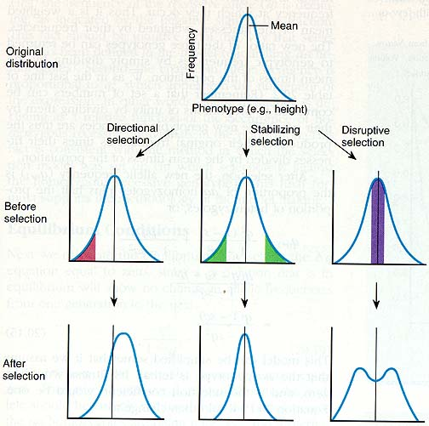
What are the different types of selection?

Slide 11
Modes of natural selection:
Measuring selection on quantitative traits
Directional selection (positive selection)
Fitness measure w
Slope of regression is estimate
of strength of selection
Trait z (e.g. flower size)
Stabilizing selection
Disruptive selection
Fitness measure w
Fitness measure w
Trait z (e.g. flower size)
Trait z (e.g. flower size)

Slide 12
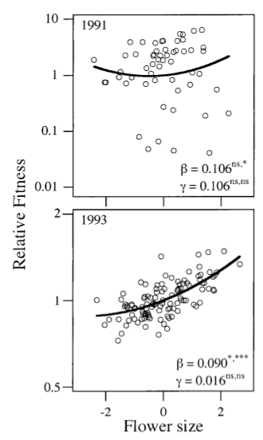
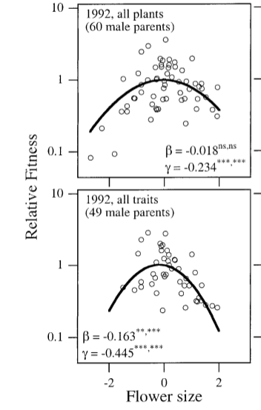
Measuring selection in wild populations
Β = linear selection
gradient (measures
directional selection)
γ = quadratic selection
gradient (measures
stabilizing and disruptive
selection)
Positive selection for larger flowers in 1993 through male function
Stabilizing selection for flower size in 1992 through male function
Morgan and Conner 2000

Slide 13
Genetic variation and response to selection
Provides the capacity for organisms to adapt
Population/species with no genetic variation can not
respond to selection

Slide 14
How do we measure genetic variation in quantitative traits?
Parent offspring regression
Mid-parent
Mid-parent
Slope=h²=0.9
Slope=h²=0
Offspring
Offspring
Parents
Parents
Frequency
Offspring
Frequency
Offspring
Trait z (e.g. flower size)
Trait z (e.g. flower size)

Slide 15
How do we measure genetic variation in quantitative traits?
Var(P) = Var(G) + Var(E) + 2Cov(G,E)‏
Var(G)‏
1 0 -1
Phenotype
H² =
Broad Sense Heritability
Var(P)‏
Var (G) = Var(add)+Var(dom)+Var(epi)‏
Additive effects = neither allele is dominant (combined effect is equal to the sum of their individual effects)
Dominance = variation from interaction of alleles
Epistasis = variation from interaction of loci
aa Aa AA
Genotype
Additive genetic variation is important for adaptation because this is the capacity of an individual to respond to selection (in a sexually reproducing outcrosser) as additive effects of genes are almost entirely responsible for the resemblance of parents and offspring.

Slide 16
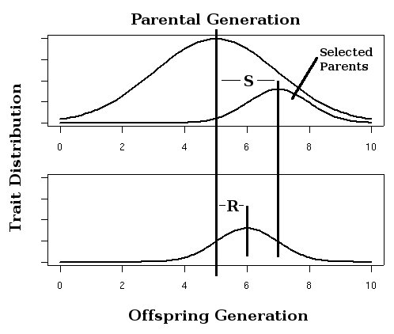
Genetic variation: quantitative traits and the breeder’s equation
Narrow Sense Heritability
Var(A)‏
R
h² =
=
R = h² S
Var(P)‏
S
S = Selection differential
difference between selected parents and the population as a whole (within a generation)
R = response to selection
difference between selected offspring and the unselected population (across generations)

Slide 17
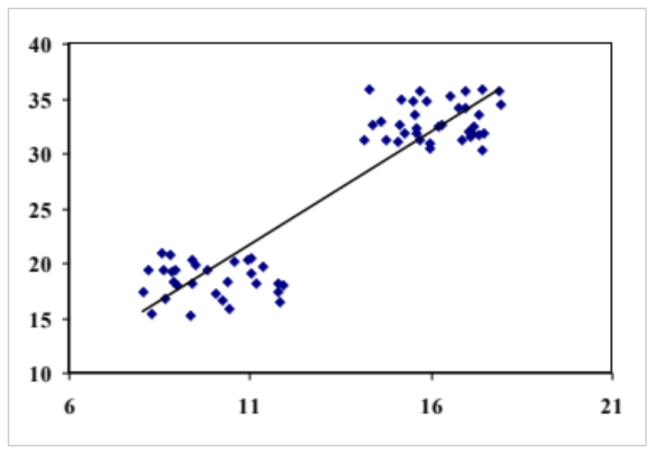
Genetic correlations can constrain adaptation
Imagine a case where a single diallelic locus controls both inflorescence height and date of first flower
Positive genetic correlation
Short inflorescence
A
a
Early flowering
NS
Inflorescence height
Tall inflorescence
NS
A
a
Late flowering
Flowering date
Can natural selection lead to late flowering plants with short inflorescences?
Can natural selection lead to early flowering plants with tall inflorescences?

Slide 18
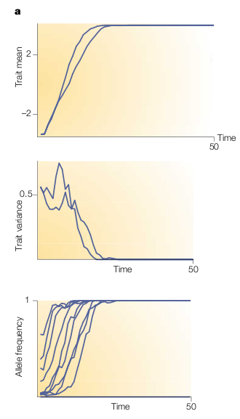
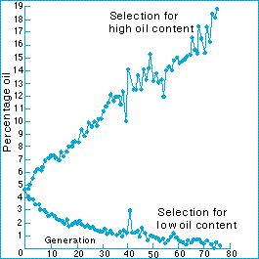
The depletion of genetic variation
Over time additive variance for a trait
is expected to be used up by selection
Population relies on new, beneficial mutations which may occur more frequently than expected as evidence by sustained responses to artificial selection
Dudley and Lambert 1992

Slide 19
Finding evidence for local adaptation
Common garden experiments/ reciprocal transplants
Clines
Qst (phenotypic differentiation) versus Fst (genetic
differentiation at neutral molecular markers)

Slide 20
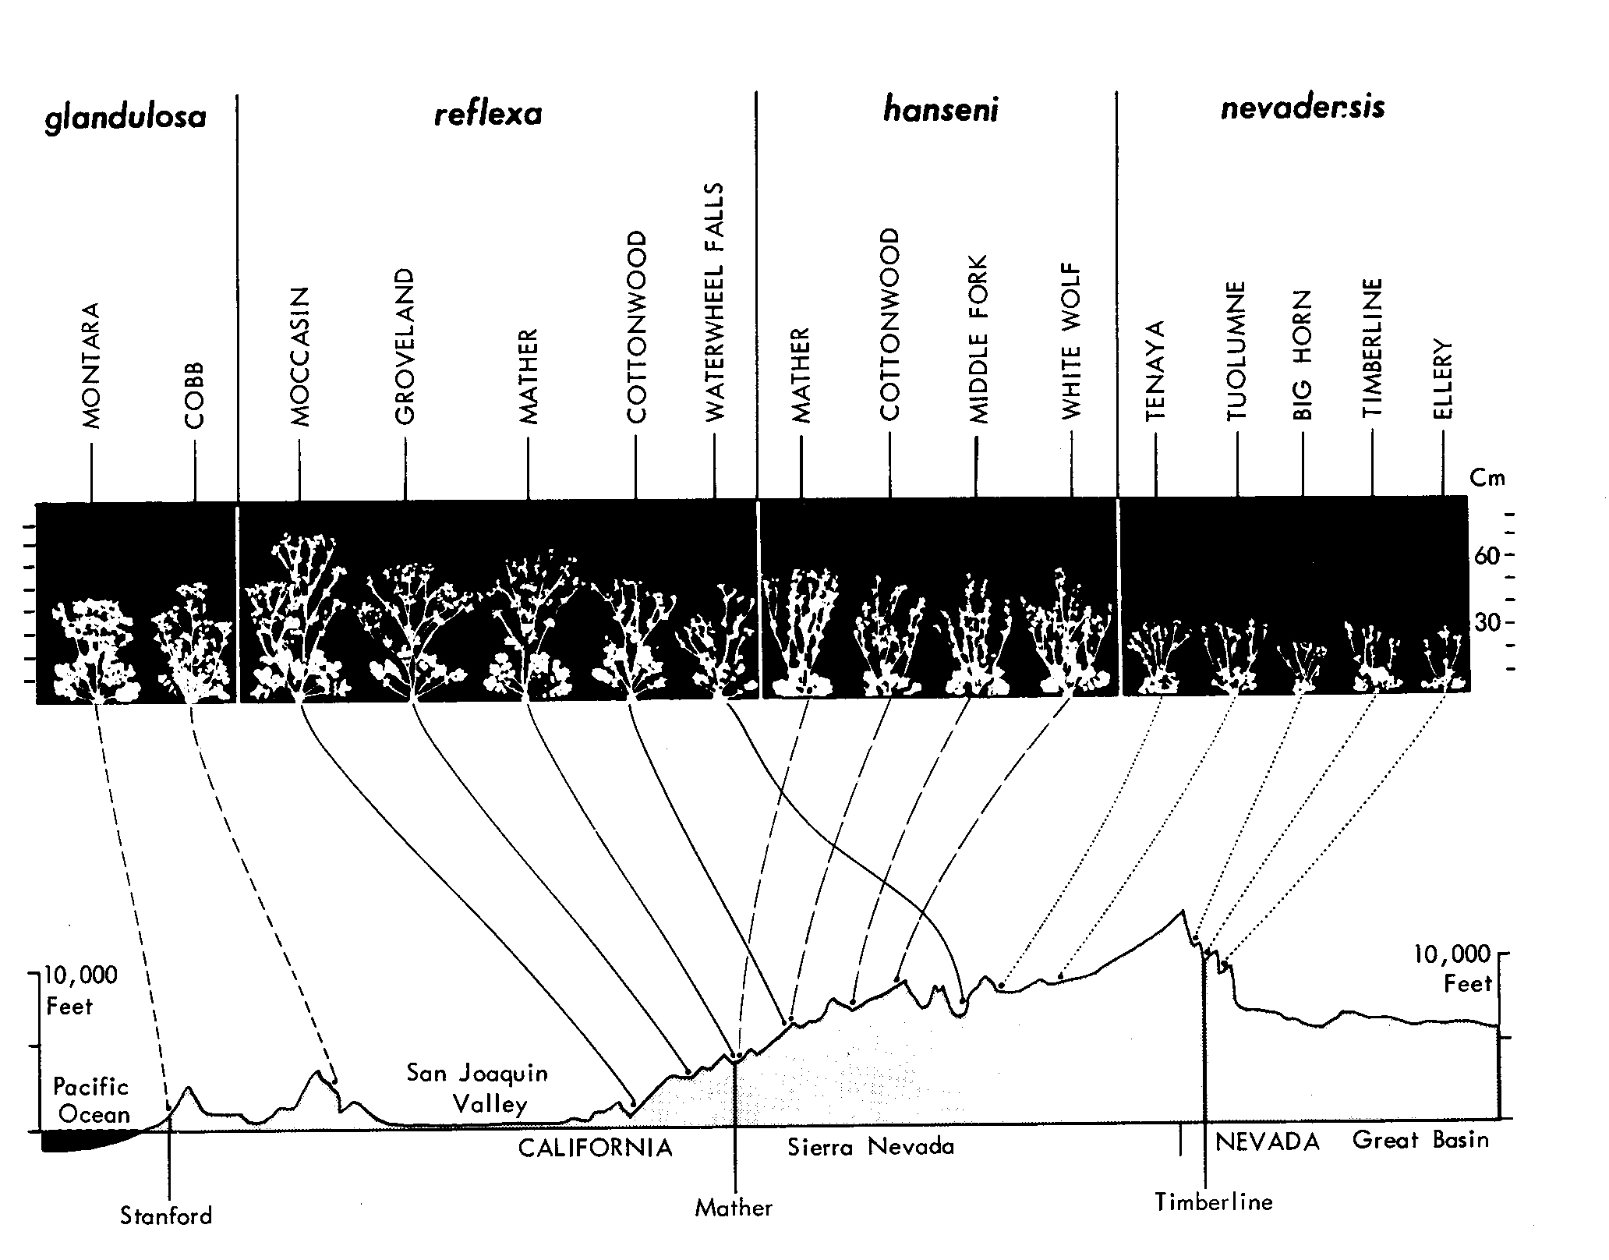
Common garden experiments
Potentilla glandulosa
Clausen, Keck, & Hiesey

Slide 21
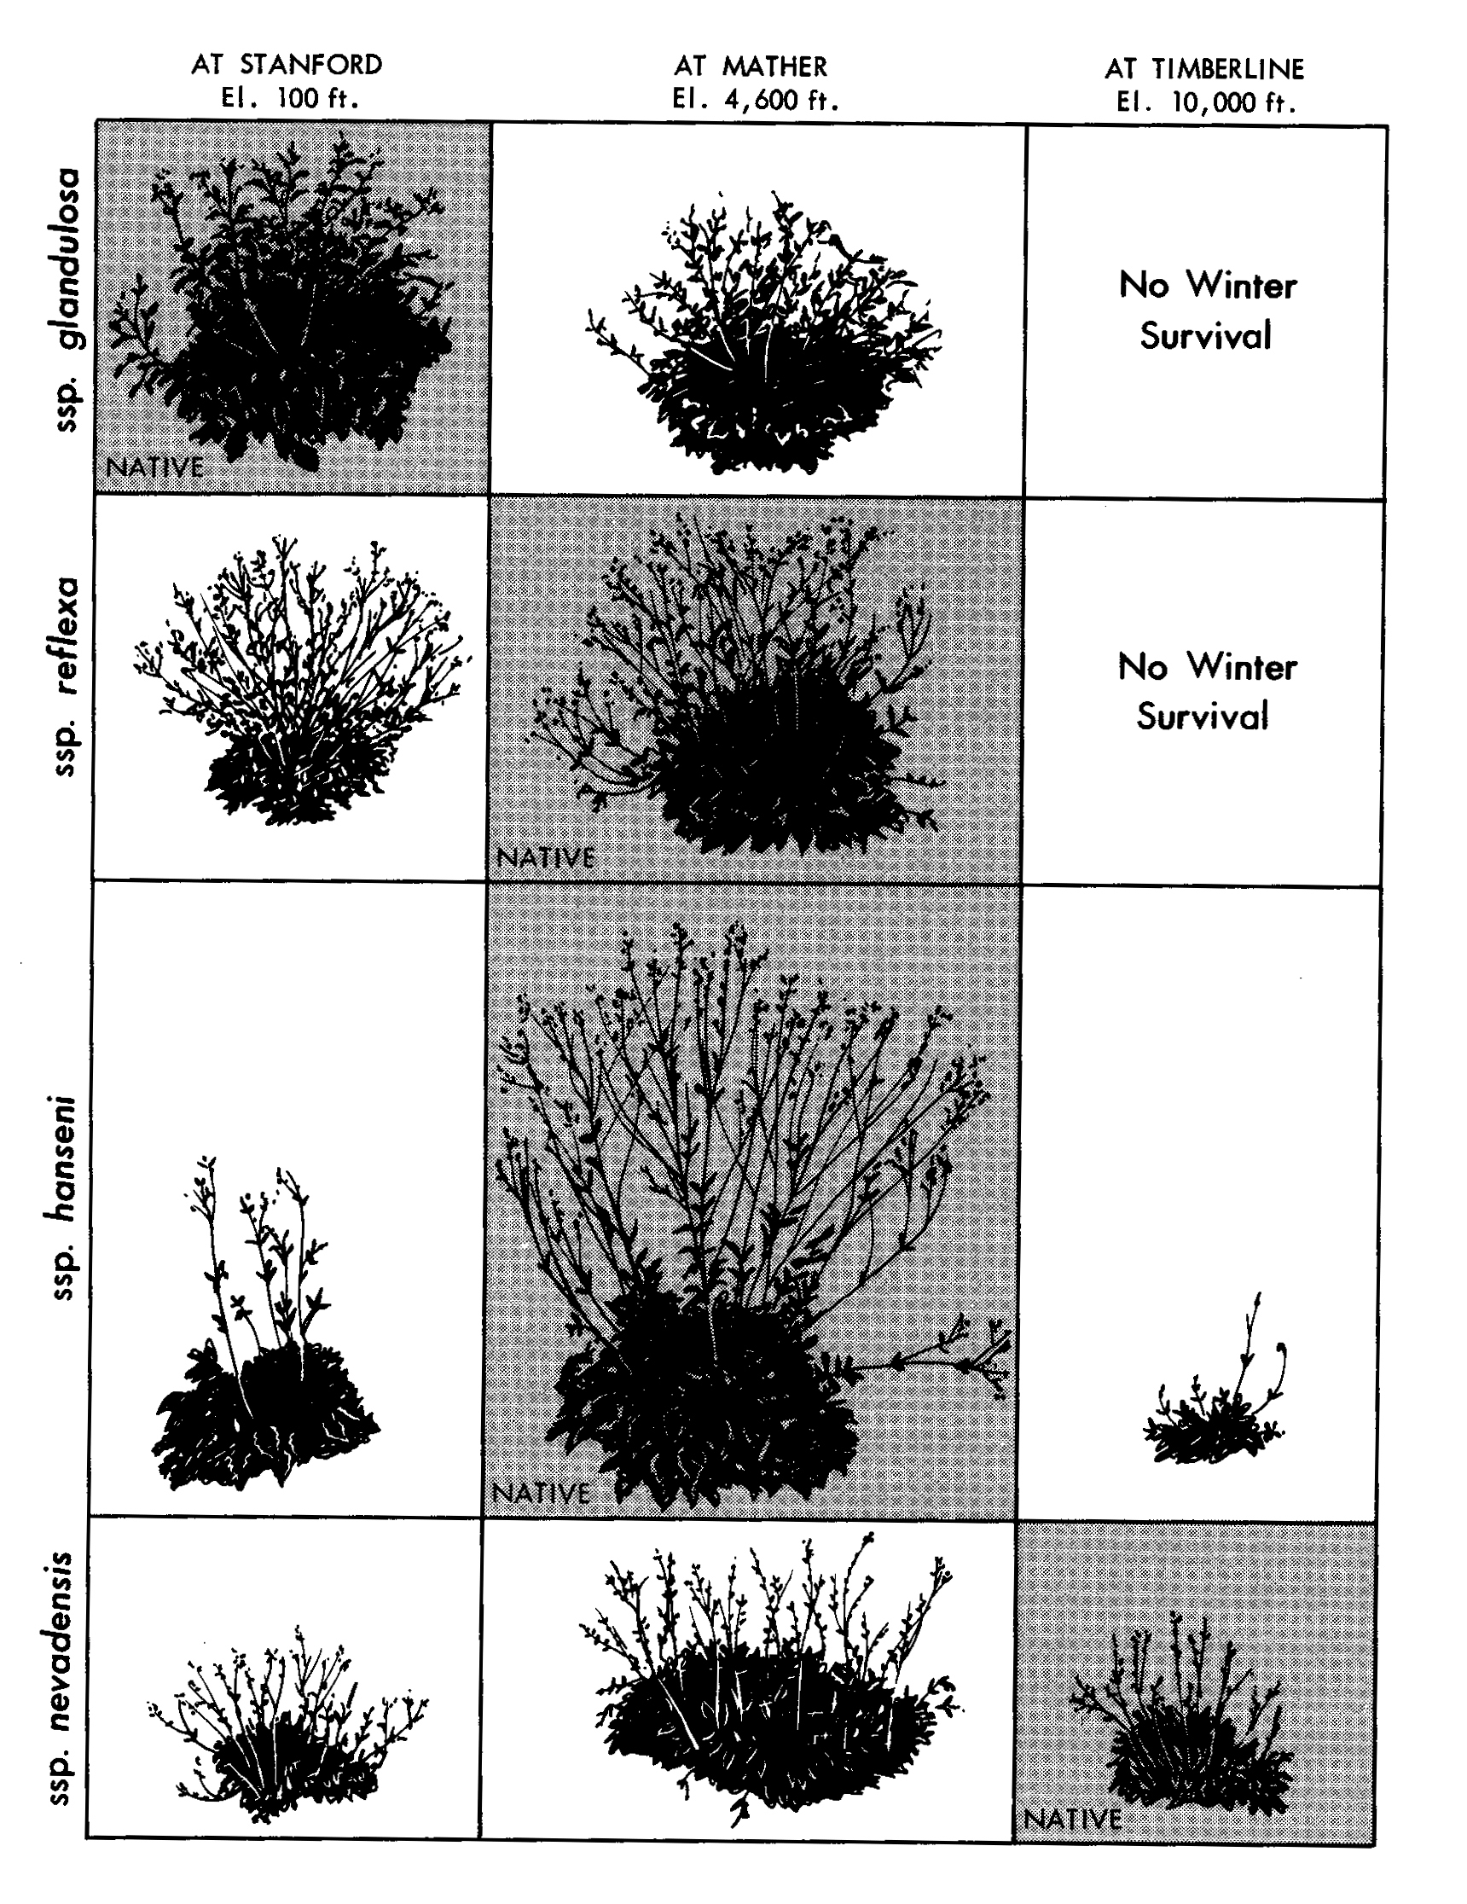
Common garden experiments
Genetic differentiation for traits related to fitness
Suggests local adaptation
Genetic difference
Phenotypic plasticity

Slide 22
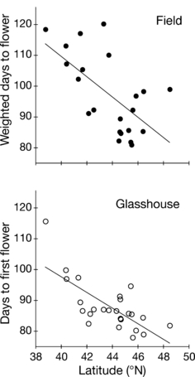
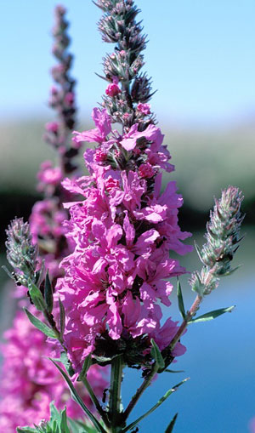
Identifying local adaptation: clinal variation
Clinal variation in traits (e.g. flowering time in purple loosestrife)
-suggests adaptation to local conditions
Why would we expect an earlier flowering time at higher latitudes?
Annual Reviews
MONTAGUE et al 2008

Slide 23
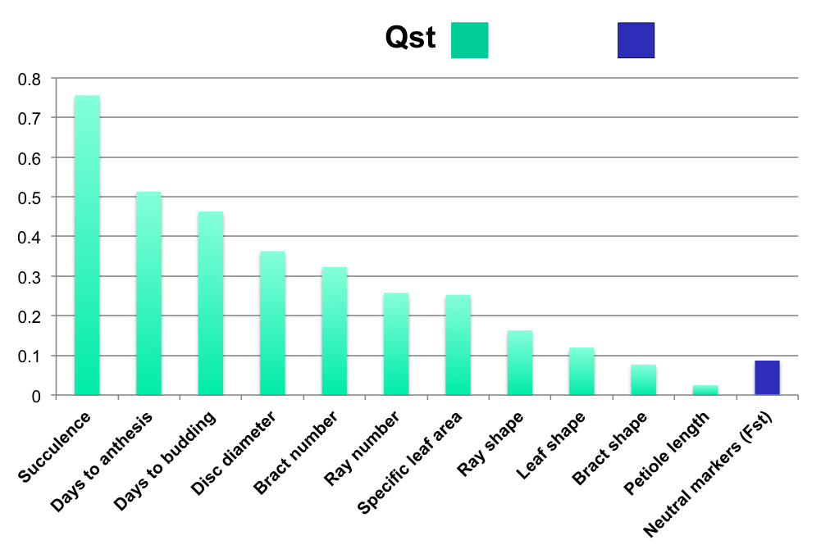
Is drift or selection driving patterns of genetic differentiation?
Fst
FST and QST values along latitudinal cline in common sunflower
FST=among population divergence in molecular markers
QST=among population variation in quantitative traits
QST>FST?
Suggests divergent selection rather than drift causing differences
QST<FST?
Suggests stabilizing selection

Slide 24
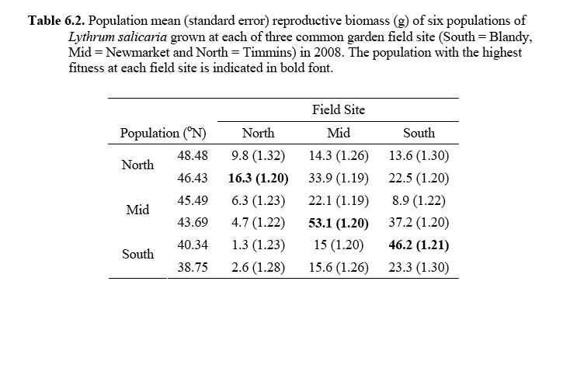

Identifying local adaptation: reciprocal transplants
This demonstrates local adaptation
But was is the mechanism underlying local adaptation? Can you think of some experiments to determine this?
Annual Reviews

Slide 25
Summary: local adaptation
Local adaptation is where local genotypes do better (have higher fitness) than immigrant genotypes
Divergent selection drives local adaptation but other factors such as gene flow can oppose it
Determining the traits underlying local adaptation and the agents of selection can be challenging
Additive genetic variation is required for an evolutionary response to selection

Slide 26
Unanswered Questions
How rapidly can populations evolve?
What sets the geographic limits of a species range?
What is the genetic architecture of adaptation?
- how many genes?
- what is the magnitude of their effects
- what is the relative importance of regulatory versus protein- coding changes?
- how repeatable is adaptation?

