Slide 1
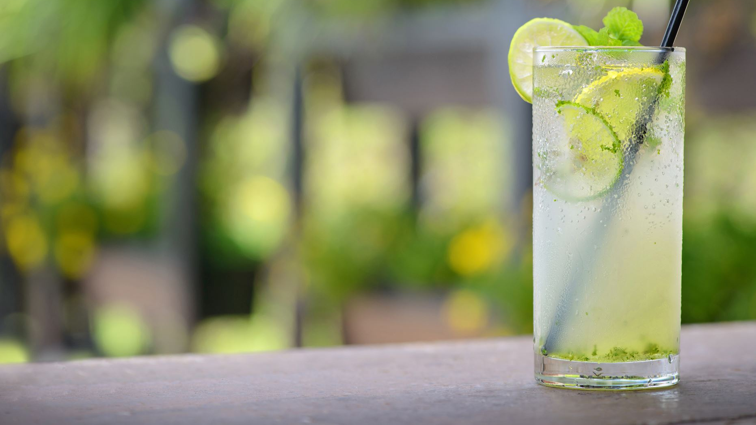
Cocktail Library Personalized Cocktail Recommendation App
Team : Allyson McGuire, Sola Lhim

Slide 2

About Cocktail Library
People enjoy cocktails but often don't know recipes or what to choose
Recipe apps exist, but they rarely let user search by taste preference
Our app bridges this gap by combining structured recipe data with the recommendation algorithm.

Slide 3
Our goal
Build a mobile IOS app where the user chooses preferences (Base spirit, Style, Flavors, etc...)
Suggest 3 – 5 recommended cocktails
Provide full recipe details( abv level, carbonation, temperature, ingredients, instructions...)
Enable data-driven recommendation with recommender algorithm
Swift UI

Slide 4
Work Flow
Step1 : Setup the environment(Swift package, XCode)
Step 2: Store 20-30 recipes as our seed data in JSON file
Fields: id, name, spirit base, style, flavors, ABV level, carbonation, temperature, ingredients, garnish
Step3: Recommendation algorithm
Step 4: Create your own recipe feature
Step 5: Swift UI screen
Step 6: Expand recipe +100
Step 7 : Deploy

Slide 5
System Architecture
CocktailCore (Swift Package)
logic, model, algorithm, tests
CocktailLibrary (XCode)
SwiftUI front-end, screen, read JSON file

Slide 6
Role & Collaboration
Sola Lhim – IOS swift app, UI/UX
Allyson McGuire – Seed data schema, algorithm design
Shared via GitHUb: https://github.com/pooloom69/Cocktail-Library

Slide 7
Thank you

