Slide 1

Sprint 2

Slide 2


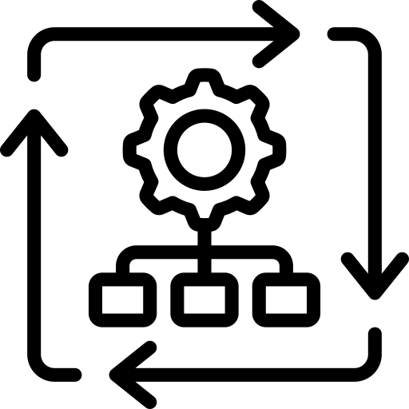



Sprint Goals
Complete workflow over C2
CI and partial CD pipeline
Implement databases
Local Kubernetes deployment

Slide 3

Sprint Planning
Authentication/authorization
CRUD shopping basket
Place an order

Slide 4
Links
Backlog
Code
Documents

