Slide 1
IDoc Listener Technical Overview

Slide 2
Disclaimer
© Copyright IBM Corporation 2009. All rights reserved.
U.S. Government Users Restricted Rights - Use, duplication or disclosure restricted by GSA ADP Schedule Contract with IBM Corp.
THE INFORMATION CONTAINED IN THIS PRESENTATION IS PROVIDED FOR INFORMATIONAL PURPOSES ONLY. WHILE EFFORTS WERE MADE TO VERIFY THE COMPLETENESS AND ACCURACY OF THE INFORMATION CONTAINED IN THIS PRESENTATION, IT IS PROVIDED “AS IS” WITHOUT WARRANTY OF ANY KIND, EXPRESS OR IMPLIED. IN ADDITION, THIS INFORMATION IS BASED ON IBM’S CURRENT PRODUCT PLANS AND STRATEGY, WHICH ARE SUBJECT TO CHANGE BY IBM WITHOUT NOTICE. IBM SHALL NOT BE RESPONSIBLE FOR ANY DAMAGES ARISING OUT OF THE USE OF, OR OTHERWISE RELATED TO, THIS PRESENTATION OR ANY OTHER DOCUMENTATION. NOTHING CONTAINED IN THIS PRESENTATION IS INTENDED TO, NOR SHALL HAVE THE EFFECT OF, CREATING ANY WARRANTIES OR REPRESENTATIONS FROM IBM (OR ITS SUPPLIERS OR LICENSORS), OR ALTERING THE TERMS AND CONDITIONS OF ANY AGREEMENT OR LICENSE GOVERNING THE USE OF IBM PRODUCTS AND/OR SOFTWARE.
IBM, the IBM logo, ibm.com, and InfoSphere trademarks or registered trademarks of International Business Machines Corporation in the United States, other countries, or both. If these and other IBM trademarked terms are marked on their first occurrence in this information with a trademark symbol (® or ™), these symbols indicate U.S. registered or common law trademarks owned by IBM at the time this information was published. Such trademarks may also be registered or common law trademarks in other countries. A current list of IBM trademarks is available on the Web at “Copyright and trademark information” at www.ibm.com/legal/copytrade.shtml
SAP is a registered trademark of SAP AG in Germany and in several other countries.
Other company, product, or service names may be trademarks or service marks of others.

Slide 3
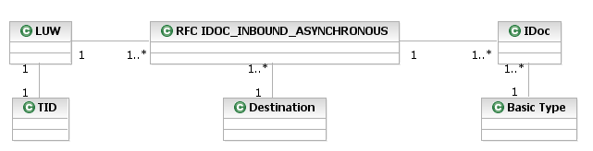
Logical Units of Work (LUW), RFC Calls and IDocs

Slide 4
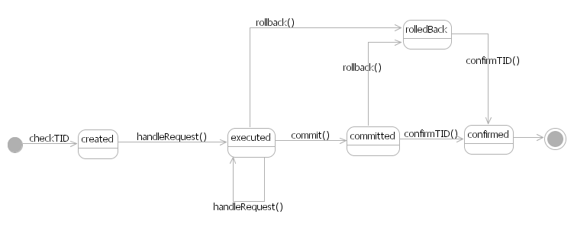
tRFC Transaction States

Slide 5
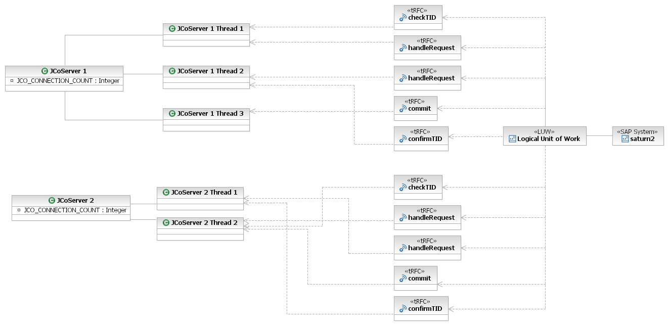
JCo tRFC and Multithreading (advanced)
CALL FUNCTION 'IDOC_INBOUND_ASYNCHRONOUS' IN BACKGROUND TASK DESTINATION 'JcoServer 1'.
CALL FUNCTION 'IDOC_INBOUND_ASYNCHRONOUS' IN BACKGROUND TASK DESTINATION 'JcoServer 1'.
CALL FUNCTION 'IDOC_INBOUND_ASYNCHRONOUS' IN BACKGROUND TASK DESTINATION 'JcoServer 2'.
CALL FUNCTION 'IDOC_INBOUND_ASYNCHRONOUS' IN BACKGROUND TASK DESTINATION 'JcoServer 2'.
COMMIT WORK.

Slide 6

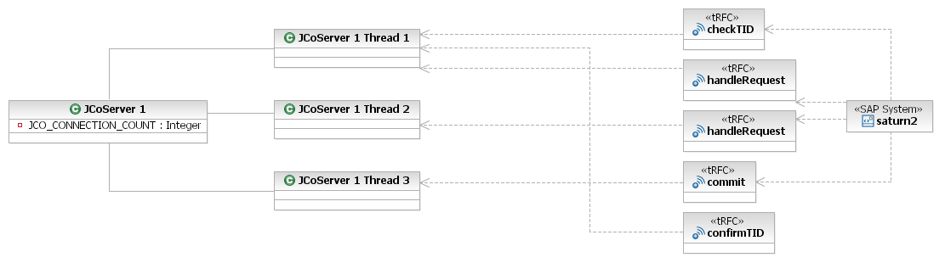
JCo tRFC and Multithreading (simple)
Example:

