Slide 1
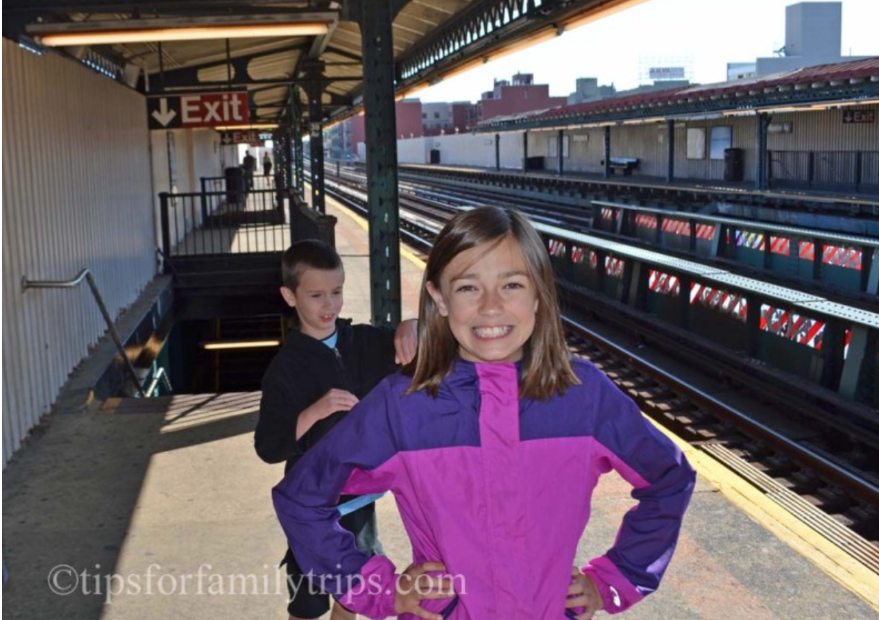
MTA LOW TRAFFIC WEEK FOR KIDS SAFE TRAVEL
EXPLORATORY DATA ANALYSIS PROJECT

Slide 2
INTRODUCTION
Motivation
MTA is the backbone of the New York Public Transportation.
Big public events often put strain on the system
Sports Competition for middle school students at Barclays Center
Estimated 5000 students and families to use MTA
7 closest stations to Barclays to be used.
Objective
Perform EDA on MTA ridership using the turnstile data for last three summer seasons to establish traffic pattern by week.
Goal
Establish best week to travel to Barclays Center via the 7 closest MTA stations.
Establish best week to travel in 2022 for MTA and New York school department to plan event (security, additional trains)
Notes:
<Click> Motivation
MTA is the backbone of the New York Public transportation. Millions of people rely on it as their transportation mechanism.
<Click>
Big public events often put more strain on the system which is already strained
<Click>
New York school department is planning to host sports competition for middle school students at Barclays center.
<Click>
3.a This will be held during the summer time. It is estimated that around 5000 students along with families will travel to Barclays center to attend the event.
<Click>
3.b. They will most likely use MTA as the transport mechanism. The 7 closest stations within walking distance to Barclays center will be most likely be used by the student.
<Click> Objective
New York School department wants to establish a MTA ridership pattern for summer season for the 7 closest station to barclays center. In order to establish a pattern, goal is to analyze last 3 years worth of Turnstile data for summer.
<Click> Goal
The goal here is to establish the best week for the kids to travel to barclays center via the 7 closest stations
As this event will be held in 2022, this established week will be used by the New Yourk Schook Department to plan for additional security, transport etc.

Slide 3
Methodology
Data Collection
Collect MTA Turnstile data for 2018, 2019 and 2021 for summer season (May,June and July)
Filter this data only for the 7 closest stations:
ATLANTIC AV
FLATBUSH AV-B.C
ATL AV-BARCLAY
25 AV
BERGEN ST
FULTON ST
LAFAYETTE AV
Data Exploration
Explore MTA data to calculate weekly MTA Turnstile Entries for above stations.
Calculate weekly entries by above station.
Tools
Pandas
Matplotlib
Seaborn
Jupyter Notebook

Slide 4
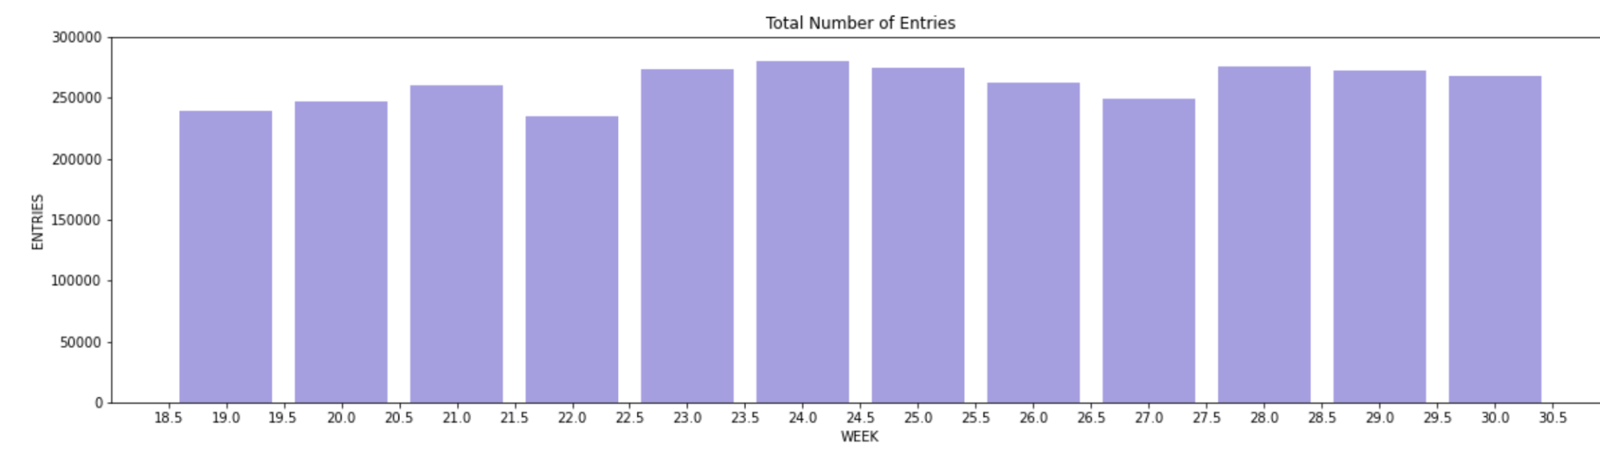
Results
Total number of entries for year 2021

Slide 5
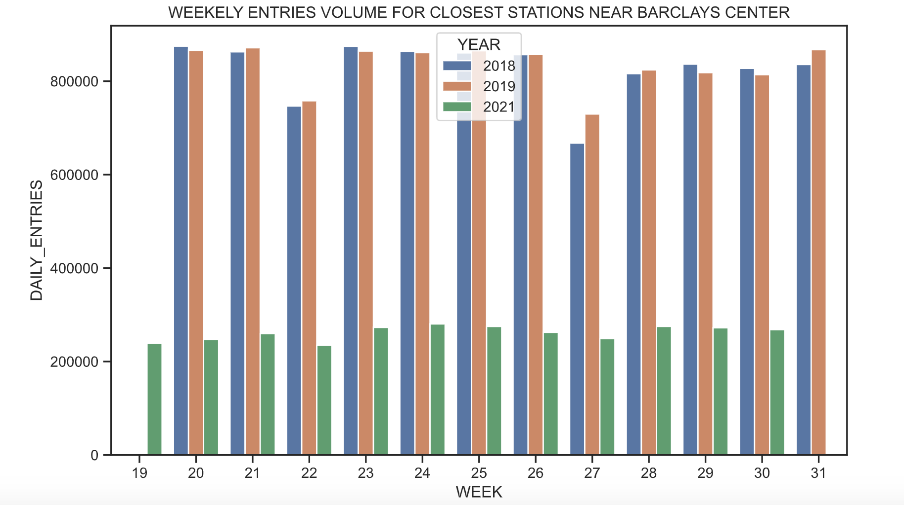

Slide 6
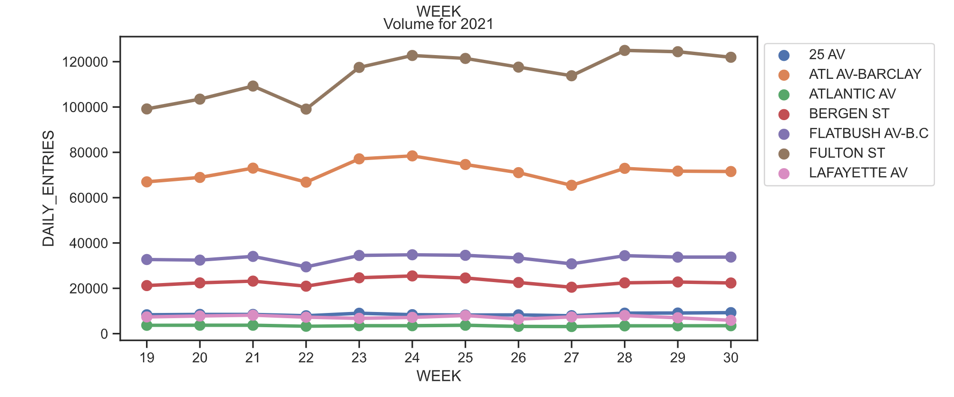
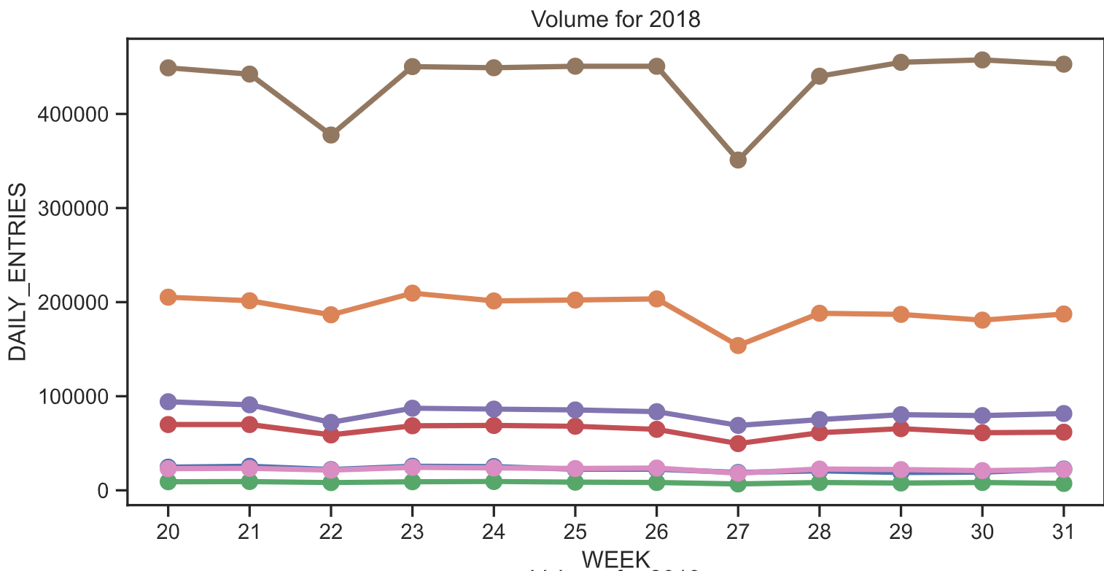
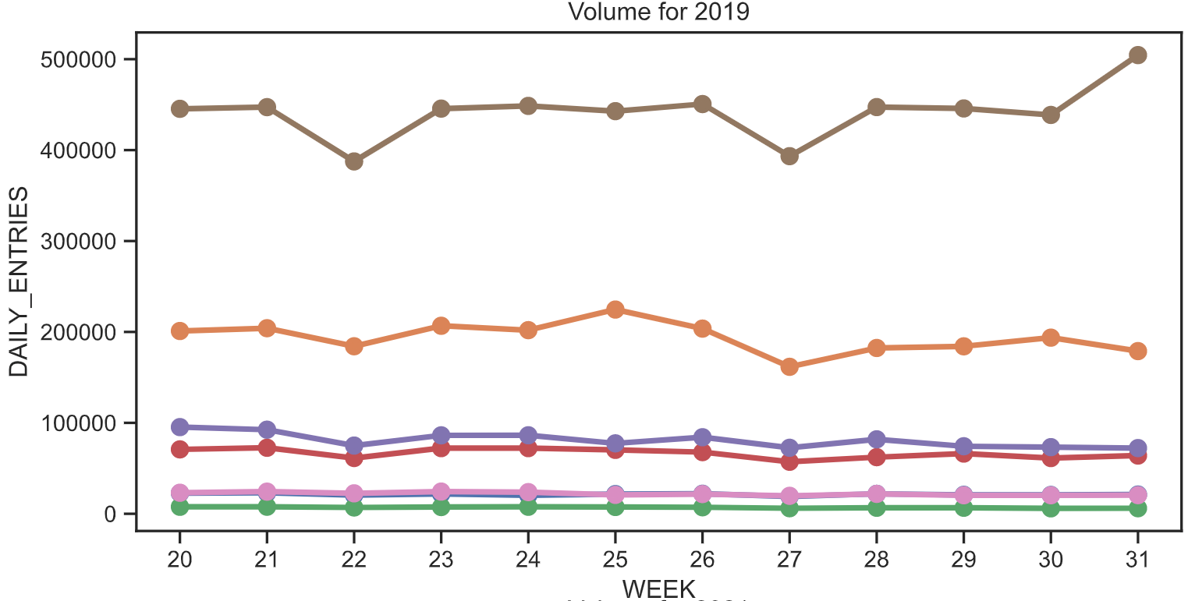

Slide 7
Conclusion
It is week 22!! - First week of June.
Best station for transit: Atlantic Avenue station
Notes:
From this analysis, we can conclude that lowest entry volume for stations near by Barclays center during first week of June.
The best week to travel is first week of June ,This way kids can travel safely using MTA to attend the event.
During this time MTA can plan additional security during the time slots throughout the transit system.

