Slide 1
http://www.vidyanidhi.com/
ketkiacharya.net@gmail.com
Ketki Acharya
From: SM VITA ATC of CDAC
9769201036
ketkiacharya.net@gmail.com

Slide 2
Window class has many methods
Lets discuss some of it
Open, close, alert, prompt, confirm
isNaN, isFinite,eval
setInterval, clearInterval
setTimeOut, clearTimeOut
Location is getter/setter

Slide 3
Open
function callme()
{
window.open('p.html')
}
function tool()
{
window.open('p.html','_blank','height=200,width=200')
}
Open will open new file in current window by default.
If you add second parameter _blank then it will open file in a new tab

Slide 4
Definition and Usage
The open() method is used to open a new browser window.
Syntax
window.open(URL,name,specs)
Parameter | Description
URL | Optional. Specifies the URL of the page to open. If no URL is specified, a new window with about:blank is opened
name | Optional. Specifies the target attribute or the name of the window. The following values are supported: _blank - URL is loaded into a new window. This is default _self - URL replaces the current page name - The name of the window
specs | Optional. A comma-separated list of items. The following values are supported:
fullscreen=yes|no|1|0 | Whether or not to display the browser in full-screen mode. Default is no. A window in full-screen mode must also be in theater mode
height=pixels | The height of the window. Min. value is 100
left=pixels | The left position of the window
menubar=yes|no|1|0 | Whether or not to display the menu bar. Default is yes
resizable=yes|no|1|0 | Whether or not the window is resizable. Default is yes
scrollbars=yes|no|1|0 | Whether or not to display scroll bars. Default is yes
status=yes|no|1|0 | Whether or not to add a status bar. Default is yes
titlebar=yes|no|1|0 | Whether or not to display the title bar. Ignored unless the calling application is an HTML Application or a trusted dialog box. Default is yes
toolbar=yes|no|1|0 | Whether or not to display the browser toolbar. Default is yes
top=pixels | The top position of the window
width=pixels | The width of the window. Min. value is 100

Slide 5
Prompt
<html>
<head><title>template</title>
<script>
var no1=window.prompt("enter number",5);
var b=parseInt(no1);
var no2=prompt();
document.write(no1+no2);//string +(concat)number
document.write("<br/>");
document.write(no1*no2);//no1.valueOf() get called
document.write("<br/>");
document.write(typeof(no1));//string
pno1=parseInt(no1);
pno2=parseInt(no2);
var ans=pno1+pno2;
document.write(ans);
document.write("<br/>");
document.write(no1*no2);
</script></head><body>
prompt("sometext","defaultvalue");
</body></html>
Accept 2 number and print sum in h1 tag
Accept 2 number and print product of two number
Use + to convert string to number
Testcase when you use patseInt
5
6
Tescase a 5.5 6
Tescase 2
When you use + as conversion
5.5
6.7

Slide 6
alert
<html>
<head><title>template</title>
<script>
alert("hello <br/> world")
alert("hello \n world")
</script>
</head>
<body>
</body>
</html>
<html>
<head><title>template</title>
<script>
alert=function(a)
{
document.write(a);
}
alert(“hello”)
</script>
</head>
<body>
</body>
</html>

Slide 7
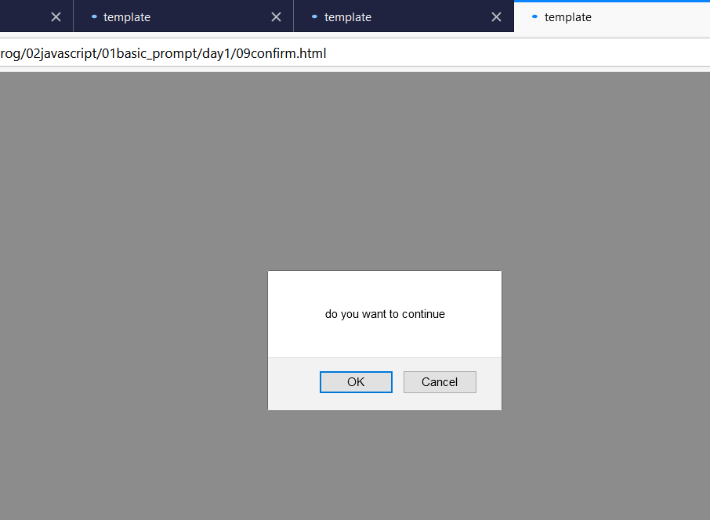
Confirm
<html>
<head><title>template</title>
<script>
a=confirm("do you want to continue");
alert(a);
</script>
</head>
<body>
</body>
</html>
If user click on ok it will return true
If you click on cancel it will return false

Slide 8
Location: To redirect user
<html>
<head>
<script type="text/javascript">
function newLocation()
{
window.location="p.html";
}
</script>
</head>
<body>
<input type="button" id="btn" value="Change URL">
<script>
document.getElementById("btn").addEventListener("click",newLocation,false);
</script>
</body>
</html>

Slide 9
resizeBy-moveBy works only in IE
resizeTo-moveTo
Works only in IE
<html>
<head>
<script type="text/javascript">
function resizeWindow()
{ window.resizeBy(50,50) }
window.moveBy(50,50)
</script>
</head>
<body>
<input type="button" onclick="resizeWindow()"
value="Resize window">
</body>
</html>
resizeTo-moveTo will work only one time as it is set to some value
resizeBy-moveBy is relative to current value so it will keep increasing by some value compare to previous value
Works only in IE

Slide 10
t= setInterval("alert('hi')",1000); //keep executeing after 1000 millisecond
//clearInterval(t)
t=setTimeout("alert('hi')",6000); //execute one time after 60000 millisecond
alert(t);
//clearTimeout(t);

Slide 11
Eval=Evaluate expresstion
5+2-3*6/2
5+2-18/2
5+2-9
7-9
-2
<html> //CSRF XSS
<head><title>template</title>
<script>
a="5+2-3"
document.write(a)
document.write("<br>"+eval(a))//4
document.write("<br>"+eval("5+2-3*6/2"))
document.write("<br>"+eval("55+6"))
</script>
</head>
<body>
</body>
</html>
<!doctypehtml>
<html><head><script>
var i;
var no1=prompt("enter no1","5");
var no2=prompt("enter no2","5");
var no3=prompt("enter no3","5");
var no4=prompt("enter no4","5");
var no5=prompt("enter no5","5");
for(i=1;i<=5;i++)
{document.write("no"+i);
document.write(eval("no"+i));
//document.write("<hr/>");
document.write("</br>");
}
</script>
</head>
</html>

Slide 12
Scrolling a window
win.scrollBy(x,y)
Scroll the window x pixels right and y down relative the current scroll. Negative values are allowed.
win.scrollTo(x,y)
Scroll the window to the given coordinates (x,y).
elem.scrollIntoView(top = true)
Scroll the window to make elem show up at the top (the default) or at the bottom for elem.scrollIntoView(false).
There’s also window.onscroll event.

Slide 13
Scrolling: scrollTo, scrollBy, scrollIntoView
Important:
To scroll the page with JavaScript, its DOM must be fully built.
For instance, if we try to scroll the page with a script in <head>, it won’t work.
Regular elements can be scrolled by changing scrollTop/scrollLeft.
We can do the same for the page using
document.documentElement.scrollTop/scrollLeft (except Safari, where document.body.scrollTop/Left should be used instead).
Alternatively, there’s a simpler, universal solution: special methods
window.scrollBy(x,y)
And
window.scrollTo(pageX,pageY).
The method scrollBy(x,y) scrolls the page relative to its current position.
For instance, scrollBy(0,10) scrolls the page 10px down.
<button onclick="window.scrollBy(0,10)">window.scrollBy(0,10)</button>
The method scrollTo(pageX,pageY) scrolls the page to absolute coordinates,
<button onclick="window.scrollTo(0,0)">window.scrollTo(0,0)</button>
so that the top-left corner of the visible part has coordinates (pageX, pageY) relative to the document’s top-left corner.
It’s like setting scrollLeft/scrollTop.

Slide 14
To scroll to the very beginning, we can use scrollTo(0,0).
These methods work for all browsers the same way.
scrollIntoView
For completeness, let’s cover one more method: elem.scrollIntoView(top).
The call to elem.scrollIntoView(top) scrolls the page to make elem visible. It has one argument:
If top=true (that’s the default), then the page will be scrolled to make elem appear on the top of the window.
The upper edge of the element will be aligned with the window top.
If top=false, then the page scrolls to make elem appear at the bottom. The bottom edge of the element will be aligned with the window bottom.
The button below scrolls the page to position itself at the window top:
<button onclick="this.scrollIntoView()">this.scrollIntoView()</button>
And this button scrolls the page to position itself at the bottom:
<button onclick="this.scrollIntoView(false)">this.scrollIntoView(false)</button>

Slide 15
Forbid the scrolling
Sometimes we need to make the document “unscrollable”. For instance, when we need to cover the page with a large message requiring immediate attention, and we want the visitor to interact with that message, not with the document.
To make the document unscrollable, it’s enough to set
document.body.style.overflow = "hidden".
<button onclick="document.body.style.overflow = 'hidden'">document.body.style.overflow = ‘hidden’</button>
The page will “freeze” at its current scroll position.
document.body.style.overflow = “ ".
<button onclick="document.body.style.overflow = ''">document.body.style.overflow = ‘’</button>
The first button freezes the scroll, while the second one releases it.
We can use the same technique to freeze the scroll for other elements, not just for document.body.
The drawback of the method is that the scrollbar disappears. If it occupied some space, then that space is now free and the content “jumps” to fill it.
That looks a bit odd, but can be worked around if we compare clientWidth before and after the freeze.
If it increased (the scrollbar disappeared), then add padding to document.body in place of the scrollbar to keep the content width the same.

