Slide 1
http://www.vidyanidhi.com/
ketkiacharya.net@gmail.com
Ketki Acharya
From: SM VITA ATC of CDAC
9769201036
ketkiacharya.net@gmail.com

Slide 2
Array collection of object type of data as everything is derived from object
<html>
<head><title>template</title>
<script>
let arr=new Array() //do not use this way
//it represent object
arr[0]=1;
arr[1]="ket";
arr[2]='g';
arr[3]=20.5;
alert(arr.length);
for(let i=0;i<arr.length;i++)
document.write("<br>"+arr[i])
document.write("<hr/>");
//toString method overriden
document.write("<br/>"+arr);
document.write("<hr/>");
for(let list of arr)// introduce in new version
document.write("<br/>"+list)
for(let x in arr)//do not use
document.write(arr[x]);
</script></head><body>
</body>
</html>
Better way to declare array is []
let a =[1,”ket”, ‘g’,20.5 ];
It stays on stack
1 | ket | g | 20.5
Heap
Key | 0 | 1 | 2 | 3
value | 1 | Ket | g | 20.5
arr

Slide 3
Be Careful
<script>
za=new Array(3,8,9,2)
document.write(za);
for(x of za)
document.write(x)
document.write("<p>")
//here 2 is size of array
var aa=new Array(2)
document.write(aa.length);
aa[0]=7;
aa[1]=3;
document.write(aa);//7,3
document.write("<hr/>");
</script>
za
0 | 1 | 2 | 3
3 | 8 | 9 | 2
7 | 3
Object
function Array() { [native code] }
document.write(za.constructor);

Slide 4
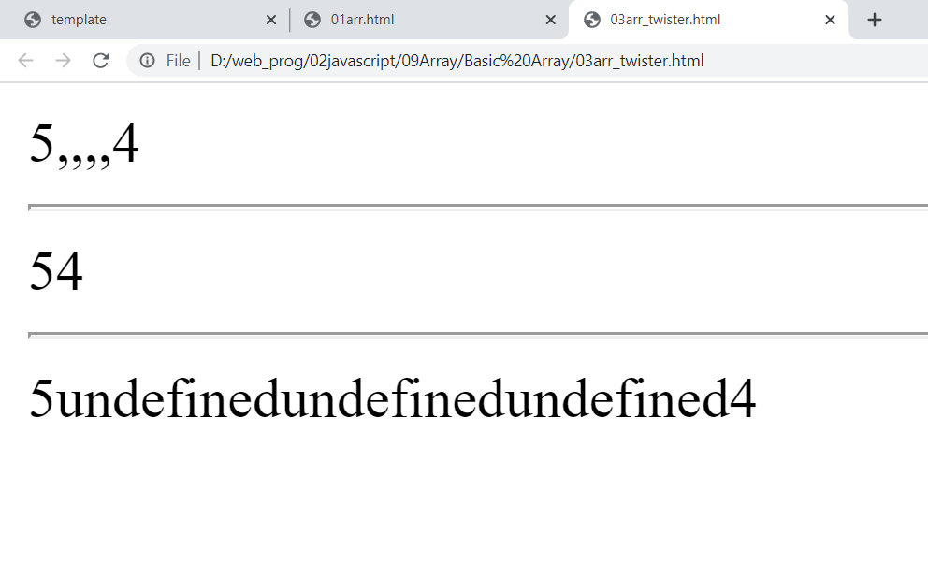
Better way to declare array
var arr=[1,2,"hi","by"]
document.write(arr)
<script>
let arr=[];
arr[0]=5;
arr[4]=4;
document.write(arr)
document.write("<hr/>");
for(let e in arr)
document.write(arr[e])
document.write("<hr/>");
for(let e of arr)
document.write(e)
//remove undefined
for(let e of arr)
if(e)
document.write(e)
</script>
5 undefined undefined undefined 4
As we discuss internally it is stored as key value so for index 1,2,3 it is saying undefined ie. There is no such key

Slide 5
2D Array
<html>
<head><script>
var a=new Array();
a[0]=new Array();
a[1]=new Array();
a[0][0]="raj";
a[0][1]=50;
a[0][2]="A"
a[1][0]="mona";
a[1][1]=80;
a[1][2]="B"
document.write(a[0][1]+"seee");
for(i=0;i<a.length;i++)
{
for(j=0;j<a[i].length;j++)
document.write(" "+a[i][j])
document.write("<hr/>");
}
</script></head><body>
</body></html>
Raj | 50 | A
a
0
1
Mona | 80 | B

Slide 6
Concat: join two array and return new array
nar
<script>
let nar=[10,20,30]
let ar=[5,6,7]
let result=ar.concat(nar)
document.write(result.constructor)
document.write(result)
document.write("<br/>"+ar);
document.write("<br/>"+nar);
</script>
10 | 20 | 30
ar
5 | 6 | 7
result
5 | 6 | 7 | 10 | 20 | 30

Slide 7
slice(begin,end)
begin : Zero-based index at which to begin extraction.
end : (Optional) Zero-based index at which to end extraction:
slice extracts up to but not including end
<script>
var cut=[100,200,300,400]
var c=cut.slice(1);
document.write("</br>"+c);
<script>
O/P: 200 300 400
cut
100 | 200 | 300 | 400
200 | 300 | 400
c
<script>
var cut=[100,200,300,400]
document.write("<br>slice(1,3)="+cut.slice(1,3))
document.write("</br>"+cut);
</script>
200 | 300
cut
100 | 200 | 300 | 400

Slide 8
Join : convert array to string
<script>
var ar=new Array(5,3,2)
ans=ar.join("-");
document.write(ans);
document.write(typeof(ans));
</script>
<script>
var ar=new Array(5,3,2)
ans=ar.join();
document.write(ans); //5,3,2
document.write(typeof(ans));
</script>
5 | 3 | 2
5-3-2
ans
string

Slide 9
POP
var arr = new Array(3);
arr[0] = "D";
arr[1] = "A";
arr[2] = "C";
document.write(arr + "<br />");
document.write(arr.pop() + "<br />");
document.write(arr);
POP
2 | C
1 | A
0 | D
C
1 | A
0 | D

Slide 10
Push
<script type="text/javascript">
var arr = new Array(3);
arr[0] = "vita";
arr[1] = "dac";
arr[2] = "acts";
document.write(arr + "<br />");
document.write(arr.push(“2020") + "<br />"); //4
document.write(arr);
</script>
3
2 | acts
1 | dac
0 | vita
2020
The push() method adds one or more elements to the end of an array and returns the new length.

Slide 11
Shift remove s 1st element from array
<script>
var nar=[100,200,300]
document.write("after shift"+nar.shift())
document.write("</br>"+nar.length)
document.write("</br>"+nar)
</script>
2 | 300
1 | 200
0 | 100
100

Slide 12
Unshift add element in the beginning of array
<script type="text/javascript">
var arr = new Array();
arr[0] = "vita";
arr[1] = "dac";
arr[2] = "acts";
document.write(arr + "<br />");
document.write(arr.unshift("2020")+"<br />");
document.write(arr);
</script>
in IE it will not show new length
3
2 | acts
1 | dac
0 | vita
3 | acts
2 | dac
1 | vita
0
2020

Slide 13
Reverse: Reverse the array
<script>
var srt=new Array("anita","zeena","beena")
document.write("<br/>"+srt.reverse())
var scpy= srt.reverse();
document.write("<br/>affecting original arr "+srt)
</script>
srt
0 | 1 | 2
anita beena | zeena zeena | beena anita
scpy
a
let ob={name:”raj”, age:25}
let ob2=ob
Shellow copy
ob
Name=raj
Age=25
5
b
ob2
a=5
b=a;
5

Slide 14
Splice to add and remove
array.splice(index, howmany, item1, ....., itemX)
Parameter | Description
index | Required. An integer that specifies at what position to add/remove items, Use negative values to specify the position from the end of the array
howmany | Optional. The number of items to be removed. If set to 0, no items will be removed
item1, ..., itemX | Optional. The new item(s) to be added to the array
<script>
var fruits = ["Banana", "Orange", "Apple", "Mango"];
fruits.splice(1, 2);
document.write("</br>"+fruits );
</script>
in the above code it will remove 2 element from index 1 so O/P:
0 | 1 | 2 | 3
Banana | Orange | Apple | Mango
var fr = ["Banana", "Orange", "Apple", "Mango"];
fr.splice(2, 0, "Lemon", "Kiwi");
document.write("</br>"+fr );
In the above code it will insert two data at index 2
0 | 1 | 2 | 3 | 4 | 5
Banana | Orange | Lemon | kiwi | Apple | Mango

Slide 15
Sort
<script>
var srt=new Array("anita","Zeena","beena")
document.write("<br/>"+srt.sort())
var srtno=[100,350,1,2]
document.write("<br/>"+srtno.sort())
document.write("<p>after sort function</p>")
function sortnumber(a,b)
{
return a-b
}
document.write("<br/>"+srtno.sort(sortnumber))
document.write("<br/>"+srtno.sort((a,b)=>a-b))
</script>
API………
function Array()
{
sort=function( sortnumber)
{
a=Sortnumber( a,b);
If(a>0)
{
swap…….
}
}
}
a-b==-1 97-98
a-a=0 97-97
b-a=1 98-97
If the sortnumber is not given then the elements are converted to strings and then sorted alphabetically.
V8: Quicksort or Insertion Sort (for smaller arrays)
Firefox: Merge sort
Safari: Quicksort, Merge Sort, or Selection Sort (depending on the type of array)

Slide 16
Sorting Array of Objects
Using a comparator function like this makes it extremely easy to sort custom objects in JavaScript
let users = [
{name: 'Scotty', age: '18'},
{name: 'Tommy', age: '21'},
{name: 'Sally', age: '71'},
{name: 'Billy', age: '18'},
{name: 'Timmy', age: '21'}
];
users.sort((a, b) => {
let keyA = a.age + a.name;
let keyB = b.age + b.name;
if (keyA < keyB) return -1;
if (keyA > keyB) return 1;
return 0;
});
This will result in the following sorted array:
[ { name: 'Billy', age: '18' },
{ name: 'Scotty', age: '18' },
{ name: 'Timmy', age: '21' },
{ name: 'Tommy', age: '21' },
{ name: 'Sally', age: '71' } ]
Note: It's important to keep in mind that this method sorts in-place, which means that the original array is actually sorted and no copy is made. So, while the .sort() method does return the sorted array, you don't actually need to assign it to anything since the array that it is called on is sorted.
If you want to reverse the order of the sorting, just switch around the comparison of a and b. So if we want the numbers to be in descending order, you'd do the following:
let keyA = a.age + a.name; “18Scotty”
let keyB = b.age + b.name; “21Tommy”
let nums = [3, 2, 6, 50, 10];
nums.sort((a, b) => b - a);
O/P
[ 50, 10, 6, 3, 2 ]
for(const obj of users)
document.write(`name=${obj.name} age=${obj.age}`);

Slide 17
Find
<script>
const array1 = [5, 12, 8, 130, 44];
const found = array1.find(element => element > 10);
console.log(found);
// expected output: 12
</script>
The find() method returns the value of the first element in the provided array that satisfies the provided testing function. If no values satisfy the testing function, undefined is returned.
<script>
const inventory = [
{name: 'apples', quantity: 2},
{name: 'bananas', quantity: 0},
{name: 'cherries', quantity: 5}
];
function isCherries(fruit) {
return fruit.name === 'cherries';
}
console.log(inventory.find(isCherries));
// { name: 'cherries', quantity: 5 }
</script>

Slide 18
Filter
The filter() method creates a new array with all elements that pass the test implemented by the provided function.
<script>
const words = ['spray', 'limit', 'elite', 'exuberant', 'destruction', 'present'];
const result = words.filter(word => word.length > 6);
console.log(result);
// expected output: Array ["exuberant", "destruction", "present"]
</script>
function isBigEnough(value) {
return value >= 10
}
let filtered = [12, 5, 8, 130, 44].filter(isBigEnough)
// filtered is [12, 130, 44]

Slide 19
at
The at() method takes an integer value and returns the item at that index, allowing for positive and negative integers. Negative integers count back from the last item in the array.
const array1 = [5, 12, 8, 130, 44];
let index = 2;
console.log(`Using an index of ${index} the item returned is ${array1.at(index)}`);
// expected output: "Using an index of 2 the item returned is 8"
index = -2;
console.log(`Using an index of ${index} item returned is ${array1.at(index)}`);
// expected output: "Using an index of -2 item returned is 130"
console.log(“Using an index of”+index+ ”the item returned is ”+array1.at(index));

Slide 20
at()
fill()
filter()
find()
includes()
<script>
const array1 = [5,12,8,130,44];
const found = array1.includes(8);
console.log(found);
// expected output: True
</script>
If matching element found then return true else false

Slide 21
array.fill(value, start, end)
Parameters
Parameter | Description
value | Required. The value to fill in.
start | Optional. The start index (position). Default is 0.
end | Optional. The stop index (position). Default is array length.
const fruits = ["Banana", "Orange", "Apple", "Mango"];
fruits.fill("Kiwi", 2, 4);
Banana,Orange,Kiwi,Kiwi

Slide 22
<script>
const array1= [1,4,9,16];
// pass a function to map
const map1=array1.map(x=>x*2);
console.log(map1);
// expected output: Array [2, 8, 18, 32]
</script>

