Slide 1
http://www.vidyanidhi.com/
ketkiacharya.net@gmail.com
Ketki Acharya
From: SM VITA ATC of CDAC
9769201036
ketkiacharya.net@gmail.com

Slide 2
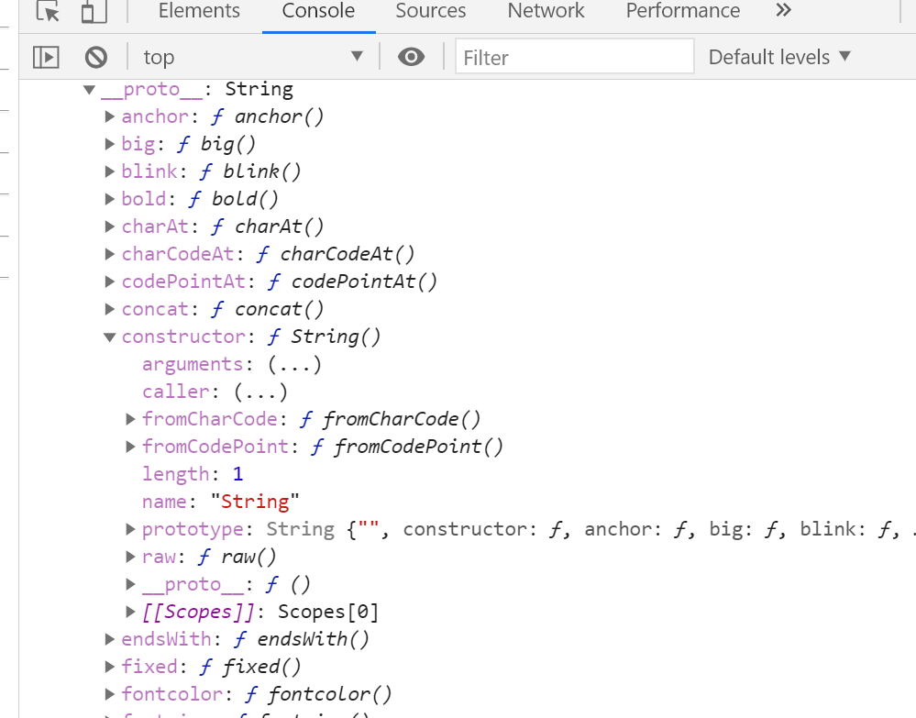
String is immutable
Do not use
new String()
new Number()
new Boolean()
new Array
<script>
var a="VIDYANIDHI"
document.write(a);
document.write("<hr/>")
document.write(typeof(a));
document.write("<hr/>")
document.write(a.length);
document.write("<hr/>")
m=a+"raj";
document.write(m);
document.write("<hr/>");
document.write(a);
document.write("<hr/>");
document.write(a.length);
document.write("<hr/>");
var str=new String("hello");
document.write(typeof(str)); //object
document.write("<hr/>");
document.write(str); </script>
VIDYANIDHI
a
VIDYANIDHIraj
m
str
Hello

Slide 3
Concat()
<script type="text/javascript">
var str1="Hello ";
var str2="world!";
var str3=str1.concat(str2);
document.write(" </br> "+str3);
document.write("<hr/>");
document.write("</br>"+str1+ " </br>"+str2);
document.write("<hr/>");
var a="vita"
document.write(a.concat("CDAC"))
document.write("<hr/>");
document.write(a)
</script>
Hello
str1
str2
world
str3
Hello world
vita
a=“vita”
a=a+”CDAC”
a
a
vita
vitaCDAC
vitaCDAC

Slide 4
String equality
<script>
var a=new String("abc");
var b=new String("abc");
document.write(a==b);//false == check reference (Arrow )which is not same
var c=b;
document.write(c==b);
document.write(a===b);//false
document.write(a.equals(b);//true deprecated do not use
document.write("<hr/>");
document.write(a.valueOf()==b.valueOf());//true
var x="abc";
var y="abc";
document.write("<hr/>");
document.write(x==y);//true
document.write(x===y);//true
document.write("<hr/>");
document.write(x.valueOf()==y.valueOf());//true
document.write(a===x);//false
document.write(a==x);//true
<script>
abc
a
abc
b
c
x
y
abc
abc
==
0
str
document.write("be alert !!!!!!!!!!!!!!!!!!!!!!");
str="";
for(i=0;i<1000000;i++)
{ str=str+i; }
document.write(str);
01
012
0123

Slide 5
charAt()
The charAt() method returns the character at the specified index in a string.
The index of the first character is 0, the second character is 1, and so on.
Str.charAt(0) ==@ error
Str.charAt(str.length-1) ==@ error
<script>
var a="VIDYANIDHI"
document.write(a.charAt(1))
</script>
0 | 1 | 2 | 3 | 4 | 5 | 6 | 7 | 8 | 9
v | I | D | Y | A | N | I | D | H | I
var str = “VIDYANIDHI"; var res = str.charAt(str.length-1);
TASK
Accept a string and revers it

Slide 6
substring
The substring() method extracts the characters from a string, between two specified indices, and returns the new sub string.
This method extracts the characters in a string between "start" and "end", not including "end" itself. If end omitted, it extracts the rest of the string
If "start" is greater than "end", this method will swap the two arguments, meaning str.substring(1, 4) == str.substring(4, 1).
If either "start" or "end" is less than 0, it is treated as if it were 0.
Note: The substring() method does not change the original string.
<script type="text/javascript">
var str="Hello world";
document.write(str.substring(3,7)); //lo w
document.write("<hr/>");
document.write(str.substring(2));// llo world
</script>
TASK
Accept a email and print domain name
Eg. training.vita@gmail.com
O/P gmail.com

Slide 7
Substr(start,length)
The substr() method extracts parts of a string, beginning at the character at the specified position, and returns the specified number of characters.
Note: The substr() method does not change the original string.
<script>
var str = "Hello world!";
var res = str.substr(6);
document.write(res);
</script>
O/p=world!
<script>
var str = "Hello world!";
var res = str.substr(1,3);
document.write(res);
</script>
O/p=ell

Slide 8
indexOf(“data”,startindex)
The indexOf() method returns the position of the first occurrence of a specified value in a string.
This method returns -1 if the value to search for never occurs.
Note: The indexOf() method is case sensitive.
It is used to check @ for email(if -1 error)
If str.length-1==index (error)
If str[0]==index (error)
<script type="text/javascript">
var txt=“PGDAC CDAC"
document.write(txt.indexOf(“D")) //2
document.write(txt.indexOf(“C“,5)) //6
document.write("<br/>")
var a=txt.indexOf(“D")
document.write(txt.indexOf(“D”,a+1))//7
document.write(txt.indexOf("X"))
document.write(txt.indexOf(“d")) //-1
</script>
TASK
Accept a email and Validate email Id
0 | 1 | 2 | 3 | 4 | 5 | 6 | 7 | 8 | 9
P | G | D | A | C |  | C | D | A | C

Slide 9
lastIndexOf(data,end index)
The lastIndexOf() method returns the position of the last occurrence of a specified value in a string.
Note: The string is searched from the end to the beginning, but returns the index starting at the beginning, at position 0.
This method returns -1 if the value to search for never occurs.
Note: The lastIndexOf() method is case sensitive!
0 | 1 | 2 | 3 | 4 | 5 | 6 | 7 | 8 | 8
P | G | D | A | C |  | C | D | A | C
<script type="text/javascript">
var txt=“PGDAC CDAC"
document.write(txt.lastIndexOf(“D")) //7
document.write("<br/>")
var a=txt. lastIndexOf(“D")
document.write(txt. lastIndexOf(“D”,a-1))//2
document.write(txt. lastIndexOf("X"))
document.write(txt. lastIndexOf(“d")) //-1
</script>
0 | 1 | 2 | 3 | 4 | 5 | 6 | 7 | 8 | 8
P | G | D | A | C |  | C | D | A | C

Slide 10
split() String to Array
The split() method is used to split a string into an array of substrings, and returns the new array.
Tip: If an empty string ("") is used as the separator, the string is split between each character.
Note: The split() method does not change the original string.
<script type="text/javascript">
var str="wel-come"
var s=str.split("-")
document.write("<br>"+s);
document.write("<BR/>")
for(i=0;i<s.length;i=i+1)
{
document.write(s[i])
}
</script>
0 | 1
wel | come
<script type="text/javascript">
var str="wel-come"
var s=str.split("")
document.write("<br>"+s);
</script>
0 | 1 | 2 | 3 | 4 | 5 | 6 | 7
w | e | l | - | c | o | m | e
TASK
Accept 5 email Id in an array and display all email and domain name in table
Eg. abc@gmail.com
xyz.@rediffmail.com
User | Domain
Abc | Gmail.com
Xyz | Rediffmail.com

Slide 11
Match()
The match() method searches a string for a match against a regular expression, and returns the matches, as an Array object.
Note: If the regular expression does not include the g modifier (to perform a global search), the match() method will return only the first match in the string. i modifier to ignore case
This method returns null if no match is found.
If str.match(“@”) null error If str.match(“.”) == null error
r= str.match(/@/) if r.length>1 error r= str.match(/\./) if r.length>3 error
<script type="text/javascript">
var str="Center Vita Center"
document.write(str.match("Center")+"<br/>")
<script/>
0
Center
<script type="text/javascript">
var str="Center Vita center“
let robj= /center/ //typeof(robj)➔object
console.log(robj.constructor);//ƒ RegExp() { [native code] }
lets s= str.match(/center/ig)
for(i=0;i<s.length;i++)
{ document.write(s[i])
}
<script/>
0 | 1
Center | center
<script type="text/javascript">
var str="Center Vita Center"
document.write(str.match("dac")+"<br/>")
<script/>
O/p Null

Slide 12
Replace
The replace() method searches a string for a specified value, or a regular expression, and returns a new string where the specified values are replaced.
Note: If you are replacing a value (and not a regular expression), only the first instance of the value will be replaced. To replace all occurrences of a specified value, use the global (g) modifier
// this is called pattern internally Object
i=ignore case
g=global occurance
<script type="text/javascript">
var str="Visit CDAC cdac is good center!";
document.write("</br>"+str);
document.write("<hr/>");
document.write(str.replace(/cdac/ig, "VITA"));
<script/>
O/P: Visit CDAC cdac is good center!
New string:
Visit VITA VITA is good center!

Slide 13
charCodeAt()/ fromCharCode()
The charCodeAt() method returns the Unicode of the character at the specified index in a string.
The index of the first character is 0, the second character 1, and so on.
The fromCharCode() method converts Unicode values into characters.
Note: This is a static method of the String object, and the syntax is always String.fromCharCode().
var str = "HELLO WORLD"; var n = str.charCodeAt(0)// 72
document.write(n)
var res = String.fromCharCode(n);//H
document.write(res)
TASK
Accept a string and print charcode of each character

Slide 14
String functions
The toUpperCase() method converts a string to uppercase letters.
Note: The toUpperCase() method does not change the original string.
Tip: Use the toLowerCase() method to convert a string to lowercase letters.
The trim() method removes whitespace from both sides of a string.
Note: The trim() method does not change the original string.
The repeat() method returns a new string with a specified number of copies of the string it was called on.(ES-6)
The endsWith() method determines whether a string ends with the characters of a specified string.
This method returns true if the string ends with the characters, and false if not.
Note: The endsWith() method is case sensitive.(ES- 6)
The startsWith() method determines whether a string begins with the characters of a specified string.
This method returns true if the string begins with the characters, and false if not.
Note: The startsWith() method is case sensitive. .(ES-6)
The includes() method determines whether a string contains the characters of a specified string.
This method returns true if the string contains the characters, and false if not.
Note: The includes() method is case sensitive. .(ES-6)
string.includes(searchvalue, start) Start | Optional. Default 0. At which position to start the search
var str = “Hello World! "; var res = str.toLowerCase();
var result = str.toUpperCase();
alert(str.trim());
document.write(str.repeat(2));
var n = str.startsWith("Hello");//true
var en = str.endsWith("rld! ");
var rr = str.includes("world!", 5);

Slide 15
Filter: Return array of matching condition
const ages = [32, 33, 16, 40]; const result = ages.filter(checkAdult); function checkAdult(age) { return age >= 18; }
Console.log(result)
Find : Return 1st matching condition
Find the value of the first element with a value over 18:
const ages = [3, 10, 18, 20, 22 ]; function checkAge(age) { return age > 18; }

Slide 16
TASK
Create a textbox and as you type each letter in textbox should appear in capital letters
Create two text box email and confirm email. On change of confirm email validate both text box has same email id
Store 5 name in array, accept a name and check if that name is there in an array if it is there print true else print false
Sto

