Slide 1
http://www.vidyanidhi.com/
ketkiacharya.net@gmail.com
Ketki Acharya
From: SM VITA ATC of CDAC
9769201036
ketkiacharya.net@gmail.com

Slide 2
Fetch
JavaScript can send network requests to the server and load new information whenever it’s needed.
For example, we can use a network request to:
Submit an order,
Load user information,
Receive latest updates from the server,
…etc.
…And all of that without reloading the page!
There’s an umbrella term “AJAX” (abbreviated Asynchronous JavaScript And XML) for network requests from JavaScript. We don’t have to use XML though: the term comes from old times, that’s why that word is there. You may have heard that term already.
There are multiple ways to send a network request and get information from the server.
The fetch() method is modern and versatile, so we’ll start with it. It’s not supported by old browsers (can be polyfilled), but very well supported among the modern ones.

Slide 3
The basic syntax is:
let promise = fetch(url, [options])
url – the URL to access.
options – optional parameters: method, headers etc.
Without options, this is a simple GET request, downloading the contents of the url.
The browser starts the request right away and returns a promise that the calling code should use to get the result.
Getting a response is usually a two-stage process.
First, the promise, returned by fetch, resolves with an object of the built-in Response class as soon as the server responds with headers.
At this stage we can check HTTP status, to see whether it is successful or not, check headers, but don’t have the body yet.
The promise rejects if the fetch was unable to make HTTP-request, e.g. network problems, or there’s no such site. Abnormal HTTP-statuses, such as 404 or 500 do not cause an error.
We can see HTTP-status in response properties:
status – HTTP status code, e.g. 200.
ok – boolean, true if the HTTP status code is 200-299.
For example:
let response = await fetch(url);
if (response.ok) { // if HTTP-status is 200-299
// get the response body (the method explained below)
let json = await response.json();
} else {
alert("HTTP-Error: " + response.status);

Slide 4
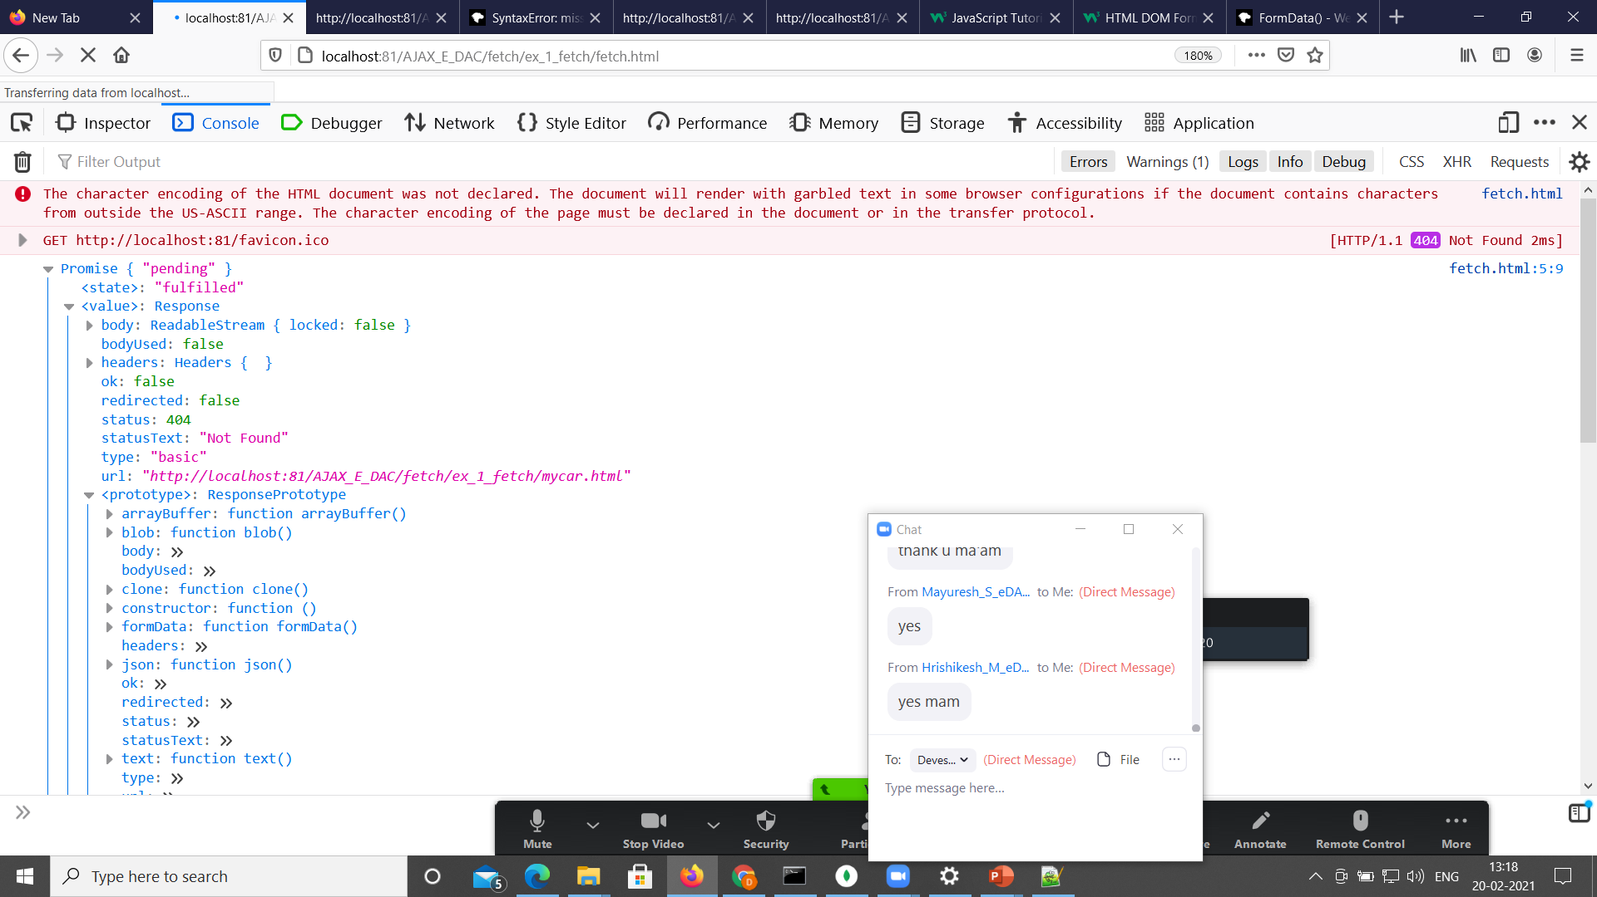

Slide 5
Second, to get the response body, we need to use an additional method call.
Response provides multiple promise-based methods to access the body in various formats:
response.text() – read the response and return as text,
response.json() – parse the response as JSON,
response.formData() – return the response as FormData object (explained in the next chapter),
response.blob() – return the response as Blob (binary data with type),
response.arrayBuffer() – return the response as ArrayBuffer (low-level representation of binary data),
additionally, response.body is a ReadableStream object, it allows you to read the body chunk-by-chunk, we’ll see an example later.
let url = 'https://api/data';
let response = await fetch(url);
let commits = await response.json(); // read response body and parse as JSON
alert(commits);
For instance, let’s get a JSON-object with latest commits from GitHub:
Or, the same without await, using pure promises syntax:
fetch('ejson.json')
.then(response => response.json())
.then(commits => alert(commits[0].author.login));

Slide 6
To get the response text, await response.text() instead of .json():
let response = await fetch('https://api.github.com/repos/javascript-tutorial/en.javascript.info/commits');
let text = await response.text(); // read response body as text
alert(text.slice(0, 80) + '...’);
We can choose only one body-reading method.
If we’ve already got the response with response.text(), then response.json() won’t work, as the body content has already been processed.
let text = await response.text(); // response body consumed
let parsed = await response.json(); // fails (already consumed)

Slide 7
Response headers
The response headers are available in a Map-like headers object in response.headers.
It’s not exactly a Map, but it has similar methods to get individual headers by name or iterate over them:
let response = await fetch('ejson.json');
// get one header
alert(response.headers.get('Content-Type')); // application/json; charset=utf-8
// iterate over all headers
for (let [key, value] of response.headers) {
alert(`${key} = ${value}`);
}

Slide 8
Request headers
To set a request header in fetch, we can use the headers option. It has an object with outgoing headers, like this:
let response = fetch(protectedUrl, {
headers: {
Authentication: 'secret'
}
});

Slide 9
…But there’s a list of forbidden HTTP headers that we can’t set:
Accept-Charset, Accept-Encoding
Access-Control-Request-Headers
Access-Control-Request-Method
Connection
Content-Length
Cookie, Cookie2
Date
DNT
Expect
Host
Keep-Alive
Origin
Referer
TE
Trailer
Transfer-Encoding
Upgrade
Via
Proxy-*
Sec-*
These headers ensure proper and safe HTTP, so they are controlled exclusively by the browser.

Slide 10
<p id="p"></p>
<script>
async function getdata()
{
res= await fetch('ejson.json');
data=await res.json()
let fd="";
for(let x of data)
{console.log(x)
for(let b in x)
{console.log(x[b])
fd+=x[b]+"<br/>"
}
fd+="<hr/>";
}
document.getElementById('p').innerHTML=fd;
}
getdata();
</script>

Slide 11
POST requests
let user = {
name: 'John',
surname: 'Smith'
};
let response = await fetch('/article/fetch/post/user', {
method: 'POST',
headers: {
'Content-Type': 'application/json;charset=utf-8'
},
body: JSON.stringify(user)
});
let result = await response.json();
alert(result.message);
To make a POST request, or a request with another method, we need to use fetch options:
method – HTTP-method, e.g. POST,
body – the request body, one of:
a string (e.g. JSON-encoded),
FormData object, to submit the data as form/multipart,
Blob/BufferSource to send binary data,
URLSearchParams, to submit the data in x-www-form-urlencoded encoding, rarely used.
The JSON format is used most of the time.
For example, this code submits user object as JSON:
Please note, if the request body is a string, then Content-Type header is set to text/plain;charset=UTF-8 by default.
But, as we’re going to send JSON, we use headers option to send application/json instead, the correct Content-Type for JSON-encoded data.

