Slide 1
PRUDENT CHOICE
Build a model to help Prudential come up with a response to life insurance applicants
Poonam Rath
Data Science Final Project, 2016
General Assembly, San Francisco

Slide 2


Data Source
Kaggle (https://www.kaggle.com/c/prudential-life-insurance-assessment)
Prudential Life Insurance company

Slide 3
CONTENTS
Project goal
Analysis approach
Results
Conclusion
Next Steps

Slide 4
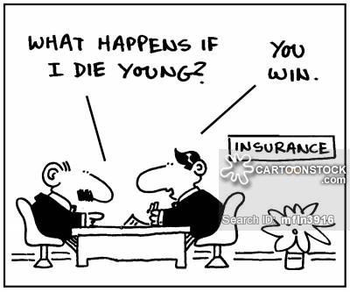
PROJECT GOAL
Analyze features collected from life insurance applicants provided by Prudential and build a model to predict the company’s likely response.
Motivation for the problem:
Prudential wants to make it quicker and less labor intensive for customers to get a quote while maintaining privacy.
Status quo is inefficient: takes the company a long time to come up with a decision, losing customers in the process.
If we come up with a model that accurately predicts the decisions the company comes up, the model can be incorporated to swiftly make decisions.

Slide 5
Problems similar to this one
Providing loans to individuals/businesses.
Solution: models that analyze customer features and provide a credit score to help banks and financial institutions decide whether to provide a loan to an applicant.

Slide 6
ANALYSIS APPROACH
Data preparation
Overview of features and outcome
Feature engineering
Dealing with missing values
Normalization
Training, testing & cross-validation
Fit random forest, gradient boosted ensemble model
Feature selection
Dealing with missing values
K-fold cross-validation for multiple values of K

Slide 7
Overview of data
There are ~50,000 rows and 127 columns: 126 features and 1 outcome column. Outcome column is called “Response” and is nominal with 8 values (1,2,3,4,5,6,7,8).
Features are de-identified; we have a vague idea about what they might represent: “Product_Info”, “Employment_Info”, “Medical_keyword”.
All but one feature columns are numeric.

Slide 8


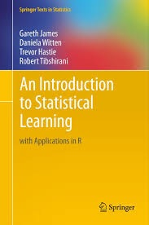

Resources used for analysis

Slide 9
Feature engineering
Obtained dummy variables for columns for which unique values were less than 0.5% of the total values.

Slide 10
Normalization
Distribution of the variables (some histograms below):
Response column distribution:

Slide 11
Exploratory data analysis
Build correlation matrix for features:
Some outcomes:
Product_Info_1 is highly positively correlated with Employment_nwdf.
blahblah is negatively correlated with visfdnslkdn.

Slide 12
Training a model - First Pass
Using all features on a small sample of the data, I fitted the following models:
Random Forest Classifier
K-Nearest Neighbor Classifier
Logistic Regression
Gradient Boosting Classifier
K-fold cross-validation score (Insert graph).
Learning curve shows that we have enough data.

