Slide 1


PRUDENT CHOICE
Build a model to help Prudential come up with a response to life insurance applicants
Poonam Rath
Data Science Final Project, 2016
General Assembly, San Francisco

Slide 2
PROJECT GOAL
Analyze features collected from life insurance applicants provided by Prudential and build a model to predict the company’s likely response.
Motivation for the problem:
Less labor-intensive for customers
Quicker time-to-decision for Prudential
Potential to gain efficiencies on both sides of the equation

Slide 3
AGENDA
Analysis approach
Results
Conclusions
Next Steps

Slide 4
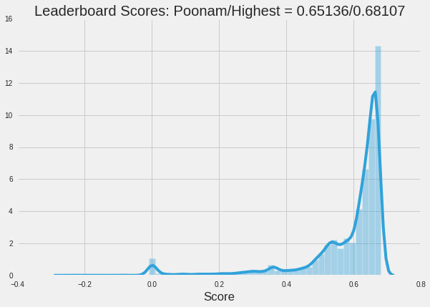
RESULT
Initial Model
Quadratic weighted Kappa = 0.46
[Used Random Forest classifiers with no feature engineering]
Final Model
Quadratic weighted Kappa = 0.65136
[Used xgboost + grid search + custom features]
???
… How did I do this ?

Slide 5
ANALYSIS APPROACH
3. Feature Learning by K-Means Clusters
Training Features and Response
OOS Test Features
Train
2. Categorical Identification & 1-Hot Encoding
4. xgboost Regressor w/ Grid Search 2-fold CV
5. Best Model from Grid Search
$$$
1. Missing Data Imputation
6. Kaggle
0. Combine
Test

Slide 6





RESOURCES USED FOR ANALYSIS

Slide 7
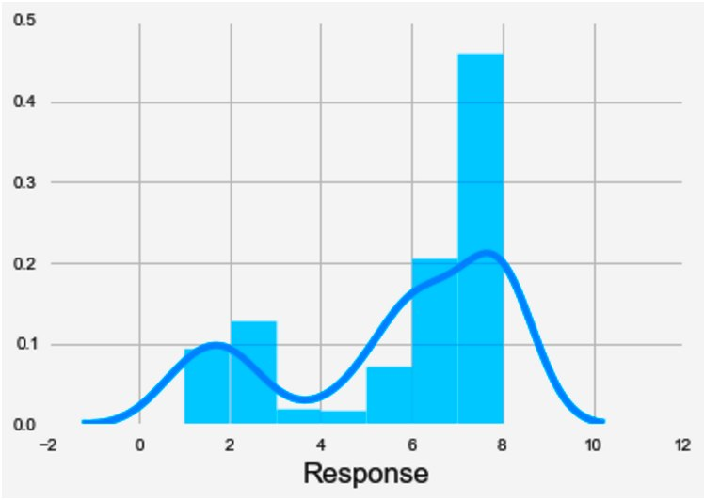
OVERVIEW OF DATA
The training data has ~60k rows and 127 columns: 126 features and 1 response column. Outcome column is called “Response” and is nominal with 8 values (1,2,3,4,5,6,7,8).

Slide 8
FEATURE ENGINEERING
Missing value imputation: Used the median value of the columns.
1-Hot Encoding: Obtained dummy variables for columns for which unique values were less than 0.5% of the total values.
NaN count: Counted all NaN’s row-wise
Medical keyword count: Count all occurrences row-wise

Slide 9
FEATURE LEARNING
Picked up idea from Kaggle forums
Run K-Means clustering (K=200) on entire dataset
For each row, measure distance from cluster center
Add K=200 additional feature columns
We do this to capture information about how rows are grouping in high-dimensional space.

Slide 10
DATA DISTRIBUTIONS
Most features are de-identified; we have a vague idea about what they might represent: “Product_Info”, “Employment_Info”, “Medical_keyword”.
All but one feature columns are numeric.
Features are normalized (according to Kaggle). If not, I would have looked at histograms, determined mean and stdev and scaled accordingly.

Slide 11
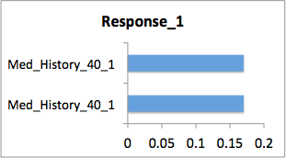
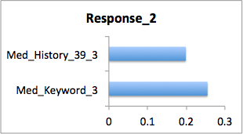
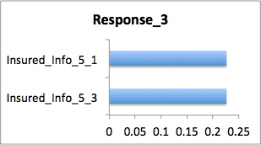
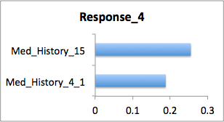
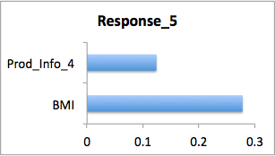
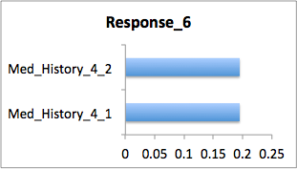
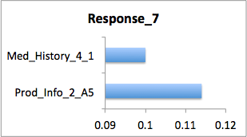
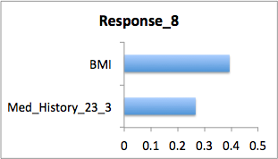
Exploratory data analysis -I
2) Most positively and negatively correlated feature for each response
Top = +ve
Bottom = -ve

Slide 12
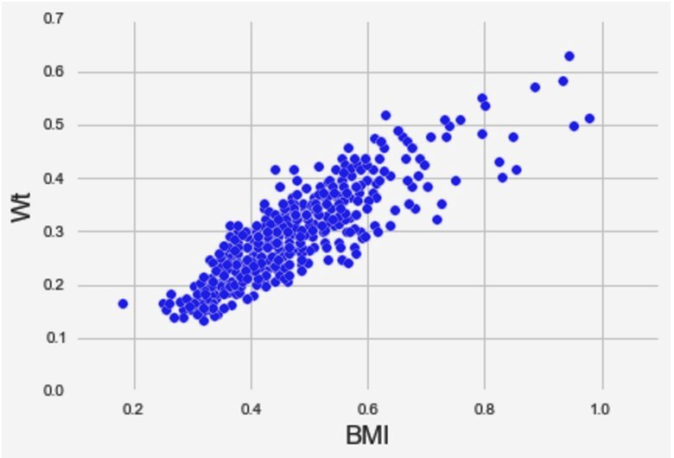
Exploratory data analysis -II
BMI is positively correlated with Weight (subset of data)

Slide 13
Measuring Model Performance
Logistic Regression: 33% accuracy
K-Nearest Neighbor Classifier: 21%
Naive Bayes: 19%
Gradient Boosting Classifier: 46.6% accuracy

Slide 14
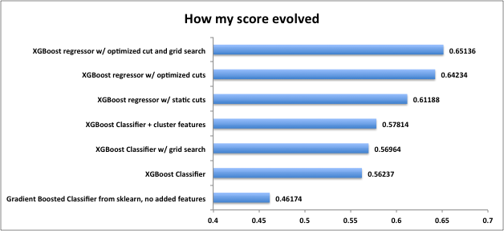
CONCLUSIONS

Slide 15
NEXT STEPS
Make Response column more even : SMOTE/undersample [though the forums said it would not make a difference.]
Use data from my estimator for feature selection
Try to learn and use neural networks!

