Slide 1
Core Java

Slide 2
Java - General
Java is:
Popular programming language, created in 1995 by James Gosling at Sun Microsystems which is now owned by Oracle.
Object-oriented, cross platform and multi-purpose programming language.
open-source and free.
It has a huge community support (tens of millions of developers)
It works on different platforms (Windows, Mac, Linux, Raspberry Pi, etc.)

Slide 3
Object Oriented Programming (OOP)
It is a programming paradigm based on the concept of "objects“.
In OOP, computer programs are designed by making them out of objects that interact with one another.
OOP languages are diverse, but the most popular ones are class-based, meaning that objects are instances of classes
Key Concepts:
Objects
Classes

Slide 4
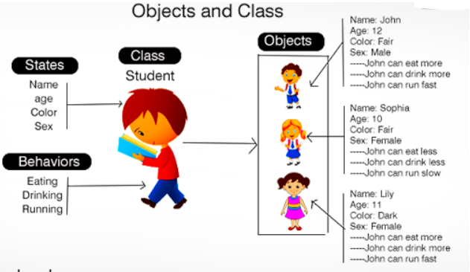
Object: any real-world things that have properties and actions.
e.g., chair, bike, marker, pen, table, car, etc.
It can be physical or logical (tangible and intangible).
The example of an intangible object is the banking system.

Slide 5
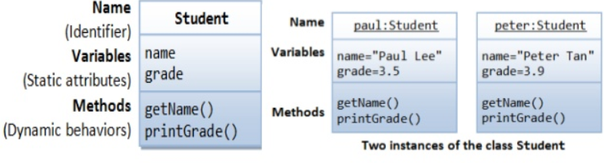
Class:
Collection of objects
Template, blueprint or contract that defines what an object’s data fields and methods will be.

Slide 6
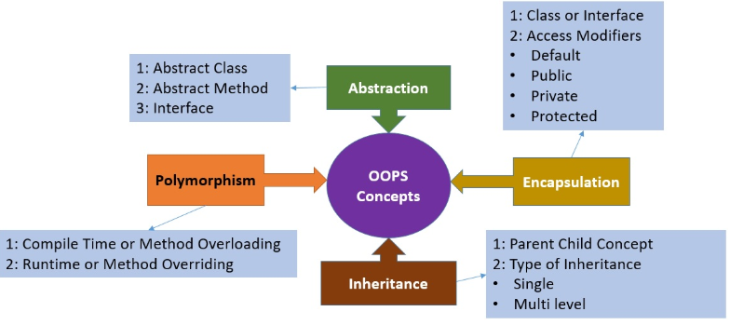
OOP continued…

Slide 7
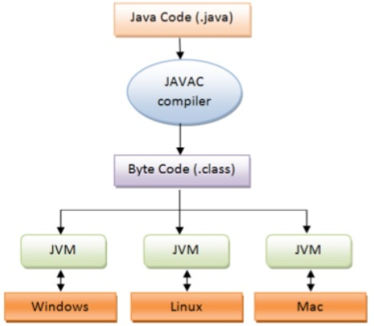
How it works…! (Simplified)

Slide 8
How it works…!
Compile-time Environment
Compile-time Environment
Class Loader
Bytecode
Verifier
Java Class
Libraries
Java
Source
(.java)
Java
Interpreter
Just in Time
Compiler
Java
Bytecodes
move locally
or through
network
Java
Virtual
machine
Java
Compiler
Runtime System
Java
Bytecode
(.class )
Operating System
Hardware

Slide 9
Explanation
Phases of program execution:
1) Writing of the program is of course done by java programmer. 2) Compilation of program is done by javac compiler.
- javac is the primary java compiler included in the JDK. It takes java program as input and generates java bytecode as output.
3) Execution: In third phase, JVM executes the bytecode generated by compiler. This is called program run phase.

Slide 10
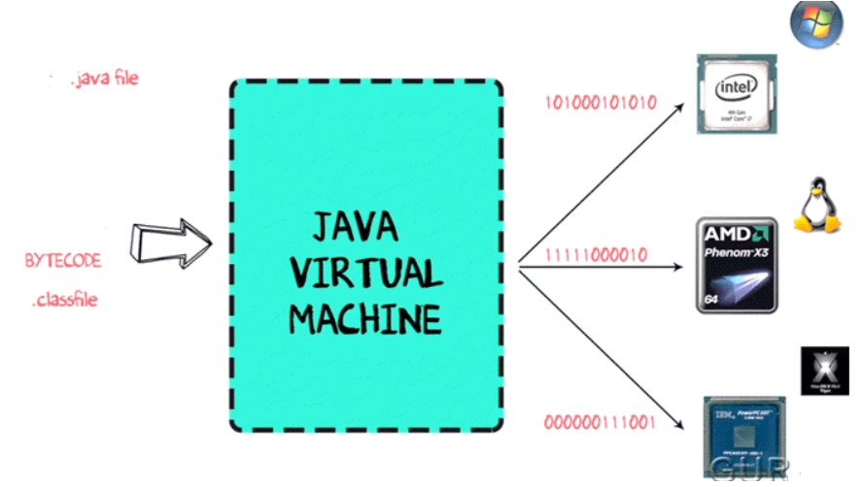
JVM
When the Virtual Machine is fed with the bytecode, it identifies the platform it is working on and converts the bytecode into the native machine code.
JIT (just in time) compilers attempt to increase speed by dynamically generating machine code for frequently used bytecode sequences in Java™ applications during their execution
JVM operations:
Loads code
Verifies code
Executes code
Provides runtime
environment

Slide 11
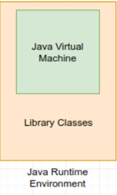
Java Runtime Environment (JRE)
It contains set of collections + other information that JVM uses at runtime.
JRE = JVM + Java Packages Classes (like util, math, lang, awt,swing etc) + runtime libraries.

Slide 12
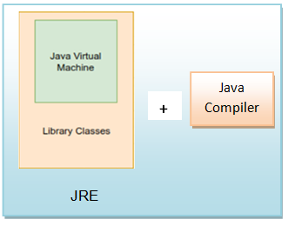
Java Software Development Kit (Java SDK)
If you need to develop Java programs you need the full Java SDK. The JRE is not enough then.
The Java Software Development Kit (Java SDK) is the JRE plus the Java compiler, and a set of other tools.

Slide 13
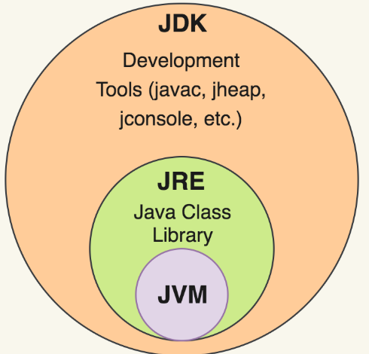

Slide 14
Java Advantages
Portable - Write Once, Run Anywhere
Security has been well thought through
Robust memory management
Designed for network programming
Multi-threaded (multiple simultaneous tasks)
Dynamic & extensible (loads of libraries)
Classes stored in separate files
Loaded only when needed

Slide 15
Java Evolutions
Java has evolved into three different sets of APIs, or "profiles“ :
The Java Standard Edition (JSE)
for desktop and standalone server applications.
The Java Enterprise Edition (JEE)
for developing and executing Java components that run embedded in a Java server.
The Java Micro Edition (JME)
for developing and executing Java applications on mobile phones and embedded devices.

Slide 16
Java Installation
https://www.w3schools.in/java-tutorial/install/
https://www.eclipse.org/downloads/packages/

Slide 17
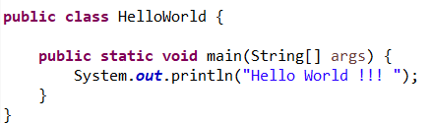
First Java Program
Output Hello World !!!

Slide 18
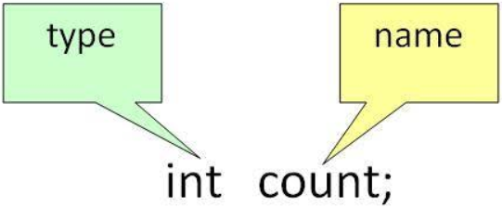
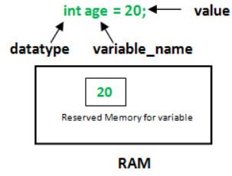
Variable
A variable is a name given to a memory location. It is the basic unit of storage in a program.
The value stored in a variable can be changed during program execution.
In Java, all the variables must be declared before use.
Declaration:
In this way, only a name is given to a memory location; it still doesn’t have any value or the data.
It can be assigned values by initializing it.

Slide 19
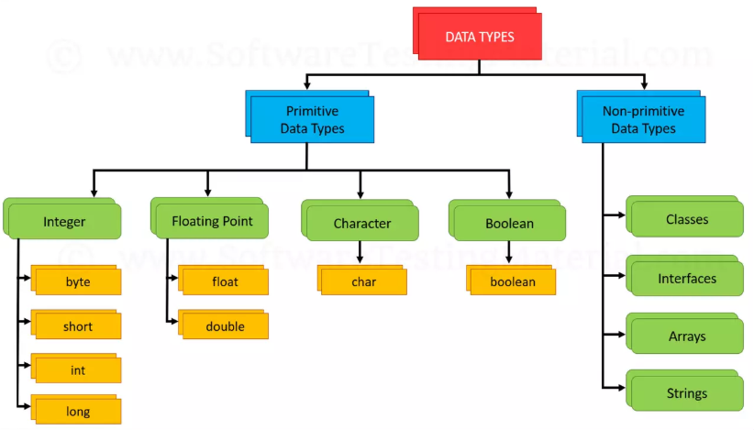
Data Types
- data storage format that can contain a specific type or range of values

Slide 20
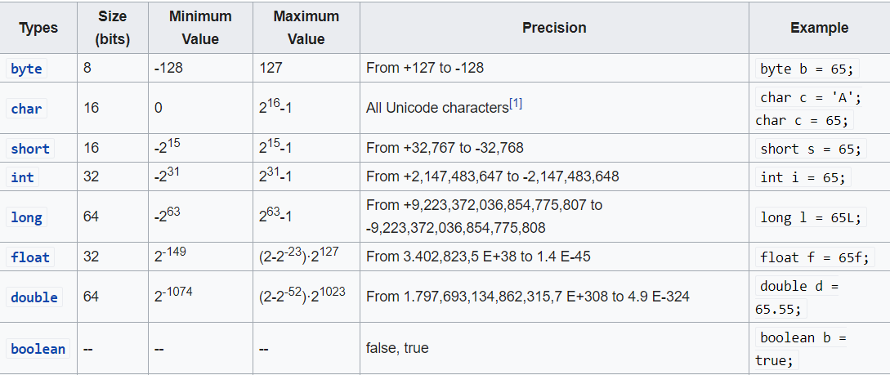
Primitive Types
They are the basic data types predefined within the Java language
There are 8 primitive data types.
boolean, char, byte, short, int, long, float, double etc.
Primitive data are only single values; they have no special capabilities.
You don’t use the new operator to create a primitive variable.

Slide 21
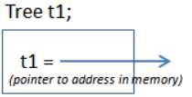
Non Primitive Types / Object Types
Non-primitive data types are not defined by the programming language, but are instead created by the programmer.
They are sometimes called "reference variables,"
or "object references," since they reference a memory location,
which stores the data.
The primitive types also come in versions that are full-blown objects. . Which are also known as wrapper classes.
Example: Boolean, Character, Byte, Integer etc
Here is how you declare a variable of (reference to) one of the core object types:
Integer age;
Here is how you initialize a object type variable or allocates memory to it:
Integer age;
age = new Integer(45);
Or,
Integer age= new Integer(45);

Slide 22
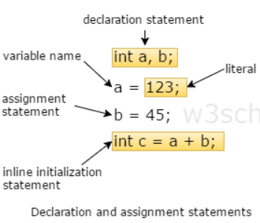
Declarations & Assignment
int index = 1.2;
boolean retOk = 1;
double fiveFourths = 5 / 4;
float ratio = 5.8f;
double fiveFourths = 5.0 / 4.0;

Slide 23
All Java assignments are right associative
int a = 1, b = 2, c = 10
a = b = c
Assignment
int a = 3;
int b = 4;
a = b = 5;
What is a and b ?

Slide 24
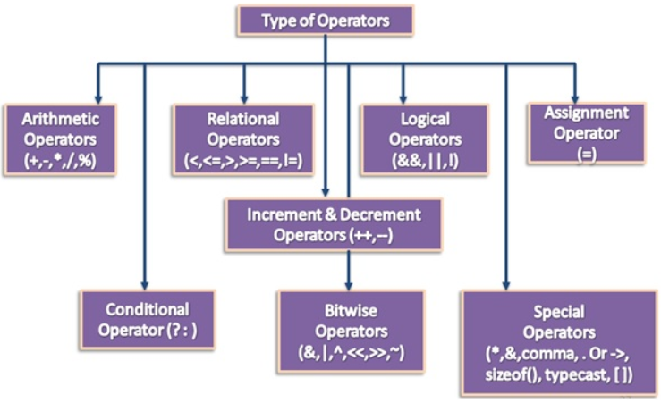
Java Operators -Special symbol that tells the compiler to perform specific type of mathematical or logical Operation.

Slide 25
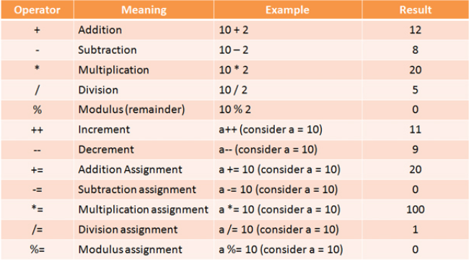
Mathematical Operators

Slide 26
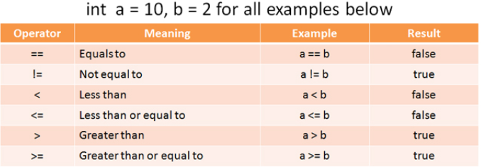
Relational Operators
Used to compare two values.
The result of comparing two values is always a boolean value true or false.

Slide 27
Conditional Operator
Ternary Operator or ? : Operator
Used to evaluate Boolean expressions.
The goal of the operator is to decide, which value should be assigned to the variable.
int max = val1 >= val2 ? val1 : val2;
the ternary operator conditions checks if the val1 value is larger than or equal to the val2 value. If it is, the ternary operator returns the val1 value. Else it returns the val2 value.

Slide 28
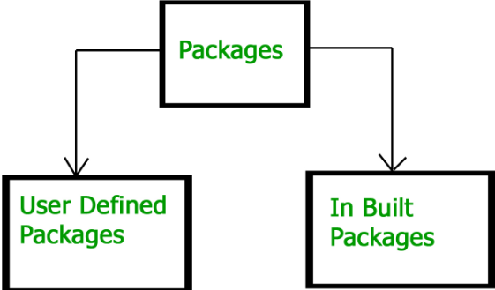
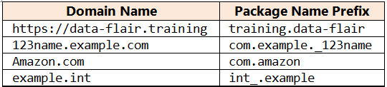
Packages
A package as the name suggests is a pack(group) of related classes, interfaces and other packages.
Its nothing but physical directory structure which provides clear-cut separation between the project modules.
Use packages to avoid name conflicts
Syntax : package package_name;
Ex: package com.bank;
Naming Convention:
Package names must be a group of words written in all-lowercase letters and should be one of the top-level domain names, like com, edu, gov, mil, net, org.
Subsequent components of the package name vary according to an organization's own internal naming conventions.
Companies use their reversed Internet domain name to begin their package names

Slide 29
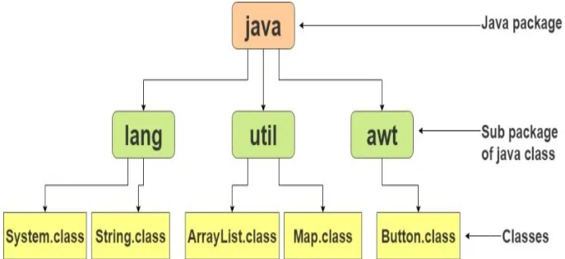
Built-in Packages
Packages already designed by the SUN micro systems and supplied as a part of JDK to simplify the task of java programmer.
The library contains components for managing input, database programming, and much more.
Core packages of java starts with java. (For example: java.lang.*)
The library is divided into packages and classes.

Slide 30
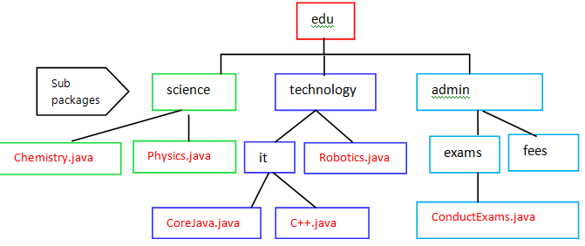
User defined Packages
Package name: edu.technology.it.CoreJava.java

Slide 31
Using the Packages
To use a public package member from outside its package, you must do one of the following:
Refer to the member by its fully qualified name
Import the package member (import package.classname;)
Import the member's entire package (import package.*;)
all the classes and interfaces of this package will be accessible but not sub-packages.

Slide 32
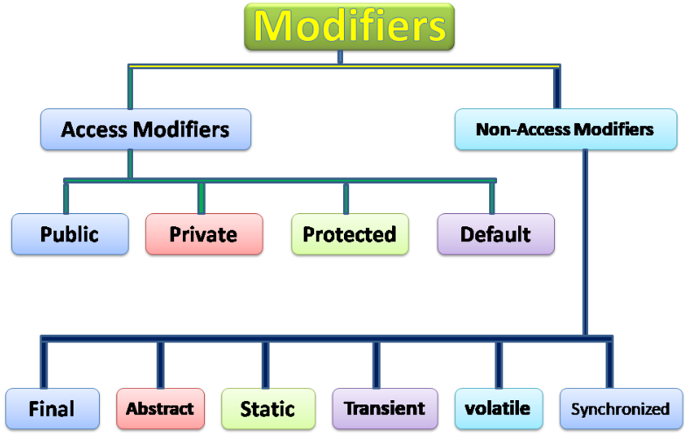
Access Modifiers
specifies which classes can access a given class and its fields, constructors and methods
# Access Modifier:
Used to control the access level of the class, attributes, methods, and constructor.
# Non-Access Modifier:
Used to restrict the further use of a class, attributes, methods, and constructor.

Slide 33
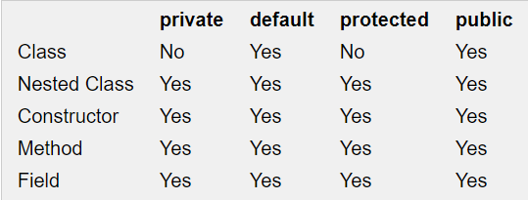
Private
Code inside the same class only can access the variable, or call the method declare with private access modifier. Code inside subclasses cannot access the variable or method, nor can code from any external class.
Public
public means that all code can access the class, field, constructor or method, regardless of where the accessing code is located. The accessing code can be in a different class and different package.
default (package)
The default access modifier means that code inside the class itself as well as code inside classes in the same package as this class, can access the class, field, constructor or method which the default access modifier is assigned to.
protected
The protected access modifier provides the same access as the package access modifier, with the addition that subclasses can access protected methods and member variables (fields) of the superclass even if the subclass is not located in the same package as the superclass.

Slide 34
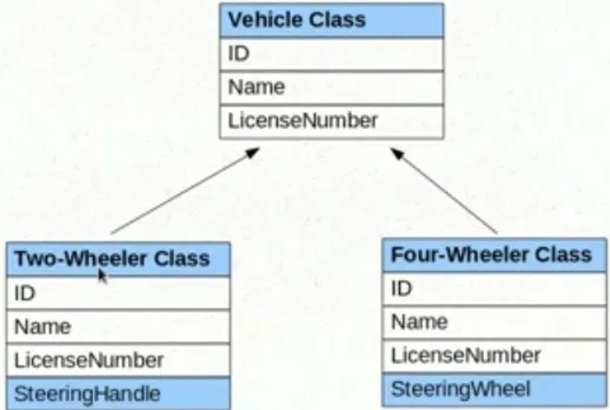
Inheritance Overview
A mechanism in which one object acquires all the properties and behaviors of a parent object.
You can create new classes that are built upon existing classes.
A class which is inherited is called a parent or superclass, and the new class is called child or subclass.
Syntax:
class Subclass-name extends Superclass-name
{
//methods and fields
}

Slide 35
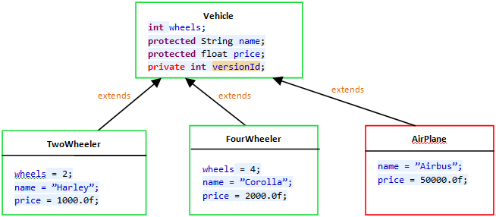
Protected
AirPlane class is in different package than TwoWheeler and FourWheeler

Slide 36
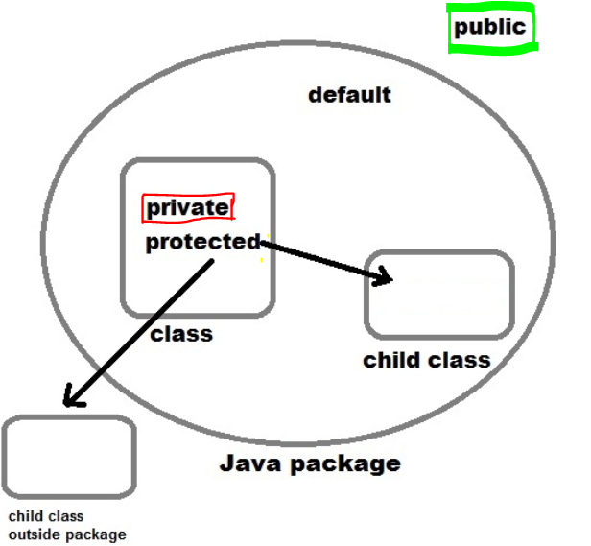
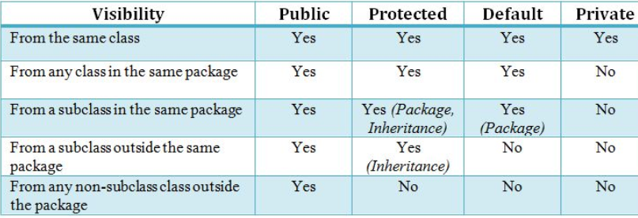
Summary

Slide 37
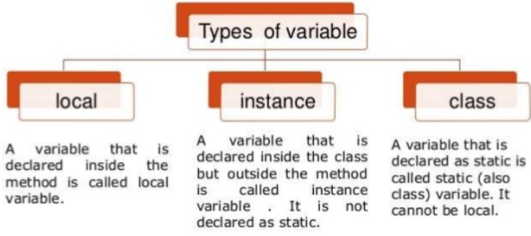
Types of Variables

Slide 38
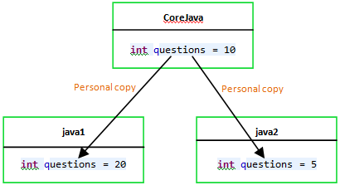
Instance variable
Declared with in a class and outside of method, block or constructor.
java1 and java2 are the objects of CoreJava

Slide 39
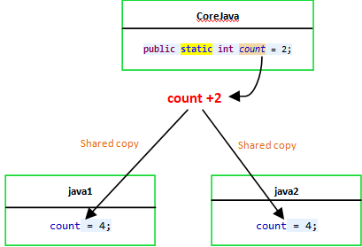
Static variable
The static variable can be used to refer the common property of all objects (that is not unique for each object) e.g. company name of employees, college name of students etc. meaning a single copy to be shared by all instances of the class.
It is a variable which belongs to the class and not to object(instance)
Static variables are initialized only once , at the start of the execution .
These variables will be initialized first, before the initialization of any instance variables
A static variable can be accessed directly by the class name and doesn’t need any object.

Slide 40
Statements & Blocks
A simple statement is a command terminated by a semi-colon:
name = “Fred”;
A block is a compound statement enclosed in curly brackets:
{
name1 = “Fred”; name2 = “Bill”;
}
Blocks may contain other blocks

Slide 41
Java Methods
Block of code which only runs when it is called by other Java code.
Do not have independent existence and they are always defined with in class.
A method takes some parameters, performs some computations and then optionally returns a value (or object).
Modifier returnType nameOfMethod (Parameter List) {
// method body
}
Example:
public float convertCelsius(float tempC) {
float tempF = ((tempC * 9.0f) / 5.0f) + 32.0f;
return tempF;
} }
How to call a Java Method?
Now you defined a method, you need to use it. For that, you have to call the method. Here's how:
obj.convertCelsius (20.0);

Slide 42
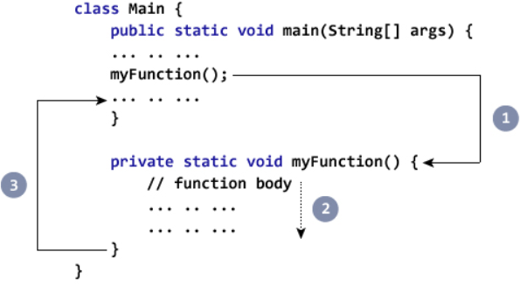

Slide 43
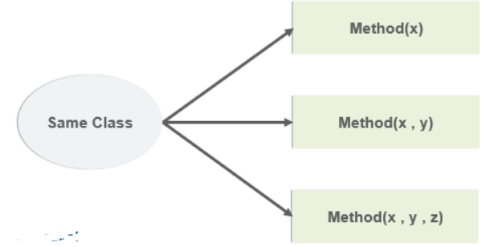
Method Overloading
When a class has two or more methods by the same name but different parameters, it is known as method overloading.
It is different from overriding. In overriding, a method has the same method name, type, number of parameters, etc.
If we have to perform only one operation, having same name of the methods increases the readability of the program.
There are two ways to overload the method in java
By changing number of arguments
By changing the data type
In java, Method Overloading is not possible by changing the return type of the method only.

Slide 44
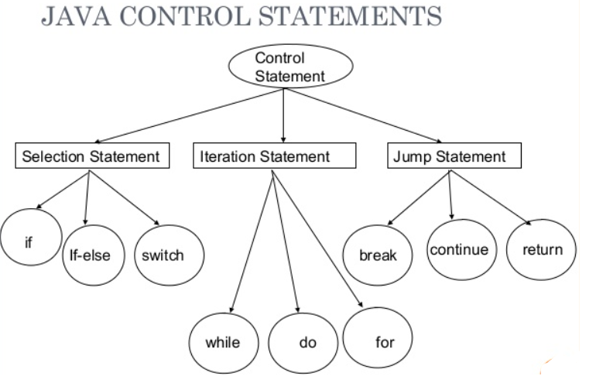

Slide 45
If – The Conditional Statement
The if statement evaluates an expression and if that evaluation is true then the specified action is taken
if ( x < 10 ) x = 10;
If the value of x is less than 10, make x equal to 10
It could have been written:
if ( x < 10 )
x = 10;
Or, alternatively:
if ( x < 10 ) { x = 10; }

Slide 46
If… else
The if … else statement evaluates an expression and performs one action if that evaluation is true or a different action if it is false.
if (x != oldx) {
System.out.print(“x was changed”);
}
else {
System.out.print(“x is unchanged”);
}

Slide 47
Nested if … else
if ( myVal > 100 ) {
if ( remainderOn == true) {
myVal = mVal % 100;
}
else {
myVal = myVal / 100.0;
}
}
else
{
System.out.print(“myVal is in range”);
}

Slide 48
else if
Useful for choosing between alternatives:
if ( n == 1 ) {
// execute code block #1
}
else if ( j == 2 ) {
// execute code block #2
}
else {
// if all previous tests have failed, execute code block #3
}

Slide 49
A Warning…
WRONG!
if( i == j )
if ( j == k )
System.out.print(
“i equals k”);
else
System.out.print(
“i is not equal to j”);
CORRECT!
if( i == j ) {
if ( j == k )
System.out.print(
“i equals k”);
}
else
System.out.print(“i is not equal to j”); // Correct!

Slide 50
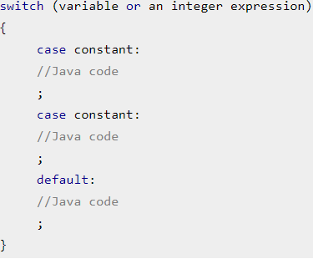
The switch Statement
Used when we have number of options (or choices) and we may need to perform a different task for each choice.

Slide 51
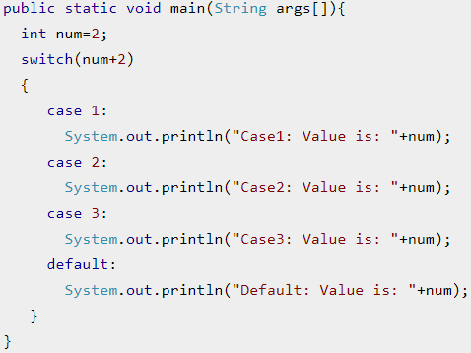
Switch case Example

Slide 52
The for loop
Loop n times
for ( i = 0; i < n; n++ ) {
// this code body will execute n times
// ifrom 0 to n-1
}
Nested for:
for ( j = 0; j < 10; j++ ) {
for ( i = 0; i < 20; i++ ){
// this code body will execute 200 times
}
}

Slide 53
while loops
while(response == 1) {
System.out.print( “ID =” + userID[n]);
n++;
response = readInt( “Enter “);
}
What is the minimum number of times the loop is executed?
What is the maximum number of times?

Slide 54
do {… } while loops
do {
System.out.print( “ID =” + userID[n] );
n++;
response = readInt( “Enter ” );
}while (response == 1);
What is the minimum number of times the loop is executed?
What is the maximum number of times?

Slide 55
Break
A break statement causes an exit from the innermost containing while, do, for or switch statement.
for ( int i = 0; i < maxID, i++ ) {
if ( userID[i] == targetID ) {
index = i;
break;
}
} // program jumps here after break

Slide 56
Continue
Can only be used with while, do or for.
The continue statement causes the innermost loop to start the next iteration immediately
for ( int i = 0; i < maxID; i++ ) {
if ( userID[i] != -1 ) continue;
System.out.print( “UserID ” + i + “ :” + userID);
}

Slide 57
Arrays
Am array is a list of similar things
An array has a fixed:
name
type
length
These must be declared when the array is created.
Arrays sizes cannot be changed during the execution of the code

Slide 58
myArray =
3
6
3
1
6
3
4
1
0
1
2
3
4
5
6
7
myArray has room for 8 elements
the elements are accessed by their index
in Java, array indices start at 0

Slide 59
Declaring Arrays
int myArray[];
declares myArray to be an array of integers
myArray = new int[8];
sets up 8 integer-sized spaces in memory, labelled myArray[0] to myArray[7]
int myArray[] = new int[8];
combines the two statements in one line

Slide 60
Assigning Values
refer to the array elements by index to store values in them.
myArray[0] = 3;
myArray[1] = 6;
myArray[2] = 3; ...
can create and initialise in one step:
int myArray[] = {3, 6, 3, 1, 6, 3, 4, 1};

Slide 61
Iterating Through Arrays
for loops are useful when dealing with arrays:
for (int i = 0; i < myArray.length; i++) {
myArray[i] = getsomevalue();
}

Slide 62
Arrays of Objects
So far we have looked at an array of primitive types.
integers
could also use doubles, floats, characters…
Often want to have an array of objects
Students, Books, Loans ……
Need to follow 3 steps.

Slide 63
Declaring the Array
1. Declare the array
private Student studentList[];
this declares studentList
2 .Create the array
studentList = new Student[10];
this sets up 10 spaces in memory that can hold references to Student objects
3. Create Student objects and add them to the array: studentList[0] = new Student("Cathy", "Computing");

Slide 64
Java Methods & Classes

Slide 65
The three principles of OOP
Encapsulation
Objects hide their functions (methods) and data (instance variables)
Inheritance
Each subclass inherits all variables of its superclass
Polymorphism
Interface same despite different data types
car
Super class
manual
auto-
matic
Subclasses
draw()
draw()

Slide 66
Simple Class and Method
Class Fruit{
int grams;
int cals_per_gram;
int total_calories() {
return(grams*cals_per_gram);
}
}

Slide 67
Methods
A method is a named sequence of code that can be invoked by other Java code.
A method takes some parameters, performs some computations and then optionally returns a value (or object).
Methods can be used as part of an expression statement.
public float convertCelsius(float tempC) {
return( ((tempC * 9.0f) / 5.0f) + 32.0 );
}

Slide 68
Method Signatures
A method signature specifies:
The name of the method.
The type and name of each parameter.
The type of the value (or object) returned by the method.
The checked exceptions thrown by the method.
Various method modifiers.
modifiers type name ( parameter list ) [throws exceptions ]
public float convertCelsius (float tCelsius ) {}
public boolean setUserInfo ( int i, int j, String name ) throws IndexOutOfBoundsException {}

Slide 69
Public/private
Methods/data may be declared public or private meaning they may or may not be accessed by code in other classes …
Good practice:
keep data private
keep most methods private
well-defined interface between classes - helps to eliminate errors

Slide 70
Using objects
Here, code in one class creates an instance of another class and does something with it …
Fruit plum=new Fruit();
int cals;
cals = plum.total_calories();
Dot operator allows you to access (public) data/methods inside Fruit class

Slide 71
Constructors
The line
plum = new Fruit();
invokes a constructor method with which you can set the initial data of an object
You may choose several different type of constructor with different argument lists
eg Fruit(), Fruit(a) ...

Slide 72
Overloading
Can have several versions of a method in class with different types/numbers of arguments
Fruit() {grams=50;}
Fruit(a,b) { grams=a; cals_per_gram=b;}
By looking at arguments Java decides which version to use

Slide 73
Java Development Kit
javac - The Java Compiler
java - The Java Interpreter
jdb - The Java Debugger
appletviewer -Tool to run the applets
javap - to print the Java bytecodes
javaprof - Java profiler
javadoc - documentation generator
javah - creates C header files

Slide 74
Stream Manipulation

