Slide 1
GPA Modelling
Anthony Poon

Slide 2

Background
Objective: | Predict academic performance of elementary schools using linear regression
Sample Size: | 400
Data: | Academic Performance
 | School Attributes
 | Family Education Background
 | Teacher Qualification

Slide 3
Data Overview
Academic Performance
api00, api99 | Academic performance in 2000, 1999 | growth | Academic performance growth from 1999 to 2000
School |  | Teacher
dnum | School district number | full | % teacher holding full credential
meals | % students receiving free meal from school | emer | % teacher holding emergency credential
ell | Number of english language learner | Family
yr_rnd | A year-around school or not | not_hsg | % of parent did not attend high school
mobility | % student is in this school for the first year | hsg | % of parent attended high school
acs_k3 | Avg. class size in kindergarten to year 3 | some_col | % of parent attended college
acs_46 | Avg class size in year 4 to year 6 | avg_ed | Average parent education level
enroll | Number of students

Slide 4
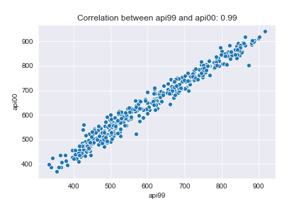
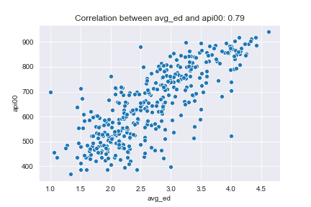
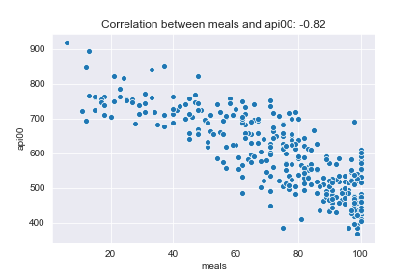
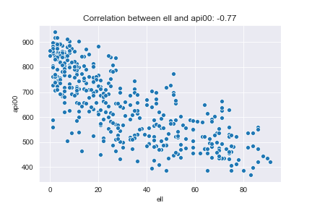
Correlation between variables
api99 and api00 positively correlated
Measuring academic performance with api99 or api00 does not make a big difference
Api00 positively correlated to meal
Api00 negatively correlated to avg_ed, ell, meals, not_hsg, emer
These variable could be useful in predicting api00

Slide 5
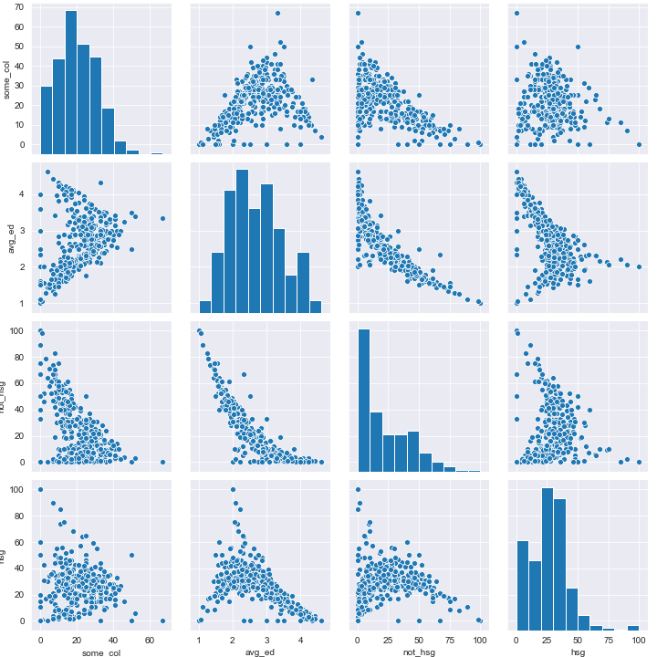
Correlation between variables
Variables describing family’s education level are correlated
Could lead to multi-collinearity
May not need 4 variables to represent family’s education level
School with very high/very low avg_ed has low value in hsg
hsg and not_hsg does not sum to 100%
hsg is likely to be erroneous
Not possible to interpret this variable

Slide 6
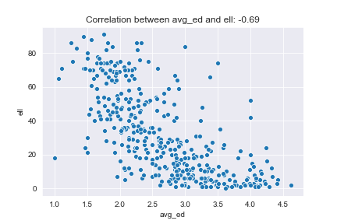
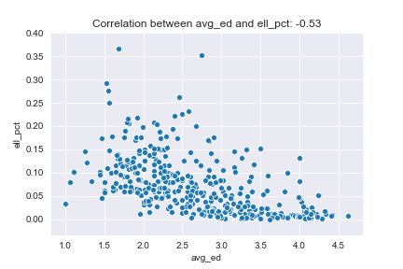
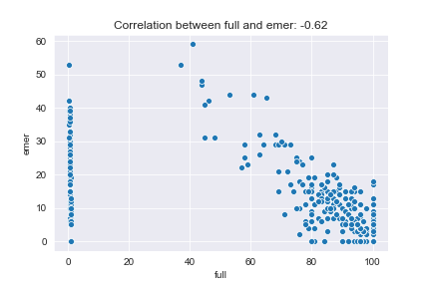
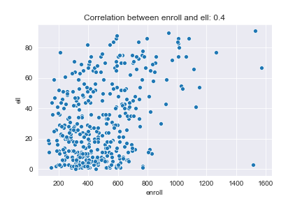
Correlation between variables
Avg_ed and ell negatively correlated
Weird correlation
Ell and enroll positively correlated
Larger school has more English learners
Calculated % of English learners to depict information independent of the school size
Full and emer negatively correlated
But they do not sum to 100%
Could be a third type of teacher not surveyed

Slide 7
Data Overview
After overviewing the data, made the below adjustment to the dataset:
Use avg_api to measure academic performance ( avg_api = (api99 + api00) / 2 )
Drop hsg
Use ell_pct to replace ell ( ell_pct = ell / enroll )
All acs_k3 (avg. class size) from dnum (school district) = 140 are negative, likely due to typo, change the values to positive
Create dummy variables for categorical data dnum

Slide 8
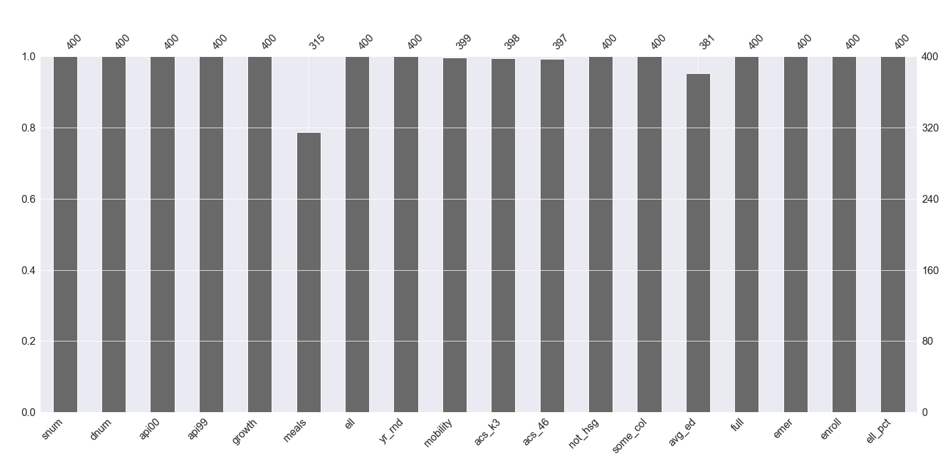
Missing Data
Major missing
85 missing data in meals
19 missing data in avg_ed
Dropping entries with NA value in these variable would lose information and representativeness
Minor missing
3 missing data in acs_k32, 2 in acs46, 1 in mobility
Dropping entries with NA value in these variable would not have significant impact

Slide 9
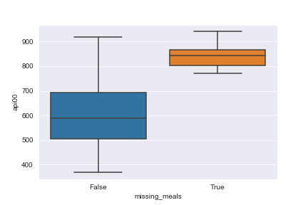
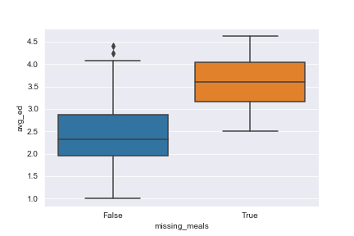
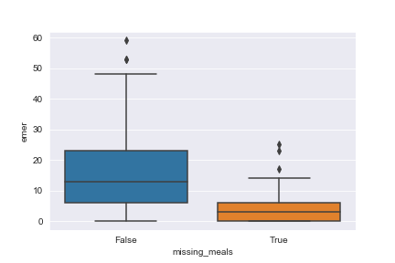
Missing Data - meals
Schools that misses data in meals have higher api
Add variable missing_meal, could be useful in predicting academic performance
Nearly all schools that misses data in meals are not year-around school
Schools that misses data in meals have higher avg_ed, lower emer, lower ell_pct
Missing data in meals are not missing completely not at random (MNAR)
Meals are related to other variables, missing values can be imputed
 | Yr_rnd
Missing_meal | False | True
False | 71% | 29%
True | 98% | 2%

Slide 10
Missing Data - avg_ed
Average parent education level is related to other variables about family education background (e.g. not_hsg, some_col)
Can also be imputed
Missing Data - Imputation
Missing data in meals are imputed (same for avg_ed)
By regressing the known meals with other predictor variables
Then use this regression model to estimate the value of missing meals

Slide 11
Preliminary Model
Good prediction:
R-squared: 0.901
Adjusted R-squared: 0.893
F Statistic p-value: 3.04E-149
Many beta estimates not significant enough:
Only 8 out of 49 parameter estimates has p-value < 0.05
Could be due to multi-collinearity
 | coef | std err | t | P>|t| | [0.025 | 0.975]
const | 1566.207 | 158.414 | 9.887 | 0 | 1254.629 | 1877.785
meals | -5.6571 | 0.423 | -13.366 | 0 | -6.49 | -4.825
avg_ed | 63.4129 | 17.132 | 3.701 | 0 | 29.716 | 97.109
emer | -4.0478 | 0.847 | -4.78 | 0 | -5.713 | -2.382
enroll | -0.0865 | 0.037 | -2.325 | 0.021 | -0.16 | -0.013
dnum_395 | 142.6761 | 54.664 | 2.61 | 0.009 | 35.159 | 250.193
dnum_507 | -162.621 | 56.082 | -2.9 | 0.004 | -272.926 | -52.315
dnum_635 | -123.832 | 59.11 | -2.095 | 0.037 | -240.094 | -7.57
missing_meals | 238.6316 | 19.604 | 12.173 | 0 | 200.073 | 277.19
Significant factors that are positive to academic performance:
avg_ed, dnum_395, missing_meal
Significant factors that are positive to academic performance:
meals, emer, enroll, dum_507, dnum_635

Slide 12
Preliminary Model
 | coef | std err | t | P>|t| | [0.025 | 0.975]
const | 1566.207 | 158.414 | 9.887 | 0 | 1254.629 | 1877.785
meals | -5.6571 | 0.423 | -13.366 | 0 | -6.49 | -4.825
yr_rnd | -33.1065 | 18.008 | -1.838 | 0.067 | -68.527 | 2.314
mobility | -1.4429 | 0.831 | -1.737 | 0.083 | -3.077 | 0.191
acs_k3 | 3.7037 | 4.947 | 0.749 | 0.455 | -6.027 | 13.434
acs_46 | -1.0436 | 1.978 | -0.528 | 0.598 | -4.935 | 2.848
not_hsg | 0.451 | 0.572 | 0.788 | 0.431 | -0.675 | 1.577
some_col | 0.257 | 0.613 | 0.419 | 0.675 | -0.948 | 1.463
avg_ed | 63.4129 | 17.132 | 3.701 | 0 | 29.716 | 97.109
full | -0.5873 | 0.885 | -0.663 | 0.507 | -2.328 | 1.154
emer | -4.0478 | 0.847 | -4.78 | 0 | -5.713 | -2.382
enroll | -0.0865 | 0.037 | -2.325 | 0.021 | -0.16 | -0.013
ell_pct | -263.212 | 150.597 | -1.748 | 0.081 | -559.416 | 32.992
dnum_98 | -9.1293 | 84.119 | -0.109 | 0.914 | -174.579 | 156.32
dnum_108 | -36.5976 | 59.64 | -0.614 | 0.54 | -153.901 | 80.706
dnum_131 | 3.1143 | 63.152 | 0.049 | 0.961 | -121.097 | 127.325
dnum_135 | -100.792 | 54.17 | -1.861 | 0.064 | -207.337 | 5.753
dnum_140 | 90.6368 | 64.625 | 1.403 | 0.162 | -36.471 | 217.745
dnum_166 | -11.5194 | 74.93 | -0.154 | 0.878 | -158.897 | 135.859
dnum_209 | 14.1108 | 65.034 | 0.217 | 0.828 | -113.802 | 142.023
dnum_238 | -150.606 | 107.478 | -1.401 | 0.162 | -362.001 | 60.789
dnum_248 | 67.1658 | 74.253 | 0.905 | 0.366 | -78.88 | 213.211
dnum_253 | -64.3978 | 55.585 | -1.159 | 0.247 | -173.726 | 44.93
dnum_259 | -1.0254 | 58.357 | -0.018 | 0.986 | -115.805 | 113.754
dnum_284 | 7.6575 | 77.361 | 0.099 | 0.921 | -144.502 | 159.817
Dep. Variable: | y | R-squared: | 0.907
Model: | OLS | Adj. R-squared: | 0.893
Method: | Least Squares | F-statistic: | 68.41
Date: | Tue, 13 Oct 2020 | Prob (F-statistic): | 3.04E-149
Time: | 23:54:52 | Log-Likelihood: | -2329.4
No. Observations: | 395 | AIC: | 4759
Df Residuals: | 345 | BIC: | 4958
Df Model: | 49
Covariance Type: | nonrobust

Slide 13
Preliminary Model
 | coef | std err | t | P>|t| | [0.025 | 0.975]
dnum_294 | -108.916 | 74.479 | -1.462 | 0.145 | -255.407 | 37.575
dnum_316 | 51.2976 | 62.331 | 0.823 | 0.411 | -71.299 | 173.894
dnum_395 | 142.6761 | 54.664 | 2.61 | 0.009 | 35.159 | 250.193
dnum_401 | -35.3893 | 85.041 | -0.416 | 0.678 | -202.654 | 131.875
dnum_473 | -84.6516 | 61.327 | -1.38 | 0.168 | -205.274 | 35.971
dnum_491 | -18.4133 | 74.074 | -0.249 | 0.804 | -164.106 | 127.28
dnum_507 | -162.621 | 56.082 | -2.9 | 0.004 | -272.926 | -52.315
dnum_541 | -34.0813 | 83.669 | -0.407 | 0.684 | -198.646 | 130.484
dnum_570 | 45.162 | 74.907 | 0.603 | 0.547 | -102.169 | 192.493
dnum_575 | -12.0711 | 64.356 | -0.188 | 0.851 | -138.651 | 114.509
dnum_600 | 37.5182 | 61.35 | 0.612 | 0.541 | -83.149 | 158.186
dnum_605 | -83.0689 | 60.025 | -1.384 | 0.167 | -201.13 | 34.992
dnum_620 | 35.7219 | 55.752 | 0.641 | 0.522 | -73.935 | 145.379
dnum_621 | 27.4408 | 61.26 | 0.448 | 0.654 | -93.05 | 147.932
dnum_627 | 26.8683 | 58.949 | 0.456 | 0.649 | -89.077 | 142.813
dnum_630 | 27.2913 | 51.751 | 0.527 | 0.598 | -74.495 | 129.078
dnum_632 | -61.4139 | 55.123 | -1.114 | 0.266 | -169.834 | 47.006
dnum_635 | -123.832 | 59.11 | -2.095 | 0.037 | -240.094 | -7.57
dnum_636 | 19.2431 | 58.984 | 0.326 | 0.744 | -96.769 | 135.256
dnum_653 | 40.5682 | 63.054 | 0.643 | 0.52 | -83.45 | 164.587
dnum_689 | -105.685 | 61.467 | -1.719 | 0.086 | -226.582 | 15.213
dnum_716 | -57.818 | 55.344 | -1.045 | 0.297 | -166.672 | 51.036
dnum_779 | -77.56 | 62.663 | -1.238 | 0.217 | -200.809 | 45.689
dnum_796 | -59.8133 | 58.396 | -1.024 | 0.306 | -174.671 | 55.044
missing_meals | 238.6316 | 19.604 | 12.173 | 0 | 200.073 | 277.19
Dep. Variable: | y | R-squared: | 0.907
Model: | OLS | Adj. R-squared: | 0.893
Method: | Least Squares | F-statistic: | 68.41
Date: | Tue, 13 Oct 2020 | Prob (F-statistic): | 3.04E-149
Time: | 23:54:52 | Log-Likelihood: | -2329.4
No. Observations: | 395 | AIC: | 4759
Df Residuals: | 345 | BIC: | 4958
Df Model: | 49
Covariance Type: | nonrobust

Slide 14
Multi-collinearity
What is it?
Predictors variable that is close to linear combination of other variables
Problem?
High variance in beta estimates
Not significant beta estimates

Slide 15
Multi-collinearity
What is it:
Dataset contains predictor variables that are close to linear combination of other variables
Problem:
High variance (low confidence) in beta estimates
Remedy:
PCA
Dropping variables that are close to linear combination of other variables (high VIF value)
(Instead of dropping variables with high VIF now, variables would be dropped using forward selection at a later stage)
Variables with VIF > 10 | VIF
acs_k3 | 144.5957
full | 71.40321
acs_46 | 67.33123
avg_ed | 39.81295
dnum_401 | 27.71314
meals | 19.17928

Slide 16
Multi-collinearity - PCA
Represent data with principle components (uncorrelated variables)
Pros:
remedy multi-collinearity
reduce dimensionality
Cons:
Harder to interpret
Variables it represents | PC1 coefficients
meals | 0.347674
not_hsg | 0.336945
emer | 0.302503
missing_meals | -0.29136
full | -0.29789
avg_ed | -0.34122
Variables it represents | PC2 coefficients
acs_k3 | 0.360821
full | 0.347162
mobility | 0.31284
dnum_632 | -0.14352
avg_ed | -0.24413
dnum_401 | -0.37016
Variables it represents | PC3 coefficients
ell_pct | 0.395215
full | 0.251209
dnum_632 | 0.181447
dnum_401 | -0.23876
yr_rnd | -0.28213
enroll | -0.41983

Slide 17
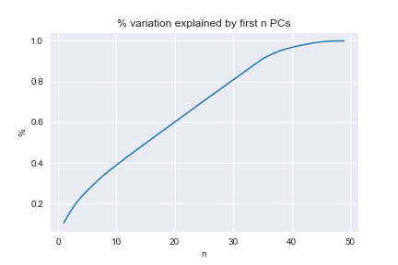
Multi-collinearity - PCA
The first 3 PCs only explain 20% of variation
35 PCs needed to explain 90% of variation
Not many redundant variables
Linear regression model does not suffer much Curse of Dimensionality
No need to drop any PCs

Slide 18
Preliminary Model with PCs
Significant factors that are positive to academic performance:
PC36, 40, 43, 46
Significant factors that are positive to academic performance:
PC1, 2, 3, 4, etc.
 | coef | std err | t | P>|t| | [0.025 | 0.975]
const | 1259.365 | 4.743 | 265.535 | 0 | 1250.036 | 1268.693
PC1 | -109.02 | 2.087 | -52.248 | 0 | -113.124 | -104.916
PC2 | -35.1792 | 3.051 | -11.53 | 0 | -41.18 | -29.178
PC3 | -31.7105 | 3.271 | -9.695 | 0 | -38.144 | -25.277
PC4 | -16.4255 | 3.587 | -4.579 | 0 | -23.482 | -9.369
PC8 | -20.9759 | 4.262 | -4.922 | 0 | -29.358 | -12.593
PC16 | -21.6413 | 4.672 | -4.632 | 0 | -30.83 | -12.452
PC17 | -17.1901 | 4.676 | -3.676 | 0 | -26.388 | -7.993
PC36 | 22.3239 | 5.511 | 4.051 | 0 | 11.485 | 33.163
PC38 | -42.3855 | 6.323 | -6.703 | 0 | -54.822 | -29.949
PC39 | -45.7025 | 7.193 | -6.354 | 0 | -59.85 | -31.555
PC40 | 45.3727 | 7.746 | 5.857 | 0 | 30.137 | 60.609
PC43 | 47.7826 | 9.173 | 5.209 | 0 | 29.741 | 65.824
PC45 | -61.5091 | 10.382 | -5.925 | 0 | -81.928 | -41.09
PC46 | 67.0445 | 13.015 | 5.151 | 0 | 41.445 | 92.644
Translate to the same model as before PCA when all PCs are considered
22 (compare to 8 before PCA) parameter estimates have p-value > 0.05

Slide 19
Preliminary Model with PCs
 | coef | std err | t | P>|t| | [0.025 | 0.975]
const | 1259.365 | 4.743 | 265.535 | 0 | 1250.036 | 1268.693
PC1 | -109.02 | 2.087 | -52.248 | 0 | -113.124 | -104.916
PC2 | -35.1792 | 3.051 | -11.53 | 0 | -41.18 | -29.178
PC3 | -31.7105 | 3.271 | -9.695 | 0 | -38.144 | -25.277
PC4 | -16.4255 | 3.587 | -4.579 | 0 | -23.482 | -9.369
PC5 | 3.2448 | 3.952 | 0.821 | 0.412 | -4.529 | 11.018
PC6 | -5.2245 | 4.043 | -1.292 | 0.197 | -13.176 | 2.727
PC7 | -11.5559 | 4.092 | -2.824 | 0.005 | -19.605 | -3.507
PC8 | -20.9759 | 4.262 | -4.922 | 0 | -29.358 | -12.593
PC9 | -4.7656 | 4.463 | -1.068 | 0.286 | -13.544 | 4.013
PC10 | 7.9663 | 4.518 | 1.763 | 0.079 | -0.921 | 16.853
PC11 | -0.0201 | 4.562 | -0.004 | 0.996 | -8.994 | 8.954
PC12 | 2.651 | 4.605 | 0.576 | 0.565 | -6.407 | 11.708
PC13 | 16.1252 | 4.642 | 3.474 | 0.001 | 6.995 | 25.256
PC14 | 13.5288 | 4.655 | 2.906 | 0.004 | 4.372 | 22.685
PC15 | 11.183 | 4.666 | 2.397 | 0.017 | 2.005 | 20.361
PC16 | -21.6413 | 4.672 | -4.632 | 0 | -30.83 | -12.452
PC17 | -17.1901 | 4.676 | -3.676 | 0 | -26.388 | -7.993
PC18 | -1.8684 | 4.68 | -0.399 | 0.69 | -11.073 | 7.336
PC19 | -1.723 | 4.687 | -0.368 | 0.713 | -10.942 | 7.496
PC20 | 7.1471 | 4.689 | 1.524 | 0.128 | -2.076 | 16.37
PC21 | -2.2238 | 4.691 | -0.474 | 0.636 | -11.45 | 7.002
PC22 | -6.7252 | 4.695 | -1.432 | 0.153 | -15.961 | 2.51
PC23 | -2.4711 | 4.698 | -0.526 | 0.599 | -11.712 | 6.77
PC24 | 7.0145 | 4.702 | 1.492 | 0.137 | -2.233 | 16.262
Dep. Variable: | y | R-squared: | 0.907
Model: | OLS | Adj. R-squared: | 0.893
Method: | Least Squares | F-statistic: | 68.41
Date: | Tue, 13 Oct 2020 | Prob (F-statistic): | 3.04E-149
Time: | 23:54:52 | Log-Likelihood: | -2329.4
No. Observations: | 395 | AIC: | 4759
Df Residuals: | 345 | BIC: | 4958
Df Model: | 49
Covariance Type: | nonrobust

Slide 20
Preliminary Model with PCs
 | coef | std err | t | P>|t| | [0.025 | 0.975]
PC25 | 1.4389 | 4.704 | 0.306 | 0.76 | -7.813 | 10.69
PC26 | -8.3324 | 4.704 | -1.771 | 0.077 | -17.585 | 0.92
PC27 | -1.4403 | 4.709 | -0.306 | 0.76 | -10.703 | 7.823
PC28 | 10.329 | 4.715 | 2.191 | 0.029 | 1.055 | 19.603
PC29 | 5.9474 | 4.716 | 1.261 | 0.208 | -3.329 | 15.223
PC30 | -0.2244 | 4.719 | -0.048 | 0.962 | -9.506 | 9.058
PC31 | -0.302 | 4.72 | -0.064 | 0.949 | -9.586 | 8.982
PC32 | 2.3478 | 4.723 | 0.497 | 0.619 | -6.942 | 11.637
PC33 | 6.1074 | 4.724 | 1.293 | 0.197 | -3.184 | 15.399
PC34 | 1.661 | 4.728 | 0.351 | 0.726 | -7.639 | 10.961
PC35 | -7.1756 | 4.735 | -1.515 | 0.131 | -16.488 | 2.137
PC36 | 22.3239 | 5.511 | 4.051 | 0 | 11.485 | 33.163
PC37 | 8.0468 | 5.804 | 1.386 | 0.167 | -3.37 | 19.463
PC38 | -42.3855 | 6.323 | -6.703 | 0 | -54.822 | -29.949
PC39 | -45.7025 | 7.193 | -6.354 | 0 | -59.85 | -31.555
PC40 | 45.3727 | 7.746 | 5.857 | 0 | 30.137 | 60.609
PC41 | 22.6619 | 8.307 | 2.728 | 0.007 | 6.324 | 39
PC42 | 29.8915 | 8.707 | 3.433 | 0.001 | 12.765 | 47.018
PC43 | 47.7826 | 9.173 | 5.209 | 0 | 29.741 | 65.824
PC44 | 23.5198 | 9.562 | 2.46 | 0.014 | 4.712 | 42.327
PC45 | -61.5091 | 10.382 | -5.925 | 0 | -81.928 | -41.09
PC46 | 67.0445 | 13.015 | 5.151 | 0 | 41.445 | 92.644
PC47 | -0.4788 | 17.359 | -0.028 | 0.978 | -34.622 | 33.664
PC48 | -4.1902 | 39.682 | -0.106 | 0.916 | -82.239 | 73.859
PC49 | 39.138 | 52.915 | 0.74 | 0.46 | -64.938 | 143.214
Dep. Variable: | y | R-squared: | 0.907
Model: | OLS | Adj. R-squared: | 0.893
Method: | Least Squares | F-statistic: | 68.41
Date: | Tue, 13 Oct 2020 | Prob (F-statistic): | 3.04E-149
Time: | 23:54:52 | Log-Likelihood: | -2329.4
No. Observations: | 395 | AIC: | 4759
Df Residuals: | 345 | BIC: | 4958
Df Model: | 49
Covariance Type: | nonrobust

Slide 21
Model Factor Selection
Overfitting (using more variable than needed) can lead to inaccurate parameter estimation
Forward Selection
Select only the more relevant variables that improves adjusted R-squared of the model
Use only 33 variables (23 parameter estimates having p-value < 0.05) to achieve the similar R-squared
Model before Forward Selection
Dep. Variable: | y | R-squared: | 0.907
Model: | OLS | Adj. R-squared: | 0.893
Method: | Least Squares | F-statistic: | 68.41
Date: | Tue, 13 Oct 2020 | Prob (F-statistic): | 3.04E-149
Time: | 23:54:52 | Log-Likelihood: | -2329.4
No. Observations: | 395 | AIC: | 4759
Df Residuals: | 345 | BIC: | 4958
Df Model: | 49
Covariance Type: | nonrobust
Model after Forward Selection
Dep. Variable: | api_avg | R-squared: | 0.906
Model: | OLS | Adj. R-squared: | 0.897
Method: | Least Squares | F-statistic: | 105.3
Date: | Wed, 14 Oct 2020 | Prob (F-statistic): | 4.34E-164
Time: | 01:37:54 | Log-Likelihood: | -2331.1
No. Observations: | 395 | AIC: | 4730
Df Residuals: | 361 | BIC: | 4866
Df Model: | 33
Covariance Type: | nonrobust

Slide 22
Forward selection Model with PCs
 | coef | std err | t | P>|t| | [0.025 | 0.975]
Intercept | 1259.365 | 4.656 | 270.479 | 0 | 1250.208 | 1268.521
PCA1 | -109.02 | 2.048 | -53.22 | 0 | -113.048 | -104.991
PCA2 | -35.1792 | 2.995 | -11.745 | 0 | -41.07 | -29.289
PCA3 | -31.7105 | 3.211 | -9.875 | 0 | -38.025 | -25.396
PCA38 | -42.3855 | 6.208 | -6.828 | 0 | -54.593 | -30.178
PCA39 | -45.7025 | 7.061 | -6.472 | 0 | -59.589 | -31.816
PCA45 | -61.5091 | 10.192 | -6.035 | 0 | -81.552 | -41.466
PCA40 | 45.3727 | 7.605 | 5.966 | 0 | 30.418 | 60.328
PCA43 | 47.7826 | 9.005 | 5.306 | 0 | 30.073 | 65.492
PCA46 | 67.0445 | 12.777 | 5.247 | 0 | 41.917 | 92.172
PCA8 | -20.9759 | 4.184 | -5.013 | 0 | -29.204 | -12.748
PCA16 | -21.6413 | 4.587 | -4.718 | 0 | -30.661 | -12.622
PCA4 | -16.4255 | 3.522 | -4.664 | 0 | -23.352 | -9.499
PCA36 | 22.3239 | 5.41 | 4.126 | 0 | 11.685 | 32.963
PCA17 | -17.1901 | 4.591 | -3.744 | 0 | -26.218 | -8.162
PCA13 | 16.1252 | 4.557 | 3.538 | 0 | 7.163 | 25.087
PCA42 | 29.8915 | 8.548 | 3.497 | 0.001 | 13.081 | 46.702
Dep. Variable: | api_avg | R-squared: | 0.906
Model: | OLS | Adj. R-squared: | 0.897
Method: | Least Squares | F-statistic: | 105.3
Date: | Wed, 14 Oct 2020 | Prob (F-statistic): | 4.34E-164
Time: | 01:37:54 | Log-Likelihood: | -2331.1
No. Observations: | 395 | AIC: | 4730
Df Residuals: | 361 | BIC: | 4866
Df Model: | 33
Covariance Type: | nonrobust

Slide 23
Forward selection Model with PCs
 | coef | std err | t | P>|t| | [0.025 | 0.975]
PCA14 | 13.5288 | 4.57 | 2.96 | 0.003 | 4.541 | 22.517
PCA7 | -11.5559 | 4.018 | -2.876 | 0.004 | -19.457 | -3.655
PCA41 | 22.6619 | 8.155 | 2.779 | 0.006 | 6.625 | 38.699
PCA44 | 23.5198 | 9.387 | 2.505 | 0.013 | 5.059 | 41.981
PCA15 | 11.183 | 4.581 | 2.441 | 0.015 | 2.174 | 20.192
PCA28 | 10.329 | 4.629 | 2.231 | 0.026 | 1.226 | 19.432
PCA26 | -8.3324 | 4.618 | -1.804 | 0.072 | -17.415 | 0.75
PCA10 | 7.9663 | 4.436 | 1.796 | 0.073 | -0.757 | 16.69
PCA20 | 7.1471 | 4.604 | 1.553 | 0.121 | -1.906 | 16.2
PCA35 | -7.1756 | 4.648 | -1.544 | 0.124 | -16.317 | 1.965
PCA24 | 7.0145 | 4.616 | 1.52 | 0.129 | -2.063 | 16.092
PCA22 | -6.7252 | 4.61 | -1.459 | 0.145 | -15.79 | 2.34
PCA37 | 8.0468 | 5.698 | 1.412 | 0.159 | -3.159 | 19.253
PCA33 | 6.1074 | 4.638 | 1.317 | 0.189 | -3.013 | 15.228
PCA6 | -5.2245 | 3.969 | -1.316 | 0.189 | -13.03 | 2.581
PCA29 | 5.9474 | 4.63 | 1.285 | 0.2 | -3.158 | 15.053
PCA9 | -4.7656 | 4.382 | -1.088 | 0.278 | -13.383 | 3.851
Dep. Variable: | api_avg | R-squared: | 0.906
Model: | OLS | Adj. R-squared: | 0.897
Method: | Least Squares | F-statistic: | 105.3
Date: | Wed, 14 Oct 2020 | Prob (F-statistic): | 4.34E-164
Time: | 01:37:54 | Log-Likelihood: | -2331.1
No. Observations: | 395 | AIC: | 4730
Df Residuals: | 361 | BIC: | 4866
Df Model: | 33
Covariance Type: | nonrobust

Slide 24
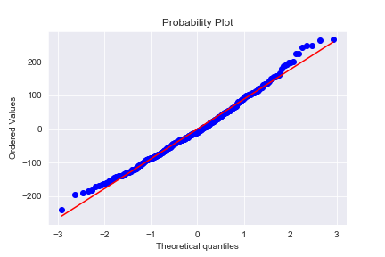
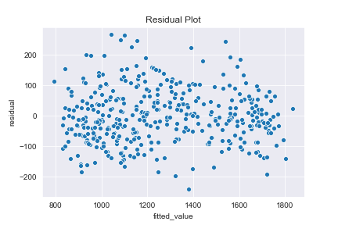
Residual Analysis
Residual close to normally distributed
Residual rather constant across different fitted value

Slide 25
Residual Analysis - Heteroscedasticity
The model is not significantly heteroscedastic (ie errors have constant variance)
Breusch-Pagan Lagrange Multiplier test:
Null hypothesis: Residuals does not depend on predictor variables
P-value = 18% > 5%, do not reject null hypothesis
In case the model is heteroscedastic, use Huber–White (HW) standard errors instead of assuming errors to have constant variance
Same parameter point estimates but different confidence intervals
Some estimates have more confident and some have less, 26 parameter estimates have p-value < 5%

Slide 26
Model using HW standard errors
 | coef | std err | t | P>|t| | [0.025 | 0.975]
const | 1259.365 | 4.656 | 270.479 | 0 | 1250.239 | 1268.49
PCA1 | -109.02 | 1.971 | -55.326 | 0 | -112.882 | -105.158
PCA2 | -35.1792 | 3.152 | -11.162 | 0 | -41.356 | -29.002
PCA3 | -31.7105 | 3.759 | -8.437 | 0 | -39.077 | -24.344
PCA38 | -42.3855 | 7.002 | -6.053 | 0 | -56.11 | -28.661
PCA39 | -45.7025 | 6.949 | -6.577 | 0 | -59.323 | -32.083
PCA45 | -61.5091 | 10.523 | -5.845 | 0 | -82.133 | -40.885
PCA40 | 45.3727 | 8.437 | 5.378 | 0 | 28.836 | 61.909
PCA43 | 47.7826 | 8.664 | 5.515 | 0 | 30.801 | 64.764
PCA46 | 67.0445 | 16.194 | 4.14 | 0 | 35.306 | 98.783
PCA8 | -20.9759 | 3.992 | -5.255 | 0 | -28.8 | -13.152
PCA16 | -21.6413 | 4.579 | -4.726 | 0 | -30.617 | -12.666
PCA4 | -16.4255 | 3.199 | -5.135 | 0 | -22.695 | -10.156
PCA36 | 22.3239 | 5.235 | 4.264 | 0 | 12.063 | 32.584
PCA17 | -17.1901 | 4.522 | -3.801 | 0 | -26.054 | -8.327
PCA13 | 16.1252 | 4.532 | 3.558 | 0 | 7.242 | 25.008
PCA42 | 29.8915 | 8.804 | 3.395 | 0.001 | 12.635 | 47.148
Dep. Variable: | y | R-squared: | 0.906
Model: | OLS | Adj. R-squared: | 0.897
Method: | Least Squares | F-statistic: | 195.2
Date: | Wed, 14 Oct 2020 | Prob (F-statistic): | 1.06E-208
Time: | 02:32:27 | Log-Likelihood: | -2331.1
No. Observations: | 395 | AIC: | 4730
Df Residuals: | 361 | BIC: | 4866
Df Model: | 33
Covariance Type: | HC1

Slide 27
Model using HW standard errors
 | coef | std err | t | P>|t| | [0.025 | 0.975]
PCA14 | 13.5288 | 4.849 | 2.79 | 0.005 | 4.026 | 23.032
PCA7 | -11.5559 | 4.16 | -2.778 | 0.005 | -19.709 | -3.403
PCA41 | 22.6619 | 8.745 | 2.591 | 0.01 | 5.522 | 39.802
PCA44 | 23.5198 | 11.325 | 2.077 | 0.038 | 1.323 | 45.717
PCA15 | 11.183 | 5.727 | 1.953 | 0.051 | -0.041 | 22.407
PCA28 | 10.329 | 4.051 | 2.55 | 0.011 | 2.389 | 18.269
PCA26 | -8.3324 | 3.83 | -2.176 | 0.03 | -15.839 | -0.826
PCA10 | 7.9663 | 4.407 | 1.808 | 0.071 | -0.671 | 16.604
PCA20 | 7.1471 | 3.953 | 1.808 | 0.071 | -0.601 | 14.895
PCA35 | -7.1756 | 0.957 | -7.497 | 0 | -9.051 | -5.3
PCA24 | 7.0145 | 3.221 | 2.178 | 0.029 | 0.702 | 13.327
PCA22 | -6.7252 | 3.43 | -1.961 | 0.05 | -13.448 | -0.003
PCA37 | 8.0468 | 6.144 | 1.31 | 0.19 | -3.995 | 20.089
PCA33 | 6.1074 | 6.486 | 0.942 | 0.346 | -6.605 | 18.82
PCA6 | -5.2245 | 3.914 | -1.335 | 0.182 | -12.895 | 2.446
PCA29 | 5.9474 | 3.975 | 1.496 | 0.135 | -1.844 | 13.739
PCA9 | -4.7656 | 3.955 | -1.205 | 0.228 | -12.517 | 2.985
Dep. Variable: | y | R-squared: | 0.906
Model: | OLS | Adj. R-squared: | 0.897
Method: | Least Squares | F-statistic: | 195.2
Date: | Wed, 14 Oct 2020 | Prob (F-statistic): | 1.06E-208
Time: | 02:32:27 | Log-Likelihood: | -2331.1
No. Observations: | 395 | AIC: | 4730
Df Residuals: | 361 | BIC: | 4866
Df Model: | 33
Covariance Type: | HC1

Slide 28
Residual Analysis - Autocorrelation
This dataset is cross-sectional data instead of time series data
Residuals are very unlikely to be autocorrelated
Durbin-Watson (DW) Test Statistics = 1.995
Very close to 2, confirms that no autocorrelation

Slide 29
Conclusion
Model: Linear Regression with constant variance error term
Data Preprocessing: Imputation, PCA
R-squared: 0.901
Adjusted R-squared: 0.893
F Statistic p-value: 3.04E-149
Variable: 33
Significant parameter estimates: 23
Factors that are … to academic performance |  | PCs that are … to academic performance
positive | negative | positive | negative
avg_ed | meals | PC40 | PC1
dnum_395 | emer | PC43 | PC2
missing_meal | enroll | PC46 | PC3
High value in PC means…
PC1 | PC2 | PC3 | PC40 | PC43 | PC46
Low value in …
Avg_ed | Dnum_401 | enroll | Meals | Acs_46 | meals
Full | Avg_ed | Yr_rnd | emer | emer | acs_46
High value in …
Meal | Acs_k3 | Ell_pct | Not_hsg | Dnum_636 | ell_pct
Not_hsg | full | full | Dnum_541 | Yr_rnd | enroll

