Slide 1
InsiderMemeBot AWS DynamoDB Training
Version: 2.0

Slide 2
Purpose & Scope
This presentation provides user instructions for accessing the Amazon Web Services (AWS) DynamoDB database used by InsiderMemeBot.
This presentation is intended for InsiderMemeBot version 1.0. Future versions will likely have changes to the data representation.
This presentation is intended ONLY for subreddit moderators approved for database access. Do not distribute these slides to anyone else!

Slide 3
Introduction
InsiderMemeBot uses a DynamoDB database to store long-term data. DynamoDB is a service provided by Amazon Web Services (AWS)
AWS Identity Access Management (IAM) is used to create and manager users for the moderators, which are used to facilitate secure database access.
IAM Users will have access to the AWS Console, from where they can access, and if necessary, modify, the InsiderMemeBot database.

Slide 4
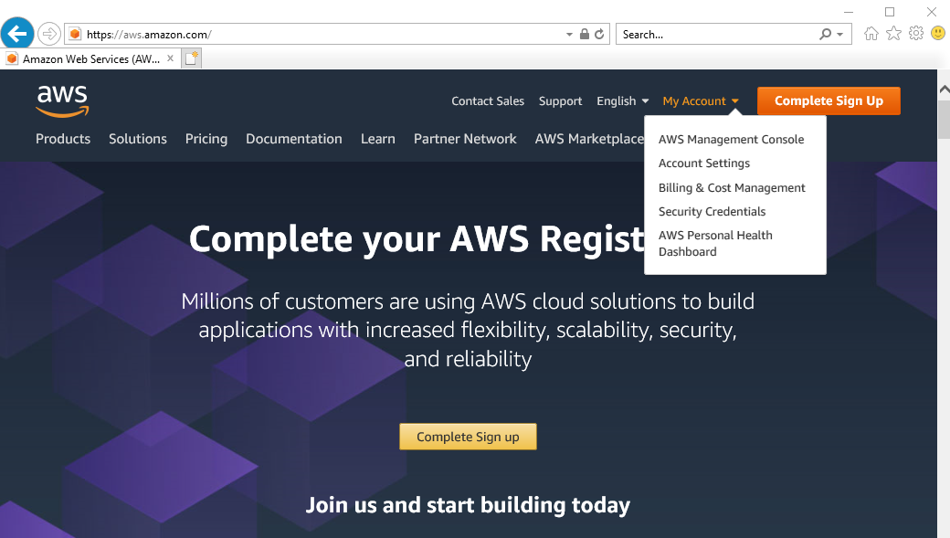

Logging into the Console
Use any web browser to go to https://aws.amazon.com
Select “My Account”, and select “AWS Management Console”

Slide 5
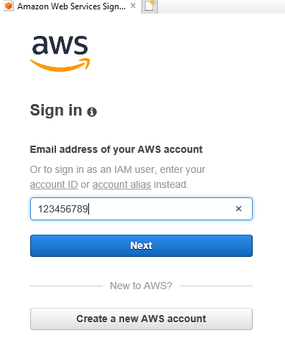
Logging into the Console
2. Enter your IAM account ID (will be provided to you). Click “Next”.

Slide 6
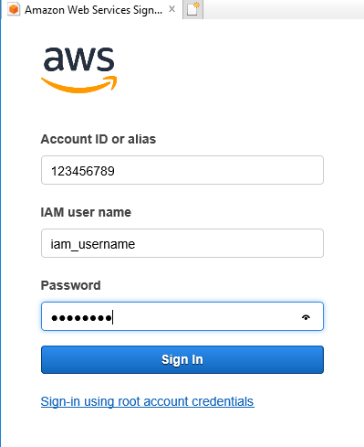
Logging into the Console
3. Enter the IAM user name and password that were given to you. Click “Sign In”.

Slide 7
Accessing the data
WARNING: The instructions in the following slides will give you access to the real database used by InsiderMemeBot. Accidental changes to the data can erase scores, or bring the bot down entirely!
Only make changes if you know for certain what you’re doing!

Slide 8
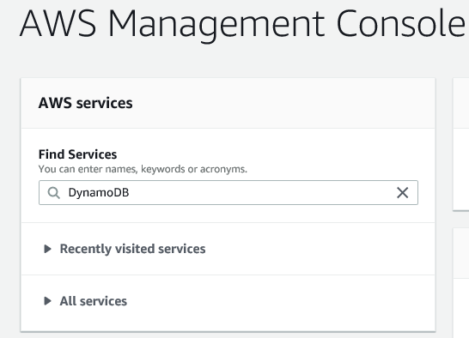
Accessing the data: Opening DynamoDB
In the AWS Management Console, enter “DynamoDB” in the “Find Services” field, and select the result that appears.

Slide 9
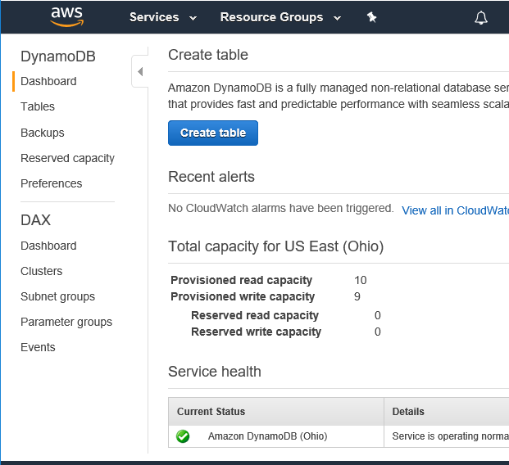

Accessing the data: Viewing the tables
Select “Tables” in the left-hand sidebar

Slide 10
Accessing the data: Selecting a table
In the tables list, select the table with the data that you want to view.
Tracking: Data for the posts that are currently being scored. Used by the bot to pick up where it left off in case of a crash or reboot
Users: Data that stores the usernames and scores of each subredditor. Values don’t include posts that are still being tracked, so values are 24-hours old.
TopPosts: Data for top-scoring examples and templates. Stores the highest scores from the last day, last week, last month, last year, and all time.
Tracking-dev, Users-dev, TopPosts-dev: Same as the tables without the –dev extension, but for use in development/beta testing of new features (This way data can be manipulated and tested without impacting real users and scores)
Vars: For future use, currently unused. Will be used to store arbitrary variables in the form of key/value pairs, for any miscellaneous need.

Slide 11
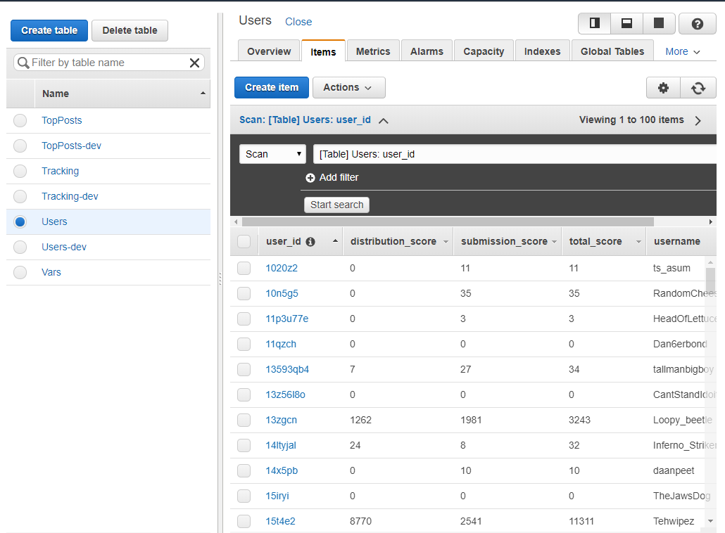

Accessing the data: Viewing the items
Select the “Items” tab to view the data.

Slide 12
Accessing the data: Viewing the items
If there are more than 100 items, press the arrow button on the right to view additional data.

Slide 13
Accessing the data: Viewing the items
You can sort the data by clicking on the columns to sort by.
Note: This will only sort the 100 items already being shown. Also, any integer values are sorted as strings, so the ordering would be “1”, “10”, “2”, etc. This feature is of limited usefulness.

Slide 14

Accessing the data: Searching and Querying
The “Scan/Query” feature can be used to locate specific data. Refer to the DynamoDB Documentation for more details: https://docs.aws.amazon.com/dynamodb/

Slide 15
The Users Table
The Users table is used to store score, ranking, and gift data for each user.
New entries are added to the Users table when a Redditor creates an account by either “!new”, or when an account is automatically created for a new user who posts a template to r/InsiderMemeTrading.
The “distribution_score”, “submission_score”, and “total_score” fields are updated when the last_update field for an item in the Tracking database exceeds the expire_time for that item. The score from that item are added to the columns as follow:
If “is_example” is True in the Tracking Item, then 80% of the score from that item is added to “distribution_score” column for the author of the example. 20% of the score is added to the “submission_score” for the author of the corresponding template.
total_score is updated to the sum of the new distribution_score and submission_score
The “distribution_score”, “submission_score”, and “total_score” fields are also updated when a user uses the “!gift” command.
Points are deducted from the giver’s User entry, and added to the User entry of the recipient. The gifted points are distributed evenly between distribution_score and submission_score whenever possible. If the gifted amount is an odd number, then the extra point is drawn from distribution_score. If the giver has insufficient points in one category, then the points are drawn from the other one.

Slide 16
The Users Table (Continued)
The “ranking” column is updated whenever InsiderMemeBot computes and posts a new scoreboard.
If a high-scoring post finishes tracking, and a user climbs up in the ranking, then the new ranking won’t be reflected until the next scoreboard post.
The “gifts” column is updated when a user uses the “!gift” command.
The column for the recipient and the sender are both updated
There is currently no mechanism, and no need, for the bot to remove items from the Users Table.

Slide 17
The Users Table: Fields
The Users table consists of the following fields:
user_id: The unique identifier used to identify a user. Not very useful for manual inspection.
distribution_score: The score that a user has gained from posting examples
submission_score: The score that a user has gained from submitting templates
total_score: The total score for the user (submissions + distribution)
ranking: Any ranking information for the user (Will be empty for new users, and populated when the next scoreboard is posted by InsiderMemeBot)
username: The Reddit username of the user
gifts: A dictionary storing information on when the user has received or sent gifts using the “!gift” bot command
attributes: For future use. Currently not used by InsiderMemeBot

Slide 18
The Tracking table
The Tracking table is used to store information on all posts that are <24 hours old, and are still having their scores monitored.
New entries are added to the Tracking table when one of the following occurs:
A new template is submitted to r/InsiderMemeTrading
A new example is posted by using the “!example” bot command in the comments.
The “last_update” and “score” fields in the Tracking Table are updated by InsiderMemeBot’s Tracker Process, which continuously cycles through all tracked templates and examples, using PRAW network requests to update the score.
Each network request can take up to several seconds, so when 100 items are being tracked it can take between 5 and 10 minutes for the Tracker process to complete an update cycle.

Slide 19
The Tracking table: Fields
The Tracking table consists of the following columns:
submission_id: The unique identifier of the post being tracked by the bot’s Tracker process. This can either be the post of a template, or the post of a linked example
author_id: The unique identifier for the user who created the post
bot_comment_id: The unique identifier of the bot’s top-level comment for a given submission. For posted examples, this is the ID of the comment on the associated template.
expire_time: The Unix epoch time at which the post will have its final score computed, and be removed from tracking.
is_example: A Boolean indication of whether the tracked item is an example or a template. (True = example, False = template)
last_update: The Unix epoch time at which the post was last updated by the bot’s Tracker process. Tracking is finished when last_update >= expire_time
permalink: The permalink to the posted template or example
score: The score of the tracked post as of last_update
template_id: For examples, this stores the unique identifier of the original template. Only applicable when is_example is true.
template_author: For examples, this stores the unique identifier of the original template’s author. Only applicable when is_example is true.
title: The title of the posted template or example

Slide 20
The TopPosts table
The TopPosts table is used to track the top-scoring examples and templates from:
The last day
The last week
The last month
The last year
All time
There are always exactly 5 items in the TopPost table: last_day, last_week, last_month, last_year, and all_time.
Each of these items stores the information for the relevant time period.
The TopPosts table is checked once per minute, and any “expired” items are removed.
For example, a high-scoring post that is 25 hours old would be removed from the “last_day” item, but can remain in the “last_week” item.
The dictionaries are always of the same length. Any “removed” item is replaced by a “No Data” placeholder, which is treated as an empty slot.
The TopPosts table is updated when a posted template or example is finished tracking.
If the post is an example, then the score is compared with the scores in the “examples” dictionaries in the TopPosts items.
If the post is a template, then the score is compared with the scores in the “submissions” dictionaries.
If the TopPosts dictionary is not yet full, then the post will simply be added, regardless of score.
If the score from the tracked example or template exceeds a score in one of the TopPosts items, then it will be added to the appropriate dictionary. If the dictionary is already at its maximum size, then the lowest scoring item will be removed.
The TopPosts “examples” and “submissions” dictionary both store more posts than what will actually be displayed on the scoreboard. This way, if a post expires from a list (i.e, a post from last_week becomes 8 days old), then it can be removed and the next-highest item will take its place.

Slide 21
The TopPosts table: Fields
The TopPosts table consists of the following columns:
key: One of
last_day
last_week
last_month
last_year
all_time
examples: A dictionary object that stores information for top-scoring examples
submissions: A dictionary object that stores information for top-scoring template submissions

