Slide 1

Insertion Sort
An overview, by Group 3

Slide 2
What is “Insertion Sort”?
Historically predates computing – humans instinctively use it to sort various items like playing cards.
First formally defined by John Mauchly in 1946 during the Moore School Lectures.
A sorting algorithm that works by iterating through the elements in the array and growing the final sorted version by comparing each element to the largest value in the sorted sub-list (which would be the previous element) and placing them in the correct order.

Slide 3
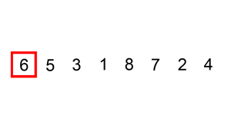
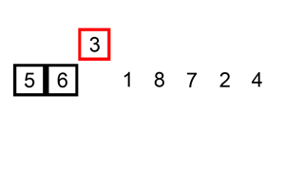
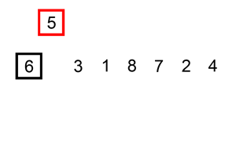
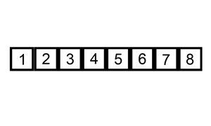
What is “Insertion Sort”?
Step 2
... Step n
Step 1

Slide 4


How does it work?
We go from left to right, element by element, and then divide the array internally into a sorted section (kept to the left) and the remainder of the array.
As we select an element, we compare it with the largest value in the sorted list (which would be its immediate predecessor) — if it’s larger, then there’s no inversion and we leave it as it is.
If it’s smaller (there’s an inversion), we shift every element in the sorted list to the right until we find a suitable position for it.

Slide 5
Okay...what’s an inversion?
An inversion between two elements in an array occurs when they’re not positioned in ascending order:
This array has 3 inversions: (3, 1), (3, 2), and (4, 2).
3 | 1 | 4 | 2 | 5

Slide 6
Let’s see an example?
Let’s have an array we’ll call A:
We make the sorted subsection include just the first element A[0], and we attempt to place the second, A[1]:
There’s an inversion, as 3 > 1, so we shift 3 to the right by swapping it with 1:
We’re at the left now, so we assume it’s solved and go on to the next element A[2]:
3 | 1 | 4 | 2 | 5
3 | 1 | 4 | 2 | 5
1 | 3 | 4 | 2 | 5
1 | 3 | 4 | 2 | 5

Slide 7
Let’s see an example?
There’s no inversion, because 3 < 4, so we extend the sorted portion into A[2]:
Next up is A[3]:
There’s an inversion because 4 > 2, so let’s shift 4 to the right:
Now comparing with the largest in the sorted list to the left of 2, which is 3, we see that there’s another inversion, and we shift 3 to the right:
1 | 3 | 4 | 2 | 5
1 | 3 | 4 | 2 | 5
1 | 3 | 2 | 4 | 5
1 | 2 | 3 | 4 | 5

Slide 8
Let’s see an example?
2 > 3, so we move on to the next element, A[4]:
There’s no inversion, and we’re at the end of the array, so we can conclude that it’s sorted!
1 | 2 | 3 | 4 | 5
1 | 2 | 3 | 4 | 5

Slide 9
We want a formal definition, please.
We can define this formally as:
Here, ⟵ denotes assignment, e.g. x ⟵ y means that the value of x changes to the value of y.
procedure insertion_sort (array: list of sortable items)
i ⟵ 1
while i < length(array)
j ⟵ i
while j > 0 and array [j - 1] > array[j]
swap array [j - 1] and array[j]
j ⟵ j - 1
end while
i ⟵ i + 1
end while
end procedure

Slide 10
Some code...perchance?
A C++ function that implements this algorithm could be written as:
The report has more code to handle user input etc., it’s omitted here for brevity.
// n is the length of arr[]
void insertionSort (int arr[], int n) {
for (int i = 1; i < n; i++) {
int val = arr[i];
int j = i - 1;
while (j >= 0 && arr[j] > val) {
arr [j + 1] = arr[j];
j -= 1;
}
arr[j + 1] = val;
}
}

Slide 11
Space complexity
The algorithm uses no additional memory — it works with the already allocated space for the array, so the auxiliary space complexity is O(1).
The total space complexity is O(n), as the space used increases linearly with the number of elements in the array.

Slide 12
Timeeeeeeeeeeee complexity
To calculate the time complexity, we need a way to quantify the “work done” in the algorithm.
The algorithm has two main loops:
procedure insertion_sort (array)
...
while i < length(array)
...
while j > 0 and array [j - 1] > array[j]
...
end while
i ⟵ i + 1
end while
end procedure
runs n times “let’s check if this element n is correctly positioned”
runs a variable number of times depending on the value of element n
“do we need to keep shifting element n to the left?”

Slide 13
Time complexity
The outer loop always runs n times, proportional to the number of elements in the array.
We can prove that swapping two elements can only decrease the number of inversions in the array – therefore if an array has 0 inversions, we can consider it sorted.
The “work done” by the algorithm can now be considered as:
T(n) = n comparisons + I swaps

Slide 14
Time complexity – Best case
The best case is an array that’s already sorted – there are 0 inversions.
In this case, our equation becomes:
T(n) = n + 0 = n
We can therefore conclude that we have a best running time of Ω(n) which is linear.

Slide 15
Time complexity – Worst case
The worst case would be an array sorted in reverse order, with the number of inversions:
If there’s 2 elements, there would be 1 inversion.
3 elements, 3 inversion
4 elements, 6 inversions
...and so on
We can deduce that for n elements, the maximum number of inversions is the n - 1th triangular number:
$$I = \frac{n(n - 1)}{2}$$

Slide 16
Time complexity – Worst case
Now our T(n) is:
$$T\left(n\right) = \left(n + \frac{n\left(n - 1\right)}{2}\right)$$
We can now infer our running time to be quadratic, i.e. O(n²).

Slide 17
Time complexity – Average case
Out of $$\frac{n(n - 1)}{2}$$ possible inversions, on average about half of them will be inverted (meaning they’ll need to be swapped), and half will not.
Our equation thus becomes:
$$T\left(n\right) = \left(n + \frac{n\left(n - 1\right)}{4}\right)$$
This still results in a quadratic running time - Θ(n²).

Slide 18
Real life applications
Educational Purposes: Insertion sort is often used as an introductory algorithm in computer science courses to teach the concept of sorting algorithms due to its simple logic and ease of understanding.
Online Algorithms: Its ability to work efficiently with live data makes insertion sort suitable for online algorithms. For instance, when continuously receiving new data elements and needing to maintain a sorted list, insertion sort can be effective as is capable of sorting data while receiving it.
Sorting a small list of numbers and datasets: Insertion sort is efficient for sorting a small list of numbers – most sorting implementations fall from quicksort to insertion sort once the number of elements dips below a certain threshold.

Slide 19
Image Attributions
https://www.pexels.com/photo/person-shuffling-playing-cards-9859348/
https://en.wikipedia.org/wiki/File:Insertion-sort-example-300px.gif
https://en.wikipedia.org/wiki/File:Insertionsort-before.png
https://en.wikipedia.org/wiki/File:Insertionsort-after.png

