Slide 1

Grade 7 Skills
Advanced Search Techniques
Find better answers online — the smart way!
Simple tips to search like a pro

Slide 2
What We’ll Learn Today
1
Why better searching helps
2
AND, OR, and NOT words
3
Quotes and star tricks
4
Cool Google tools
5
Where to search
6
Follow the book trail
7
Is this website true?
8
Try it yourself!
Advanced Search Tips · For Grade 7
2 / 10

Slide 3

Why Search Skills Matter
Searching isn’t just typing words!
• Google shows millions of results.
• Many of them are ads or junk.
• Smart search = better homework help.
• You save time and find real facts.
• This skill helps you forever!
Advanced Search Tips · For Grade 7
3 / 10

Slide 4
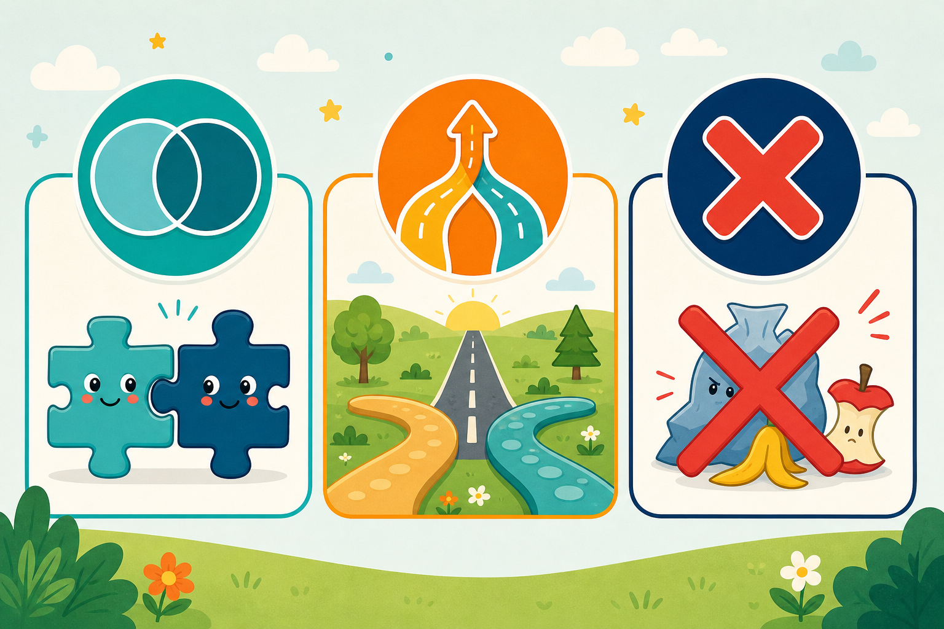
Magic Words: AND · OR · NOT
Think of it like this:
• AND = both words must show up
• OR = either word is okay
• NOT = don’t show me that!
AND
OR
NOT
Puts ideas together
Gives you more choices
Takes something away
dogs AND training
kids OR children
jaguar NOT car
Advanced Search Tips · For Grade 7
4 / 10

Slide 5

Quotes " " and the Star *
Use quotes for exact words
"global warming" This keeps the words stuck together — in that exact order.
Use a star * for word endings
teach* Finds: teach, teacher, teaching, teachers… all at once!
Advanced Search Tips · For Grade 7
5 / 10

Slide 6

Cool Google Tricks
site:.edu
Search school websites
filetype:pdf
Find PDF files only
intitle:
Word must be in the title
-word
Hide a word you don’t want
Advanced Search Tips · For Grade 7
6 / 10

Slide 7

Where Should You Search?
Google
Good for everyday questions
Google Scholar
Better for school research papers
Library / databases
Books & articles your school trusts
Kid-safe sites
.edu, museums, NASA, Britannica
Advanced Search Tips · For Grade 7
7 / 10

Slide 8

Follow the Trail of Good Sources
Found one great article?
• Look at its Sources or References.
• Those books and links can help too!
• In Google Scholar, click “Cited by.”
• That shows newer papers that used it.
• It’s like a treasure map of ideas!
Advanced Search Tips · For Grade 7
8 / 10

Slide 9

Stop! Can You Trust This?
Who made it?
A teacher, scientist, or just a random blog?
Is it true?
Does it give facts and sources?
Is it fresh?
Old news may not help anymore.
Why was it made?
To teach you — or to sell you something?
Advanced Search Tips · For Grade 7
9 / 10

Slide 10
Your Turn — Try These!
"solar system" planets filetype:pdf
Find school-style PDFs
volcanoes AND eruption site:.edu
Only education sites
frogs OR amphibians -poison
More results, skip poison frogs
intitle:"water cycle" kids
Title must say water cycle
Remember: Smart searches = better answers. You’ve got this!
Advanced Search Tips · For Grade 7
10 / 10

