Slide 1
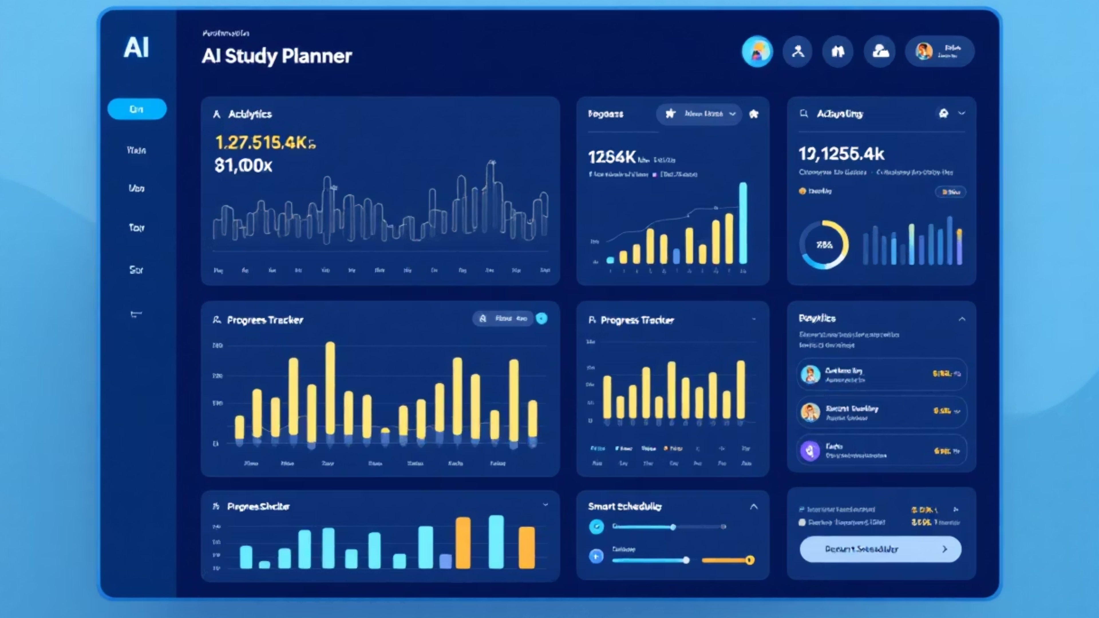
AI Study Planner Dashboard
Transforming Academic Productivity Through Intelligent Study Management
Presented by Vamsi and team

Slide 2

Dashboard Overview
The AI Study Planner Dashboard is your central hub for academic success, offering a comprehensive and intuitive platform to manage your educational journey.
Comprehensive Study Tracking
Monitor all your academic activities, including assignments, deadlines, and study sessions, in one unified view.
Intelligent Analytics
Leverage AI-driven analysis to understand your study patterns, identify strengths, and pinpoint areas needing more focus.
Personalized Insights
Receive tailored recommendations and adaptive learning paths designed to optimize your individual learning style and pace.
Progress Optimization
Continuously refine your study strategies and habits to maximize efficiency and achieve superior academic performance.

Slide 3
Key Metrics at a Glance
247
85%
6
12
Total Study Hours
Completion Rate
Active Subjects
Achievements Unlocked
Time invested in learning
Overall task accomplishment
Currently engaged courses
Badges earned for progress

Slide 4




Why Choose AI Study Planner Dashboard?
Discover the unparalleled advantages our AI-powered platform offers to students, educators, and productivity enthusiasts alike.
Elevate Academic Performance
Maximize Time Optimization
Utilize adaptive learning paths, targeted practice, and AI feedback to significantly improve understanding and achieve higher grades.
Automate schedule creation, prioritize tasks, and minimize distractions, ensuring every study session is highly productive and efficient.
Alleviate Study Stress
Harness Data-Driven Insights
Gain peace of mind with a clear overview of deadlines, balanced workloads, and predictive insights that prevent last-minute cramming.
Receive personalized analytics on your progress, identify learning gaps, and adapt your strategies for continuous, informed improvement.

Slide 5




Transform Your Study Experience Today
Ready to elevate your academic journey? The AI Study Planner Dashboard is your essential partner for unprecedented success.
Sign Up Now
Explore Features
Create your free account in minutes and begin your path to optimized learning and higher grades.
Dive into personalized analytics, smart scheduling, and adaptive learning paths that cater to your unique needs.
Get In Touch
Have questions or need assistance? Our dedicated support team is here to help you every step of the way.

Slide 6
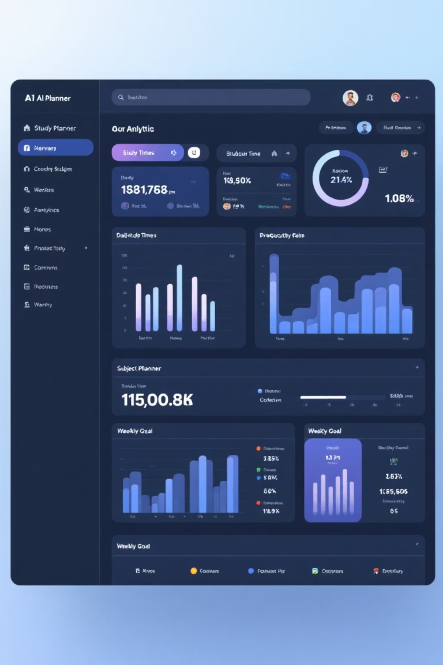
Weekly Study Analytics
Dive deeper into your learning habits with detailed weekly breakdowns, helping you understand and optimize your study routine for maximum effectiveness and consistent academic growth.
Daily Time Tracking
Visualize your study duration each day to maintain consistency and ensure adequate time investment across all your learning activities.
Productivity Insights
Discover your personal peak productivity hours by analyzing when you are most focused and effective, allowing for optimized scheduling.
Balanced Learning
Gain insights into your subject rotation to ensure comprehensive coverage across all courses, preventing neglect and promoting holistic understanding.
Goal Attainment
Monitor your progress against weekly study goals, celebrating achievements and making necessary adjustments to stay on track.

Slide 7
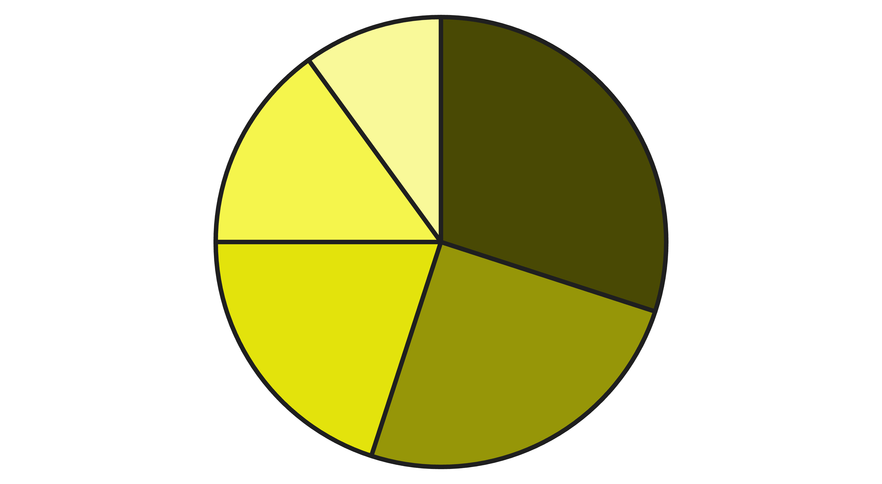
Subject Management & Task Distribution
Efficiently organizing your academic commitments is crucial for success. Our dashboard provides robust tools to manage subjects and tasks, ensuring nothing falls through the cracks.
Subject Priority Ranking
Task Categorization
The AI automatically prioritizes subjects based on upcoming deadlines, personal performance, and instructor-assigned importance.
Categorize tasks into assignments, readings, practice problems, and projects for a clear and organized study plan.
Dynamic Deadline Management
Intelligent Workload Balancing
Visualize all deadlines at a glance and receive smart reminders to keep you on track without last-minute stress.
Get personalized recommendations to distribute your study load evenly across subjects, preventing burnout and promoting consistent learning.
Below is an example of a typical subject breakdown, illustrating how your study time and tasks are distributed across different courses, ensuring a balanced academic focus.
Science
Mathematics
Literature
History
Electives
This chart represents a student's workload distribution, with Science and Mathematics accounting for the largest portions, while Literature, History, and Electives comprise the remainder. This visual helps in understanding where the most effort is directed.

Slide 8





Upcoming Study Sessions & Smart Scheduling
Our dashboard revolutionizes your study routine with intelligent scheduling, ensuring every minute counts towards your academic success while preventing burnout.
AI Session Recommendations
Receive personalized study session suggestions based on your learning patterns and academic goals for optimal efficiency.
Seamless Calendar Sync
Integrate effortlessly with your existing digital calendars, bringing all your commitments into one unified, manageable view.
Optimal Study Time Alerts
Leverage AI to identify and suggest your most productive hours, maximizing retention and minimizing wasted effort.
Automated Break Planning
Intelligently schedule restorative breaks to combat fatigue and maintain peak concentration throughout your study sessions.

Slide 9





Achievement System & Progress Motivation
Our dashboard gamifies your learning journey, transforming study into an engaging quest. Unlock milestones, earn rewards, and celebrate every step forward to cultivate lasting study habits.
Milestone Tracking
Badge Rewards
Visualize your journey towards larger academic goals with clear, achievable milestones that keep you focused and motivated.
Earn unique digital badges for mastering subjects, completing challenges, and demonstrating consistent effort, celebrating your accomplishments.
Streak Counters
Progress Celebrations
Maintain consistent study habits with daily streak counters, encouraging continuous engagement and building discipline over time.
Get recognized for your efforts! Automated celebrations acknowledge your achievements, boosting morale and reinforcing positive study behaviors.
By integrating these gamified elements, the AI Study Planner Dashboard turns learning into a rewarding experience, driving continuous improvement and helping you build strong, enduring study habits.

Slide 10

Thank You!
The AI Study Planner Dashboard transforms academic productivity through intelligent analytics, smart scheduling, and personalized insights, making your learning journey more engaging and effective.
"The beautiful thing about learning is that no one can take it away from you." - B.B. King
Contact Us
Email
Phone
support@aistudyplanner.com
+1 (555) 123-STUDY

