Slide 1
Cricket Batsmen Salary Prediction

Slide 2
Overview
Pain Point:Predicting cricket batsmen salary based on his batting average
Existing System:Using player stats as factors those are batting average,total runs,no of matches he played,strike rate
Proposed system:By using above defined factors we solve the problem

Slide 3
DATASET:(name of cricketer,no of matches,batting ave,salary,strike rate,no of 100 and no of 50)
Business Usecase:cricket board can able to fix salaries of cricket batsmens based on their stats
Target Variable:we target on only batting average
Categorised Variable:we have variables like no of matches and strike rate and total runs

Slide 4
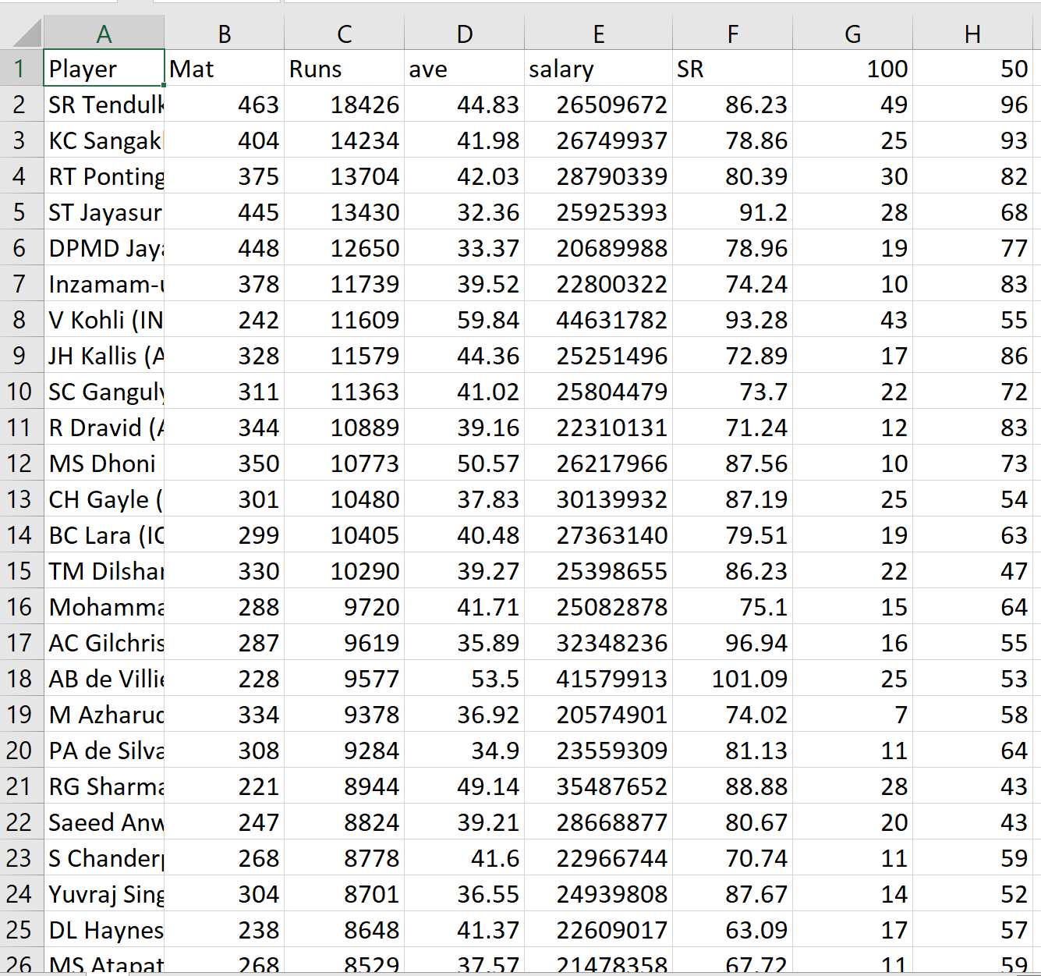

Slide 5
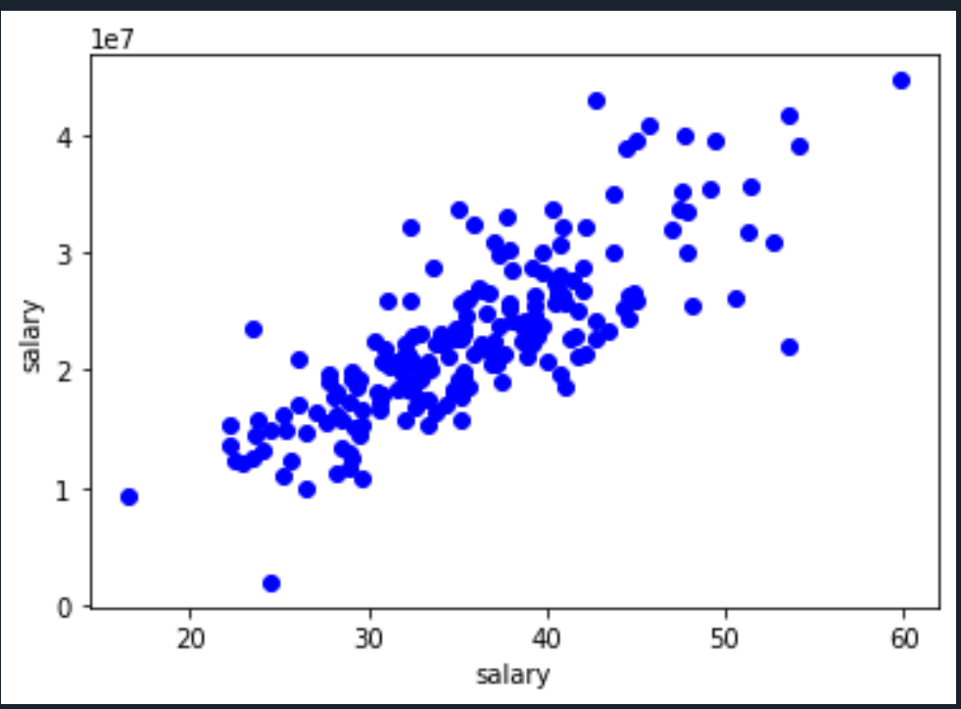
Observations

Slide 6
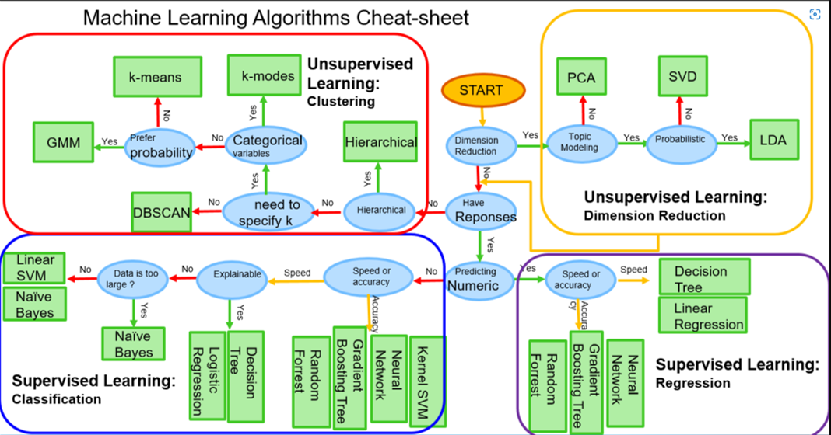
model Selection

Slide 7
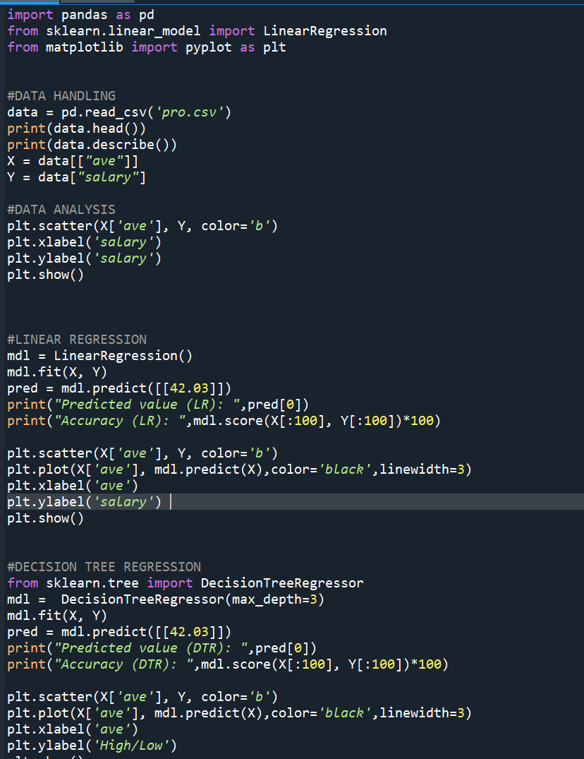
Code:

Slide 8
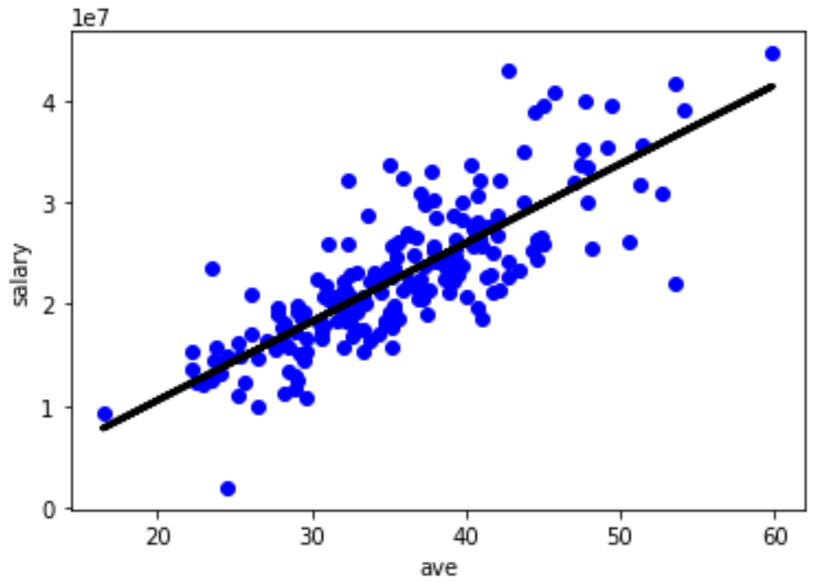
Result

Slide 9
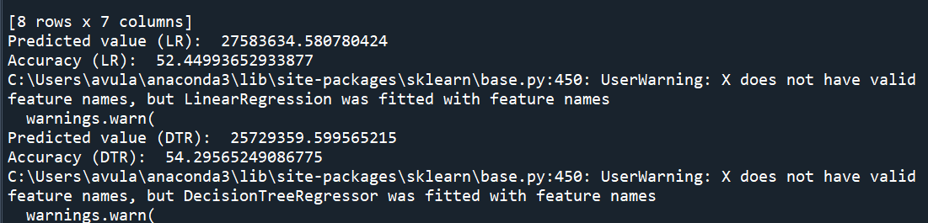
Output:

