Slide 1

23AID113
Elements of Computing 2
HackTwin: A Digital Twin Framework for Hack CPU & HDL Hardware Designs
Automated Telemetry Extraction, Persistence, Bottleneck Analysis, and Design Comparison
TEAM-14:
Boyilla Charan Teja Reddy
Poornashree P
Thulasiram Sudheeswar Reddy
Harshitha Tippireddy
[CB.AI.U4AAR25011]
[CB.AI.U4AAR25036]
[CB.AI.U4AAR25053]
[CB.AI.U4AAR25054]

Slide 2
PROBLEM STATEMENT & MOTIVATION
The HDL Verification Challenge:
Evaluating Computer Architecture (HDL) designs requires executing standard benchmark programs across successive design iterations.
Each iteration must be simulated and its performance captured before the next design change can be evaluated, and this becomes harder to manage as the number of design variants grows.
.
Raw Trace — Manual Inspection Pain Point
time reset AReg DReg PC[] RAM[0] RAM[1] RAM[2]
0 0 0 0 0 0 0 0
1 0 2 0 1 0 0 0
2 0 2 2 2 0 0 0
3 0 3 2 3 0 0 0
4 0 3 5 4 0 0 0
5 0 0 5 5 0 0 0
6 0 0 5 6 5 0 0
7 1 0 5 0 0 0 0
8 0 2 5 1 0 0 0
Workflow Challenges Addressed by HackTwin:
Manual Trace Inspection: manually parsing cycle-by-cycle simulator .out files is slow, error-prone, and fundamentally unscalable.
Limited Persistence: telemetry from earlier design revisions is routinely discarded, leaving regression tracking without a historical baseline.
Lack of Automated Root-Cause Attribution: isolating performance penalties — register churn, PC loop spinning, RAM write contention — still relies on painstaking manual debugging

Slide 3
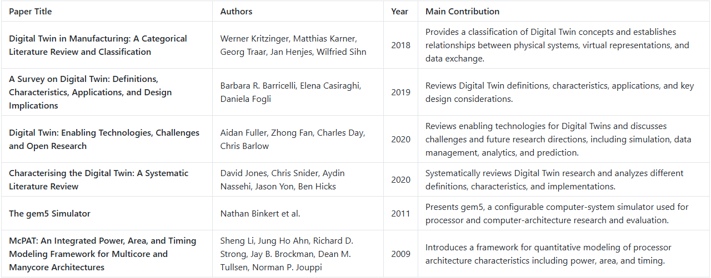
LITERATURE REVIEW

Slide 4
PROPOSED SOLUTION & CORE OBJECTIVES
HackTwin Solution:
An integrated 8-phase Digital Twin platform for Hack Computer HDL designs, enabling automated simulation, telemetry collection, analysis, comparison, and future performance prediction.
Core Objectives:
Headless Execution & Extraction:
Batch-simulate HDL designs through the nand2tetris Hardware Simulator and capture cycle-level hardware signals.
Versioned Telemetry Store:
Persist normalized simulation telemetry in an indexed SQLite database with design revision and lineage tracking.
Automated Bottleneck Analysis:
Analyze execution traces to identify instruction hotspots, PC loops, register churn, and memory-write bottlenecks.
Root-Cause Diagnostics:
Convert low-level execution telemetry into actionable diagnostic insights about potential performance bottlenecks.
Multi-Design Comparison:
Compare CPU design variants using cycle counts, telemetry differences, output agreement, and efficiency metrics.
Design Ranking :
Provide quantitative performance and efficiency rankings across different CPU implementations.
Predictive Performance Layer:
Develop an analytical/ML model to predict execution cycles and performance trends from historical twin telemetry.
Visualization & Decision Support:
Provide an interactive dashboard for trace visualization, bottleneck analysis, and design comparison.

Slide 5
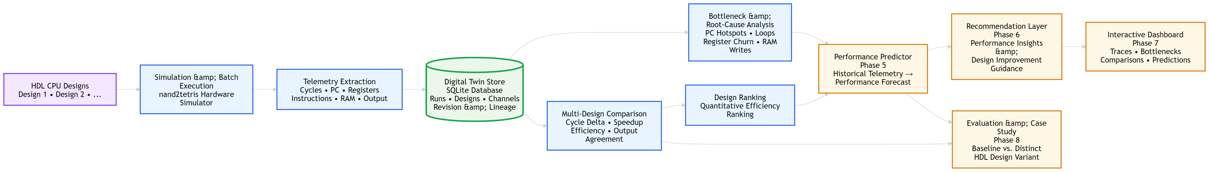
OVERALL SYSTEM ARCHITECTURE
Complete Phase 0 to Phase 8 end-to-end Digital Twin flow, from raw HDL designs to simulation batch runner, JSONL parser, SQLite twin store, analytics engines, predictor, and dashboard UI.

Slide 6
METHODOLOGY & IMPLEMENTATION WORKFLOW
Define the Experimental Setup:
Establish a standardized set of Hack CPU benchmark programs and define the execution parameters and telemetry required for evaluation.
Execute HDL Designs:
Run each CPU design against the benchmark suite using the nand2tetris Hardware Simulator in an automated and repeatable environment.
Collect Execution Telemetry:
Capture cycle-level execution information, including program counter, instructions, registers, memory accesses, and program outputs.
Construct the Digital Twin:
Normalize the collected simulation data and maintain it as a persistent representation of each HDL design, including design identity and revision lineage.
Analyze System Behaviour:
Mine the stored execution traces to identify recurring execution patterns and potential cycle, register, and memory bottlenecks.
Compare Design Variants:
Evaluate different HDL implementations using their observed execution behaviour and quantitative performance metrics to determine relative efficiency.
Derive Performance Insights:
Use the accumulated Digital Twin data as the basis for performance prediction and design-improvement insights.
Visualize and Validate Results:
Present the collected telemetry and analysis through a visualization layer and evaluate the framework using standardized benchmarks and distinct HDL design variants.

Slide 7
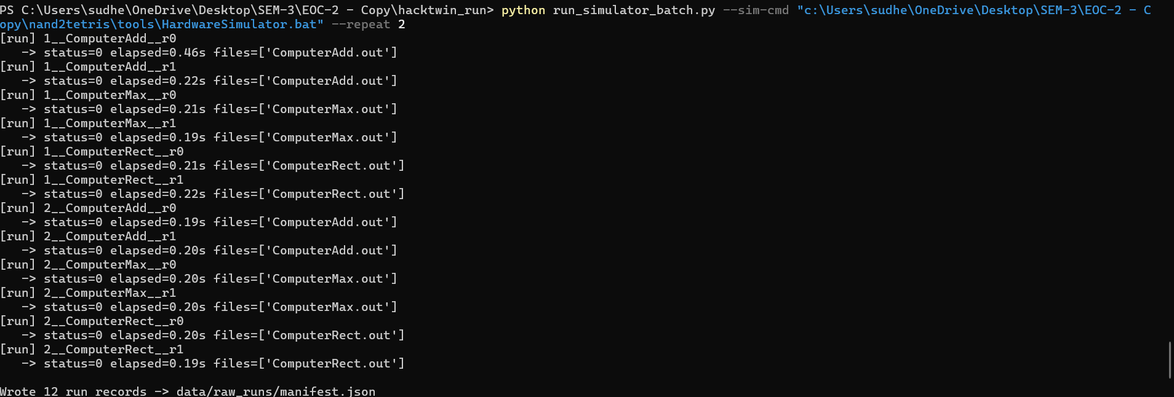
PHASE 1: SIMULATOR INTEGRATION
Headless Batch Runner (run_simulator_batch.py): sandboxes HDL chips (CPU.hdl, ALU.hdl, Memory.hdl, Computer.hdl) and .tst/.hack benchmarks.
Uses the nand2tetris Hardware Simulator batch interface with --repeat 2 determinism checks.
Trace Parsing & Normalization (parse_simulator_output.py): deduplicates tick/tock half-cycles into settled clock states.
Extracts per-cycle Program Counter (PC[]), ARegister, DRegister, and RAM cell transitions (RAM16K[N]).

Slide 8
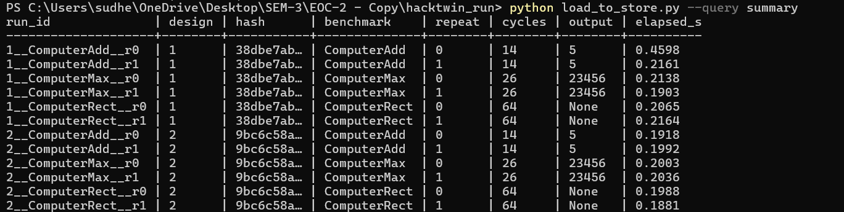
PHASE 2: DIGITAL TWIN TELEMETRY STORE
Relational Storage Engine (twin_store.py, load_to_store.py): embedded SQLite store (data/hacktwin.db) with zero external pip dependencies.
3-Table Schema: designs (ID, hdl_source_hash, parent_design_id), runs (metadata, cycle count, output, traces), channels (multi-output script details).
Lineage Tracking: enables ancestry traversal (parent_design_id chain) to track evolution across design revisions (v1 → v2 → v3).

Slide 9
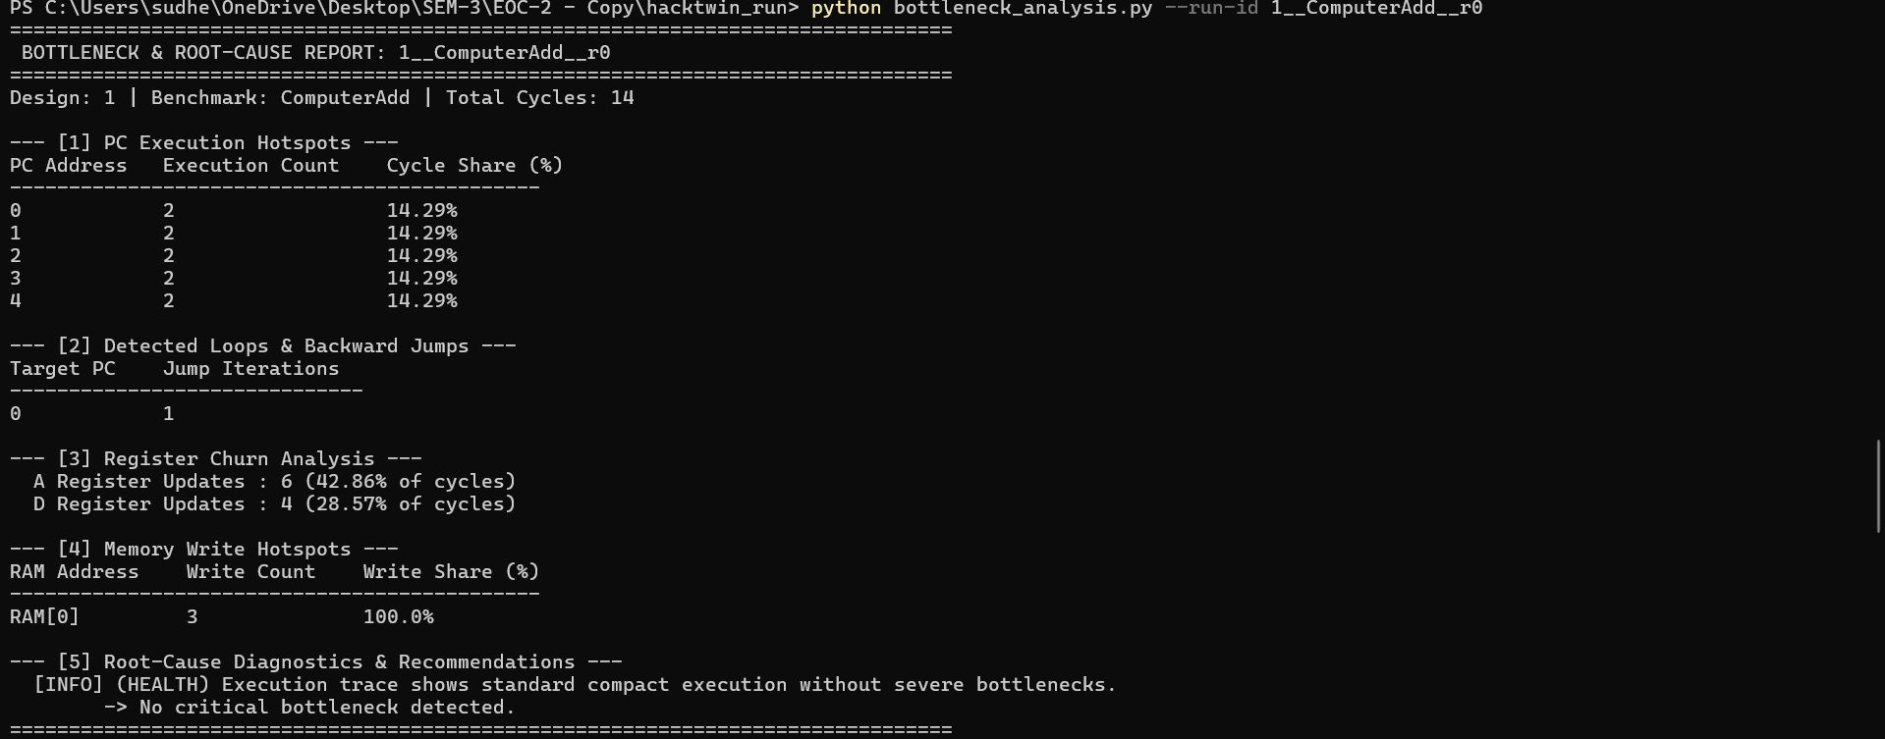
PHASE 3: BOTTLENECK & ROOT-CAUSE ENGINE
Analytics Engine (bottleneck_analysis.py)
PC Execution Hotspots: identifies top executed instruction addresses and cycle share (%).
Loop Detection: pinpoints backward jumps and self-loop execution cycles.
Register Churn Rate: measures A and D register update frequencies (% of execution cycles).
Memory Write Hotspots: identifies high-density RAM write locations (e.g. RAM[0], RAM[2], Screen memory).
Automated Diagnostics: evaluates trace health and flags actionable optimization recommendations.

Slide 10
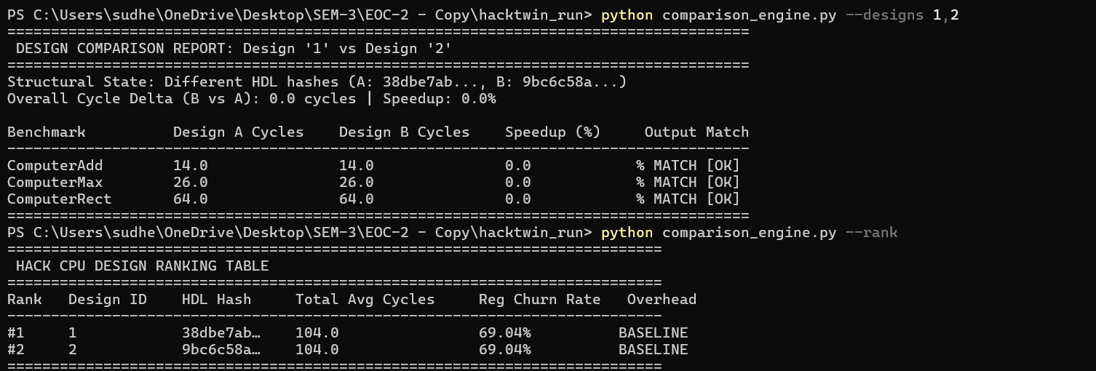
PHASE 4: COMPARISON ENGINE & RANKER
Comparative Analysis Engine (comparison_engine.py)
Speedup & Delta Analysis: calculates cycle differences, speedup percentages, and execution time variance between designs.
Output Agreement Verification: validates that design variants produce bit-exact program outputs.
Structural Differentiation: detects HDL source differences using content hashes across design iterations.
Composite Design Ranker: ranks CPU designs across benchmark suites based on cycle efficiency and register churn.
Validation Note
Baseline validation executed using byte-for-byte identical design copies (designs/1 & designs/2), confirming pipeline determinism; architectural speedup evaluation awaits a distinct HDL design variant.

Slide 11
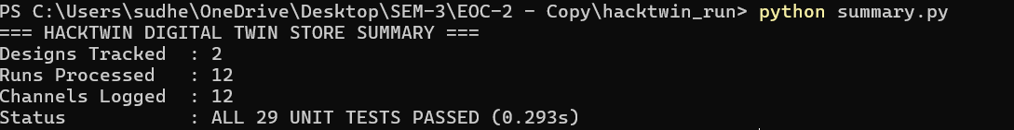
EXPERIMENTAL RESULTS & LIVE TELEMETRY VERIFICATION
Verification on HDL Simulation Runs: executed across 2 design copies × 3 nand2tetris benchmarks × 2 repeats = 12 full runs.
Program Output Verification: ComputerAdd = 5 (RAM[0]), ComputerMax = 23456 (RAM[2]), ComputerRect = null (Screen RAM).
Live Empirical Telemetry & Unit Test Suite: 29 passing unit tests across test_twin_store, test_bottleneck_analysis, and test_comparison_engine (0.293s execution).
Benchmark | Design 1 Avg Cycles | Design 2 Avg Cycles | Output Match | Test Status
ComputerAdd | 14.0 | 14.0 | MATCH (5) | PASSED
ComputerMax | 26.0 | 26.0 | MATCH (23456) | PASSED
ComputerRect | 64.0 | 64.0 | MATCH (Screen RAM) | PASSED

Slide 12
WORK TO BE DONE
Phase 5 — Performance Predictor: build an analytical/ML model to project cycle counts for unseen benchmarks or scaled parameters based on twin store history.
Phase 6 — Recommendation Generator: automated rule-based engine suggesting specific HDL optimizations based on bottleneck diagnostic findings.
Phase 7 — Dashboard & Visualization UI: web/CLI visualizer for interactive cycle traces, bottleneck charts, and design comparison tables.
Phase 8 — Evaluation Case Study: comprehensive evaluation comparing a baseline CPU against a distinct optimized microarchitectural variant.

Slide 13
SUMMARY & CONCLUSION
Current Project Status
Phases 0–4 Implemented — Phases 1–3 Verified End-to-End; Phase 4 Comparison Pipeline Implemented (meaningful comparative evaluation pending a distinct HDL variant).
Key Deliverables Completed
Headless batch simulation pipeline (Phase 1), SQLite Digital Twin Store with design lineage (Phase 2), Automated Bottleneck Analyzer (Phase 3), Multi-Design Comparison & Ranking Engine (Phase 4), 29 automated unit tests.
Next Steps
Phase 5 (Performance Predictor), while introducing a distinct HDL microarchitectural variant to enable meaningful Phase 4 comparison and Phase 8 evaluation.

Slide 14
Thank You

