Slide 1
Quantum-Assisted Health Analysis for Pathology with AI-Driven Data Analysis and Secure Web3 Storage
By team Tech Trekkers

Slide 2

Steps in our Implementation Stage
Implement Quantum Computing Modules.
Develop User Interfaces
Develop Blockchain Components
Integrate Web3, Blockchain, and Quantum Components
Implement Backend Logic

Slide 3
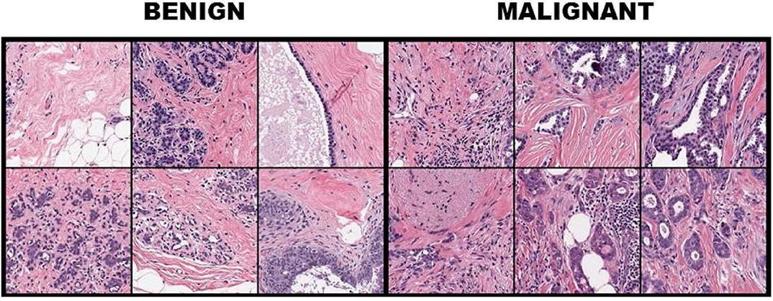
Introduction - Analysis of cell and behaviour
The analysis of pathological (study of abnormal or diseased cells) phenotypes plays a key role in cancer research and medicine; it remains a challenge to deﬁne these phenotypes.
These analyses are vital to link molecular mechanisms with disease prognosis.
Owing to the complexity of cancer, its different morphologies, spatial arrangements and behaviors : multiscale pathology features need to be extracted using deep learning methods.
A hybrid Ǫuantum Computing approach increased the accuracy of pathological
cancer classiﬁcation.

Slide 4
Implement Quantum Computing Modules
Quantum Model Selection : We utilize a hybrid classical-quantum neural network (QNN) model.
PennyLane: Quantum Circuit can be created by PennyLane using the QNN Reference : https://docs.pennylane.ai/projects/lightning/en/stable/lightning_gpu/device.html https://pennylane.ai/qml/demos/tutorial_learningshallow/

Slide 5
Quantum Device : Lightning GPU Reference : https://docs.pennylane.ai/projects/lightning/en/stable/lightning_gpu/device.html\
Hybrid Model Integration : Integrating the classical CNN with the quantum circuit to form a hybrid classical-quantum neural network model.
Training and Optimization : Training over 2 Lakh+ data consisting dataset size as 7 GB takes more time to train . We test model with Test cells[images] to predict the accuracy of Model.

Slide 6

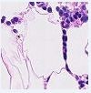
Dataset preparation
Dataset was taken from Kaggle : https://www.kaggle.com/competitions/histopathologic-cancer-detection/data
A cancerous image A non cancerous image
The whole dataset contains 220,025 images. It is divided into train set (75%) and validation set (25%).
Train Set: 165,018, Validation Set: 55,007.

Slide 7
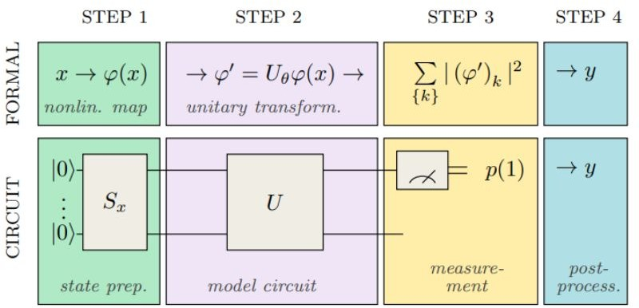
Quantum model
The quantum model contains 4 parts
The State preparation circuit which prepares the initial state to be passed.
The Ǫuantum model which contains the below components.
The Embedding circuit, which converts from classical to Hilbert space.
The Ansatz, which is the model with trainable parameters.
The Measurement circuit which converts back from Hilbert space to classical
The post processing circuit.

Slide 8
2 . Developing User Interfaces
Our application is a web-based platform that combines cutting-edge technologies from both the quantum computing and blockchain domains to revolutionize healthcare analysis and diagnosis. The platform serves as a bridge between medical professionals (doctors) and patients, facilitating efficient and accurate analysis of cellular data and health predictions.

Slide 9
Flask -> We use flask , a Web framework for building web applications and APIs
Django (for backend)
HTML/CSS/JavaScript (for frontend)
Web3js : To interact with the Ethereum blockchain and decentralized data storage from users .

Slide 10
Functionality for Doctors:
Cellular Analysis: Doctors can upload cellular images and analyze them using our quantum computing model. The model processes the images and provides detailed insights into cellular structures, abnormalities, and potential health indicators.
Health Predictions: Based on the analysis results, our model generates personalized health predictions for patients, enabling doctors to make informed decisions about treatment plans and preventive measures.

Slide 11
Functionality for Patients:
Viewing Results: Patients can securely access their health predictions and diagnostic results through the platform. This empowers them to stay informed about their health status and collaborate effectively with their healthcare providers.
Monitoring Health: By regularly monitoring their health predictions and diagnostic data, patients can take proactive steps to manage their well-being and seek timely medical attention when necessary.

Slide 12
3.BlockChain Components
i ) Solidity : To implement the backend smart contract functionality for our healthcare application on the Ethereum blockchain, we'll need to write Solidity code.
ii ) Integration with Web3 : We use Web3.js to send transactions to the Ethereum network. This includes sending Ether between accounts, deploying new smart contracts, and calling functions on existing smart contracts. iii ) An basic overview of how we will implementation Smart Contract using solidity

Slide 13
Smart Contract implementation idea
// SPDX-License-Identifier: MIT
pragma solidity ^0.8.0;
contract HealthPrediction {
// Define struct to represent a health prediction
struct HealthPrediction {
address doctor; // Address of the doctor who made the prediction
string prediction; // Health prediction made by the doctor
}
// Mapping to store health predictions associated with patient IDs
mapping(string => HealthPrediction) public predictions;
// Event to log when a new health prediction is made
event NewPrediction(string indexed patientId, address indexed doctor, string prediction);
// Function to make a new health prediction
function makePrediction(string memory patientId, string memory prediction) public {
// Store the prediction in the mapping
predictions[patientId] = HealthPrediction(msg.sender, prediction);
// Emit an event to log the new prediction
emit NewPrediction(patientId, msg.sender, prediction);
}
// Function to retrieve a patient's health prediction
function getPrediction(string memory patientId) public view returns (address, string memory) {
// Retrieve and return the prediction associated with the patient ID
HealthPrediction memory prediction = predictions[patientId];
return (prediction.doctor, prediction.prediction);
}
}

Slide 14
The HealthPrediction contract defines a data structure to represent a health prediction made by a doctor, including the doctor's address and the prediction text.
ft defines a mapping called ‘predictions’ to store health predictions associated with patient IDs. Each patient ID is mapped to a ‘HealthPrediction’ struct.
The ‘makePrediction’ function allows a doctor to make a new health prediction for a patient by specifying the patient ID and the prediction text. The prediction is stored in the ‘predictions’ mapping.
The ‘NewPrediction’ function allows anyone to retrieve a patient's health prediction by providing the patient ID. It returns the doctor's address and the prediction text associated with the patient ID.

