Slide 1
Presented by:
Team Four nought four

Slide 2
Team members:
1.Poornachandra kashi
2.Rakshith
3.Anand teertha

Slide 3
ARCADE 360 [Offline Gaming]
“Offline gaming to de-stress”

Slide 4
Problem statement-
>How many of you have used Google Chrome and played the T-Rex game?
>The competition for online games is saturated.
Stats reported 20 billion flows for over 5k+ games.
>Compared to this , apart from standalone , computational intensive games , we have 1 offline game that can run without any MSI setup.

Slide 5
>The problem we are trying to solve
is boredom.
>We are creating games carefully crafted to get users to indulge in some refreshing , entertaining games. All offline , with no dependencies other than you browser.
>You can stop that endless loop of doing your
work , stressing out and then redirecting to
a post about how baby guinea pigs have a
natural craving for carrots in your break time.

Slide 6
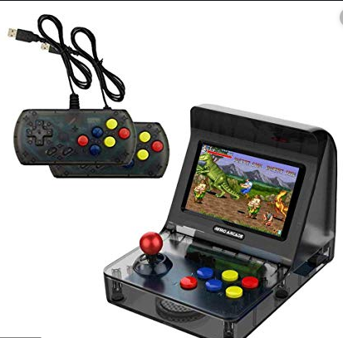
ARCADE
Meant to be played offline.
Refreshes mind.
Offline time for you to unwind and get back concentration.

Slide 7

>Currently no other alternative extension/product for offline gaming.
>Games are built using frameworks like Construct 2
and Phaser ingestible by the Facebook gaming platform.
>360 images are captured using MI camera.

Slide 8

>We play Fortnite a lot,so we know how important it is to cater to colour blindness.
>One in twelve men,and one in two hundred women suffer from colour blindness.

Slide 9
AR that supports the people who
dont have both the hands can now
Type like a pro.
We have used the face tracker feature that is available in spark ar to build this module.

Slide 10
THANK YOU.

