Slide 1
Classification of Standard FASHION MNIST Dataset Using Deep Learning Based Algorithms
By Team 4
Gayathri Patel
Poornashree Ganapathi Subramanian

Slide 2
Introduction
Image classification is a crucial aspect of computer vision, involving the automated categorization of images into predefined classes or labels.
Artificial Neural Networks (ANN) and Convolutional Neural Networks (CNN) are advanced machine learning techniques used to extract distinctive features from images.
CNN, known for its hierarchical architecture, uses Convolutional layers to extract features from input data, capturing spatial hierarchies and enabling robust pattern recognition.
Both ANN and CNN have revolutionized image-related tasks, exhibiting exceptional performance in image classification, object detection, and facial recognition.
This study evaluates the effectiveness of both models on the Fashion MNIST dataset for classifying clothing articles.

Slide 3
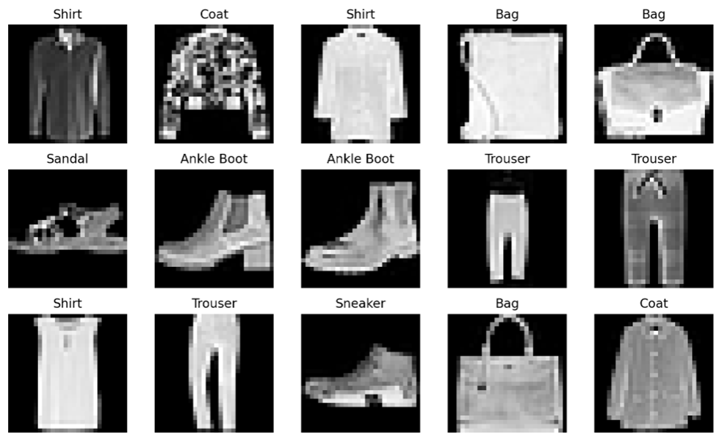
Dataset
Fashion-MNIST is intended as direct drop-in replacement for the original MNIST dataset. It shares the same image size and structure of training and testing splits.
Fashion-MNIST is a dataset consisting of 70000 grayscale images with a training set of 60,000 examples and a test set of 10,000 examples. Each example is a 28x28 grayscale image, associated with a label from 10 classes.
Every image in the dataset belong to one of the 10 classes, which includes T-shirt/top, Trouser,Pullover,Dress,Coat,Sandal,Shirt,Sneaker,Bag,Ankle boot.

Slide 4
Methodology
Dataset doesn’t have any missing values or corrupted images which makes it easier to use for our analysis. Data normalization is crucial for image classification as it ensures consistent feature scales, preventing dominance by certain features.
We have implemented both ANN and CNN on the fashion mnist dataset. Artificial Neural Network (ANN) is motivated by its capability to capture intricate patterns within the data.
As a second choice, a Convolutional Neural Network (CNN) is used, because of its specialization in image-related tasks and its efficient handling of spatial hierarchies of features through shared weight parameters.

Slide 5
Artificial Neural Network
The ANN comprised with fully connected layers with input size 784 neurons, corresponding to the flattened 28x28 images.
Network is then trained for 25 epochs with a batch size of 64 using the ReLU activation function and Adam optimizer with a learning rate of 0.003.
Layers in ANN:
Fully Connected Layer: The primary purpose of this layer is to introduce non-linearity and allow the network to learn complex patterns in the data.
Dropout Layer:Dropout layers are utilized for regularization to prevent overfitting by randomly dropping a fraction of neuron activations during training.
Output Layer/Softmax Layer: LogSoftmax layer is applied to produce class probabilities as the output.

Slide 6
Convolutional Neural Network
The CNN consists of a convolutional block followed by a dense block.
Network is trained for 25 epoch with a batch size of 128 using the ReLU activation function and Adam optimizer with a learning rate of 0.001.
The batch size was increased to 128 from the 64 to allow for larger batch-normalized parameter updates to speed up training.
Layers in CNN:
Convolution Layer: The primary purpose of Convolution in case of a CNN is to extract features from the input image.
Pooling Layer: Pooling reduces the dimensionality of each feature map but retaining the most important information.
Fully Connected Layer/Dense Layer: Fully Connected implies that every neuron in the previous layer is connected to every neuron on the next layer.

Slide 7
Model Evaluation
The trained models are evaluated on testing dataset. A variety of performance indicators, including accuracy, confusion matrices, and classification reports, are used to assess the trained models.
Precision, recall and F1 scores for each class were computed to analyze performance variation across classes. A confusion matrix was plotted to uncover specific misclassifications.
Model evaluation ANN
The ANN model attained a accuracy of 88% , demonstrating a effective generalization.
The model performed very well in categories like Trouser, Sandal and Sneaker with F1 scores above 0.95 and most of the misclassifications are happening between the classes Shirt, T-shirt/top, Pullover and Coat which are majorly impacting the performance of the classifier.
Model evaluation CNN
The CNN model attained a accuracy of 92% ,comparable to the ANN model.
The model performed very well in categories like Trouser, Sandal, Sneaker and Ankle boot with F1 scores above 0.95 and most of the misclassifications are happening between the classes Shirt, T-shirt/top, Pullover and Coat which are majorly impacting the performance of the classifier.

Slide 8
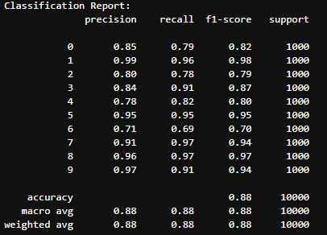
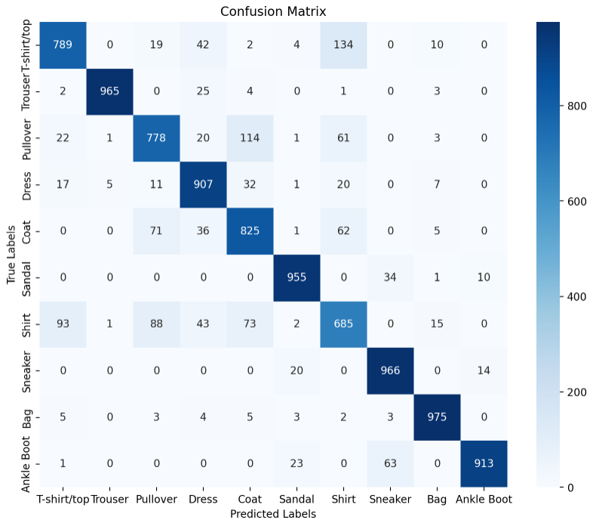
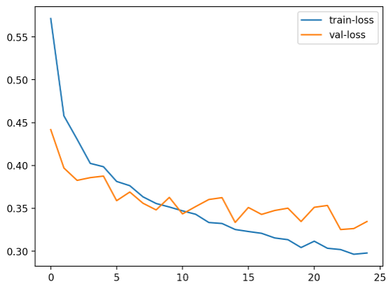
Results-ANN

Slide 9
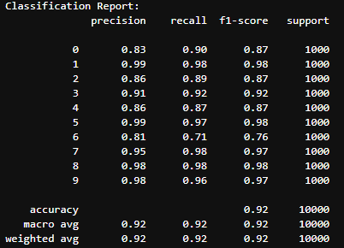
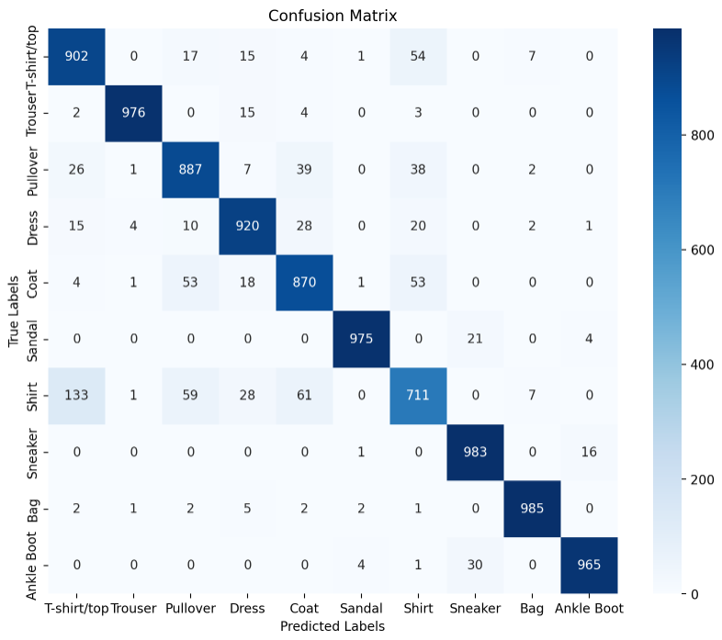
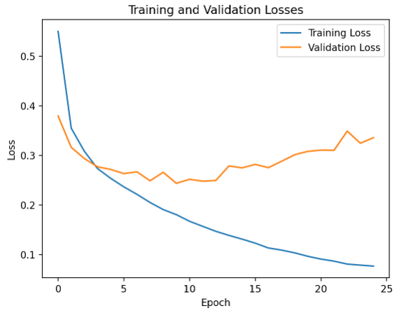
Results-CNN

Slide 10
Conclusion
In conclusion, the Fashion MNIST dataset was successfully used to train and test Artificial Neural Network (ANN) and Convolutional Neural Network (CNN) models for the image classification task.
CNN exhibited superior accuracy, achieving an impressive 92%, compared to ANN’s commendable 88%.
The classification reports revealed insightful metrics such as precision, recall, and F1-score for each class, providing a detailed understanding of the models' strengths and weaknesses. Both ANN and CNN displayed robust performance across various fashion item categories, demonstrating their efficacy in real-world image classification tasks.
The CNN model's high accuracy has encouraging implications for a clothing company. Given CNN model’s greater performance in image classification, it is possible that these models will be essential in automating the classification of clothing items.
To further improve the classifier performance, we should collect more samples and give more images to the model so the classifier can learn more features or patterns even better.

Slide 11
Thank you for listening!
Any Questions?

