Slide 1
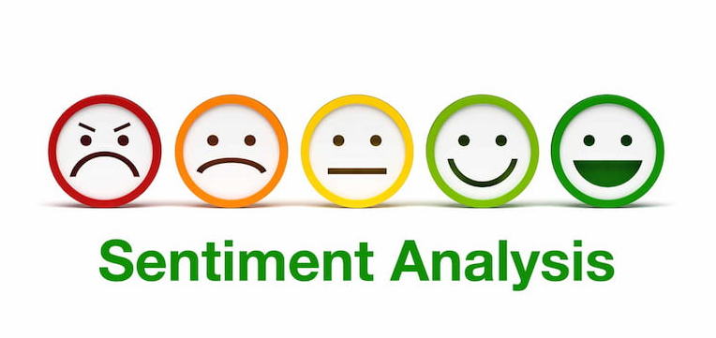
Poornashree Ganapathi Subramanian, Yukta J Gujjar, Bhuvana Muttanapalli ​

Slide 2
Introduction
Sentimental Analysis or opinion mining
The process of computationally identifying and categorizing opinions expressed in a piece of text, especially in order to determine whether the writer’s attitude towards a particular topic, product, etc. is positive, negative, or neutral.
Huge amount of data is posted on the social media platforms on a daily basis. The sentimental analysis is a process understanding opinions, feelings, and thoughts of people about a given subject. Its advantages being scalability, real-time analysis and consistent criteria.
This paper analyses amazon reviews data using supervised learning.
The digital revolution has propelled social media into a powerhouse of expression, engaging millions worldwide to voice their diverse thoughts and ideas. This surge in user-generated content has birthed a deluge of data, a resource ripe for exploration.

Slide 3
Dataset Overview
1.5 million Amazon Reviews
500,000 training reviews
1 million test reviews
Ensuring Data Excellence: Preprocessing techniques:
Noise removal
Word contraction mapping
Eliminating errors, slang, special characters, URLs, mentions, HTML tags
Enhancing Model Features:
Mapping contractions to formal language
Objective: Elevate sentiment analysis accuracy for a dependable portrayal of user sentiment.
Join us as we navigate through this wealth of data, aiming to decipher sentiments and enhance the reliability of sentiment analysis in the vibrant world of social media.

Slide 4
Flowchart of method used in this project
Amazon review Data
Exploratory data Analysis :
I) Positive
II) Negative
Feature Extraction
N –Gram , Count Vectorizer , TF-IDF
Preprocessing : Noise&Stop Removal , Spell correction, Lemmatization and Word-Stemming
Results :
Confusion matrix , Precision , Recall , Accuracy
ML Algorithm :​
Multinomial Naïve bayes ​
Support vactor Machine (RBF Kernal) ​
Convolution neural Network​
Optimization : Adam, Stochastic Gradient Descent , Adagrad and RMSProp

Slide 5
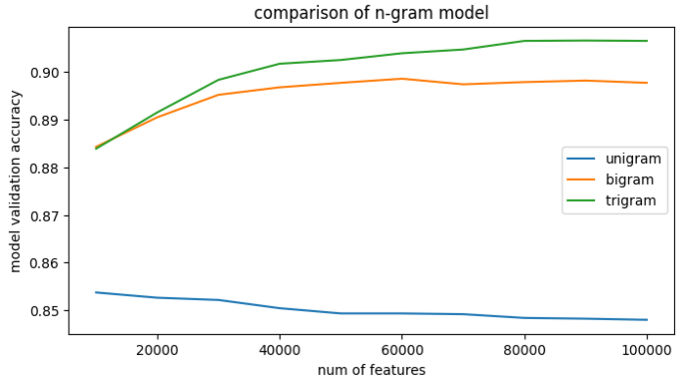
Feature Extraction :
Approach:
Experimentation with three-word representations
Utilization of N-gram models for feature extraction
Feature Vectorization:
TdfVectorizer function in Scikit-learn library employed
Conversion of reviews into feature vectors
TF-IDF Method:
Term Frequency-Inverse Document Frequency technique
Assigns unique indices to words, determining feature indexes
Values set based on word frequency and count proportionately adjusted
Uni-gram, Bi-gram, Tri-gram Employment:
Analysis showcasing the effectiveness of using word sequences in bi- and tri-grams over unigrams
Fig: N-gram Model Performance

Slide 6
Classifiers used for Sentimental Analysis
Naive Bayes:
Algorithm grounded in Bayes' theorem
Assumption: Features are independent within classes
Efficient text classification via Multinomial Naive Bayes (Scikit-learn)
Support Vector Machine (SVM):
Supervised learning for classification tasks
Establishes optimal boundary between data classes
Kernel selection crucial: Linear for separable data, RBF for non-linear relationships
Parameter tuning via Grid Search with Cross Validation
Convolutional Neural Network (CNN):
Widely recognized in computer vision, also applied to text classification
Implemented using Keras (TensorFlow backend) for NLP tasks
Tokenization of reviews into numerical sequences
Architecture: Four hidden layers, multiple optimization algorithms, prevention of overfitting

Slide 7
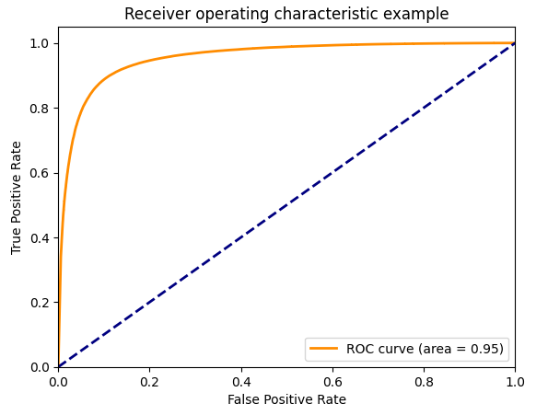
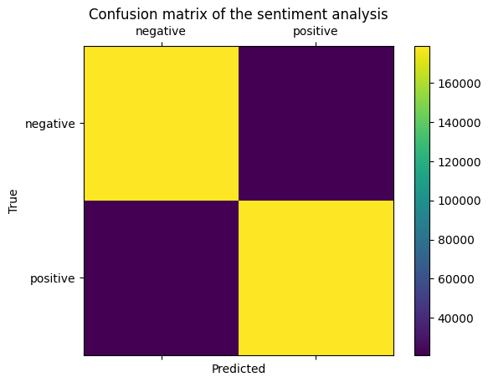
Multinomial Naïve Bayes :
Fig : ROC curve- Naïve Bayes classifier Fig : Confusion Matrix ​
​
Accuracy | 89.37%
Class | Precision | Recall
Negative | 0.8945 | 0.8929
Positive | 0.8931 | 0.8947
Table 1: Naïve Bayes classification result

Slide 8
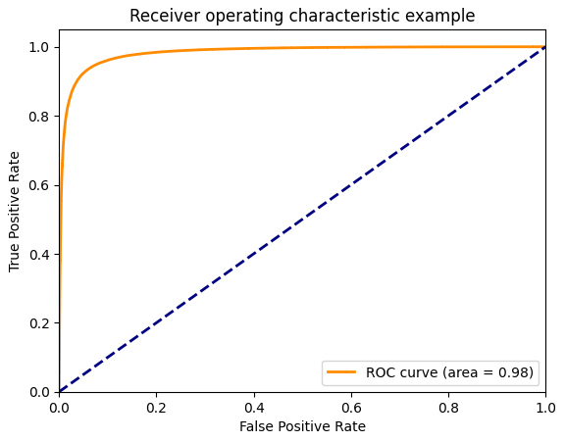
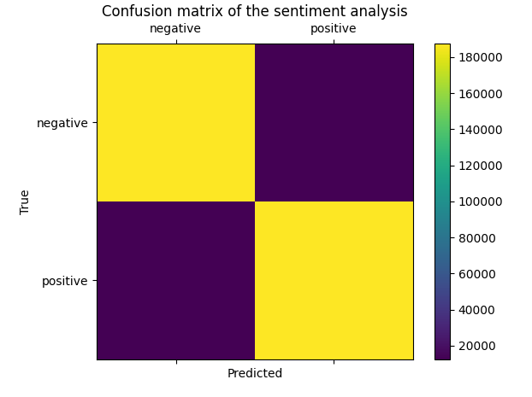
Support Vactor Machine :
​
​
​
Fig : ROC curve- SVM classifier - Linear Kernel Fig : Confusion Matrix ​
Accuracy | 93.753%
Class | Precision | Recall
Negative | 0.9377 | 0.9373
Positive | 0.9373 | 0.9378
​
Table : SVM classification result

Slide 9
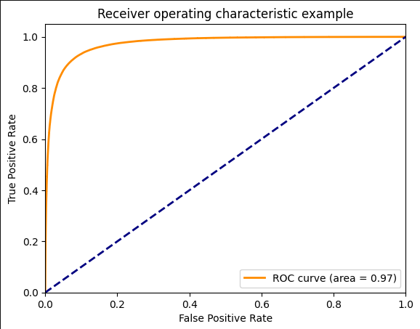
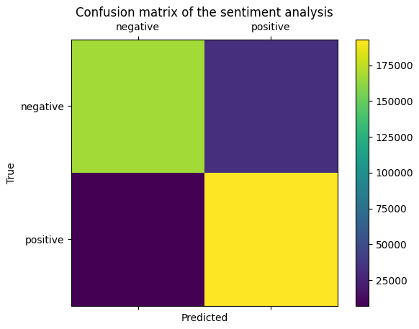
Convolution Neural Network:
Fig : ROC curve- CNN classifier Fig : Confusion Matrix
Accuracy | 90.09%
Class | Precision | Recall
Negative | 0.9594 | 0.8372
Positive | 0.8556 | 0.9646
Table : CNN classification result ​

Slide 10
Conclusion :
Dominance of Linear SVM:
Outperformed both Naive Bayes and CNN
Leveraged due to linear separability within the dataset
Optimal Algorithm for Analysis:
Recommended model: SVM with Linear Kernel (93.75%)
Especially effective for linearly separable data, as seen in Amazon reviews
Critical Factors Affecting Performance:
Data Collection, Preprocessing, and Feature Extraction crucial for success
Data quality plays a pivotal role in all machine learning tasks

Slide 11
Challenges in Model Design:
Ease of training post-preprocessing for Naive Bayes & SVM due to fewer parameters
Neural Network complexity in parameter tuning due to numerous variables
Preferred Model Choice: SVM with linear kernel for Amazon review sentiment analysis
Emphasis on high-quality data for optimal performance
Naive Bayes and SVM proved efficient; Neural Network requires meticulous tuning

Slide 12
Reference:
Andreea Salinca. "Convolutional Neural Networks for Sentiment Classification on Business Reviews". In: arXiv (2017).
Korovkinas, K., &amp; Danėnas, P. (2017). SVM and Naïve Bayes Classification Ensemble Method for sentiment analysis. Baltic Journal of Modern Computing, 5(4).
Alhashmi, S. M., Khedr, A. M., Arif, I., & El Bannany, M. (2021). Using a Hybrid-Classification Method to Analyze Twitter Data During Critical Events. IEEE Access, 9, 141023–141035.
Y. Xu, X. Wu, and Q. Wang. Sentiment analysis of yelps ratings based on text reviews, 2015.
Shaikh, T., & Deshpande, D. (2016). Feature Selection Methods in Sentiment Analysis and Sentiment Classification of Amazon Product Reviews. International Journal of Computer Trends and Technology, 36(4), 225–230.

