Slide 1

SEIS763 Project Listening to the Progression of Parkinson’s Disease
Alexandra Graves
Poornendu Narayanan
Shantanu Dilip Hadap
Shubha Shubha

Slide 2
What is Parkinson’s disease and symptoms?
What is Parkinson's disease (PD)
a neurodegenerative disorder
no cure, complications make (PD) the14th leading US cause of death
Monitoring the disease
Treatment is determined by severity
Unified Parkinson Disease Rating Scale

Slide 3
Data Exploration , Features
Subject # | Integer that uniquely identifies each subject
Age | Subject Age
Sex | Subject Gender, ‘0’ Male; ‘1’ Female
Test_Time | Time since recruitment into the trial
Motor_UPDRS | Clinician’s motor UPDRS score, linearly interpolated
Total_UPDRS | Clinician’s total UPDRS score, linearly interpolated
Jitter (%) | Measures of variation in fundamental frequency
Jitter (Abs) | Measures of variation in fundamental frequency
Jitter: RAP | Measures of variation in fundamental frequency
Jitter PPQ5 | Measures of variation in fundamental frequency
Jitter: DDP | Average absolute difference of differences between jitter cycles
Shimmer | Measures of variation in amplitude
Shimmer (dB) | Measures of variation in amplitude
Shimmer: APQ3 | Three-point amplitude perturbation quotient
Shimmer: APQ5 | Five-point amplitude perturbation quotient
Shimmer: APQ11 | 11-point amplitude perturbation quotient
Shimmer: DDA | Average absolute differences between the amplitudes of consecutive periods
NHR | Noise-to-harmonics ratio
HNR | Harmonics-to-noise ratio
RPDE | Recurrence period density entropy measure
DFA | Signal fractal scaling exponent of detrended fluctuation analysis
PPE | Pitch period entropy

Slide 4
Initial model Performance
Model | R2 Score | MSE
Multivariate Linear Regression | 0.15 | 57.58
Polynomial Regression | 0.20 | 51.88
Decision Tree Regressor | 0.90 | 6.24
Random Forest Regressor | 0.96 | 2.18
Gradient Boosting | 0.76 | 16.02

Slide 5
Initial model Performance
Model | R2 Score | MSE
Multivariate Linear Regression | 0.15 | 57.58
Polynomial Regression | 0.20 | 51.88
Decision Tree Regressor | 0.90 | 6.24
Random Forest Regressor | 0.96 | 2.18
Gradient Boosting | 0.76 | 16.02

Slide 6
Feature Elimination
Backward Elimination
Eliminated Features | p-value
Shimmer:DDA | 0.98
RPDE | 0.65
Jitter:RAP | 0.29
Jitter:DDP | 0.10
Shimmer(dB) | 0.06
Selected Features
Age | Shimmer:Apq3
Sex | Shimmer:Apq5
Test_time | Shimmer:Apq11
Jitter(%) | NHR
Jitter(Abs) | HNR
Jitter:PPQ5 | DFA
Shimmer | PPE
Random Forest |  | Gradient Boosting
MSE Before | MSE After | MSE Before | MSE After
2.18 | 2.05 | 16.02 | 15.39

Slide 7
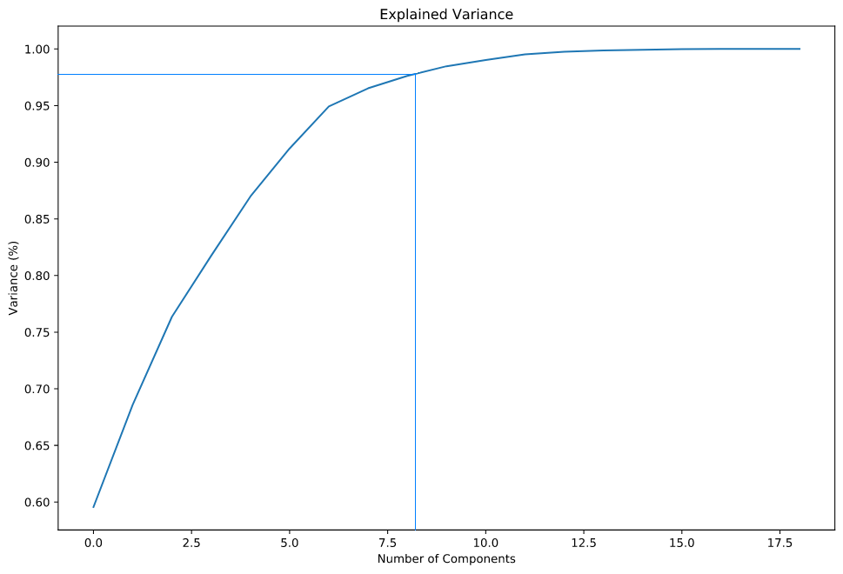
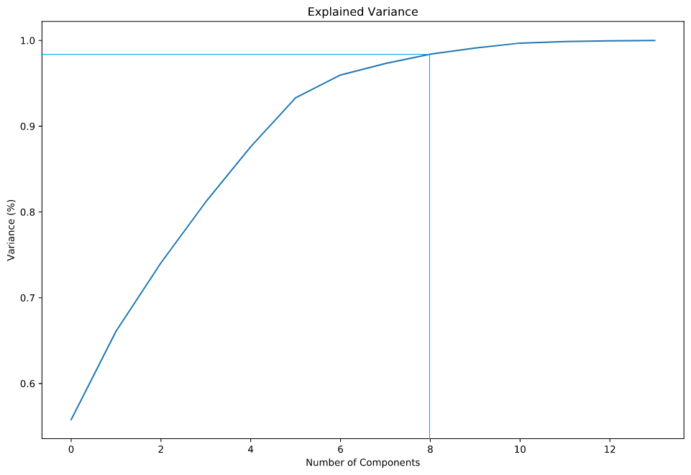
Feature Extraction
Explained Variance Graph
All Features Eliminated Features

Slide 8
Feature Elimination and Feature Extraction
Model Stage | Random Forest |  | Gradient Boosting
 | MSE Before | MSE After | MSE Before | MSE After
Feature Elimination | 2.18 | 2.05 | 16.02 | 15.39
PCA | 2.18 | 25.30 | 16.02 | 41.03
PCA on FE | 2.05 | 22.80 | 15.39 | 37.01
KPCA | 2.18 | 25.79 | 16.02 | 41.02
KPCA on FE | 2.05 | 22.32 | 15.39 | 37.01

Slide 9
Hyper parameter tuning
GridSearchCV
GradientBoostingRegressor and RandomForestRegressor
RandomForestRegressor | GradientBoostingRegressor
bootstrap: True | learning_rate: 0.03
min_samples_leaf: 1 | max_depth: 8
min_samples_split: 2 | n_estimators: 400
n_estimators: 137 | subsample: 0.9
Mean Squared Error : 2.19 | Mean Squared Error : 1.82

Slide 10
Ensemble
Meta-algorithms that compare different ML algorithms
Decrease variance and bias
Increase predictability

Slide 11
Ensemble
Two Models Used:
Random Forest Regressor-97,2.19
Gradient Booster – 97,1.82
Ensemble model gave and accuracy of – 98, MSE – 1.27
Voting Regressor was used to create the ensemble.
The average of the r-squared of the two models give the r-squared of the ensemble model.

Slide 12
K-fold CV
Re- sampling the dataset.
Our team used a 10-fold cross validation
Applied on our 3 best models:- Random Forest Regressor Gradient Booster Ensemble
Random Forest Regressor | 0.97 | 1.61
Gradient Boosting | 0.97 | 1.62
Ensemble | 0.98 | 1.27

Slide 13

Results
Our Champion Model –
Ensemble

