Slide 1

BIRCH
An Efficient Data Clustering Method for Very Large Databases
Tian Zhang; Raghu Ramkrishnan; Miron Livny
Presenters: .
Ken Tsui
Damián Roqueiro

Slide 2
Outline
Motivation
  BIRCH: characteristics
Background
Tree Operations
Algorithm Analysis

Slide 3
Motivation
When dealing with large datasets, how can we do clustering taking into account … ?
  High dimensionality of data.
  Memory limitations.
  High cost of I/O (running time)
  High computational cost of brute force approaches.
BIRCH characteristics
  Identifies dense regions of points and treats them collectively as a cluster.
  Tradeoff between memory space (accuracy) and minimizing I/O (performance)

Slide 4
Outline
Motivation
Background
  Data point representation: CF
  CF Tree
Tree Operations
Algorithm Analysis

Slide 5
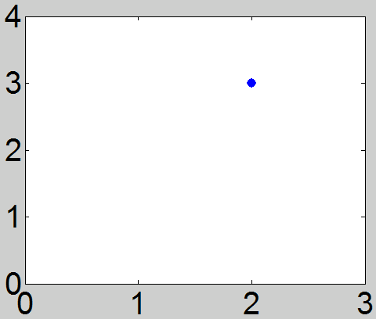


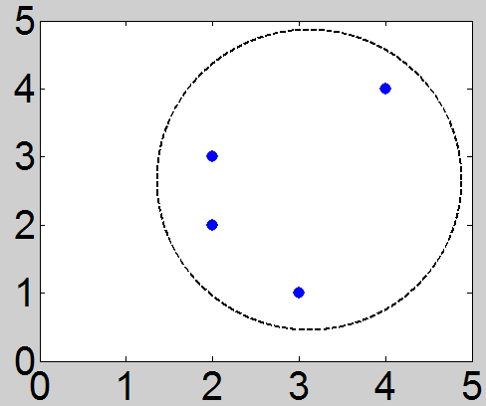
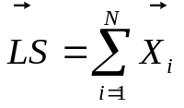
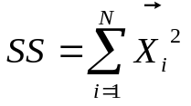
Data Point representation: CF
Given
N data points
Dimension d
Data set = where i = 1, 2, …, N
We define a Clustering Feature (CF)
where
N is # of data points in cluster
Example/diagram
Point = (2, 3)
CF = <1, (2, 3), 13>
Points = (2, 3), (2, 2),
(3, 1),(4, 4)
CF = <4, (11,10), 63>

Slide 6
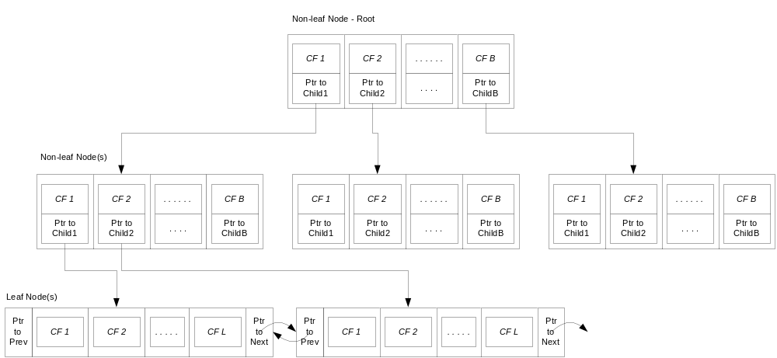
CF Tree
B = branching factor
L = max number of CFs in leaf node

Slide 7


CF Additive Property
Assume we have two disjoint clustering features:
The CF of the cluster formed by merging the two disjoint subclusters is:
The CFs can be stored and calculated incrementally and consistently as subclusters are merged or new data points are inserted into an existing cluster.

Slide 8
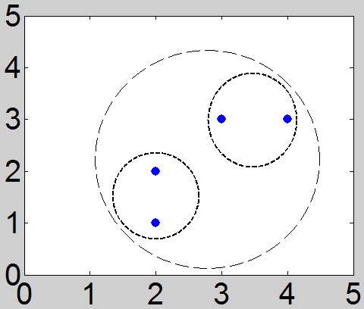
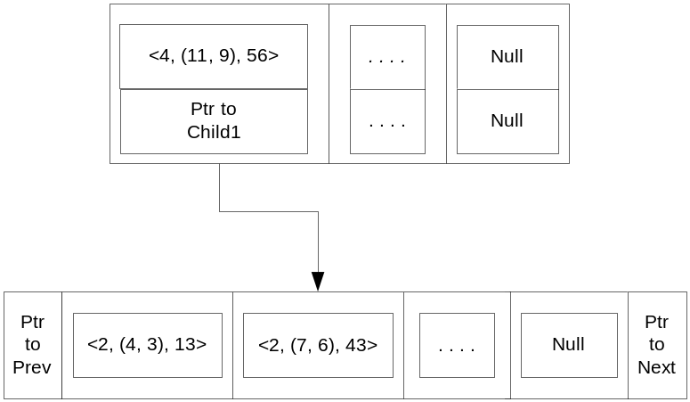
CF Tree Example
Tree
Cluster space
CF_{a} = <1, (2,1), 5>
CF_{b} = <1, (2,2), 8>
CF_{c} = <1, (3,3), 18>
CF_{d} = <1, (4,3), 25>

Slide 9
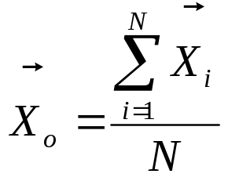
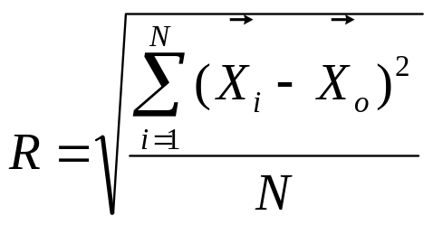
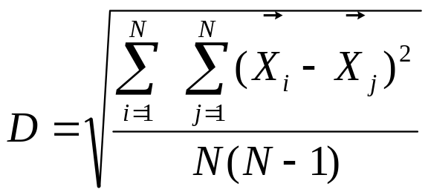
Notation
Centroid
Radius
Diameter

Slide 10

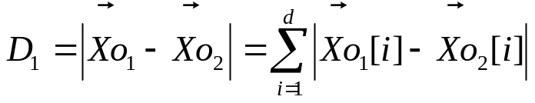
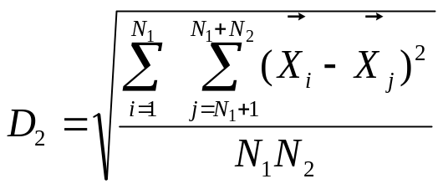
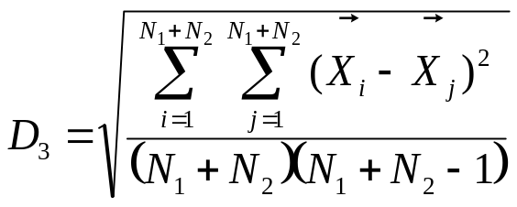
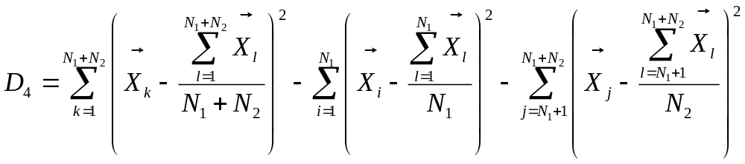
Other distance measures
D₀ = Euclidean distance of two clusters
D₁ = Manhattan distance of two clusters
D₂ = Average inter-cluster distance
D₃ = average intra-cluster distance
D₄ = variance increase distance

Slide 11
Outline
Motivation
Background
Tree Operations
  BIRCH: Running phases
  Inserting a data point (with & without split)
  Reducing the tree
  Delay split
  Handling outliers
Algorithm Analysis

Slide 12
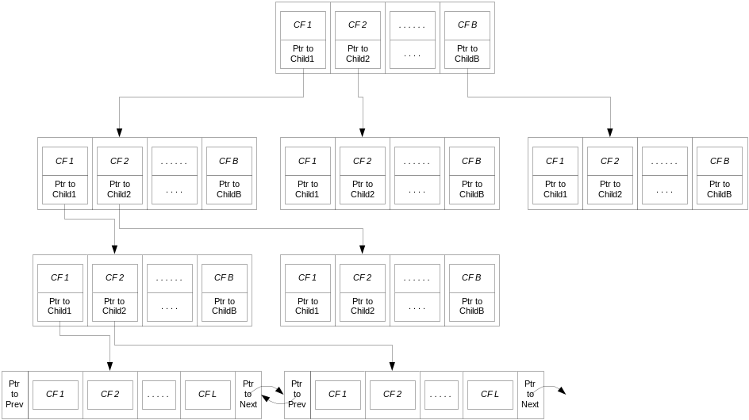
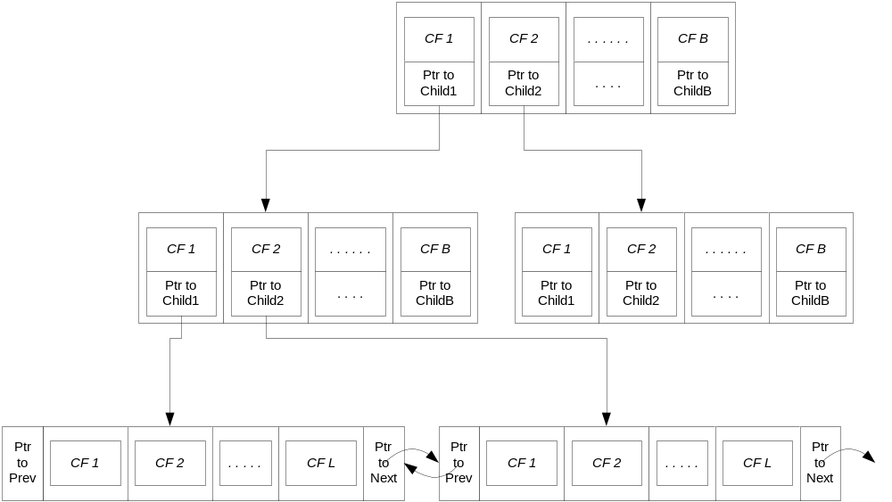
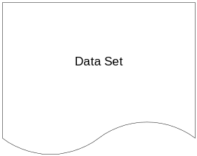
BIRCH: Running phases
Phase 1: read dataset and create tree
  Hierarchical representation of data
  Initial clustering of data that can be refined in subsequent phases
Phases 2 & 3: use any clustering
algorithm to cluster the leaf nodes
of the tree
  Condense tree
  Refine clusters
  Process outliers
Phase 4: Additional scans to redistribute data points

Slide 13
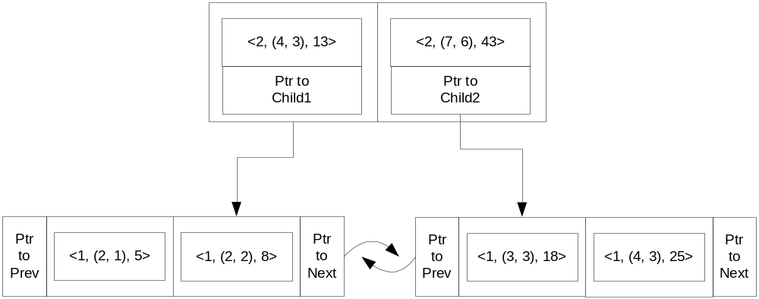
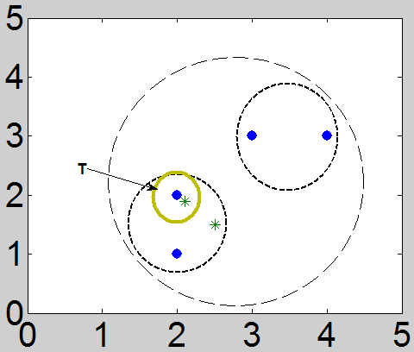
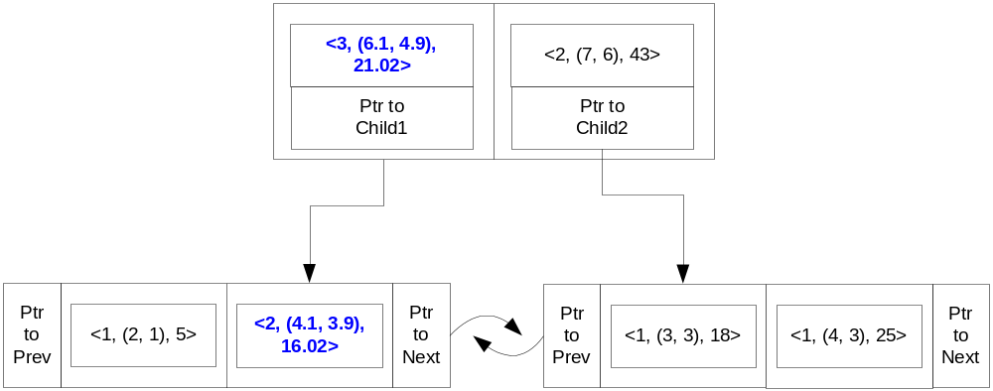
Inserting a data point
CF = <1, (2.1, 1.9), 8.02>

Slide 14
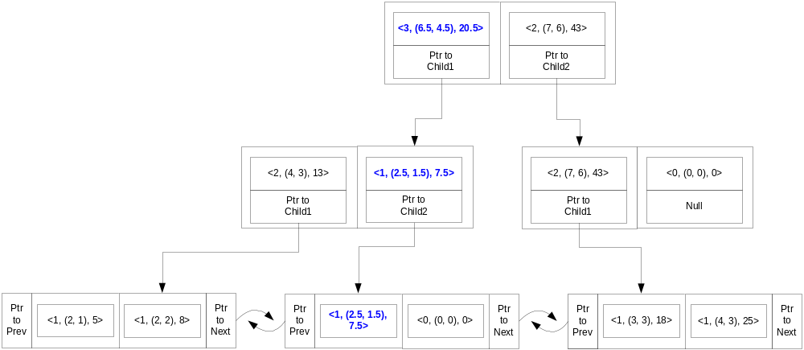
Inserting a data point (cont.)
CF = <1, (2.5, 1.5), 7.5>

Slide 15
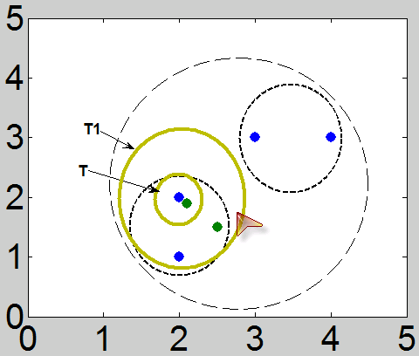
Reducing the tree
When program runs out of memory
Need to adjust the tree: old_tree has more nodes than new_tree)
No reprocess of past data
Increase threshold

Slide 16
Delay split
Postpone reducing the tree
If a data point will cause a split and the program will run out of memory
Write data point to disk
Proceed reading data
More data points can fit in the tree before we have to rebuild

Slide 17
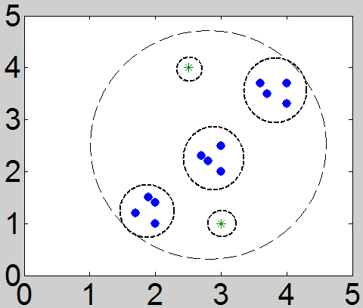
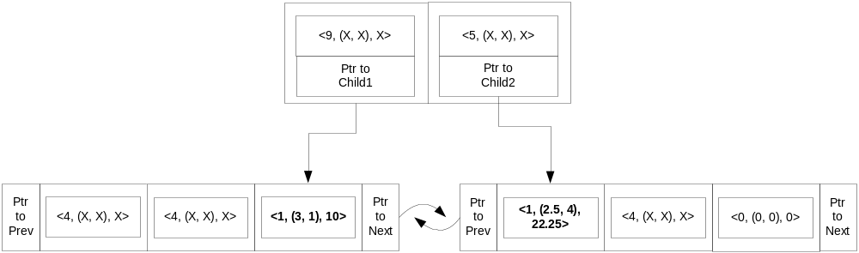
Handling outliers
The outliers are written to disk and processed later

Slide 18
Outline
Motivation
Background
Tree Operations
Algorithm Analysis
  Analysis
  An alternative: CURE

Slide 19
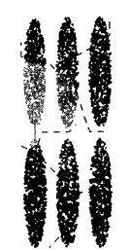
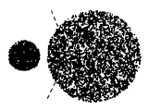
Analysis
Pros
State of the art algorithm for large datasets
Runs on memory bound conditions
Improved performance reducing I/O
Cons
Unsuitable for clusters that have different sizes
Fails to identify clusters with non-spherical/non-convex shapes (e.g. elongated)
Labeling using centroids causes problems

Slide 20
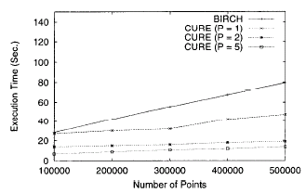
An alternative: CURE
Differences between CURE and BIRCH
CURE:
Random sampling and partitioning
To label, it uses multiple random representative points for each cluster.
  Correctly labels points when shapes of clusters are non-spherical or have different sizes

