Slide 1



GENERATIVE PROJECT IE(7295) NEURAL NETWORK / DEEP LEARNING
Group 06
DEV PATEL
HITAXI LETHWALA
POORNIKA JALAVADI
RIAN DBRITTO

Slide 2
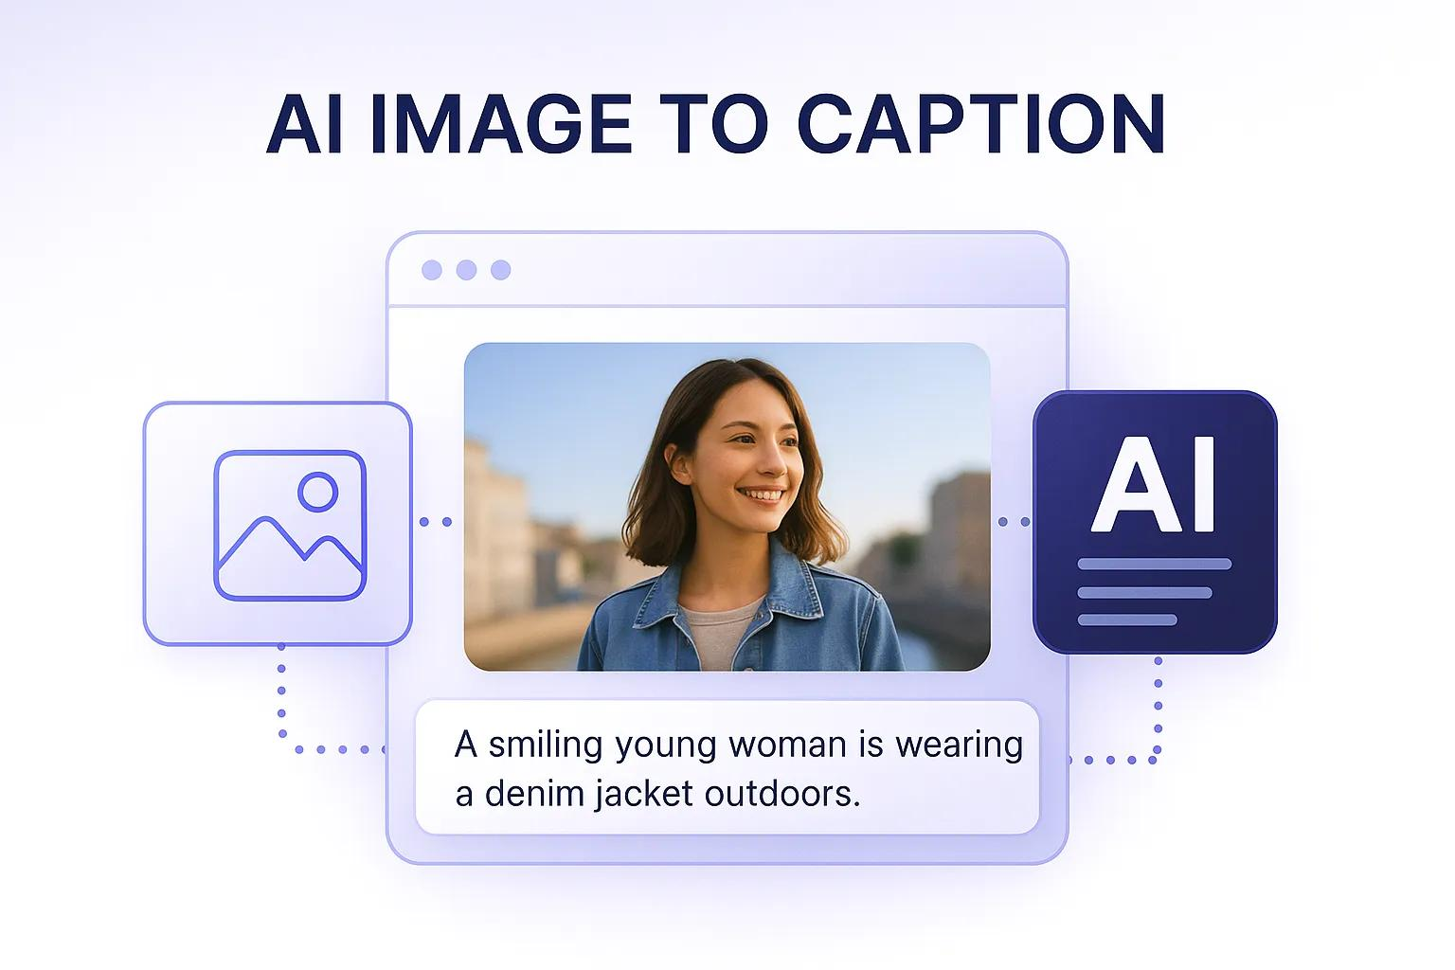
PROBLEM STATEMENT
Machines can process images, but they still struggle to truly understand them.
Generating captions requires both visual understanding and language skills together.
Most existing models produce captions that are too generic or miss key details.
Writing captions manually for large datasets is time-consuming and not scalable.
There is a need for a system that can generate accurate and human-like descriptions automatically.
OBJECTIVE
To build a model that can generate captions directly from images.
To combine visual understanding (CLIP) with language generation (GPT-2).
To produce captions that are accurate, meaningful, and human-like.
To compare different decoding strategies and improve output quality.
To create a system that can be used in real-world applications.

Slide 3
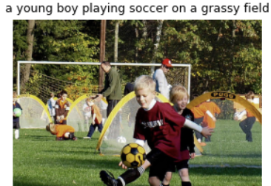
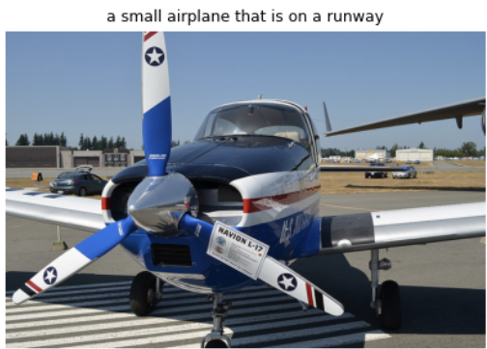
DATASET
Used COCO 2017 dataset with real-world images and captions.
Sampled 5000 images from ~118k dataset.
After filtering, ~1486 valid image-caption pairs were used.
Each image is paired with a caption describing the scene.

Slide 4
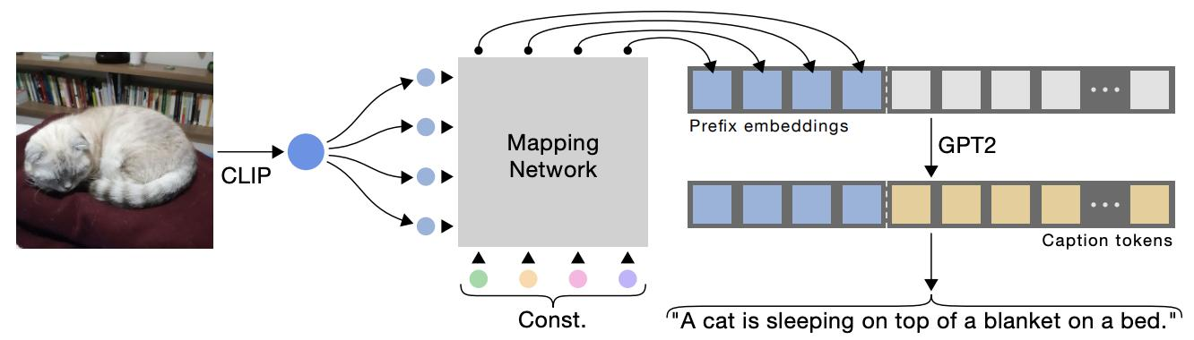
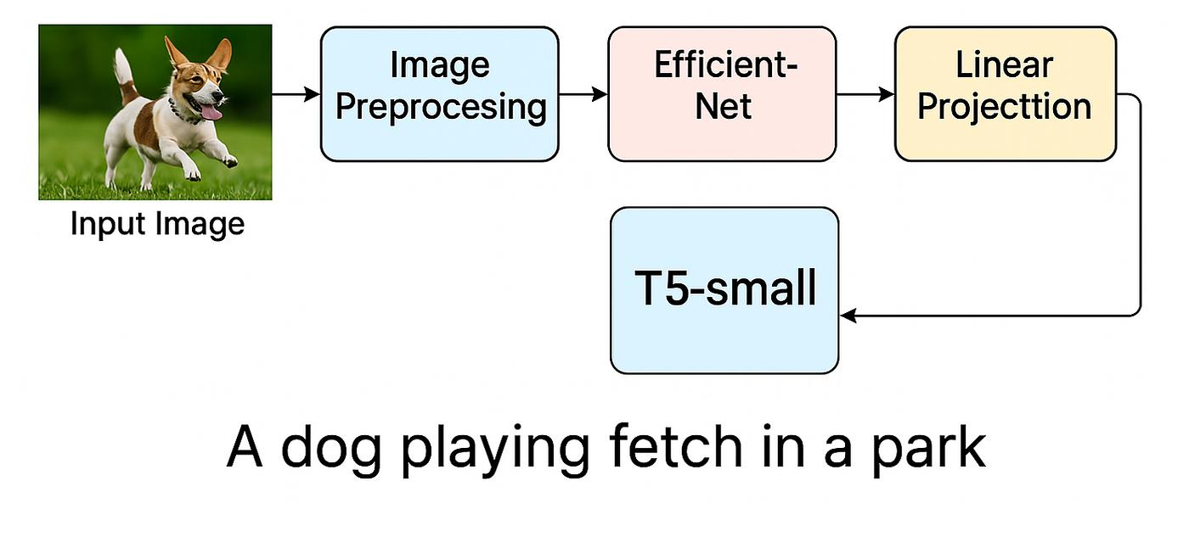
END-TO-END PIPELINE
Load COCO dataset and sample images
Create image-caption pairs
Extract image features using CLIP
Convert captions into tokens using GPT-2
Train model by combining image and text features
Generate captions for new images
DATA PREPARATION
Sampled subset of COCO dataset
Cleaned and filtered image-caption
Resized and normalized images for CLIP input
Tokenized captions using GPT-2 tokenizer

Slide 5
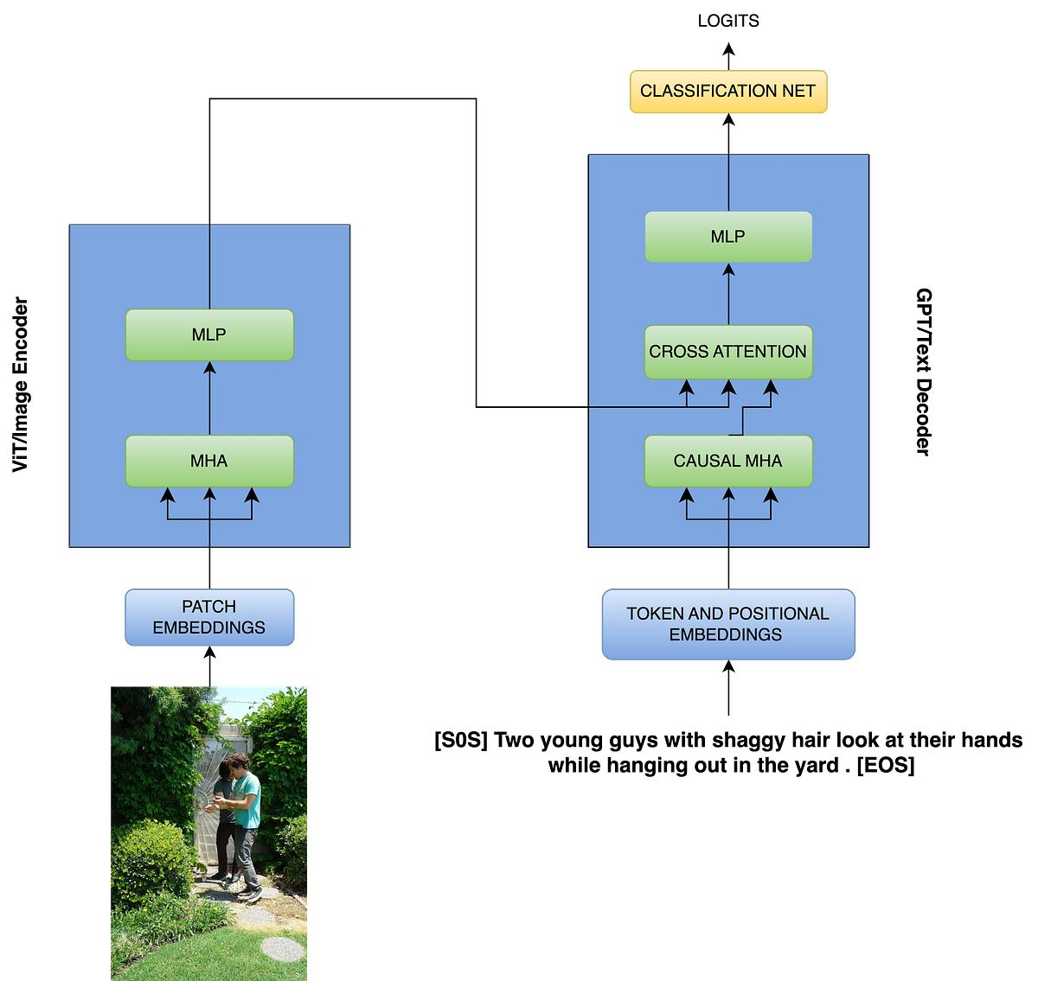
IMAGE EMBEDDING (CLIP)
Used CLIP ViT-B/32 as image encoder
Extracted 512-dimensional embeddings
Normalized embeddings for stable learning
Captures semantic meaning of images
TOKENIZATION
Used GPT-2 tokenizer for text processing
Added special tokens (start, end, padding)
Converted captions into fixed-length sequences
Ensures compatibility with transformer model

Slide 6
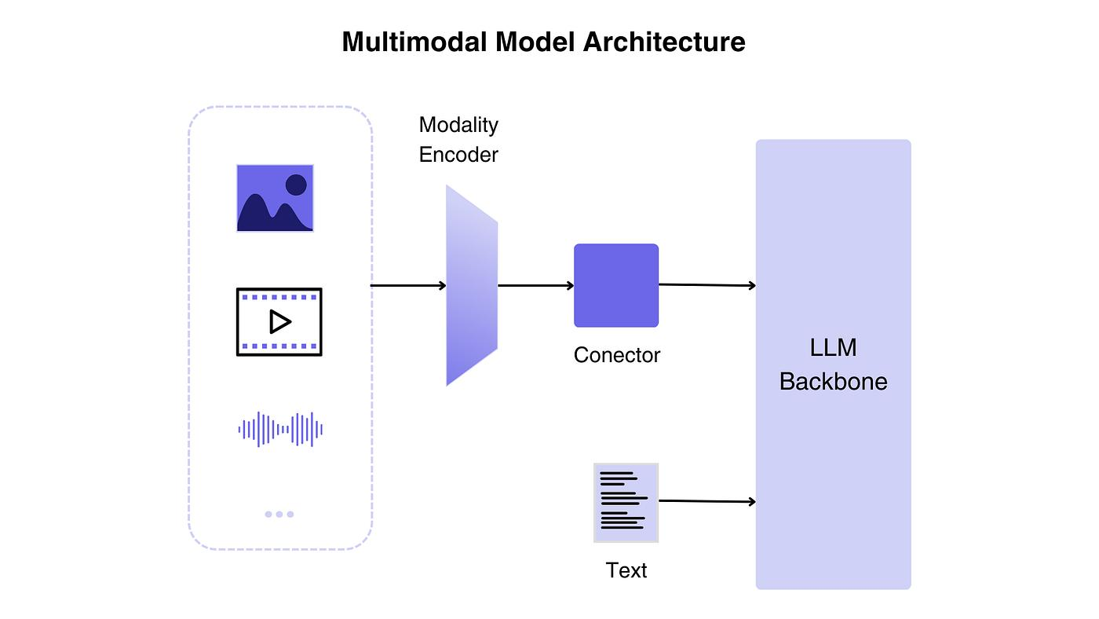
MODEL ARCHITECTURE
CLIP encodes images into feature vectors
Projection layer aligns image features with GPT-2
GPT-2 generates captions autoregressively
Implemented prefix conditioning and cross-attention
Enables effective multimodal learning
EXPERIMENTS
Tested different decoding strategies
Compared greedy, beam search, and top-p sampling
Observed variations in caption quality
Evaluated how randomness affects output

Slide 7
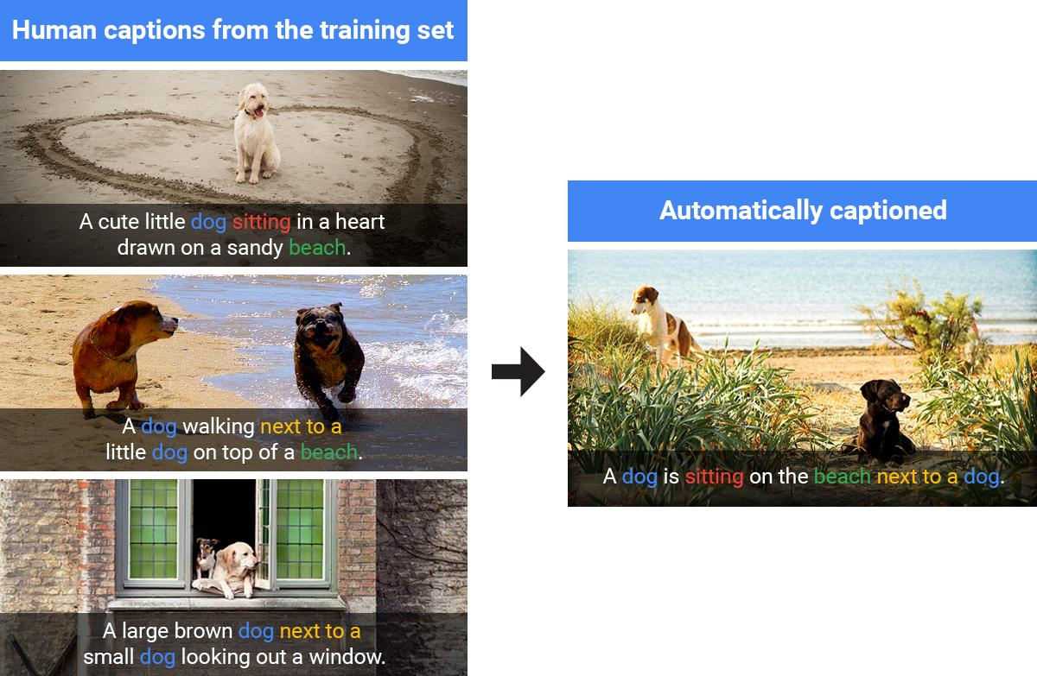
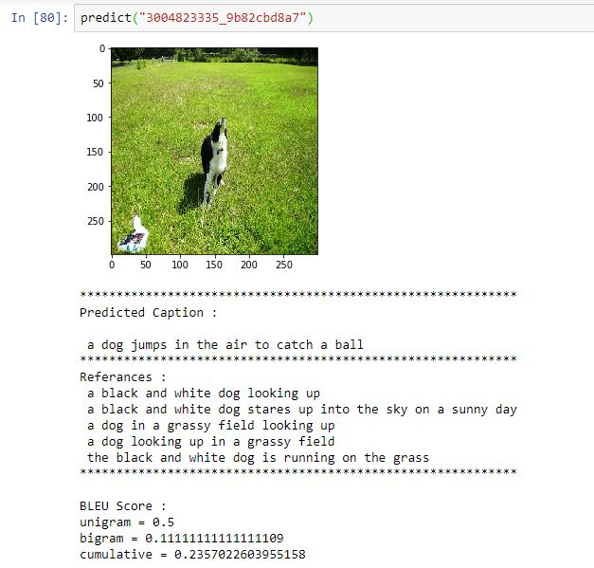
RESULTS
Model generates captions for unseen images
Accurate for simple and common scenes
Some captions closely match human descriptions
Output quality depends on decoding strategy
EVALUATION
Evaluated captions qualitatively using visual inspection
Compared generated captions with actual images
Observed semantic alignment between image and text
Metrics like BLEU, METEOR, CIDEr can be used for evaluation

Slide 8
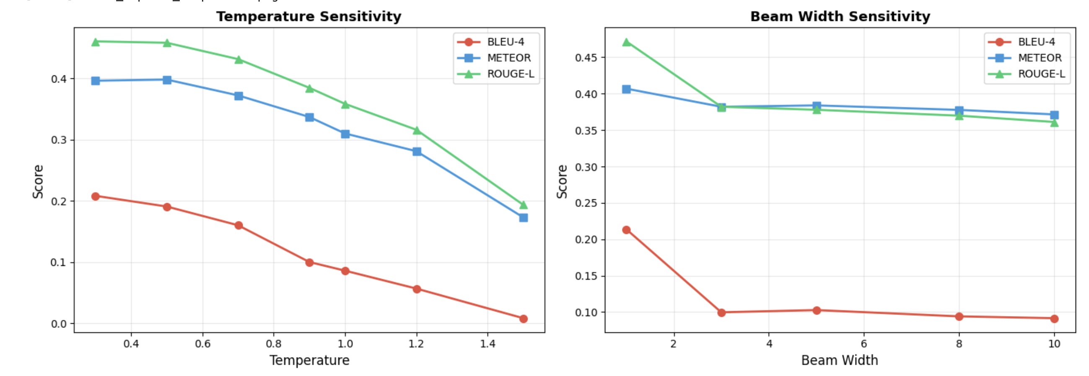
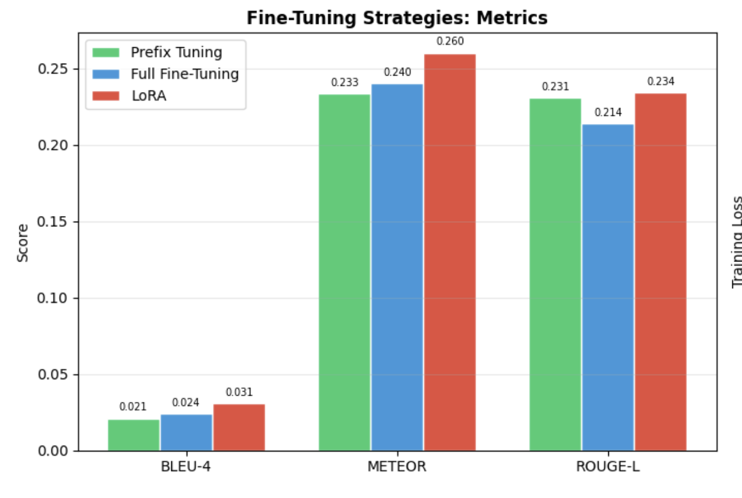
Fine-Tuning Strategies (From Graph)
LoRA performs best overall across all metrics
Highest scores in BLEU-4, METEOR, and ROUGE-L
Full Fine-Tuning performs well but slightly lower than
LoRA
Prefix Tuning is the weakest among the three
Temperature
Low → accurate but repetitive
High → creative but less accurate
Best balance at 0.5
Beam Width
Increasing width gives little improvement
Higher beams = more computation
Greedy (beam = 1) works well
Decoding Strategies
Greedy performs best overall
Highest accuracy across all metrics
Simple but most reliable

Slide 9
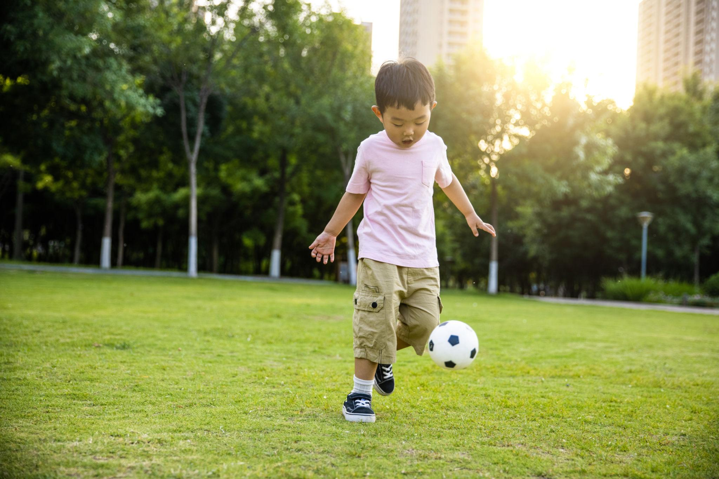
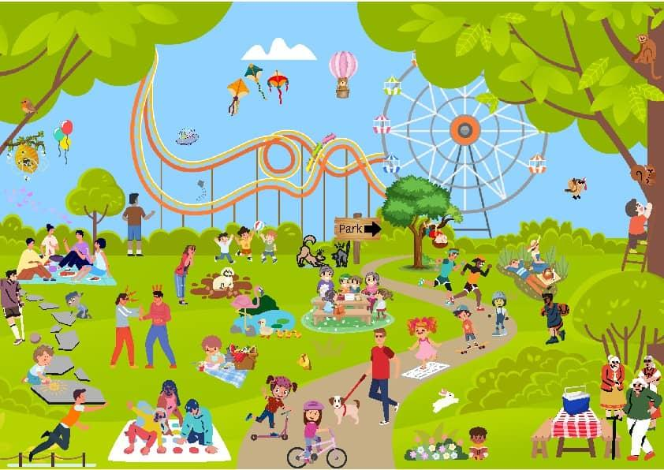
ANALYSIS
Model performs well on simple and clear images
Struggles with complex or crowded scenes
Beam search improves accuracy but reduces diversity
Sampling methods improve creativity but may reduce correctness
CHALLENGES
Training required high computational resources
Caption quality varies across images
Cross-modal alignment is complex
Handling diverse datasets is challenging

Slide 10
REFLECTION
Multimodal models are powerful but complex
Trade-off between accuracy and creativity
Potential bias in dataset affects output
Important for applications like accessibility and AI assistants
CONCLUSION
Successfully built an image captioning system using CLIP and GPT-2.
The model was able to generate meaningful captions for different images.
Combining visual and language models improved overall understanding.
Results show a balance between accuracy and creativity in captions.
The approach can be extended further using more advanced models and larger datasets.

Slide 11

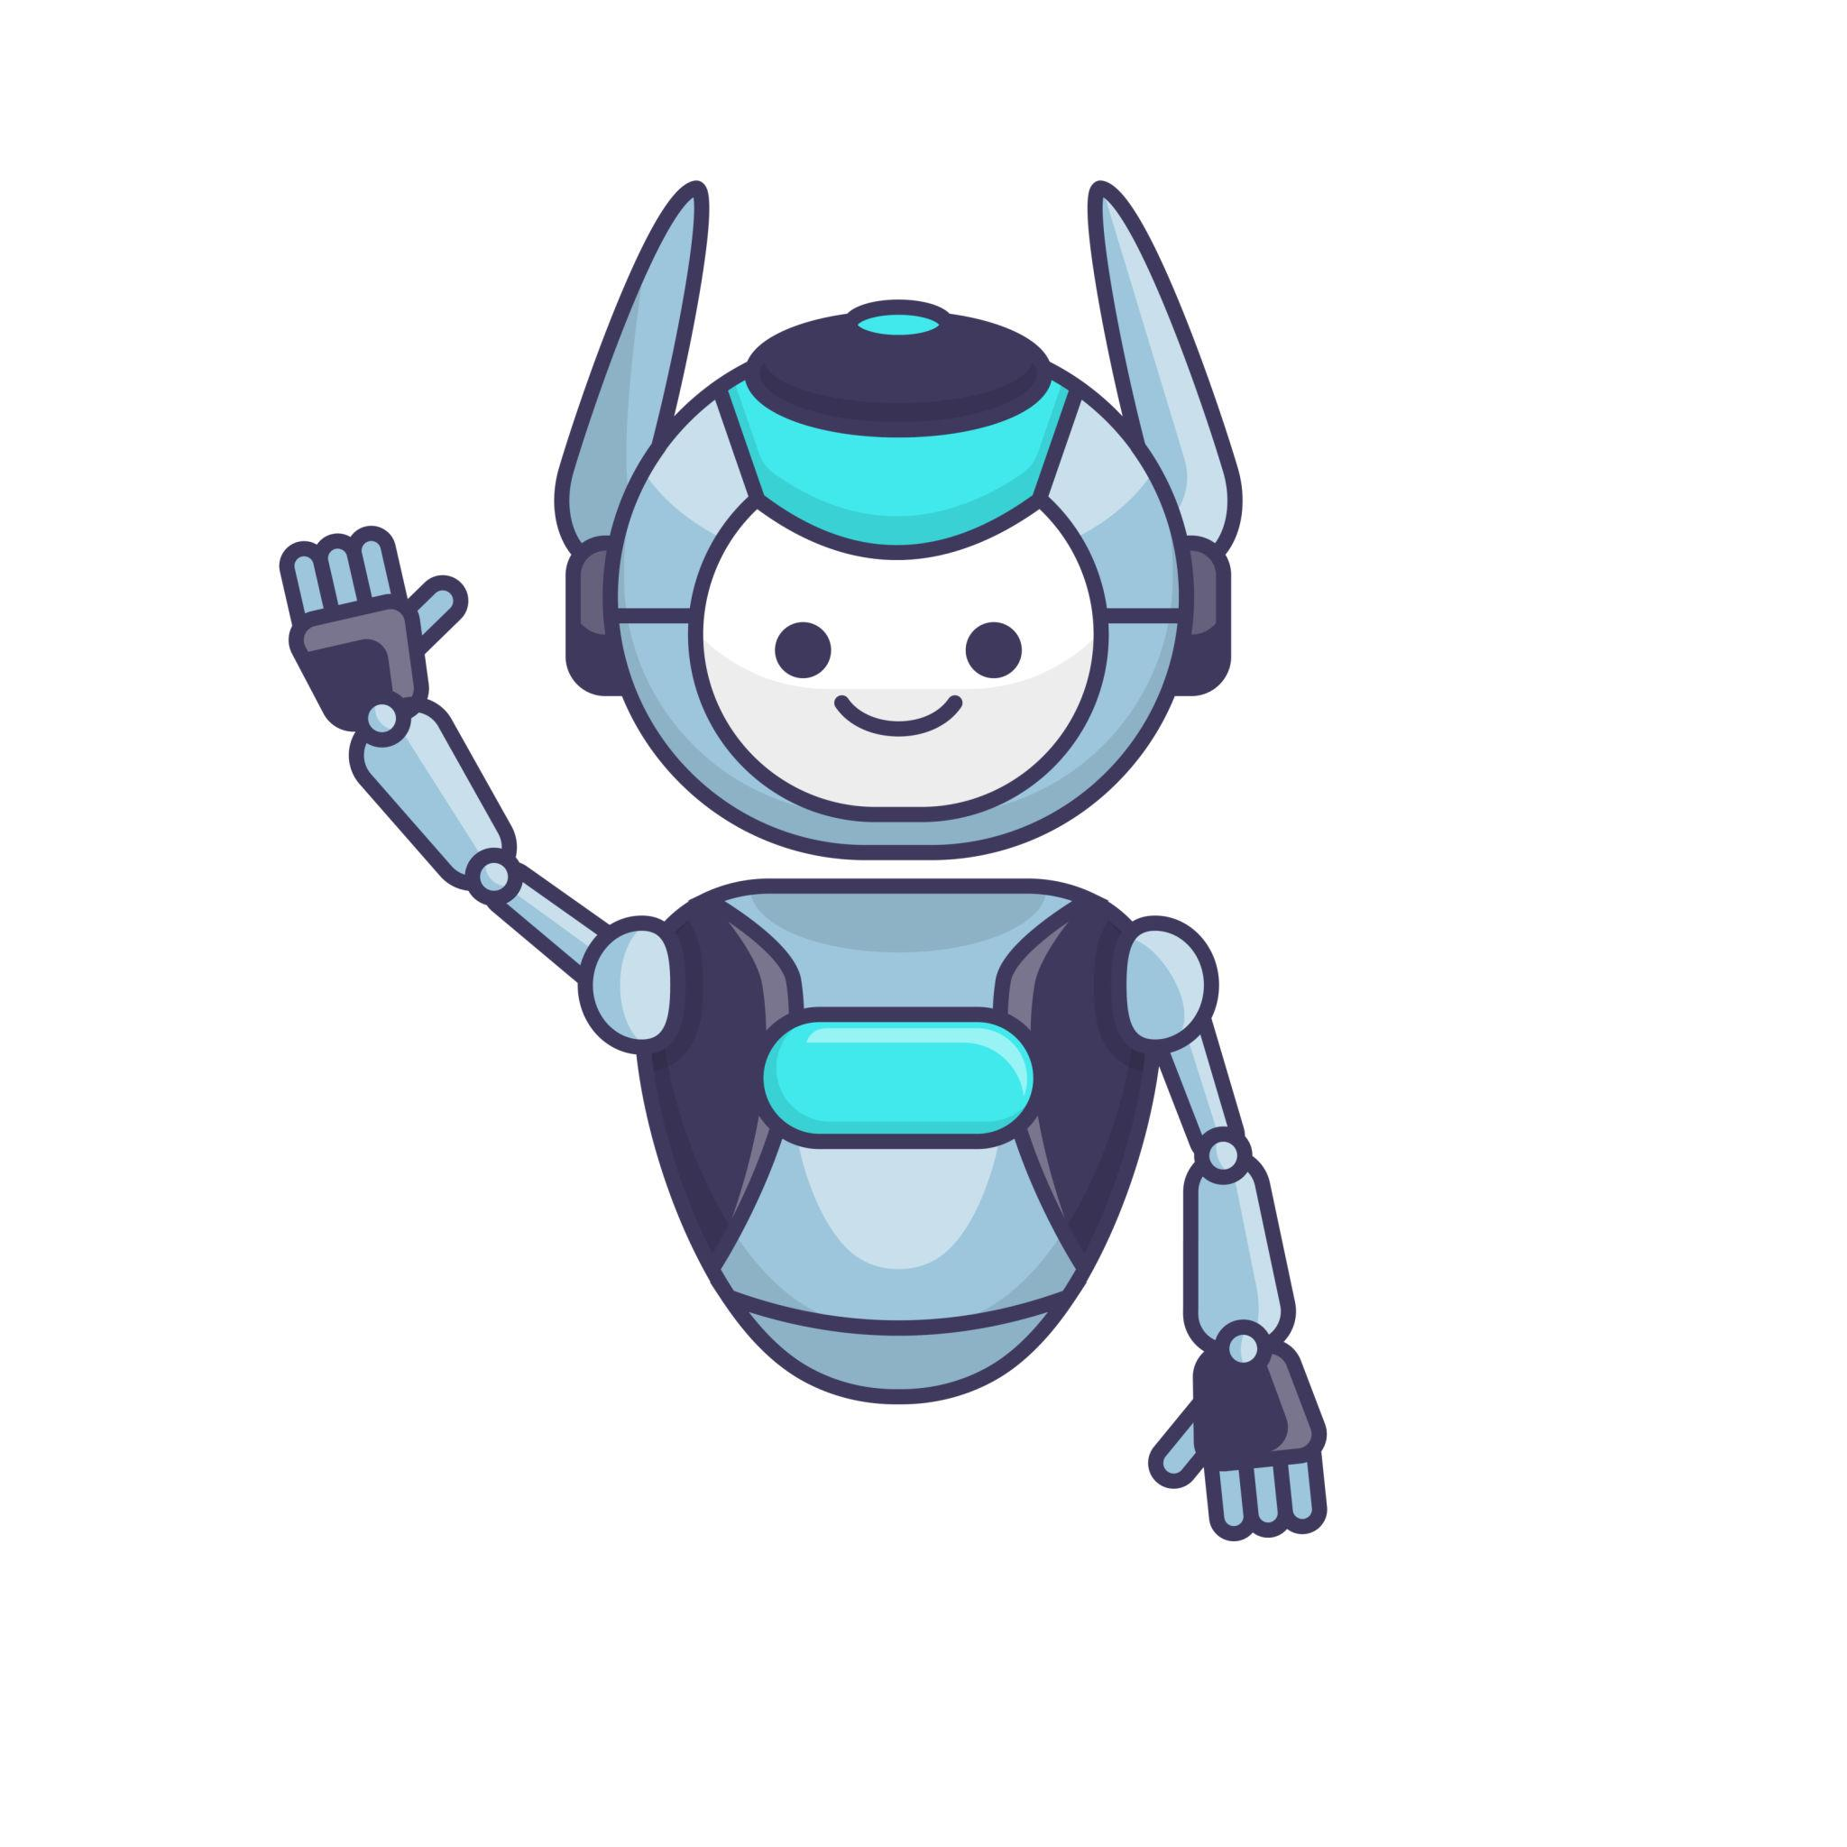
Thank You

