Slide 1
Question 1
Draw the term-document incidence matrix for:
Doc1: new home sales top forecasts
Doc2: home sales rise in july
Doc3: increase in home sales in july
Doc4: july new home sales rise
Answer queries:
(i) home AND sales AND july
(ii) rise AND sales NOT increase

Slide 2
Term | D1 | D2 | D3 | D4
new | 1 | 0 | 0 | 1
home | 1 | 1 | 1 | 1
sales | 1 | 1 | 1 | 1
top | 1 | 0 | 0 | 0
forecasts | 1 | 0 | 0 | 0
rise | 0 | 1 | 0 | 1
in | 0 | 1 | 1 | 0
july | 0 | 1 | 1 | 1
increase | 0 | 0 | 1 | 0

Slide 3
Answer 1
Query (i): home AND sales AND july
Documents containing all three terms:
D2 ✔
D3 ✔
D4 ✔
✅ Answer: D2, D3, D4

Slide 4
Answer 1
Query (ii): rise AND sales NOT increase
Documents with rise → D2, D4
Documents with sales → D1, D2, D3, D4
Documents with increase → D3
Exclude D3.
✅ Answer: D2 and D4

Slide 5
Question 2
Compute the edit distance to convert CATS to FATS.

Slide 6
Answer 2
CATS → FATS
One substitution (C → F)
Edit Distance = 1

Slide 7
Question 3
Draw the inverted index for:
Doc1: one fish, two fish
Doc2: red fish, blue fish
Doc3: one red bird

Slide 8
Answer 3
Term | Document IDs
one | D1, D3
fish | D1, D2
two | D1
red | D2, D3
blue | D2
bird | D3

Slide 9
Question 4
Compute the Levenshtein edit distance between GUMBO and GAMBOL.

Slide 10
Answer 4
GUMBO → GAMBO (U→A)
GAMBO → GAMBOL (Insert L)
Levenshtein Distance = 2

Slide 11
Question 5
Construct 2-gram, 3-gram and 4-gram index for:
a) banana
b) pineapple
c) computer

Slide 12
Answer 5
banana:
2g: ba an na an na
3g: ban ana nan ana
4g: bana anan nana
pineapple:
2g: pi in ne ea ap pp pl le
3g: pin ine nea eap app ppl ple
4g: pine inea neap eapp appl pple
computer:
2g: co om mp pu ut te er
3g: com omp mpu put ute ter
4g: comp ompu mput pute uter

Slide 13
Question 6
Draw the inverted index for:
Doc1: new home sales top forecasts
Doc2: home sales rise in july
Doc3: increase in home sales in july
Doc4: july new home sales rise

Slide 14
Answer 6
Term | Document IDs
new | D1, D4
home | D1, D2, D3, D4
sales | D1, D2, D3, D4
top | D1
forecasts | D1
rise | D2, D4
in | D2, D3
july | D2, D3, D4
increase | D3

Slide 15
Question 7
Compute the Levenshtein edit distance between paris and alice.

Slide 16
Answer 7
paris → alice
Steps
Substitute p → a → aris
Substitute r → l → alis
Substitute i → i → no change
Substitute s → c → alic
Insert e → alice
Operations = 4
Levenshtein Distance = 4

Slide 17
Question 8
A search system retrieves 12 documents for a query. Out of these:
8 documents are relevant
Total relevant documents in the collection = 20
Tasks:
Calculate Precision
Calculate Recall
Calculate F1-score

Slide 18
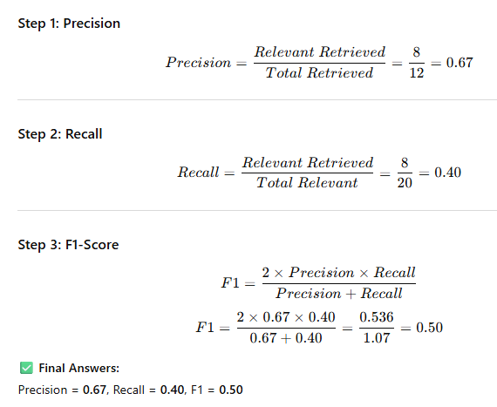
Answer 8

Slide 19
Question 9
For a query, the system retrieves documents in the following order:
Relevant documents appear at ranks: 1, 3, 6, 8
Total relevant documents for the query = 5
Tasks:
Compute Precision at each relevant rank
Calculate the Average Precision (AP)

Slide 20
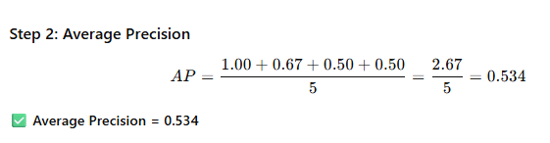
Answer 9
Precision at relevant ranks
Rank | Precision
1 | 1/1 = 1.00
3 | 2/3 = 0.67
6 | 3/6 = 0.50
8 | 4/8 = 0.50

Slide 21
Question 10
Mean Average Precision (MAP)
Average Precision values for three queries are:
Query 1 AP = 0.62
Query 2 AP = 0.48
Query 3 AP = 0.70
Task:
Calculate the Mean Average Precision (MAP).

Slide 22
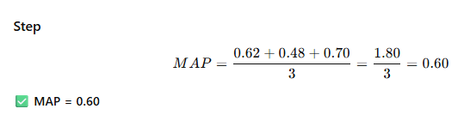
Answer 10

Slide 23
Question 10
Compare Two IR Systems
Two IR systems return the following results for the same query:
Tasks:
Which system is better for precision-oriented tasks?
Which system is better for recall-oriented tasks?
Justify your answer.

Slide 24
Question 10
System | Precision | Recall
A | 0.75 | 0.40
B | 0.55 | 0.65

Slide 25
Answer 10
Precision-oriented → System A
Recall-oriented → System B

Slide 26
Question 11
A search engine returns the following ranked list for a query:
Task
Compute:
Precision@1
Precision@3
Precision@5
Rank | Document | Relevant
1 | D1 | Yes
2 | D2 | No
3 | D3 | Yes
4 | D4 | Yes
5 | D5 | No

Slide 27
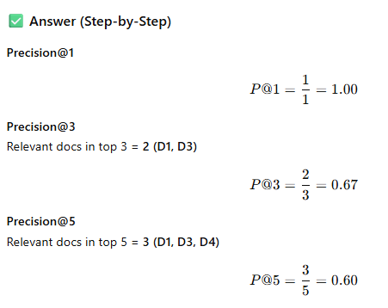
Answer 11

Slide 28
Question 12
For a query:
Total relevant documents = 4
Relevant documents appear at ranks: 1, 3, 5, 6
Task
Compute R-Precision.

Slide 29

Answer 12
Step 1: Find R
R=4
Step 2: Consider top R = top 4 documents
Relevant in top 4 ranks:
Rank 1 ✔
Rank 3 ✔
Total relevant = 2
Step 3: Compute R-Precision

Slide 30

Thank you…

