Slide 1
Kotlin Loops Demo App
Explaining XML + Kotlin Code (For, While, Do-While)

Slide 2
XML Layout Explanation
• RelativeLayout is the main container.
• Button (btnPrintLoop): When clicked, it will print loop values.
• TextView: Just shows a message that output will appear in Logcat.
• layout_centerHorizontal makes button centered horizontally.
• layout_below places TextView below the button.

Slide 3
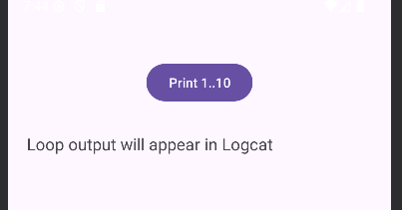

Slide 4
Kotlin Code: onCreate()
• setContentView loads the XML layout.
• findViewById connects Kotlin with XML views.
• btnPrintLoop.setOnClickListener runs when button is clicked.
• TAG is used to filter logs in Logcat.

Slide 5
For Loop Explanation
for (i in 1..10) {
Log.d(TAG, "For loop value: $i")
}
• Runs from 1 to 10.
• Prints each value in Logcat.
• Easy when you know start and end range.

Slide 6
While Loop Explanation
var j = 1
while (j <= 10) {
Log.d(TAG, "While loop value: $j")
j++
}
• Runs as long as condition is true.
• Good when you don't know the end in advance.

Slide 7
Do-While Loop Explanation
var k = 1
do {
Log.d(TAG, "Do-While loop value: $k")
k++
} while (k <= 10)
• Executes at least once.
• Condition checked after running the block.

