Slide 1
Android Activity Lifecycle Demo
Understanding Lifecycle Methods using Logcat & Toast

Slide 2
Aim of the Practical
• To understand Android Activity Lifecycle
• To observe lifecycle methods using Logcat
• To display lifecycle events using Toast messages

Slide 3
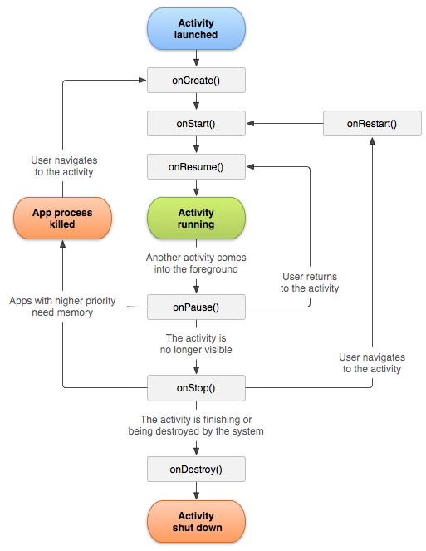

Slide 4
Method | Meaning
onCreate() | Create UI
onStart() | Visible
onResume() | Interactive
onPause() | Partially hidden
onStop() | Completely hidden
onRestart() | Coming back
onDestroy() | Destroyed

Slide 5
XML Layout Explanation
• RelativeLayout is the parent layout
• TextView is centered using layout_centerInParent
• Displays the title: Activity Lifecycle Demo
• Simple UI for demonstration purpose

Slide 6
What is Activity Lifecycle?
• Lifecycle is the sequence of states of an Activity
• Managed by Android OS automatically
• Helps manage memory and resources efficiently

Slide 7
Activity Lifecycle Flow
onCreate() → onStart() → onResume()
onPause() → onStop() → onDestroy()

Slide 8
Required Imports
import android.util.Log
import android.widget.Toast
• Log prints messages in Logcat
• Toast shows short popup messages

Slide 9
onCreate() Method
• Called when Activity is created
• setContentView() loads the layout
• Initialization of components happens here

Slide 10
onStart() & onResume()
onStart(): Activity becomes visible
onResume(): Activity comes to foreground
User can now interact with the app

Slide 11
onPause() & onStop()
onPause(): Another activity comes in front
onStop(): Activity is no longer visible

Slide 12
onDestroy() Method
• Called before Activity is destroyed
• Final cleanup of resources
• Happens when app is closed

Slide 13
Logcat and Toast Output
• Log.d(TAG, "message") → Logcat output
• Toast shows lifecycle method on screen
• Helps visualize lifecycle execution

