Slide 1
Time Series Analysis of S&P 500 Tech Stocks
AAPL, AMZN, GOOG, MSFT - 5 Year Study
Prepared by: Poornima

Slide 2
Project Objective
- Perform time series analysis on closing stock prices of AAPL, AMZN, GOOG, and MSFT
- Explore trends using moving averages, returns, correlations, and visualizations
- Gain insights for investment and financial strategies

Slide 3
Dataset Overview
- Source: S&P 500 tech stock data from 2013 to 2018
- 505 individual CSV files with 7 columns: Date, Open, High, Low, Close, Volume, Name
- Combined major tech stocks (AAPL, AMZN, GOOG, MSFT) for analysis
- Total Rows: 4752 | Cleaned and formatted

Slide 4
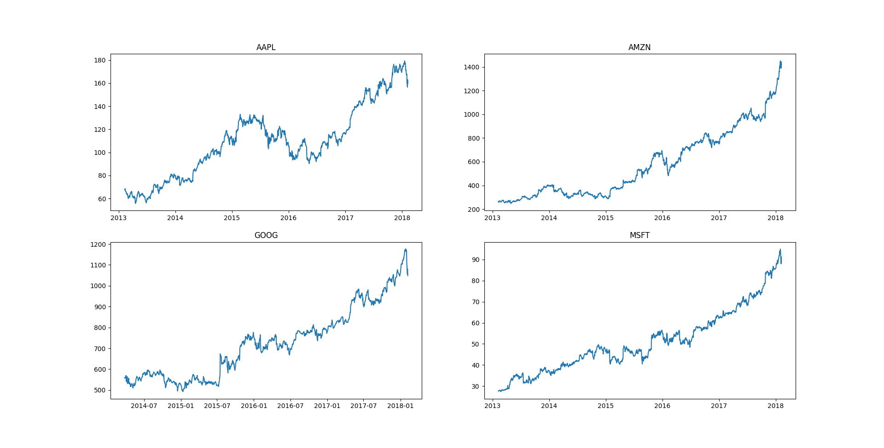
Stock Closing Prices Over Time

Slide 5
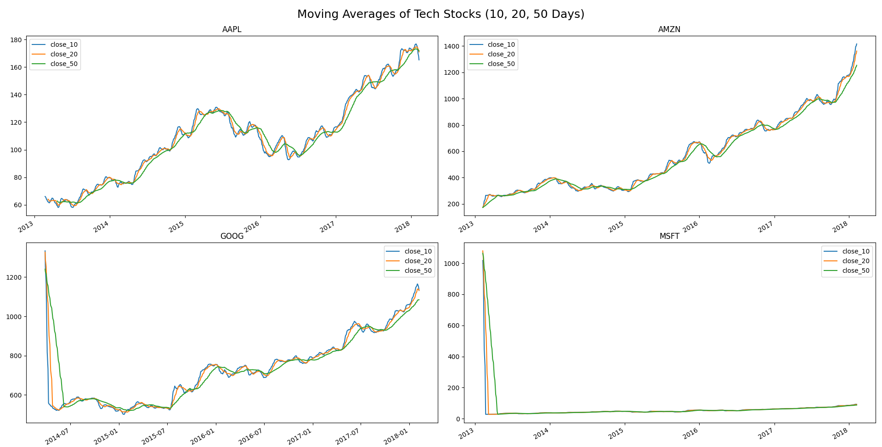
Moving Averages (10, 20, 50 Days)

Slide 6
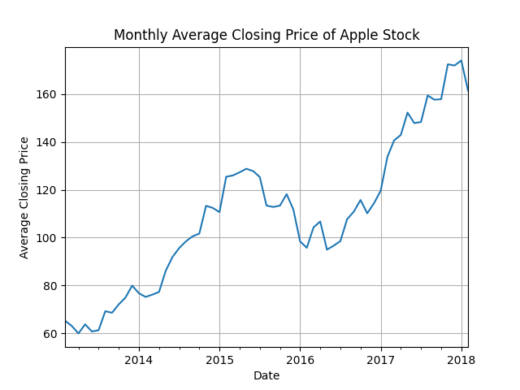
Monthly Average Close - Apple

Slide 7
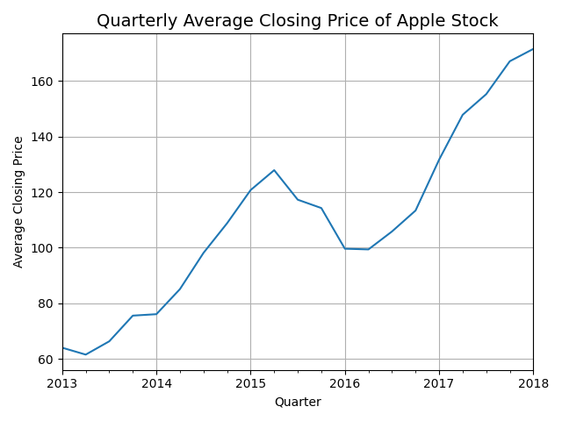
Quarterly Average Close - Apple

Slide 8
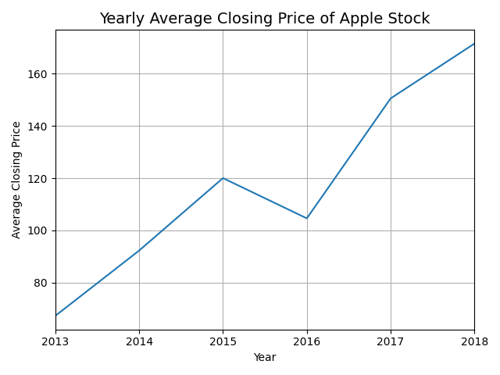
Yearly Average Close - Apple

Slide 9
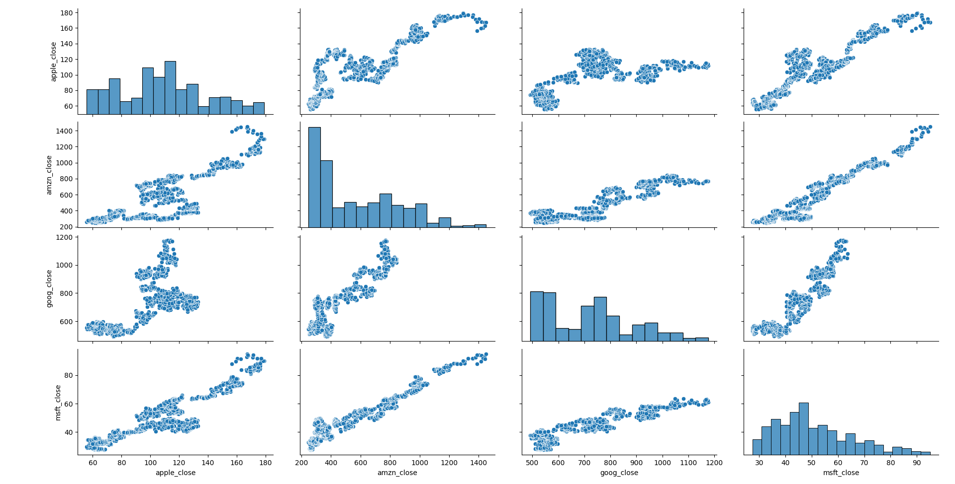
Pairwise Relationships (Seaborn Pairplot)

Slide 10
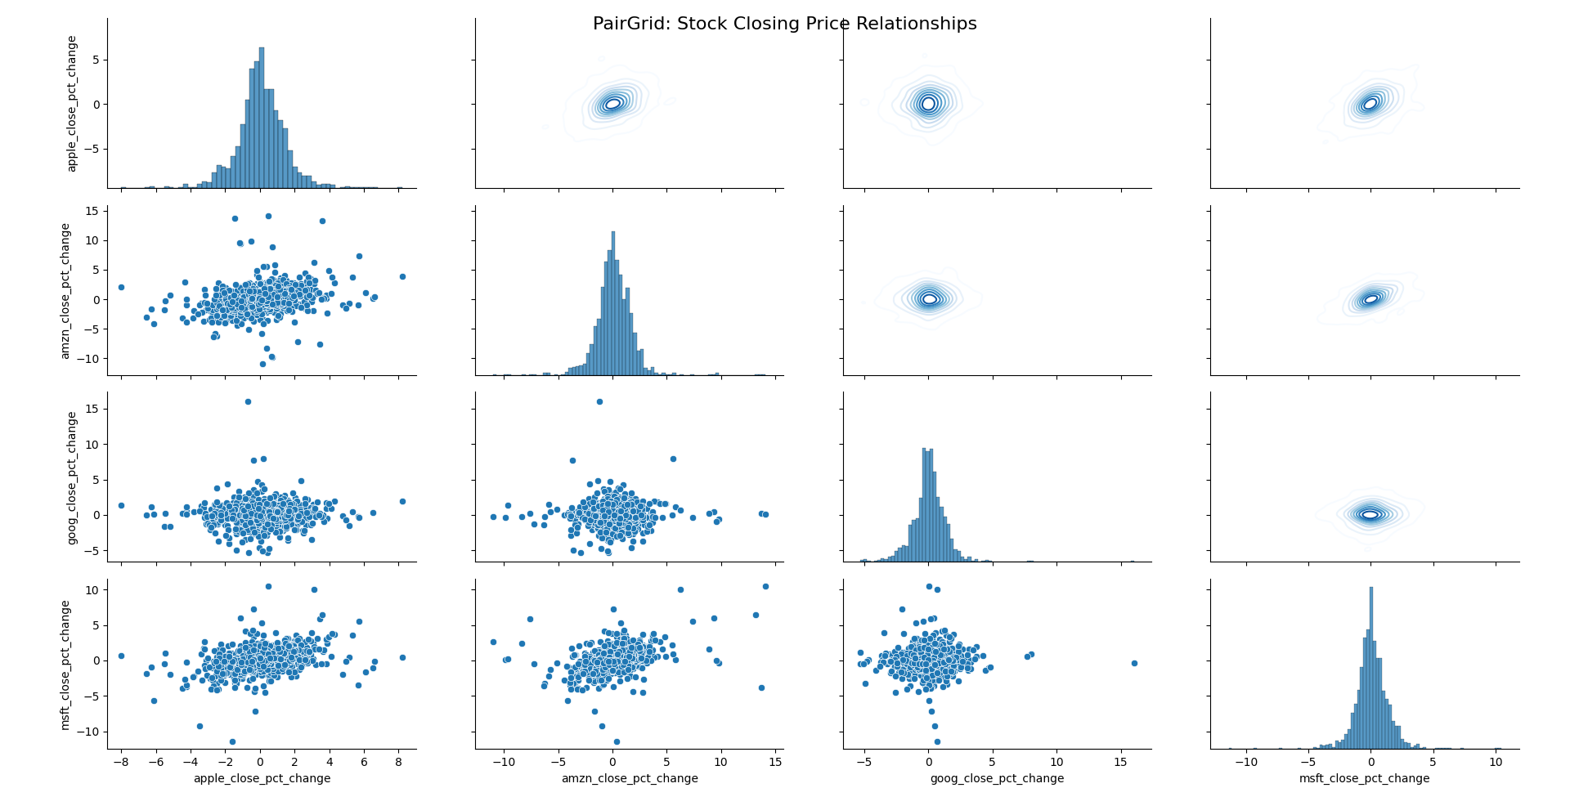
PairGrid Plot of Stock Closing Price

Slide 11
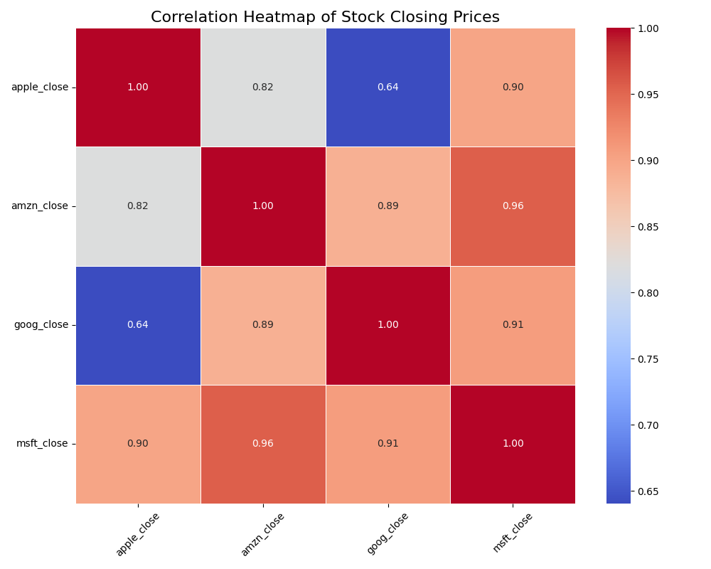
Correlation Heatmap

Slide 12
Summary & Key Insights
- All four tech stocks show strong positive correlations
- MSFT and AMZN had highest correlation (~0.95)
- Moving averages highlight trends and entry/exit signals
- Apple stock showed seasonal trends across months, quarters, and years
- Data is now ready for prediction or further financial modeling

