Slide 1
YouTube Comment & Content Analysis
Data-Driven Insights to Optimize Engagement

Slide 2
Project Objective
- Analyze YouTube video and comment data
- Extract insights from viewer comments using sentiment and emoji analysis
- Understand the impact of punctuation, category, and content design on views, likes, and engagement
- Deliver actionable recommendations for content creators

Slide 3
Tools & Libraries Used
- Python, Pandas, Seaborn, Matplotlib, Plotly
- TextBlob, WordCloud, Emoji, SQLAlchemy
- SQLite Database

Slide 4
Data Sources
- UScomments.csv: ~690K user comments
- USvideos.csv and others: Video metadata (likes, dislikes, views)
- US_category_id.json: Category mapping

Slide 5
Data Cleaning
- Removed nulls, duplicates, non-ASCII
- Emoji encoding fixed
- Merged with category names for analysis

Slide 6
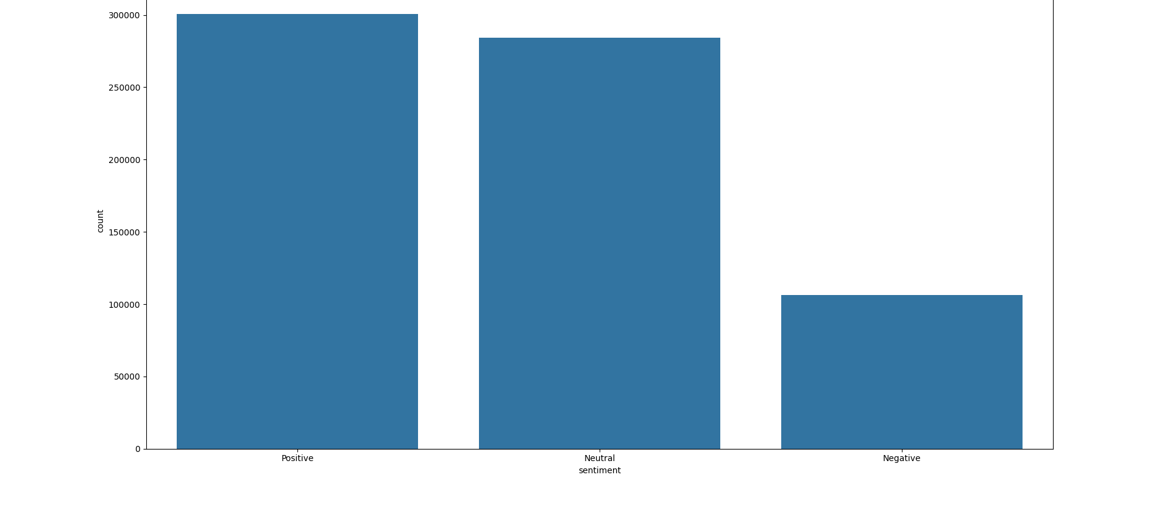
Sentiment Distribution of Comments

Slide 7
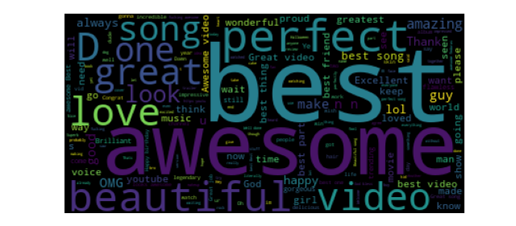
Positive Comments Word Cloud

Slide 8
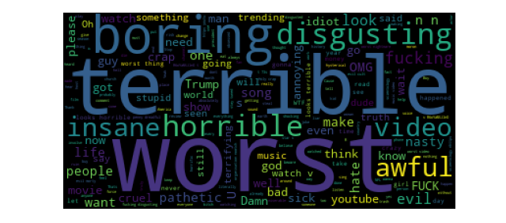
Negative Comments Word Cloud

Slide 9
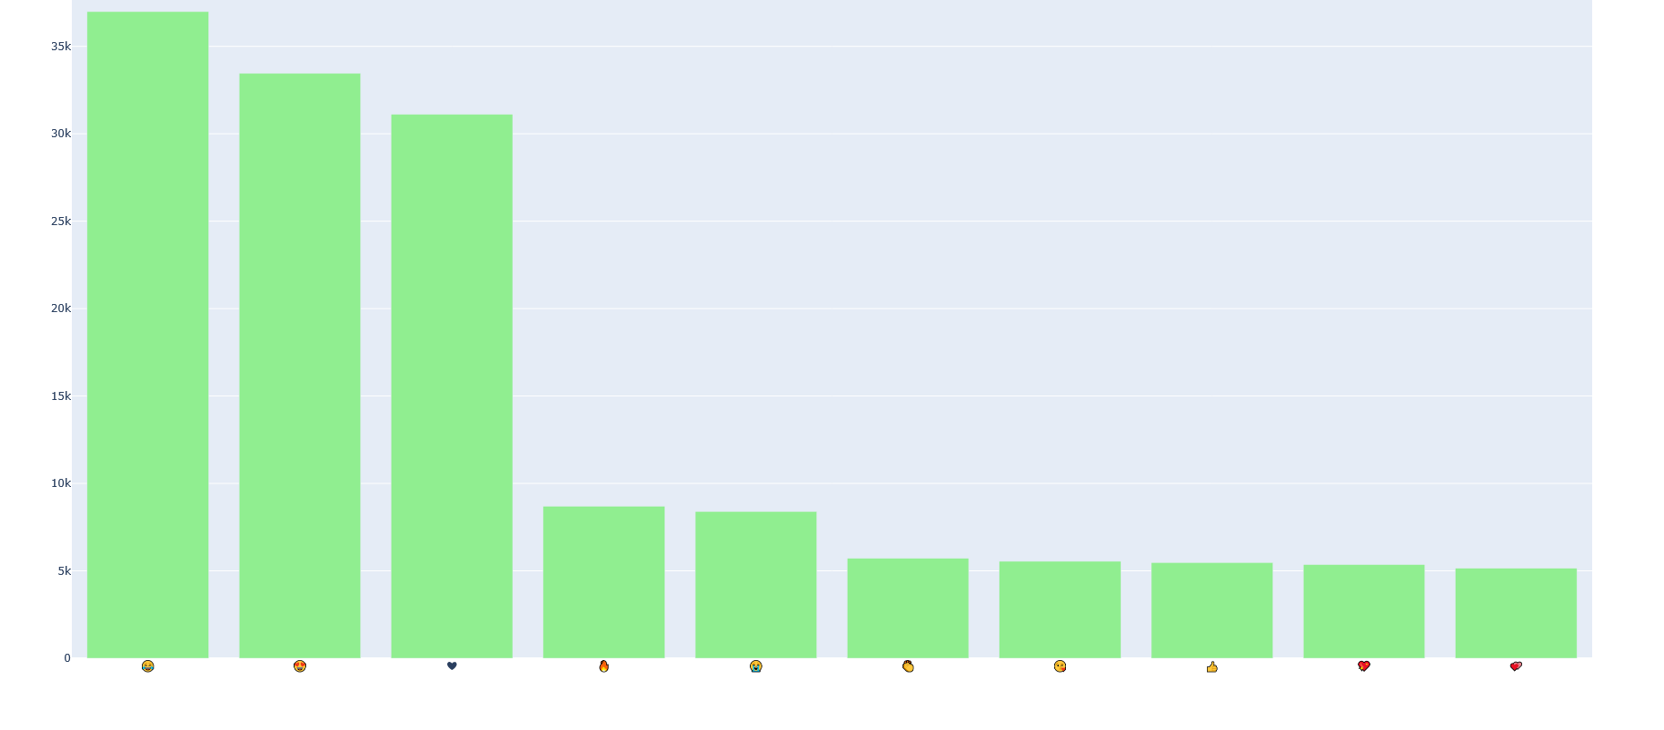
Top Emojis Used in Comments

Slide 10
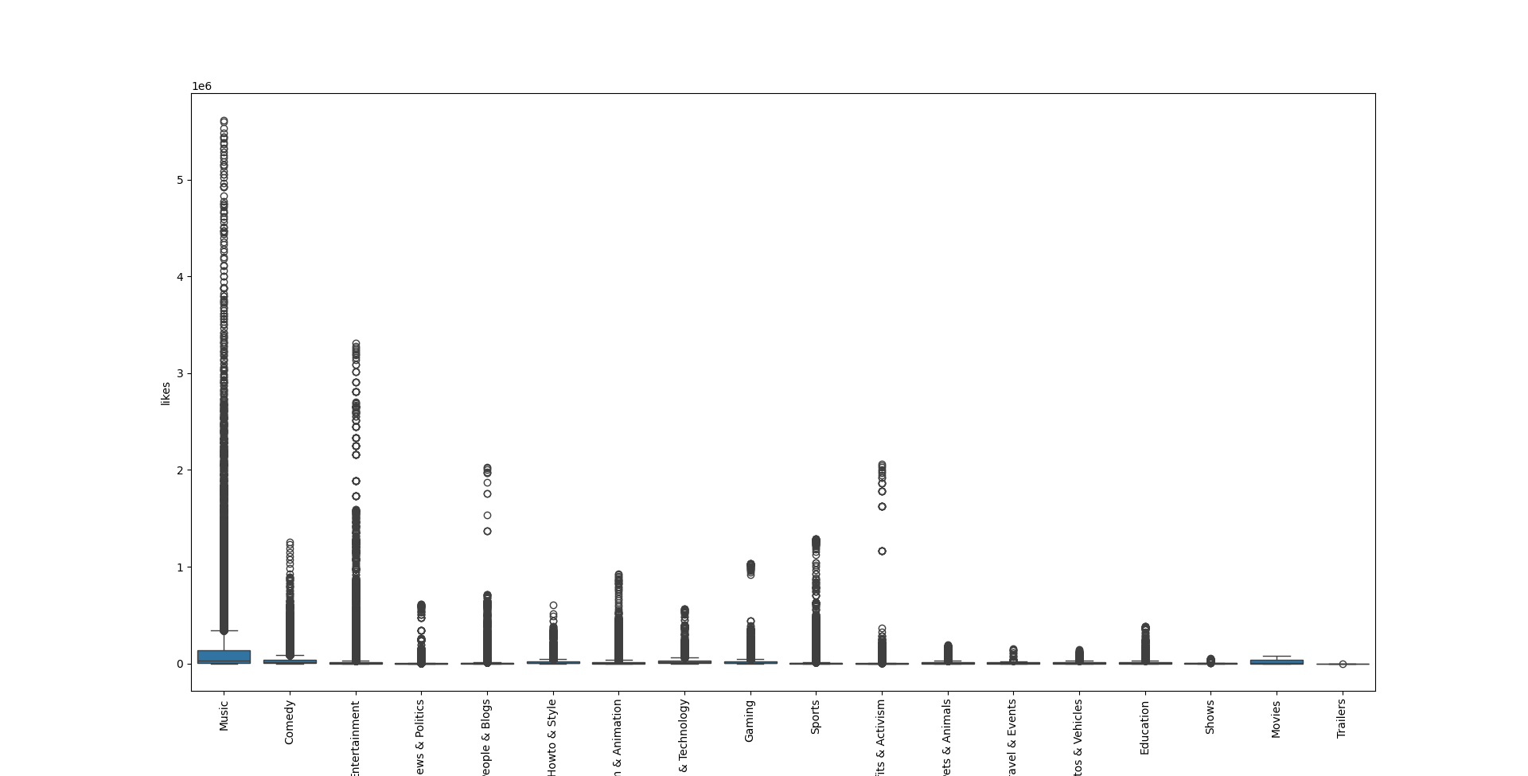
Likes by Category

Slide 11
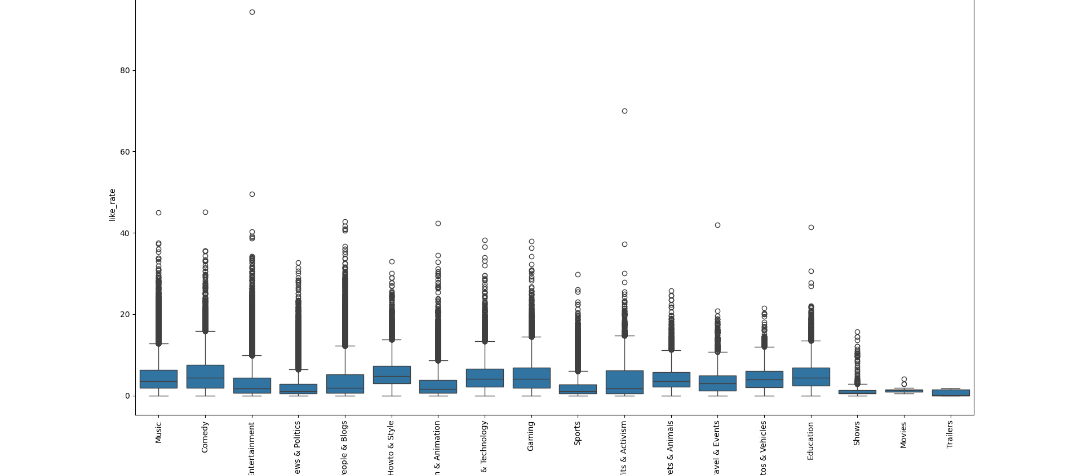
Like Rate by Category

Slide 12
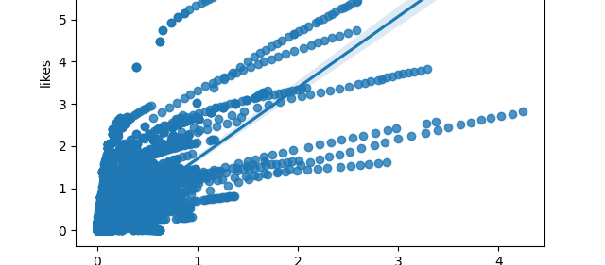
Views vs Likes

Slide 13
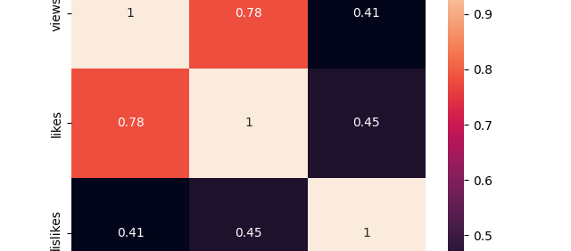
Correlation Heatmap

Slide 14
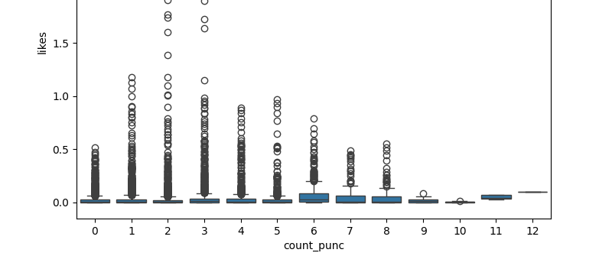
Top Channels by Trending Videos

Slide 15
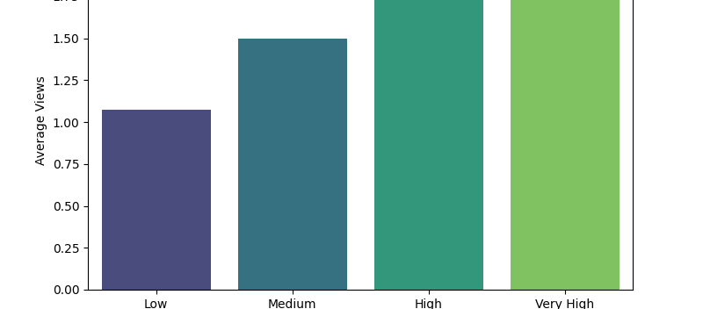
Punctuation vs Views

Slide 16
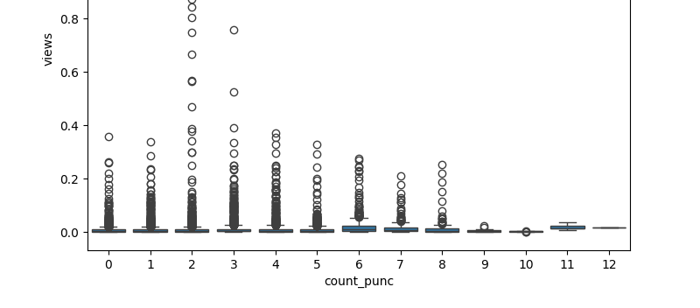
Punctuation Count Distribution

Slide 17
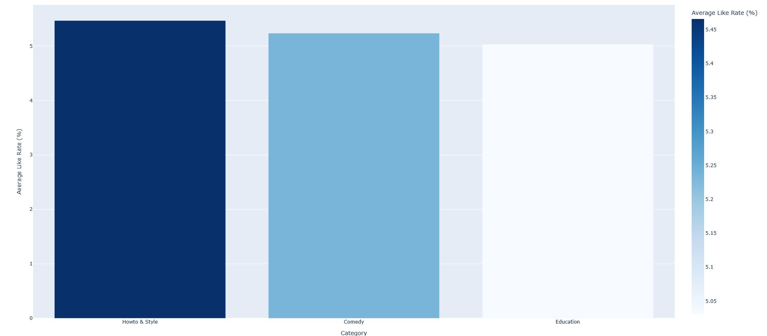
Top Categories by Like Rate

Slide 18
Recommendations
1. Use emojis (❤, 😂, 😍) in titles/thumbnails
2. Medium-to-High punctuation in titles improves views
3. Best categories: Howto & Style, Comedy, Education
4. Emotional & Positive content gets more engagement

Slide 19
Final Dashboard Summary
- Sentiment: Mostly positive comments
- Emojis: Frequently used in top videos
- Categories: Comedy, Education, Style are top-performing
- Punctuation: Medium-to-High use increases CTR
- Engagement: Strong correlation between likes and views

Slide 20
Q&A
Thank you!
Questions / Feedback welcome
Contact: [poornima.data.analyst@gmail.com]

