Slide 1
COASTLINE EXTRACTION FROM AERIAL IMAGES BASED ON EDGE DETECTION
Presented By:
Poornima Manjunath

Slide 2
Outline
Motivation
Overview of Methodology
Pre-processing
Region Segmentation
Post-processing
Coastline modelling
Conclusion

Slide 3
Motivation
Significance of Coastline Extraction
Geographical exploration
Autonomous navigation
Coastal resource inventory and management
Coastal erosion monitoring and modelling

Slide 4
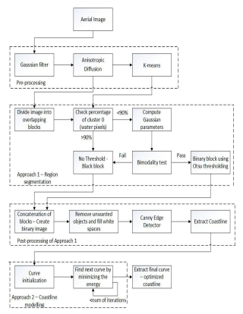
Block diagram of proposed methodology
Figure.1 Block Diagram [Ref.1]

Slide 5
Pre-processing
Step 1: Apply a Gaussian filter
Step 2 : Apply Anisotropic Diffusion Algorithm

Slide 6
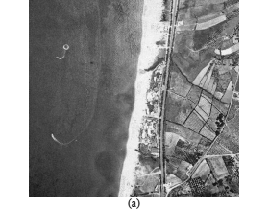

Result of pre-processing
Figure.2 a)Initial Image b)Image after Pre-processing[Ref.1]

Slide 7
Region segmentation
Step 1: Clustering of the image using K-means
Step 2: Divide the image into square overlapping blocks of width ‘w’
Step 3:Examine the percentage of zero value pixels.
Step 4: Examine the bimodality.
Step 5: A threshold ‘T’ is calculated by using the Otsu’s method.

Slide 8

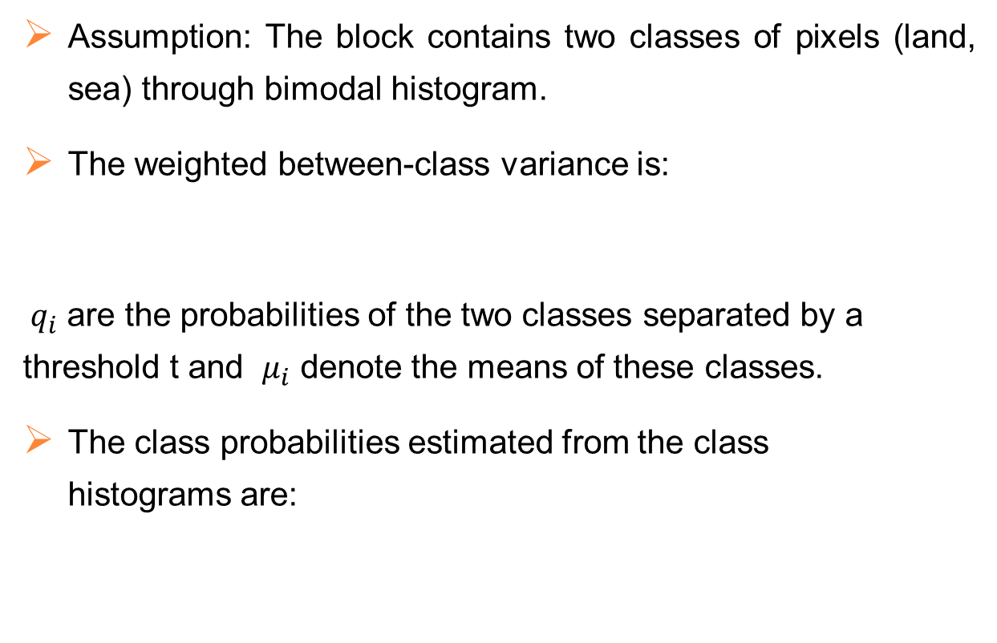
Otsu’s algorithm
Assumption: The block contains two classes of pixels (land, sea) through bimodal histogram.
The weighted between-class variance is:
${ q}_{i}$ are the probabilities of the two classes separated by a threshold t and $μ_{i}$ denote the means of these classes.
The class probabilities estimated from the class histograms are:

Slide 9


Otsu’s algorithm contd..
The class means are given by:
Compute the threshold that maximizes the between class variance.
Apply the threshold on each block.

Slide 10
Post-processing
Concatenate the blocks in order to recreate the image in a binary form.
Apply the morphological operations of erosion and dilation.
An erosion procedure followed by a dilation.
Further, apply a closing operation, which is a dilation followed by an erosion.

Slide 11
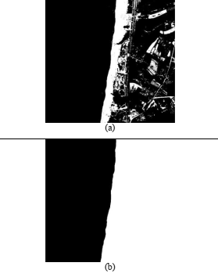
Post-processing contd..
Figure.3 (a) Image after concatenation of binary blocks (b) Image after morphological operations[Ref. 1]

Slide 12
Post-processing contd..
Canny edge detection method.
Find the intensity gradient of the image.
Apply non-maximum suppression.
Hysteresis is applied to eliminate gaps

Slide 13
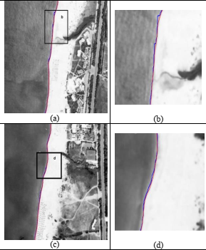
Coastline modelling
Open active contour method:
Figure.4 Estimation of coastline modelling approach [Ref.1]

Slide 14
Conclusion
Provides coastline extraction using aerial images through image processing techniques.
Local Thresholding Method, Canny edge detection and Active Contour Fitting improve the accuracy.
Future Scope:
Implementing the transform for moving from image coordinates to real-world coordinates.
Basis for post processing and computations of real-world measures

Slide 15
REFERENCES
[1] V. Paravolidakis, K. Moirogiorgou, L. Ragia , M. Zervakis, C. Synolakis,
”Coastline Extraction From Aerial Images Based On Edge Detection”, ISPRS Annals of the Photogrammetry, Remote Sensing and Spatial Information Sciences, Volume III-8, 2016,XXIII ISPRS Congress, 12–19 July 2016.
[2] H. LIU , K. C. JEZEK, “Automated extraction of coastline from satellite imagery by integrating Canny edge detection and locally adaptive thresholding methods”, INT. J. REMOTE SENSING, 10MARCH, 2004, VOL. 25, NO. 5, 937–958.
[3] John Canny, “A Computational Approach To Edge Detection”, IEEE Transactions On Pattern Analysis And Machine Intelligence, Vol. Pami-8, No. 6, November 1986.
[4] DongjuLiu, JianYu,” Otsu method and K-means “ Ninth International Conference on Hybrid Intelligent Systems,2009
[5] Muhammet Baştan , Syed Saqib Bukhari, Thomas Breuel, “Active Canny: edge detection and recovery with open active contour models”, IET Image Processing,2017

Slide 16
Thank you

