Slide 1

PROCUREMENT NEGOTIATION AI
Applied Game-Theory Modelling for Strategic Negotiation Preparation
Sample Capstone Project
SUPPLIER ANALYSIS
& ALTERNATIVES
BATNA • ZOPA
& BARGAINING
GAME THEORY
& STRATEGY
Synthetic data used for demonstration — not actual customer findings.
CILICONCHIP | Procurement Negotiation AI | 1

Slide 2
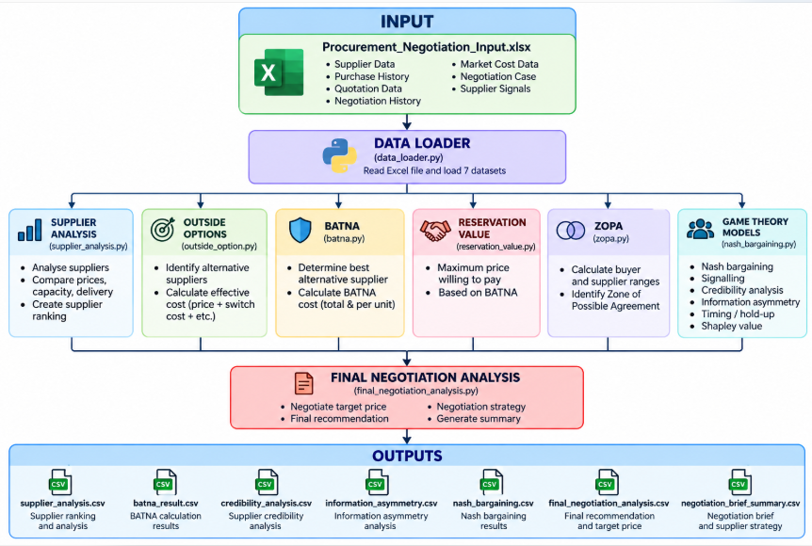

Slide 3
1. Business Problem
PROCUREMENT
DATA
SUPPLIER
COMPARISON
NEGOTIATION
BOUNDARIES
BETTER
DECISION
• Procurement teams need a clear view of supplier options before entering a negotiation.
• The buyer needs a target price and a walk-away point.
• If the current negotiation fails, the buyer needs to know the best realistic alternative.
• Supplier claims may be useful, but they need to be assessed for evidence and credibility.
CILICONCHIP | Procurement Negotiation AI | 2

Slide 4
2. Project Objective
01
02
03
04
05
Analyze
Suppliers
Find
Outside Options
Calculate
BATNA & ZOPA
Apply
Game Theory
Generate
Strategy
FINAL OUTPUT → NEGOTIATION BRIEF
Opening • Target • Walk-away • Risks • Recommended actions
CILICONCHIP | Procurement Negotiation AI | 3

Slide 5
3. Strategic Procurement Negotiation Preparation Flow
PROCUREMENT DATA
SUPPLIER ANALYSIS
OUTSIDE OPTIONS
SIGNALLING
& CREDIBILITY
TIMING
DEPENDENCY
←
BATNA
INFORMATION
ASYMMETRY
SHAPLEY
ANALYSIS
←
RESERVATION VALUE
ZOPA
NASH BARGAINING
FINAL NEGOTIATION DECISION
CILICONCHIP | Procurement Negotiation AI | 4

Slide 6
4. Synthetic Procurement Dataset
Dataset | Records | What it represents
supplier_data.csv | 4 suppliers | Supplier master information
purchase_history.csv | 6 records | Historical purchases
quotation_data.csv | 4 quotations | Current RFQ quotations
negotiation_history.csv | 4 records | Previous negotiation rounds
market_cost_data.csv | 5 records | Market / commodity cost information
negotiation_case.csv | 1 case | Current negotiation being analyzed
supplier_signals.csv | 4 signals | Supplier claims / evidence
4 SUPPLIERS
1 NEGOTIATION CASE
7 DATA FILES
SYNTHETIC DATA
CILICONCHIP | Procurement Negotiation AI | 5

Slide 7
5. From Data to Negotiation Decision
Supplier Data
BATNA / ZOPA
Purchase History
NEGOTIATION
STRATEGY
SUPPLIER
ANALYSIS
GAME THEORY
Quotation Data
Negotiation History
RISK / SIGNALS
Market Data
The project converts raw procurement records into a structured negotiation recommendation.
Supplier Signals
CILICONCHIP | Procurement Negotiation AI | 6

Slide 8
6. Supplier Analysis
Supplier | Price | Capacity | Quality | Reliability | Delivery | Decision
S001 – A | ₹120 | 15,000 | 94 | 91 | 30 days | Current supplier
S002 – B | ₹108 | 8,000 | 88 | 96 | 25 days | Capacity insufficient
S003 – C | ₹111 | 12,000 | 92 | 94 | 20 days | Feasible
S004 – D | ₹115 | 20,000 | 90 | 89 | 35 days | Delivery too long
CURRENT
S001
BEST FEASIBLE
S003
BATNA CANDIDATE
S003
CILICONCHIP | Procurement Negotiation AI | 7

Slide 9
7. BATNA, Reservation Value & ZOPA
BATNA
S003 – Supplier C
₹11.30 lakh effective cost
RESERVATION VALUE
₹11.30 lakh total
₹113 / unit
ZOPA
₹111 – ₹113 / unit
Supplier C
Supplier quote
₹111
NEGOTIATION ZONE ₹111 → ₹113
₹113
Buyer limit
Simple meaning: if the negotiation stays inside ₹111–₹113 per unit, a deal is feasible under this prototype.
CILICONCHIP | Procurement Negotiation AI | 8

Slide 10
8. Supplier Signals → Credibility → Verification
Supplier | Signal | Evidence | Strength | Interpretation
S001 | Alternative customer @ ₹125 | Yes | 0.9 | Strong evidence
S003 | Alternative customer @ ₹118 | No | 0.2 | Weak / unverified
S001 | Capacity constraint = 0.95 | Yes | 0.8 | Strong evidence
S003 | Raw-material increase = 8 | Yes | 0.7 | Strong evidence
SIGNALLING
What is the supplier claiming?
CREDIBILITY
How strong is the evidence?
VERIFICATION
Can we rely on the claim?
These are prototype evidence-strength indicators, not calibrated truth probabilities.
CILICONCHIP | Procurement Negotiation AI | 9

Slide 11
9. Applied Game-Theory Layer
SIGNALLING
Supplier claims
CREDIBILITY
Evidence
NASH
Reference price
TIMING
Dependency
SHAPLEY
Lever value
FINAL NEGOTIATION DECISION
Combine quantitative boundaries + game-theory signals + risks
Purpose: support the buyer before negotiation — not autonomously negotiate with the supplier.
CILICONCHIP | Procurement Negotiation AI | 10

Slide 12
10. Sample Negotiation Case
CASE NEG001
RFQ001
M001 – Brake Valve
10,000 units
Item | Value
Current supplier | S001 – Supplier A
Current offer | ₹120 / unit
Required delivery | 30 days
Best alternative | S003 – Supplier C
Supplier C quote | ₹111 / unit
Buyer reservation | ₹113 / unit
Nash reference | ₹112 / unit
RESULT → Supplier C is the strongest negotiation alternative
CILICONCHIP | Procurement Negotiation AI | 11

Slide 13
11. Negotiation Strategy Output
OPENING
₹109.76 / unit
TARGET
₹112 / unit
WALK-AWAY
₹113 / unit
Start below target
Move toward ₹112
Protect ₹113 limit
DECIDE
Negotiation actions: verify claims • use S003 as the alternative • protect delivery terms • avoid crossing the walk-away boundary.
CILICONCHIP | Procurement Negotiation AI | 12

Slide 14
12. Technology & Project Structure
DATA
FILES
PYTHON
PANDAS
ANALYTICAL
MODULES
MAIN.PY
Module | Purpose
supplier_analysis.py | Supplier scoring and feasibility
outside_option.py | Alternative supplier cost
batna.py / reservation_value.py | BATNA and buyer boundary
zopa.py / nash_bargaining.py | Negotiation zone and reference price
signalling.py / credibility.py | Supplier claims and evidence
timing_model.py / shapley.py | Timing risk and lever attribution
negotiation_decision.py | Final rule-based recommendation
CILICONCHIP | Procurement Negotiation AI | 13

Slide 15
13. Assumptions & Limitations
• All values are synthetic/sample values created for the capstone demonstration.
• BATNA and reservation value use simplified prototype assumptions.
• ZOPA uses a simplified supplier-side boundary.
• Historical average price is used as a proxy for supplier reservation value in the Nash model.
• Signal and information-asymmetry scores are prototype indicators, not calibrated probabilities.
• Timing analysis identifies dependency/risk; it does not prove supplier hold-up behaviour.
• Current system is a decision-support prototype, not an autonomous negotiation agent.
Production use would require real data, calibration, validation and stronger governance.
CILICONCHIP | Procurement Negotiation AI | 14

Slide 16
Output File | What it tells us
supplier_analysis.csv | Which suppliers are suitable for this requirement?
outside_options.csv | If our current negotiation fails, what alternatives do we have and what would they cost?
batna_result.csv | If I cannot reach an agreement with my current supplier, what is my best backup option?
reservation_value.csv | What is my maximum acceptable price before I should walk away
zopa_analysis.csv | Is there a possible negotiation zone where a deal can happen
signalling_analysis.csv | What is the supplier claiming, and how strong is the evidence behind that claim?
credibility_analysis.csv | How much should we trust the supplier's claim
verification_analysis.csv | Can we actually use this supplier claim in our negotiation analysis, or should we verify it first?
information_asymmetry.csv | Where do we have an information disadvantage?
negotiation_brief_summary.csv | Give me the important things I need to know before the negotiation.
timing_analysis.csv | Could timing or delivery requirements create negotiation risk?
negotiation_brief_supplier_strategy.csv | What should I specifically do when negotiating with this supplier?
shapley_analysis.csv | How should the buyer actually enter and conduct the negotiation?
nash_bargaining.csv | If bargaining power is treated equally under our simplified model, what price would be a reasonable reference point?

Slide 17
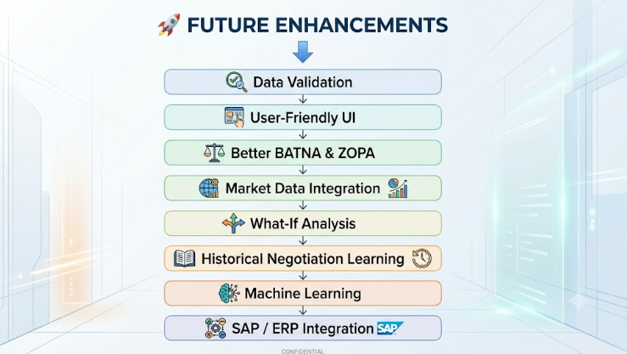

Slide 18
14. Conclusion
1
DATA → ANALYSIS
2
ANALYSIS → BOUNDARIES
3
BOUNDARIES → STRATEGY
Sample recommendation: negotiate with Supplier C around ₹112/unit, with ₹113/unit as the prototype walk-away boundary.
The project demonstrates how procurement data and game theory can support structured negotiation preparation.
THANK YOU

