Slide 1

LLM for Secure Code – POC Approach
https://github.com/poornimadevip/Vulnerable-Code-Snippets
Improve Chunking
GPT Models
Existing Code Scanners
Improve Prompt
Scan Results
Scan Results
Compare Results
Feedback Loop

Slide 2
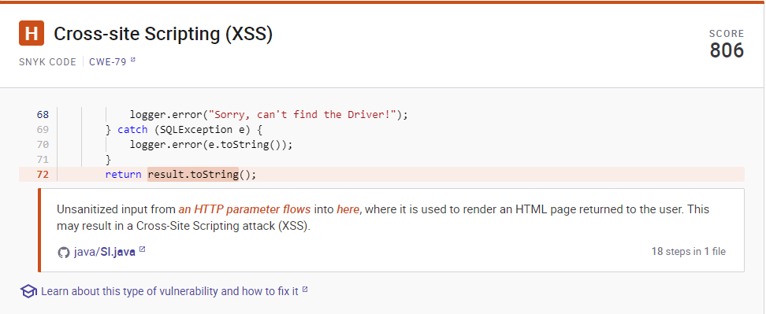
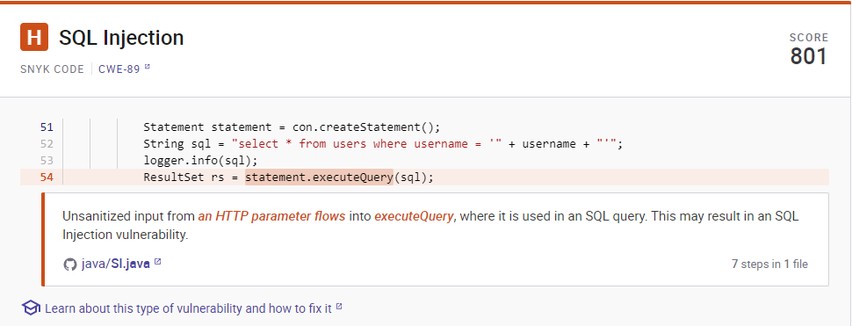
LLM for Secure Code – Findings by Snyk Security

Slide 3
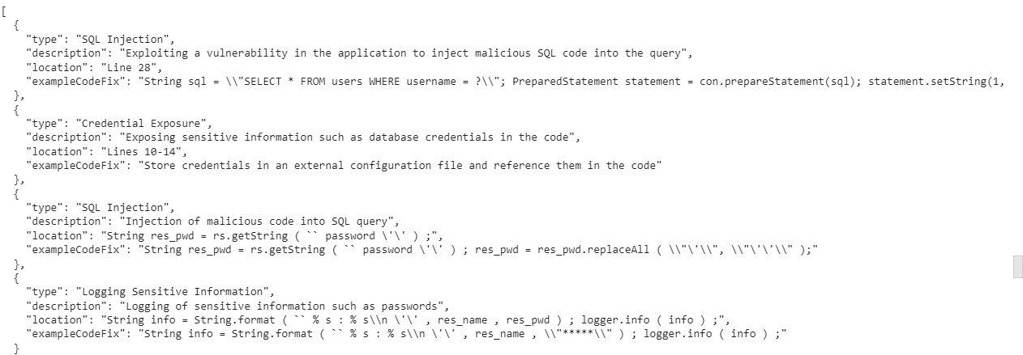
LLM for Secure Code – Findings by GPT-3

Slide 4
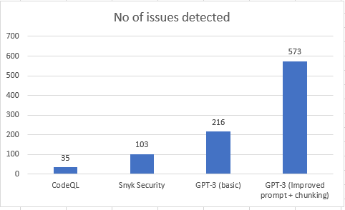
LLM for Secure Code – Summary
Total Files in the repository : 128
Language : python, java, C, C++, C#, Ruby, Go, PHP

