Slide 1
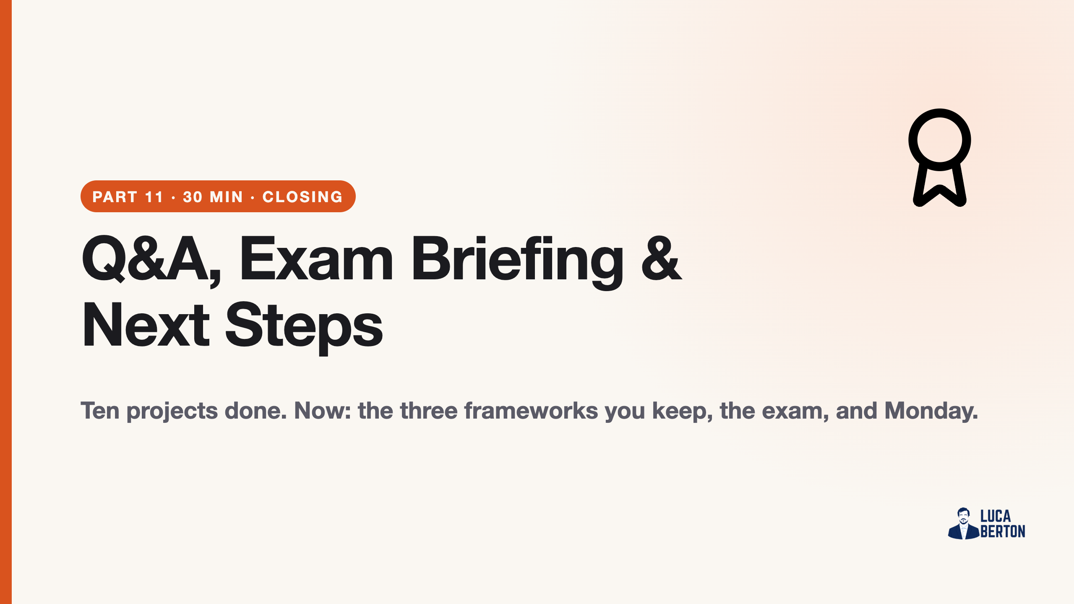
Notes:
duration: 30 min SPEAKER NOTES — slide 1 (hook, 60 sec) - One line: "This block is the bridge from workshop to your real repo."

Slide 2
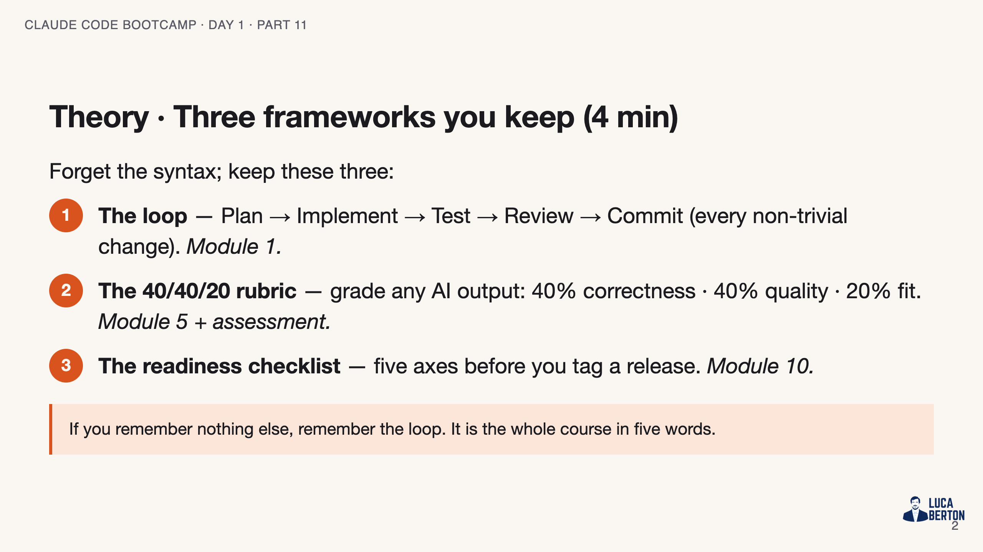
Notes:
SPEAKER NOTES — slide 2 (theory, 4 min) - These three transfer to any model, any tool, any repo. That's the carry-out.

Slide 3
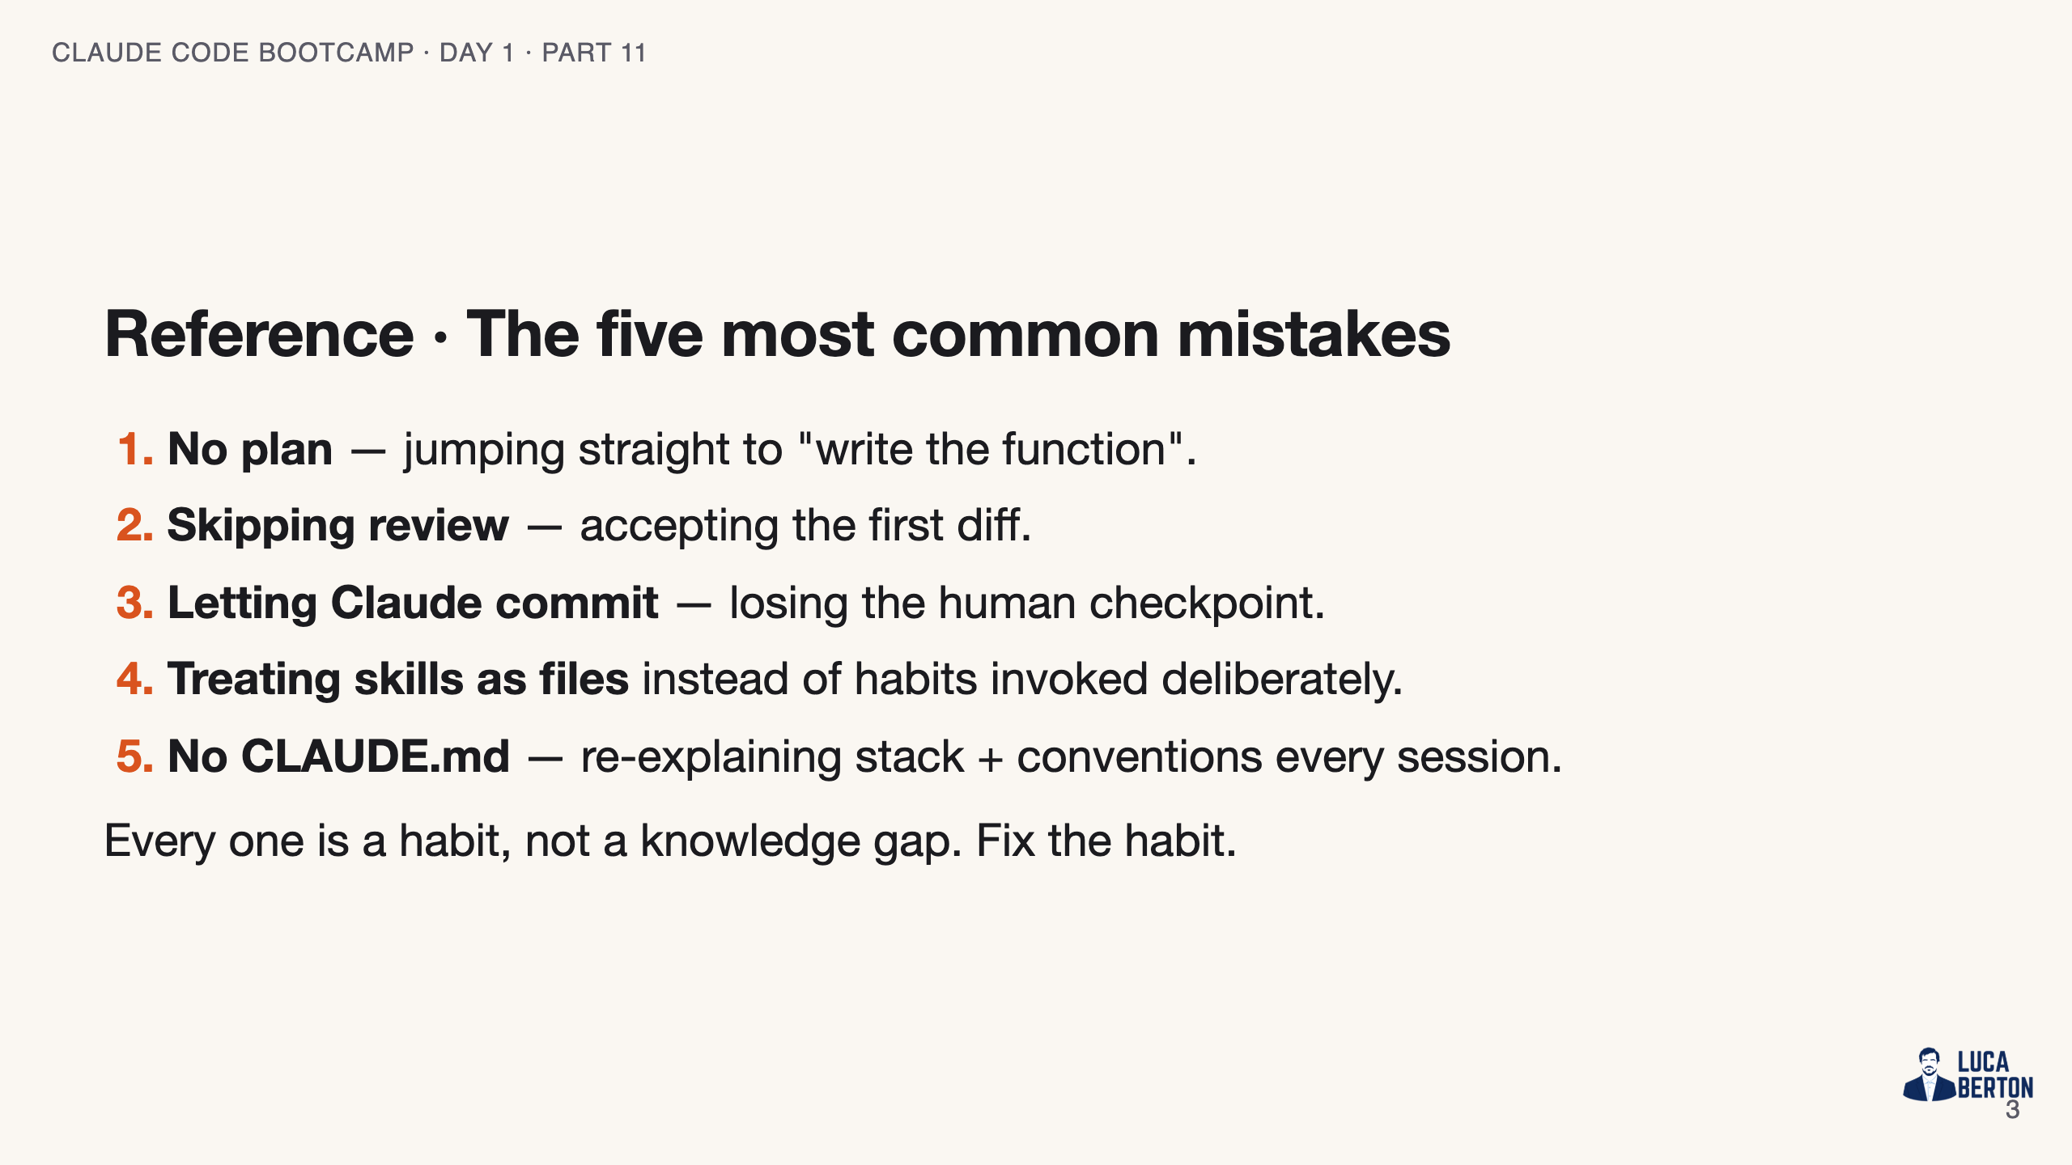
Notes:
SPEAKER NOTES — slide 3 (reference, 1 min) - Ask the room which one they're most guilty of. Quick show of hands.

Slide 4
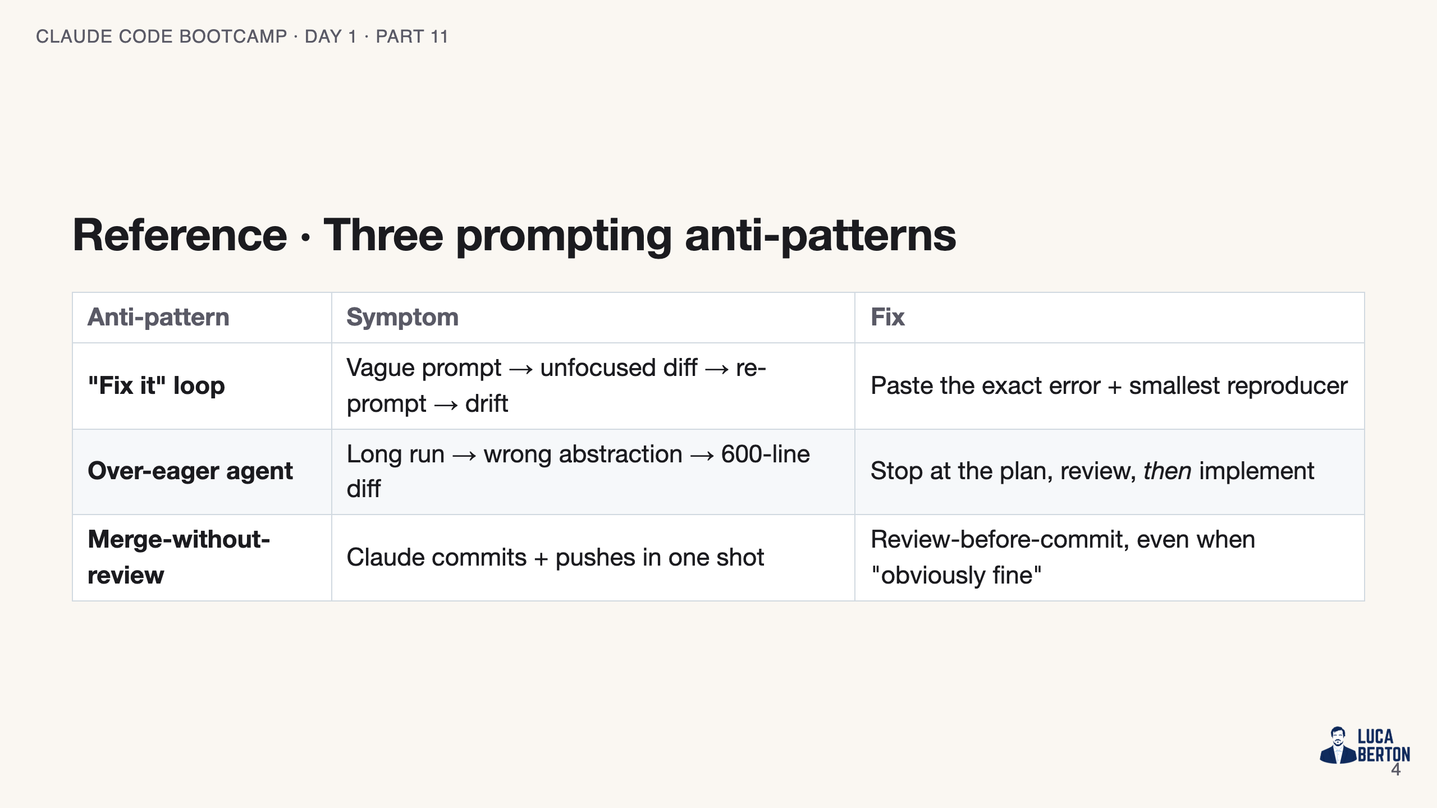
Notes:
SPEAKER NOTES — slide 4 (reference, 3 min) - Demo each anti-pattern + its fix if time allows. Otherwise narrate from the table.

Slide 5
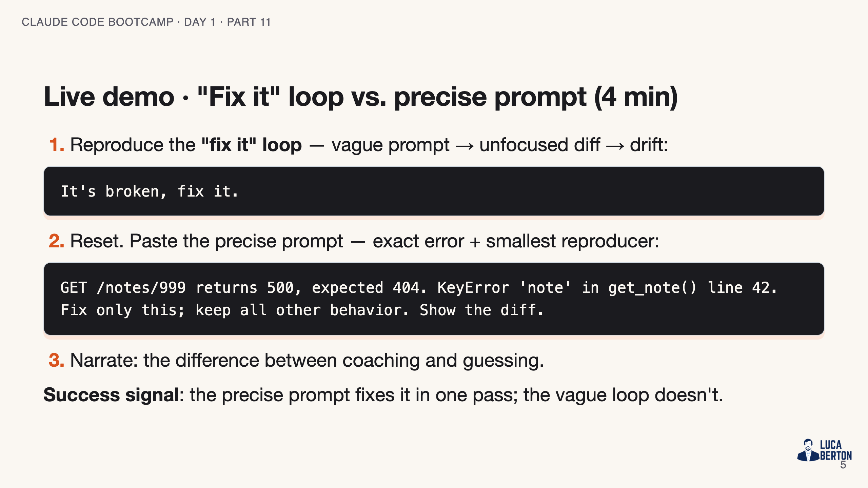
Notes:
SPEAKER NOTES — slide 5 (demo, 4 min)

Slide 6
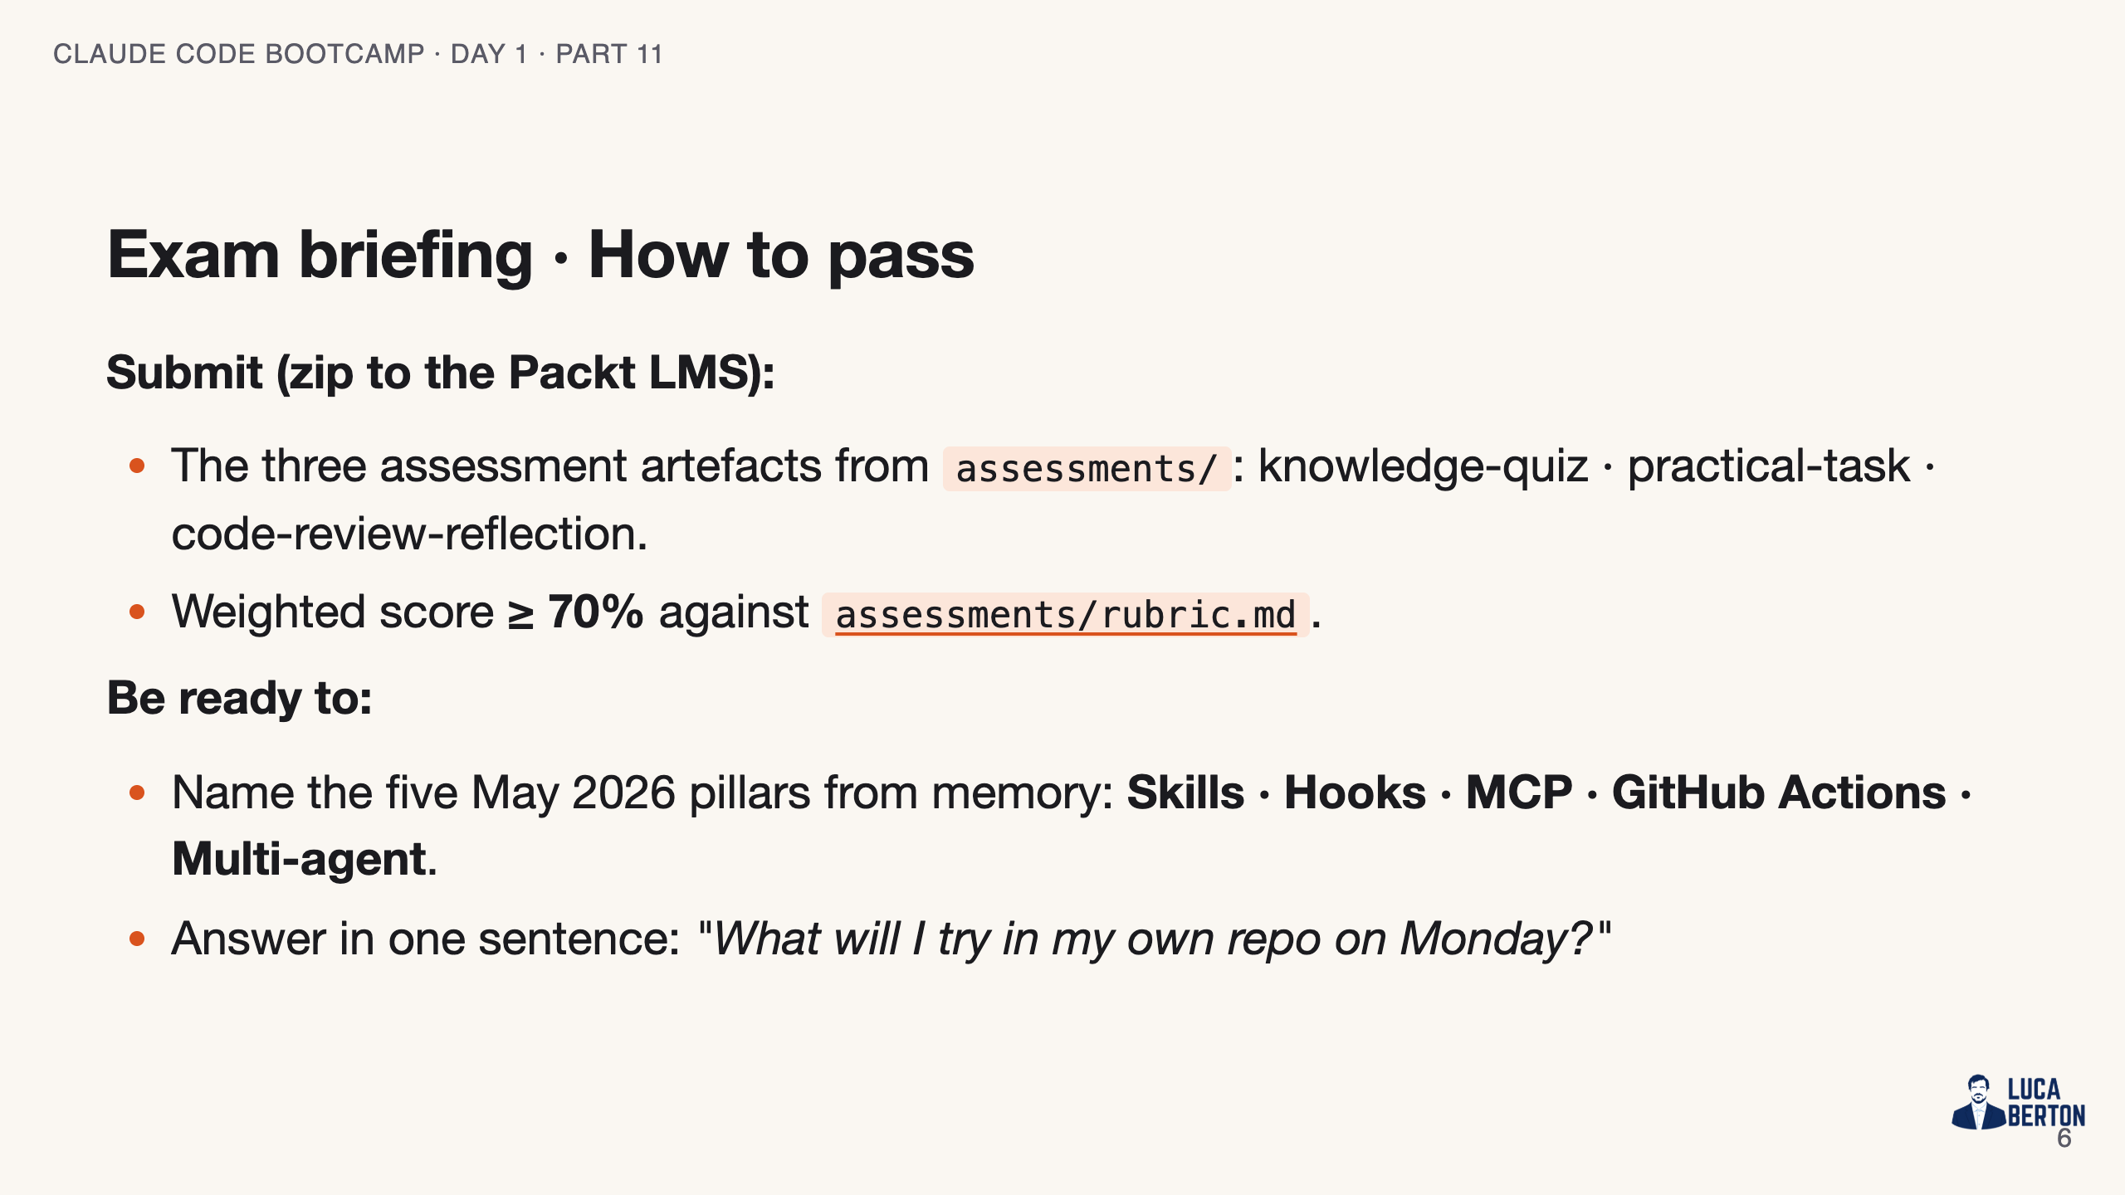
Notes:
SPEAKER NOTES — slide 6 (exam, 3 min) - Read the 70% bar out loud. Point students at the rubric file now.

Slide 7
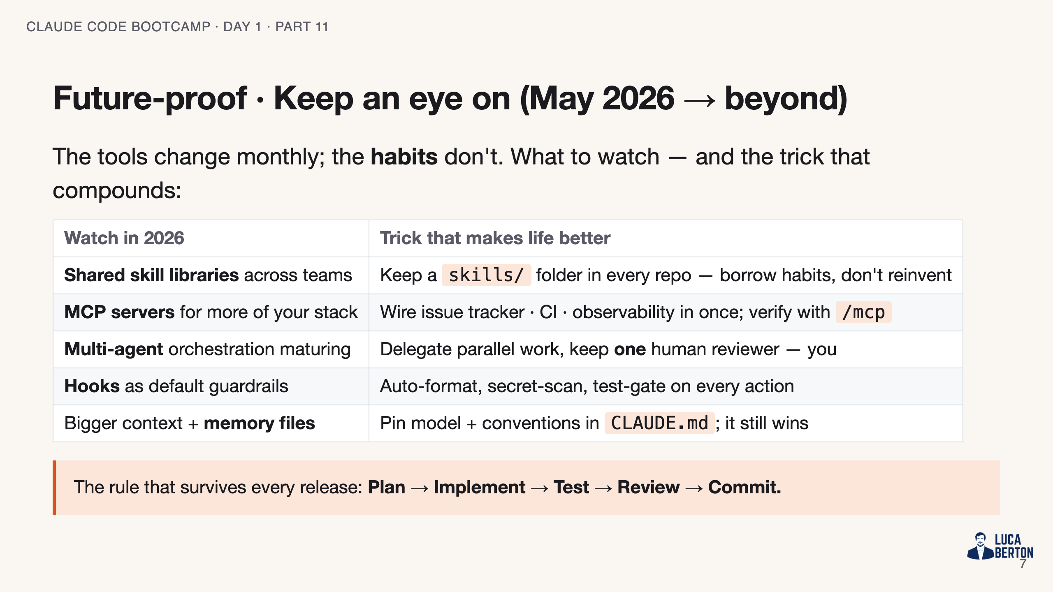
Notes:
SPEAKER NOTES — slide 7 (future-proof, 2 min) - Theme: chase habits, not features. Every 2026 capability amplifies the loop, never replaces the reviewer. - Tell them to bookmark the repo's skills/ folder as their starting point Monday.

Slide 8
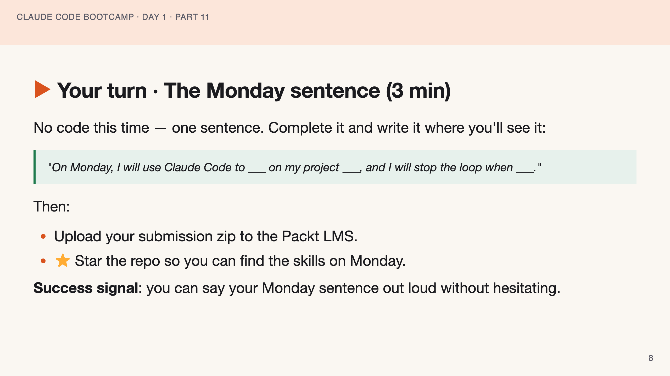
Notes:
SPEAKER NOTES — slide 8 (3 min) - If a student can't complete the sentence, send them to re-watch Module 9 before submitting.

Slide 9
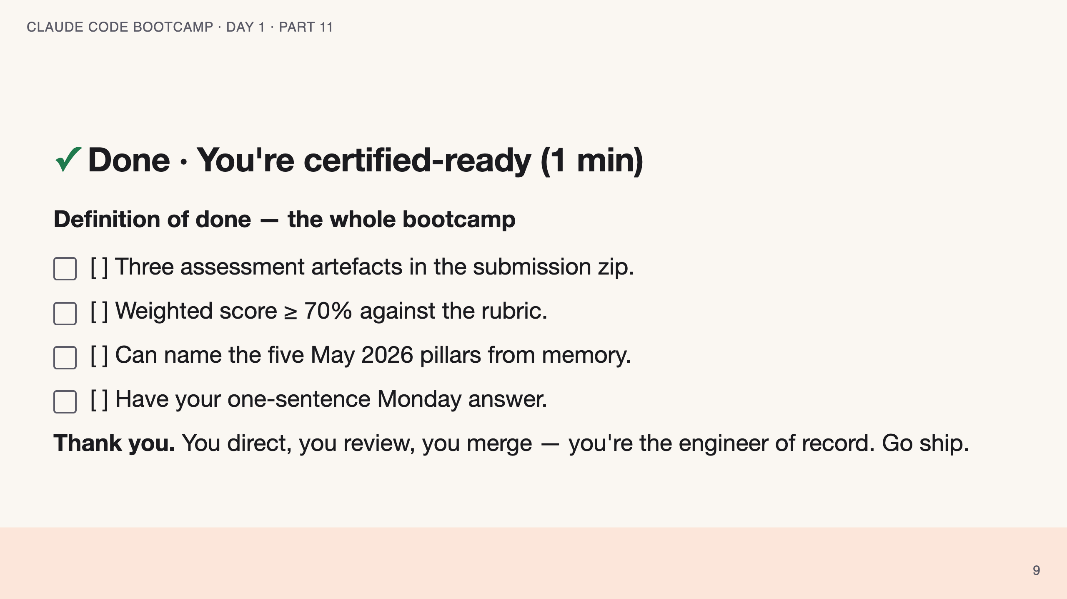
Notes:
SPEAKER NOTES — slide 9 (close, 1 min) - End on the through-line: the loop goes home with them. Open the floor for Q&A. polish-log 2026-05-28 · lean instructor-pacing shape (closing variant: no hands-on exercise). cover -> theory (3 frameworks) -> reference (mistakes · anti-patterns) -> live demo -> exam briefing -> your turn (Monday sentence) -> done.

