Slide 1
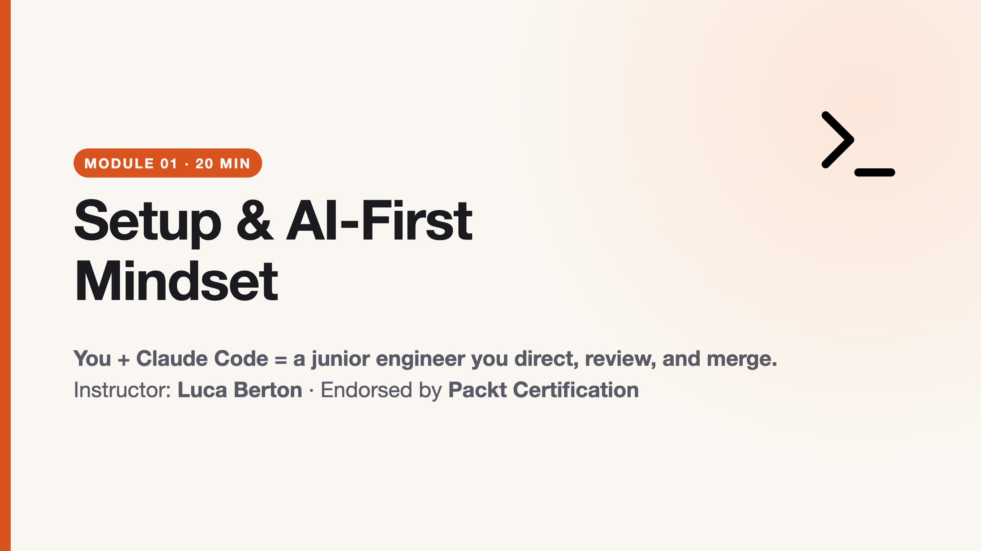
Notes:
duration: 20 min SPEAKER NOTES — slide 1 (60 sec hook) - Welcome. Confirm everyone joined the LMS. Show today's schedule on your second screen. - ONE sentence: "By the end of today you'll ship 10 small projects with Claude Code." - DO NOT do live installs here. Pre-work is the entry condition.

Slide 2
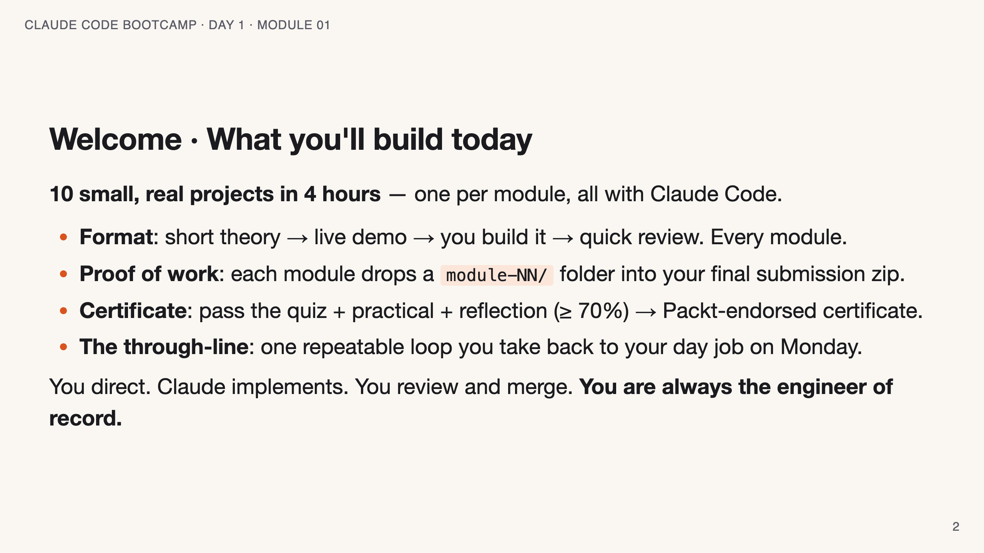
Notes:
SPEAKER NOTES — slide 2 (course intro, 2 min) - Point at the schedule in README.md on your second screen. - Set expectations on breaks. Time is the scarce resource today — say it out loud.

Slide 3
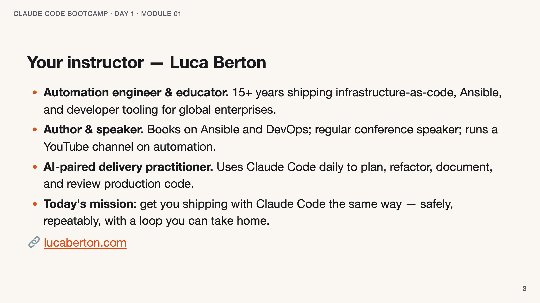
Notes:
SPEAKER NOTES — slide 3 (instructor, 1 min) - Keep it short and credible. The students are here to build, not to hear a résumé.

Slide 4
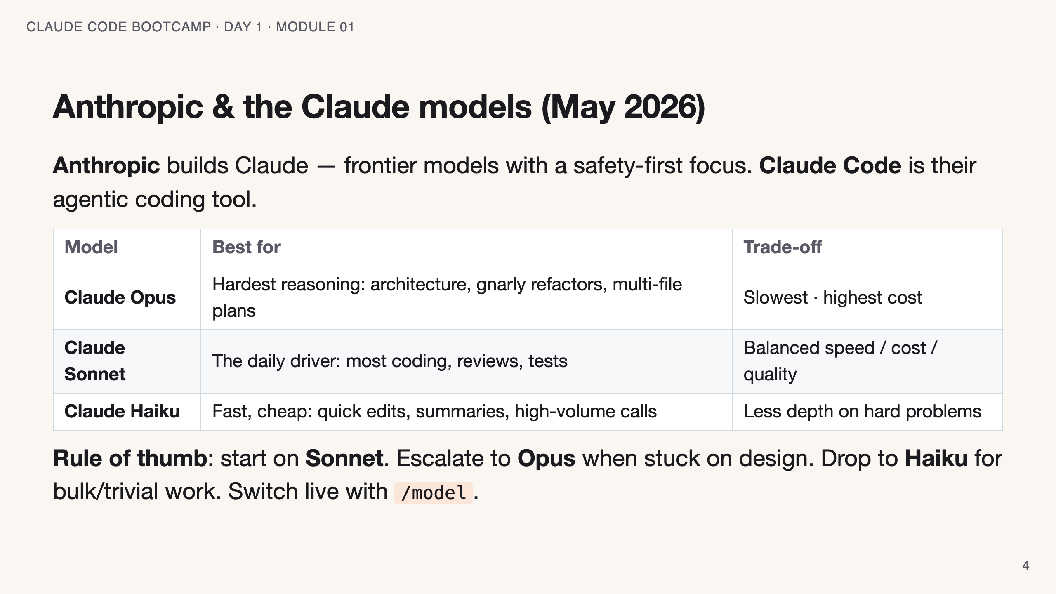
Notes:
SPEAKER NOTES — slide 4 (models, 2 min) - Don't quote exact prices — they move. Teach the SHAPE: Opus=think, Sonnet=do, Haiku=fast. - Most of today runs fine on Sonnet. Mention you'll call out where Opus earns its cost.

Slide 5
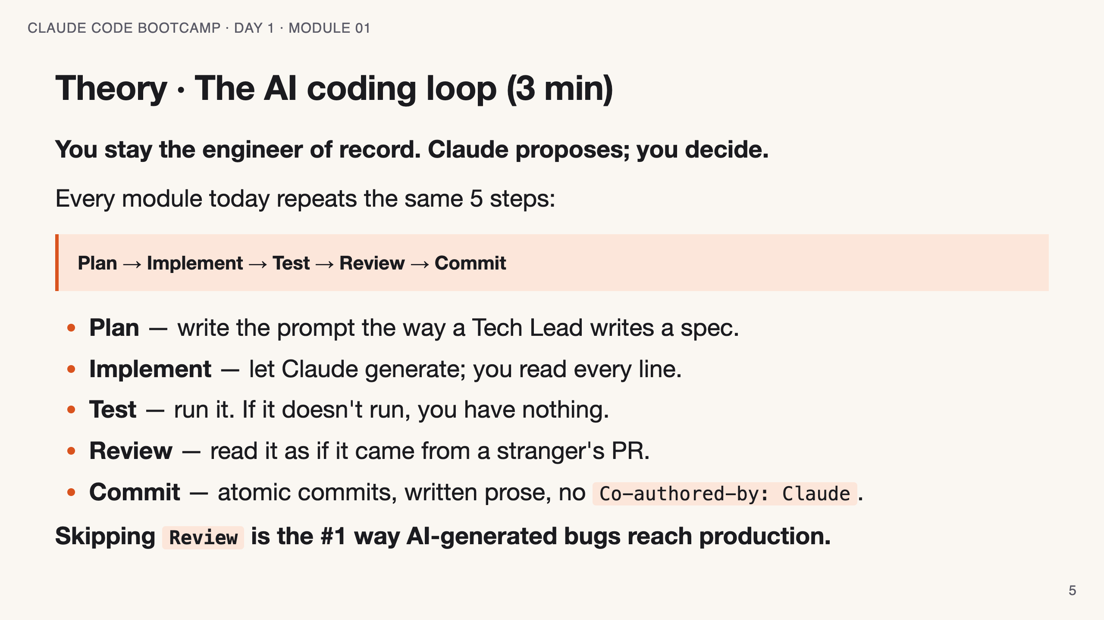
Notes:
SPEAKER NOTES — slide 5 (theory, 3 min) - Draw the loop on the whiteboard while talking through it. - Anchor "engineer of record" — you sign the PR, not Claude.

Slide 6
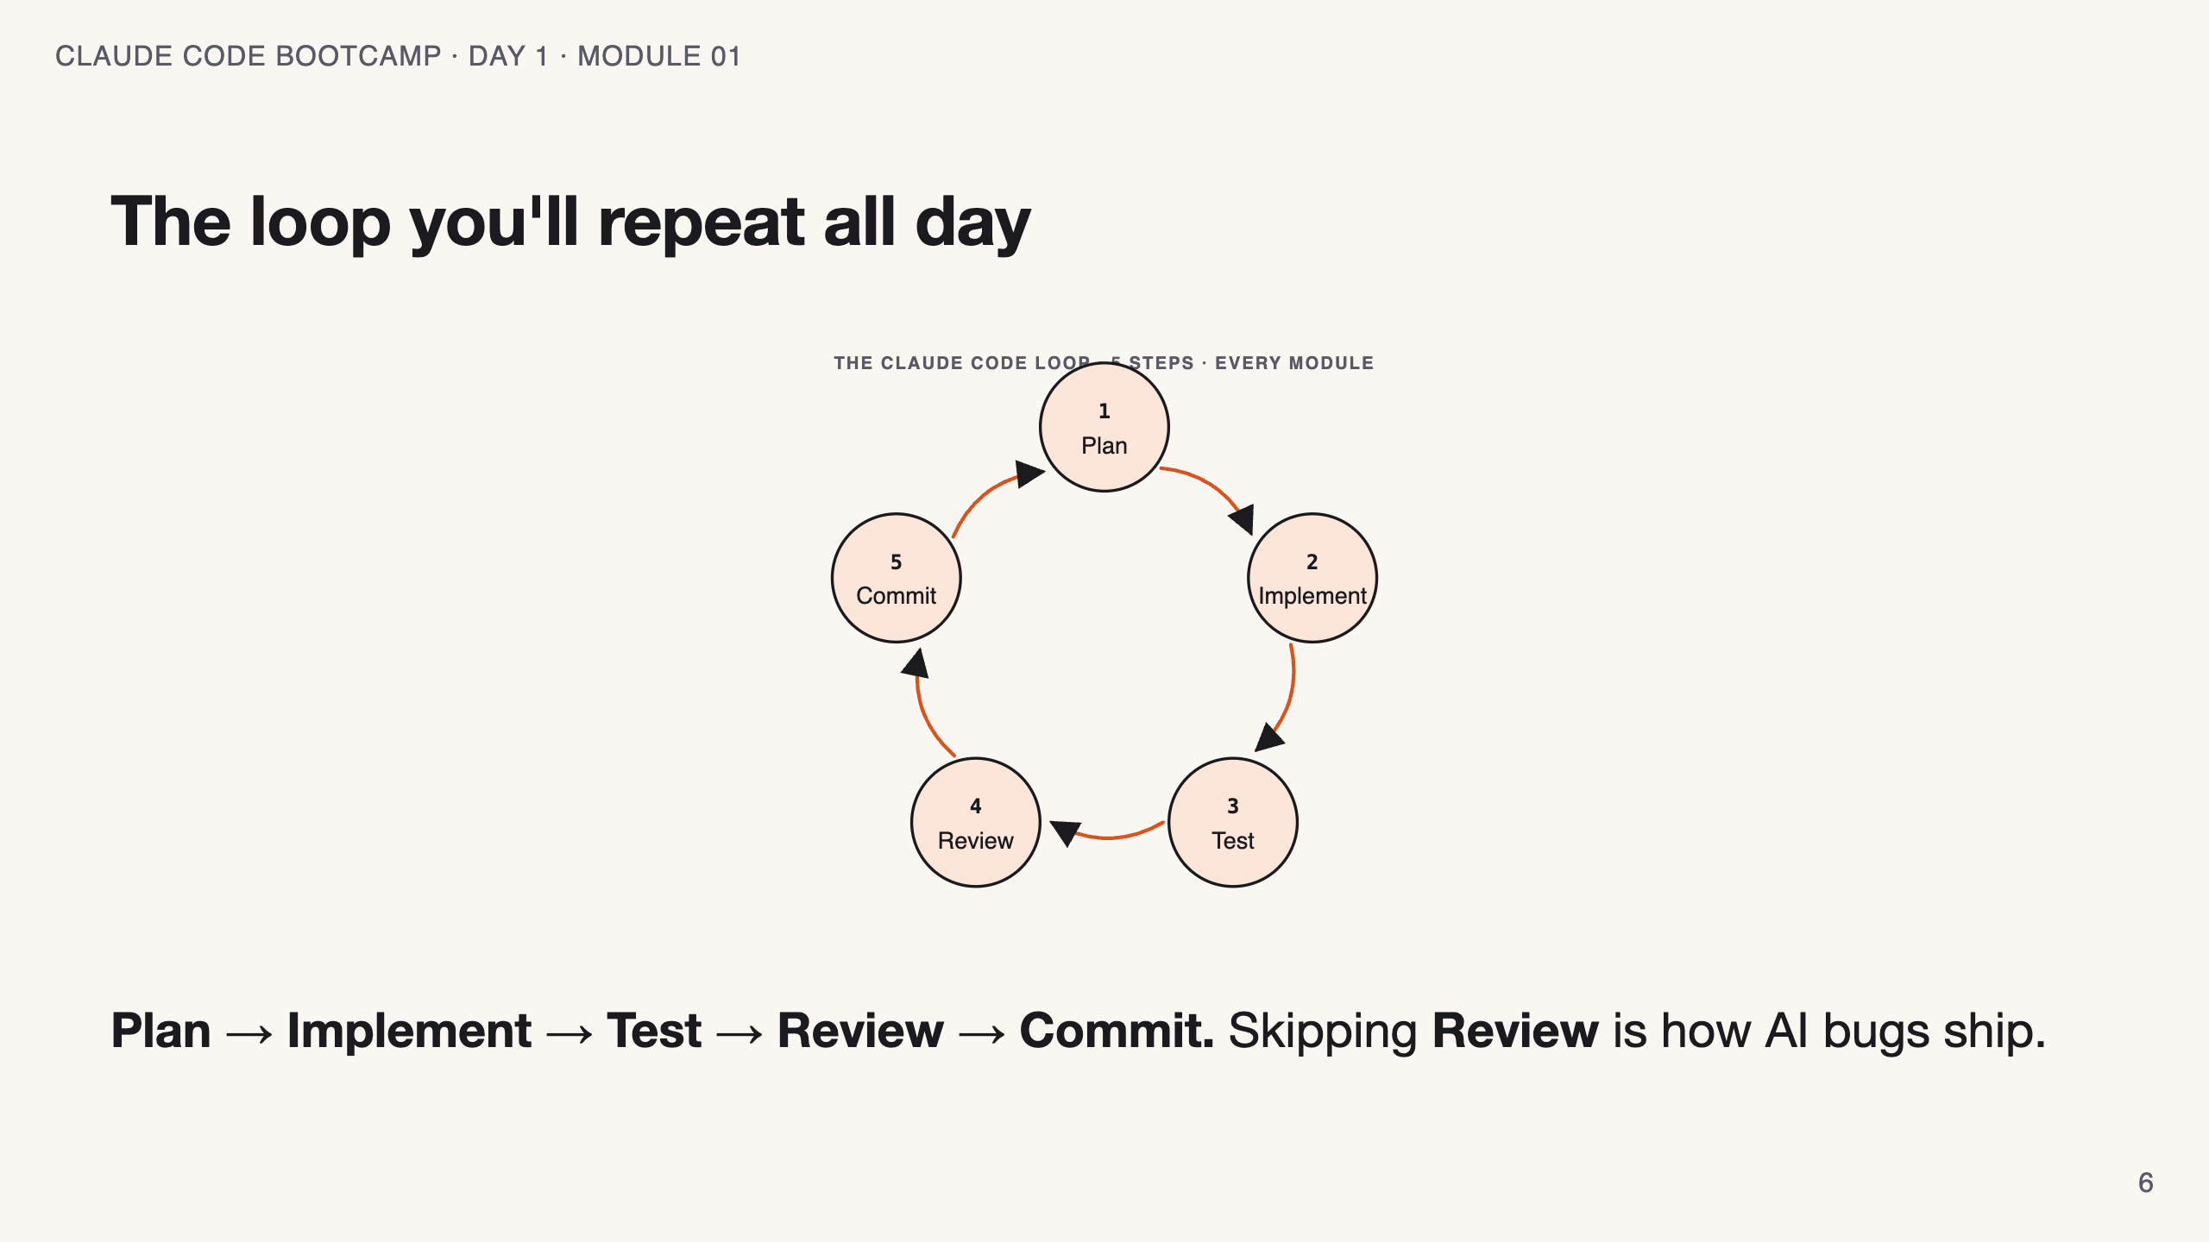
Notes:
SPEAKER NOTES — slide 6 (diagram, 1 min) - Trace the arrows once with your cursor; the cycle is the whole course in one picture.

Slide 7
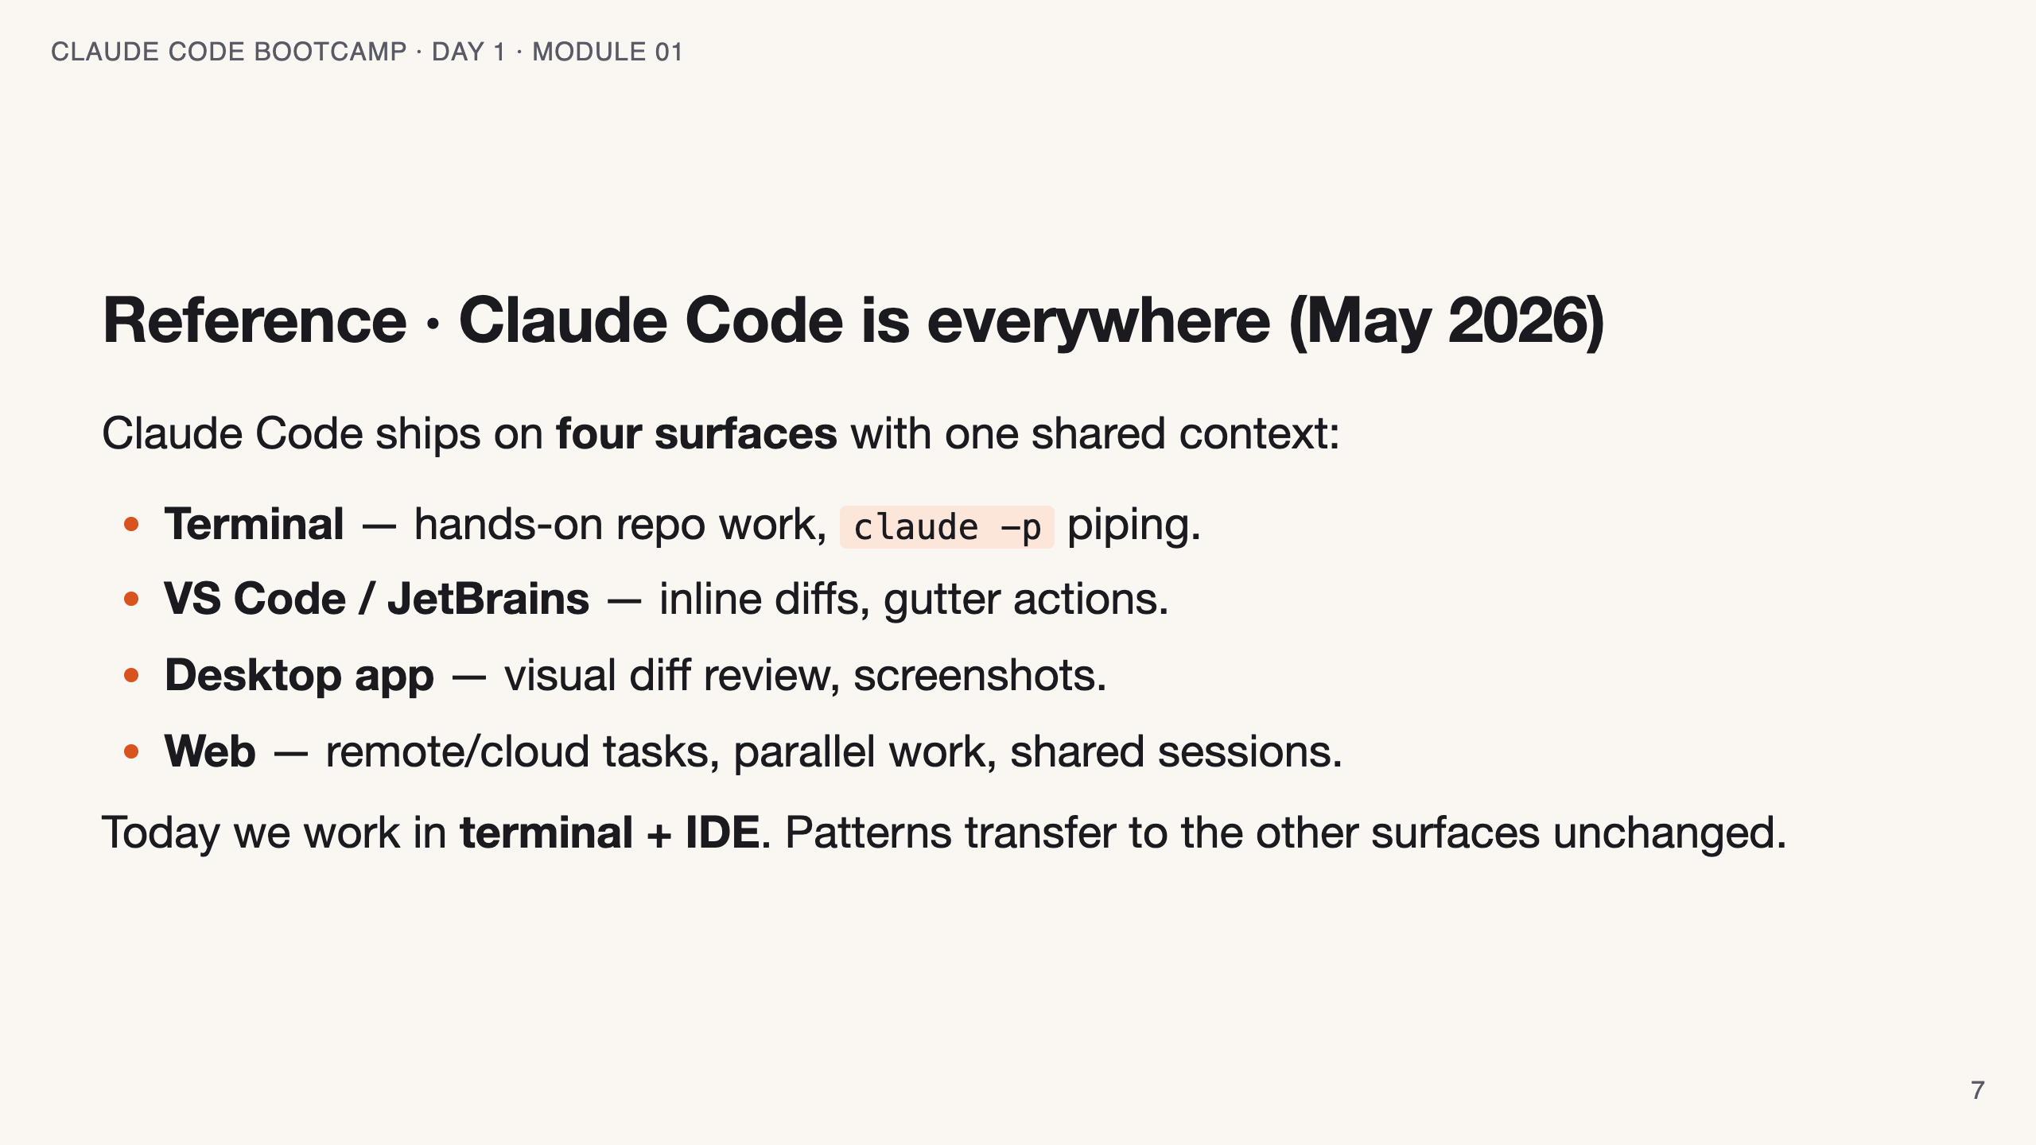
Notes:
SPEAKER NOTES — slide 6 (surfaces, 1 min) - One sentence each. Students only need to know: pick terminal or IDE today.

Slide 8
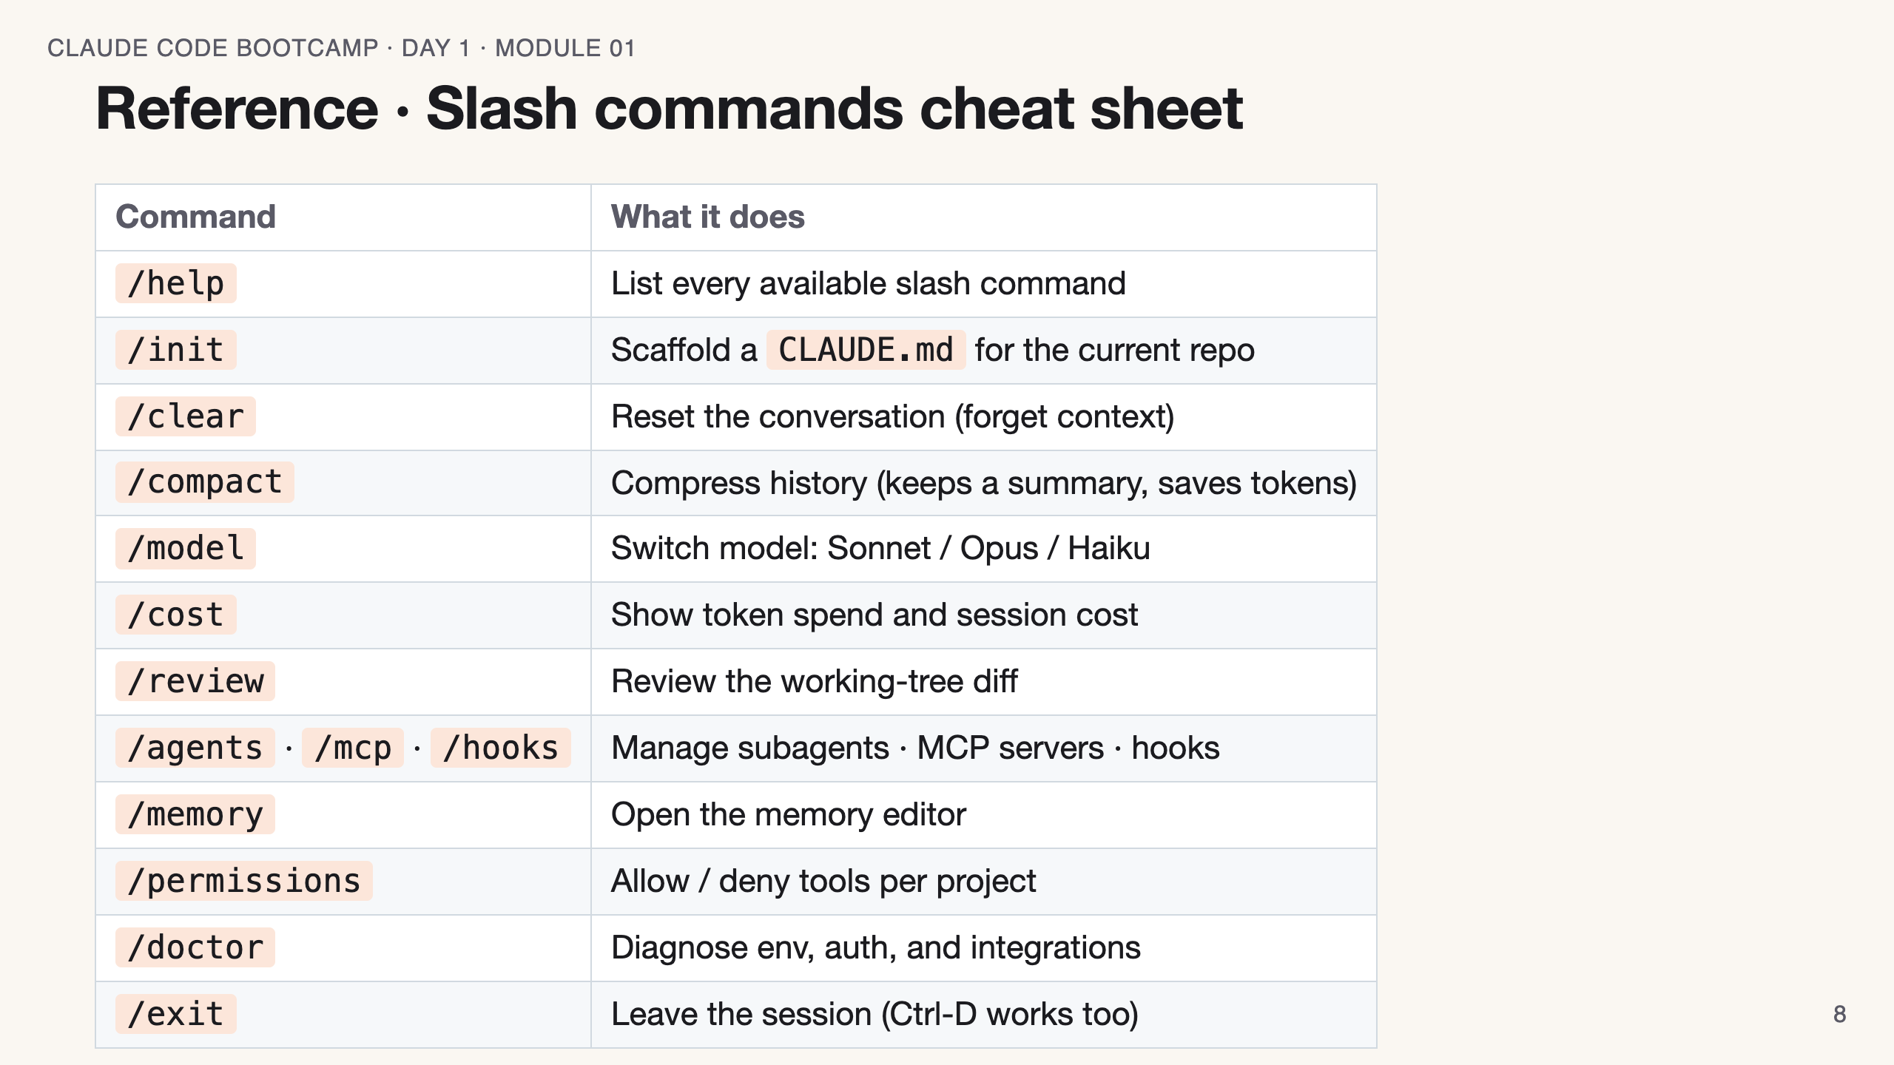
Notes:
SPEAKER NOTES — slide 7 (slash commands, 1 min) - Don't read the table. Call out the 4 you'll use today: /init, /model, /review, /clear.

Slide 9
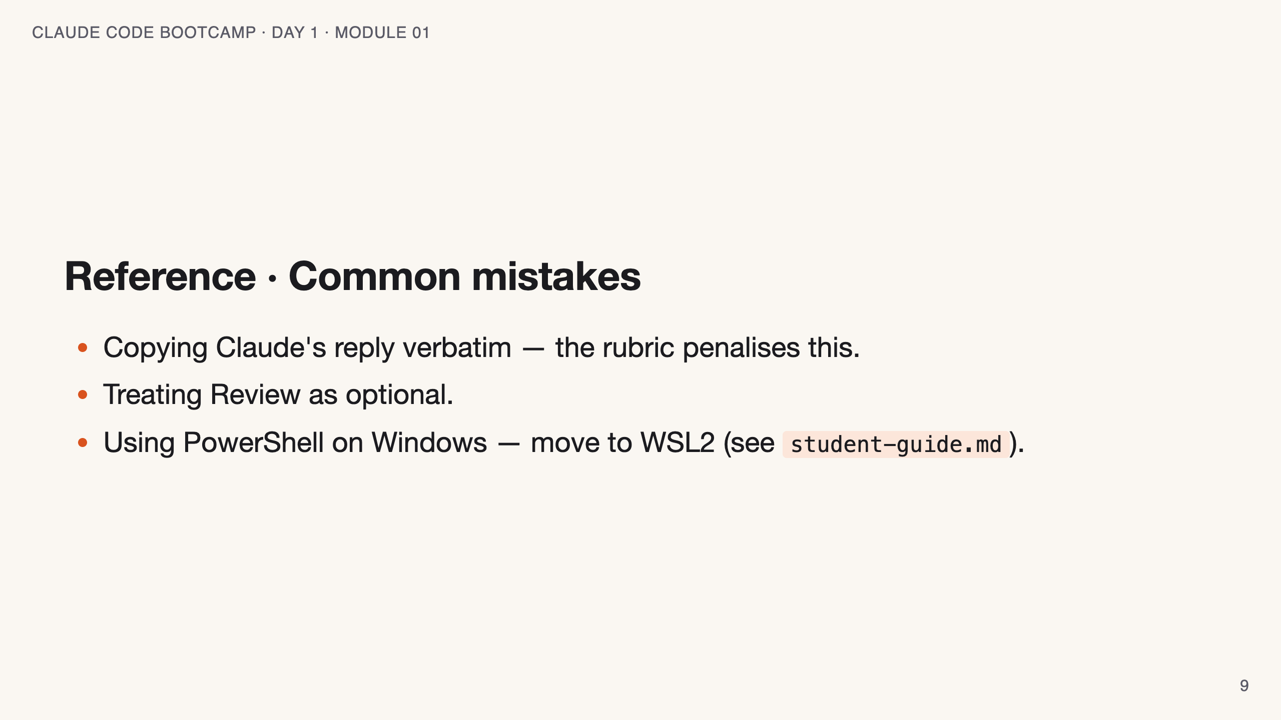
Notes:
SPEAKER NOTES — slide 8 (common mistakes, 30 sec) - Flag the "verbatim copy" trap now — it costs students points later. Instructor cues: - Hard-cap this block at 20 min. Mindset only — no live installs. - Open from Claude Code on a known repo, not a slide. - Broken environment? Pair the student. Move on.

Slide 10
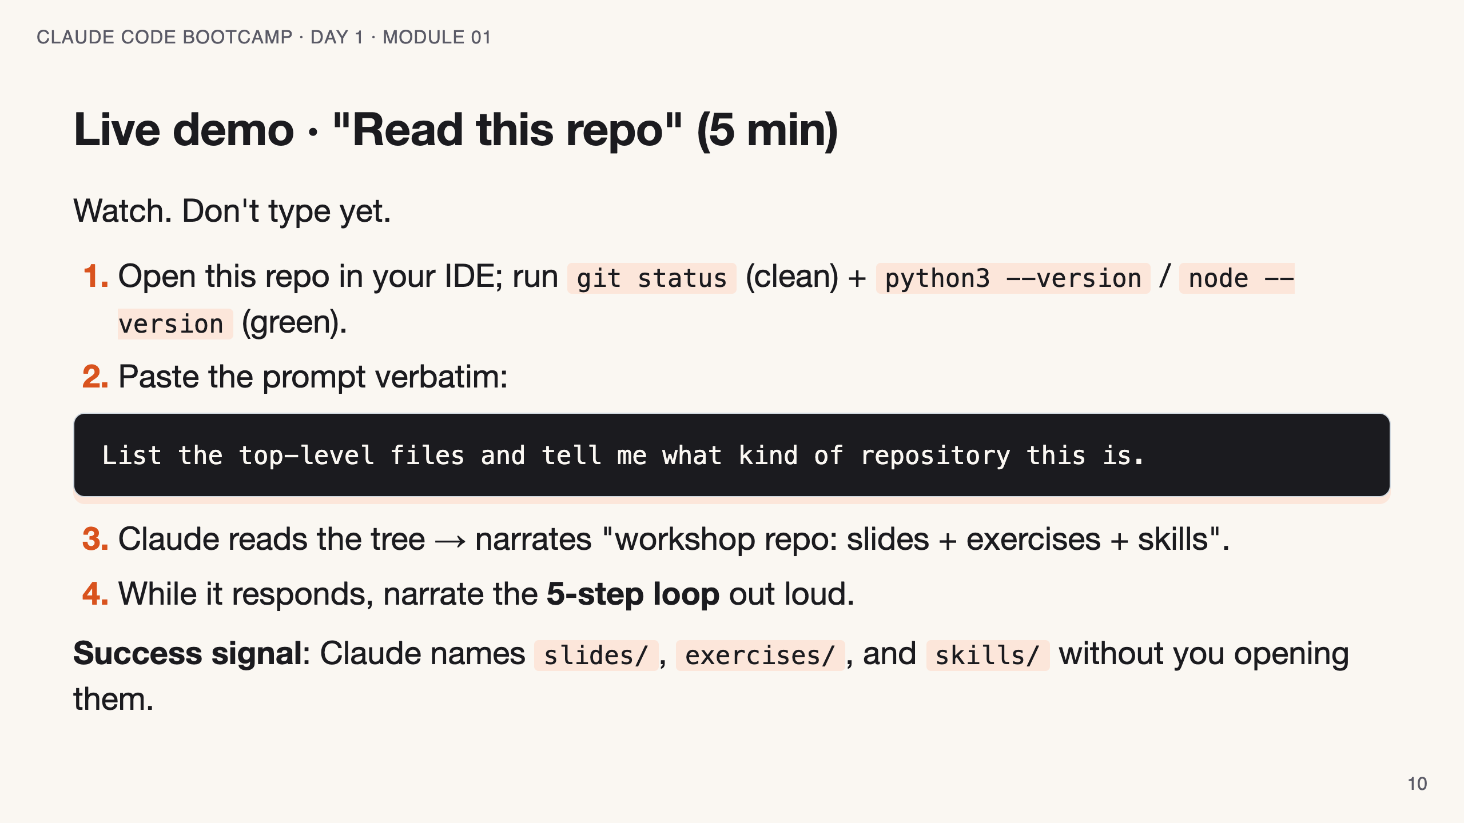
Notes:
SPEAKER NOTES — slide 9 (demo, 5 min) - Project this terminal full-screen, font ≥ 18pt. - If Claude says something wrong, DO NOT correct it silently — narrate "see, this is why we review". - Backup plan if Claude is slow: switch to /cost and show the token spend.

Slide 11
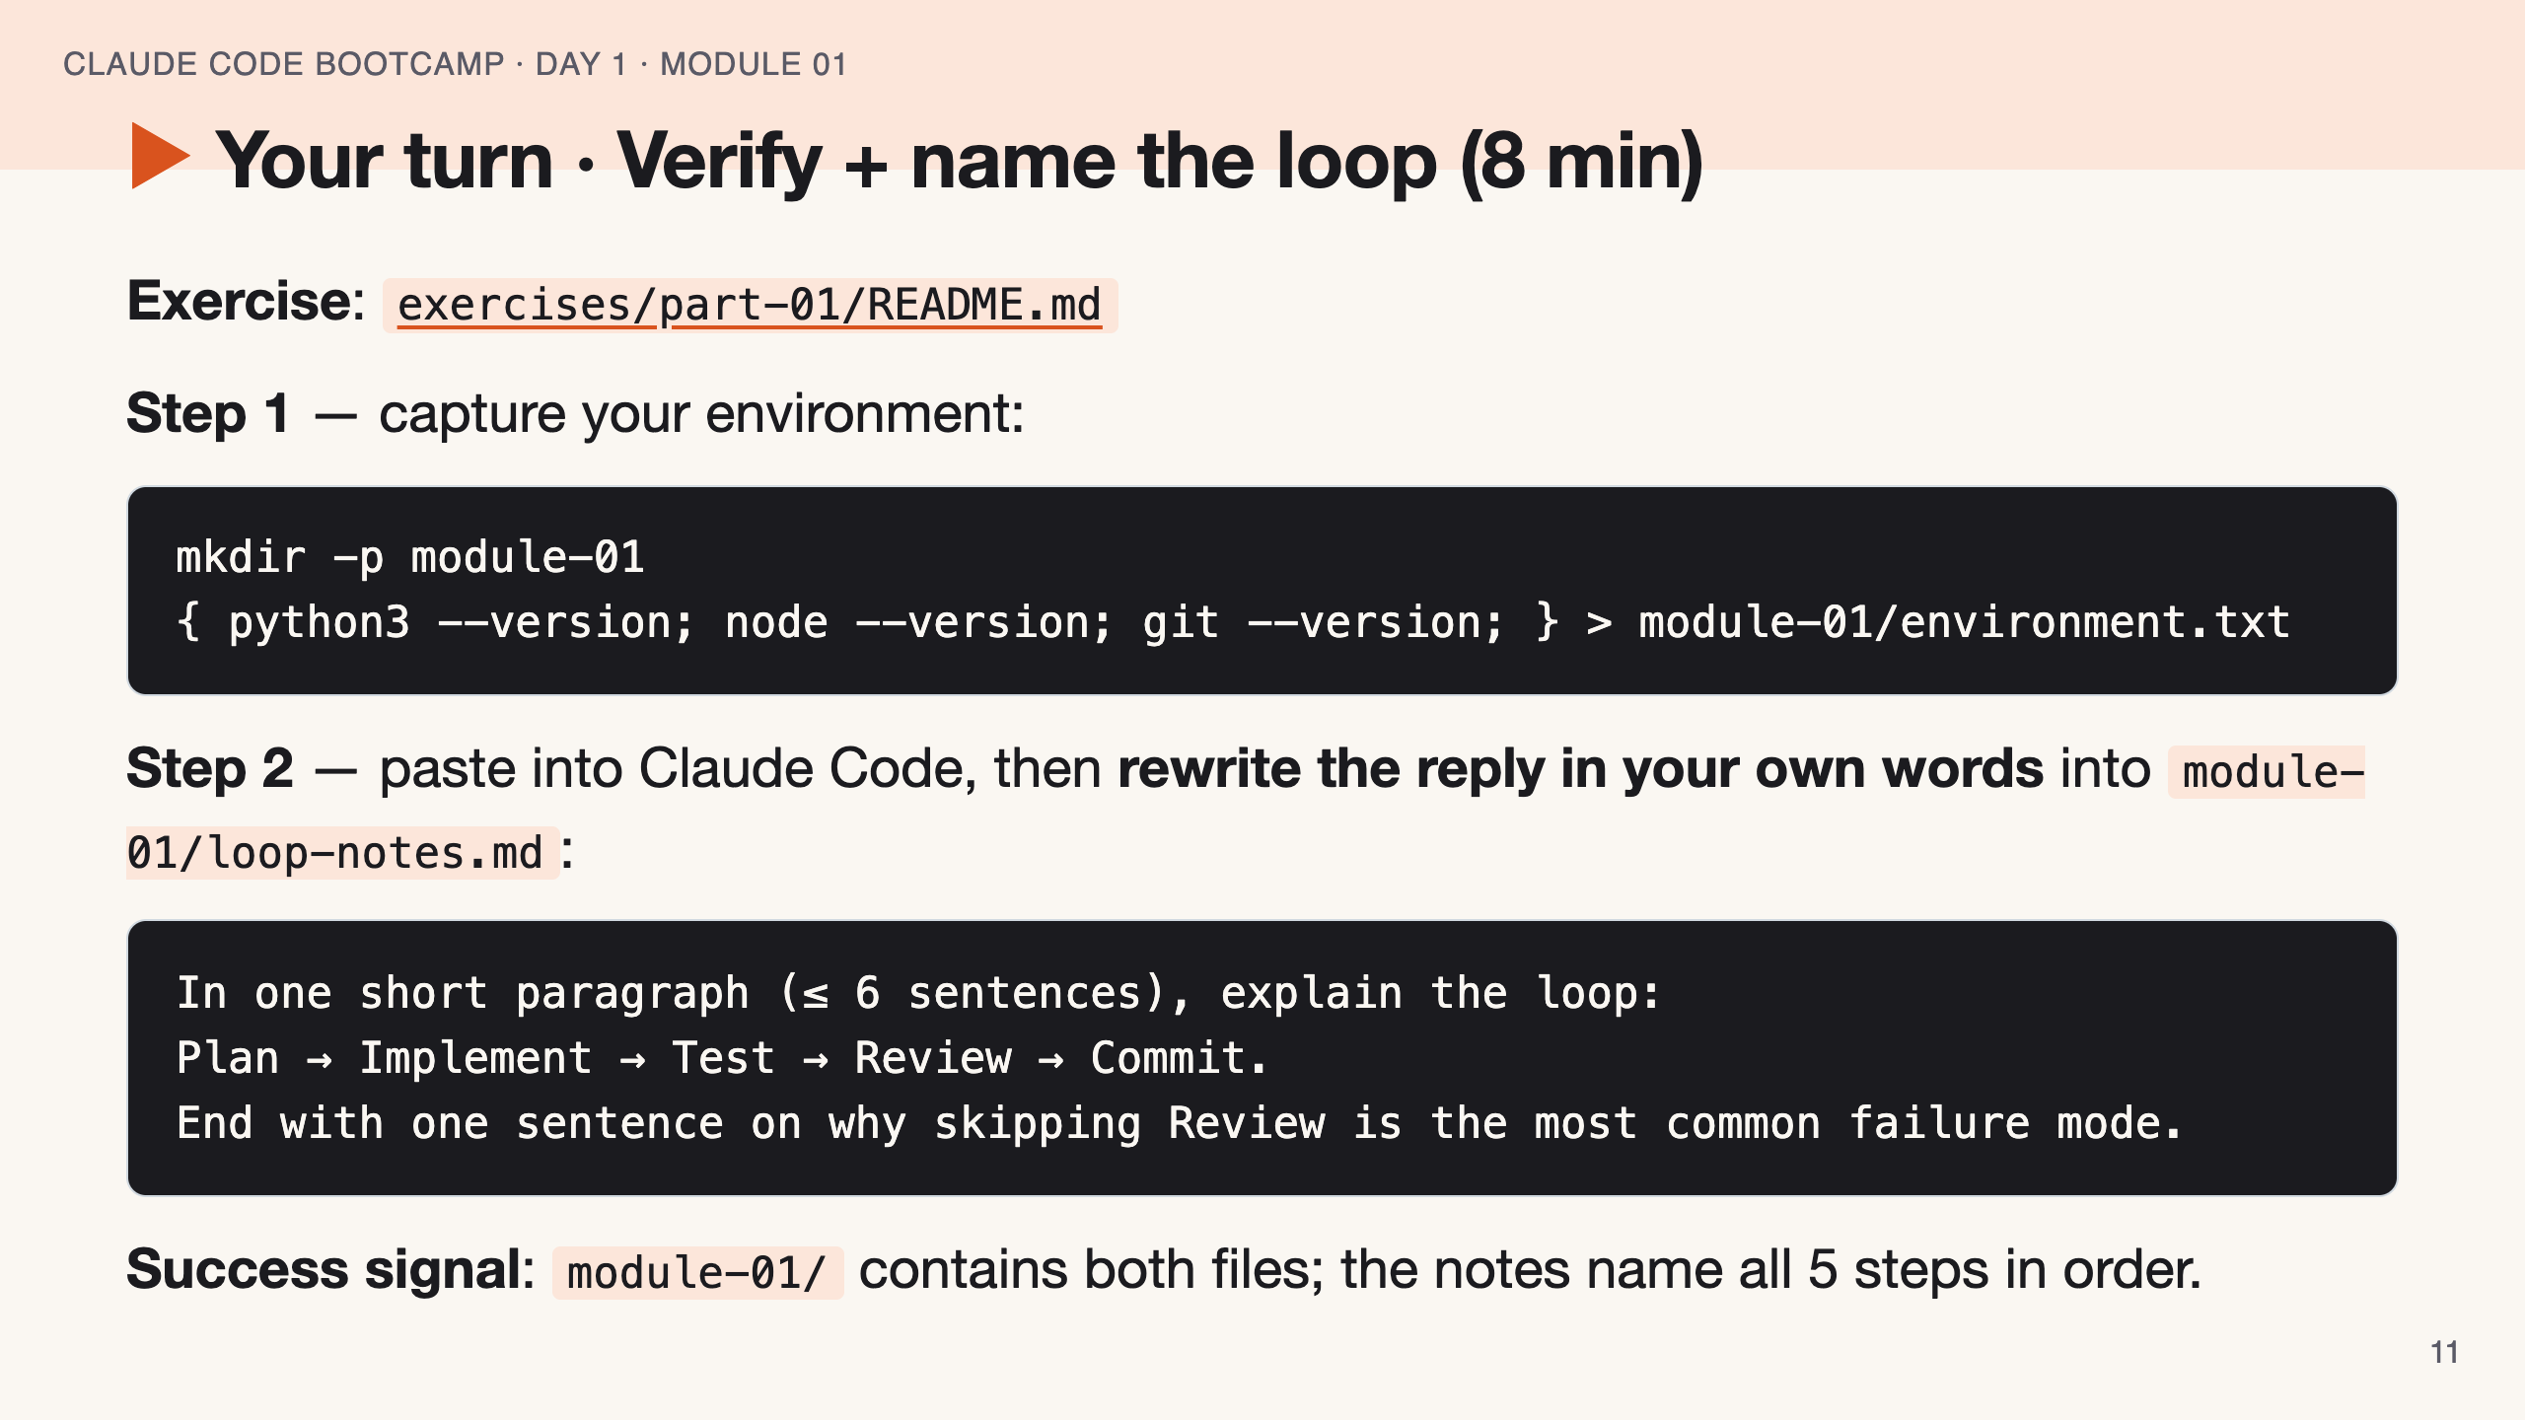
Notes:
SPEAKER NOTES — slide 10 (hands-on, 8 min) - Walk the room. Catch students copy-pasting Claude verbatim — that's the rubric trap. - If pre-work was skipped, pair them with a neighbour; no live installs in this block. - 2-min warning at the 6-min mark.

Slide 12
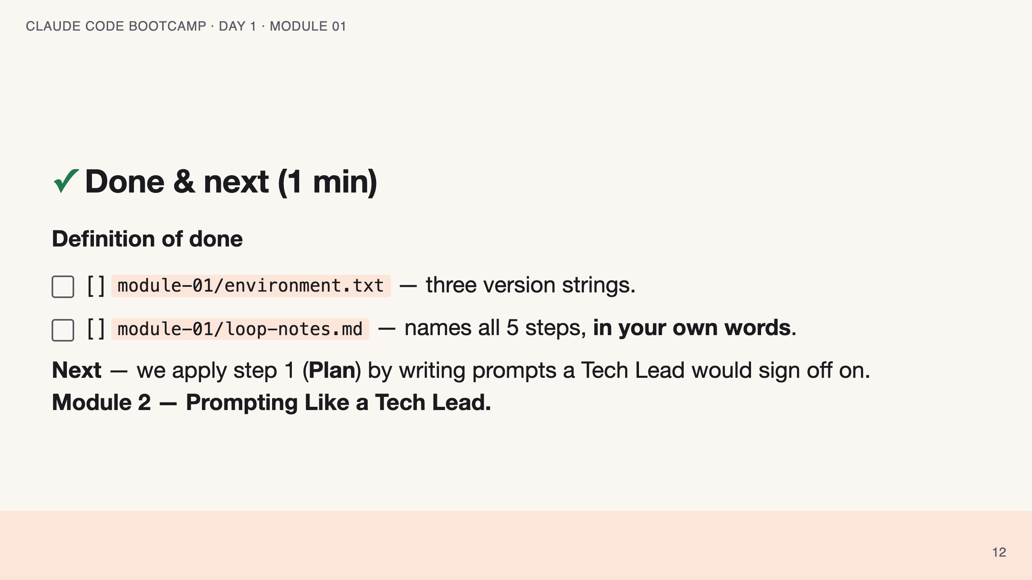
Notes:
SPEAKER NOTES — slide 11 (wrap, 1 min) - Show the DoD on screen for a full 30 seconds. - Bridge in one sentence — don't over-explain Module 2 yet. polish-log 2026-05-28 · feature 005 follow-up — instructor-pacing shape. Flow: cover → welcome/course → instructor → Anthropic & models → theory loop → 3 reference slides (surfaces · slash commands · mistakes/cues) → live demo → hands-on → done & next. Instructor notes in HTML comments (visible in PPTX presenter view).

