Slide 1
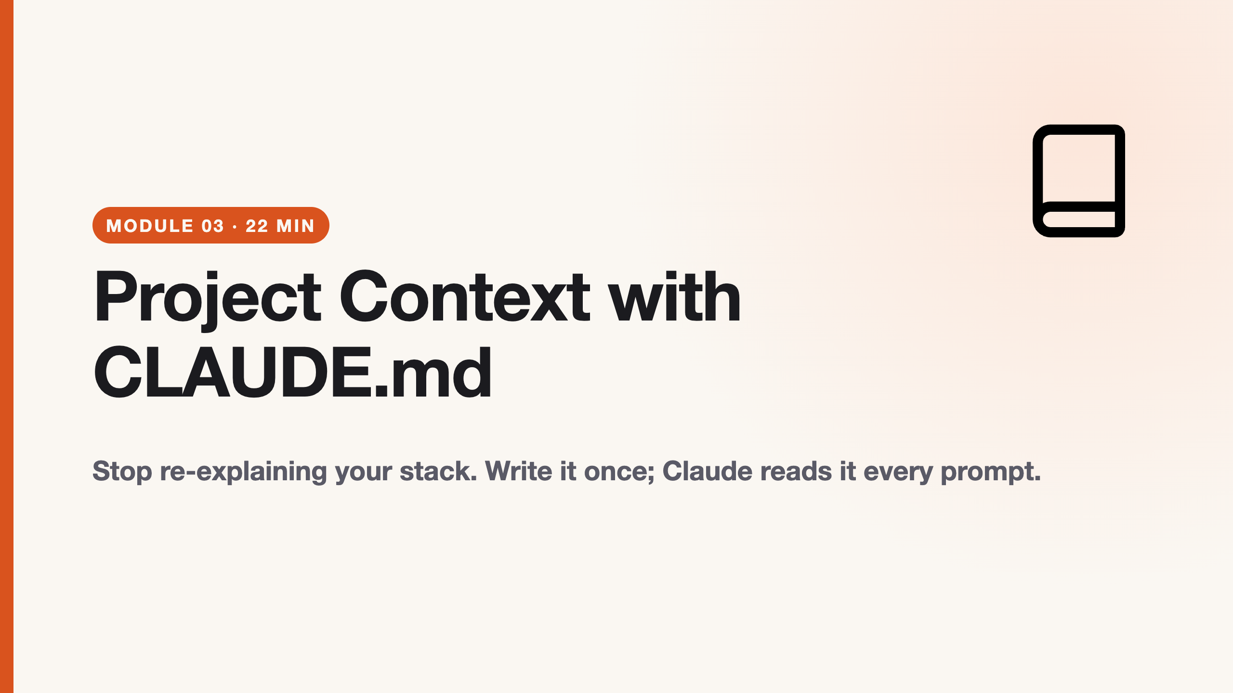
Notes:
duration: 22 min SPEAKER NOTES — slide 1 (hook, 60 sec) - One line: "CLAUDE.md is the difference between coaching a new hire every morning and one good onboarding doc."

Slide 2
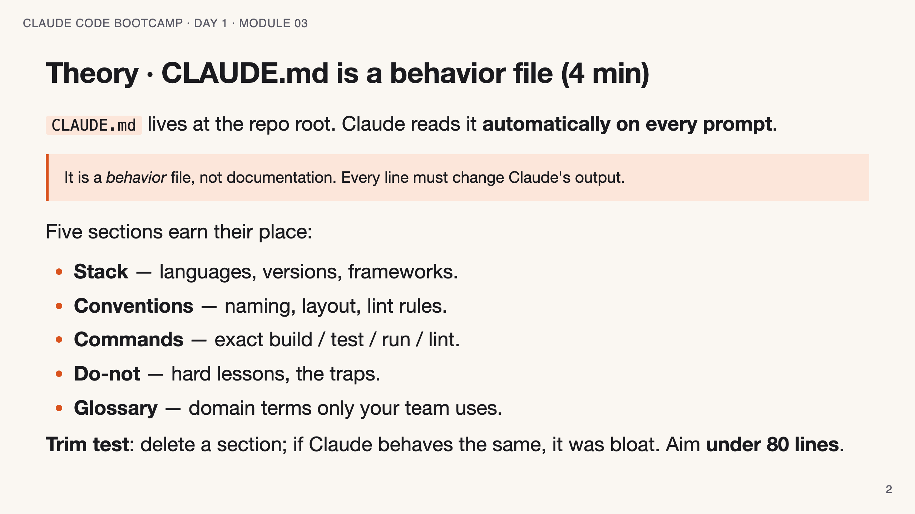
Notes:
SPEAKER NOTES — slide 2 (theory, 4 min) - Hammer the README vs CLAUDE.md split: nice-to-know -> README; changes-output -> CLAUDE.md.

Slide 3
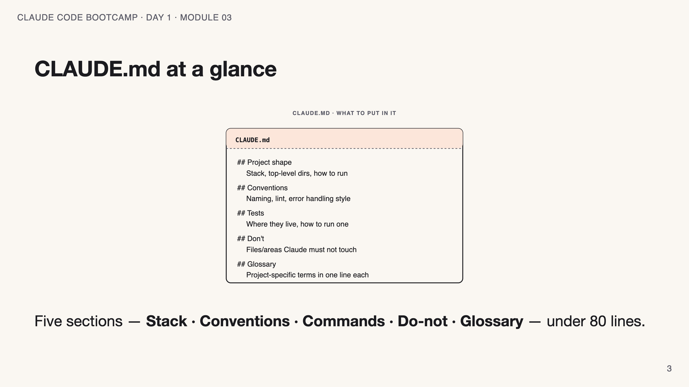
Notes:
SPEAKER NOTES — slide 3 (diagram, 1 min) - Each box is a section; the file on the next slide is this picture as text.

Slide 4
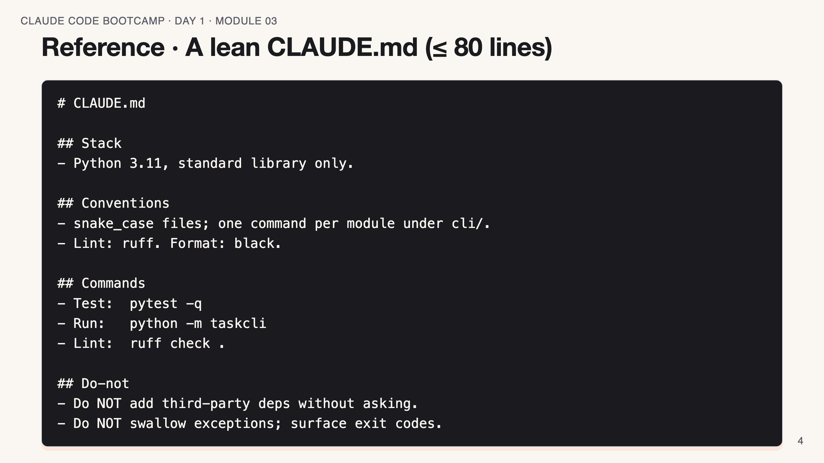
Notes:
SPEAKER NOTES — slide 3 (reference, 1 min)

Slide 5
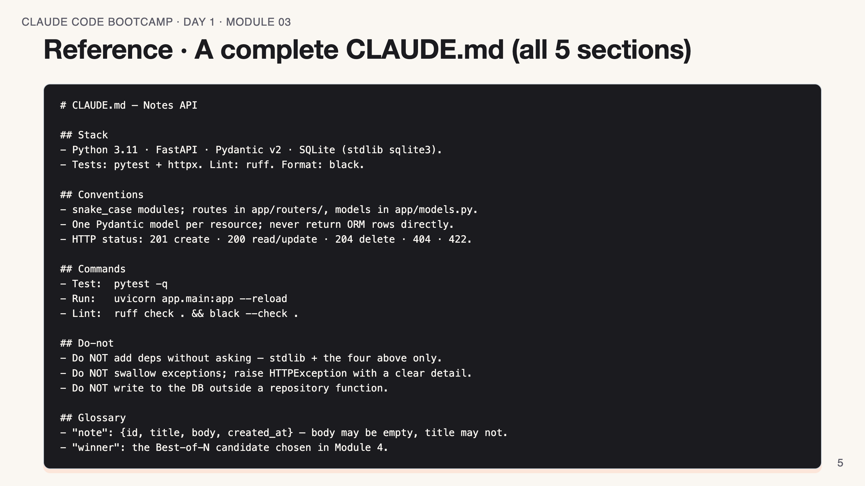
Notes:
SPEAKER NOTES — slide 4 (reference, 1 min) - This is the "good example" — point out each section earns its place. - Glossary is short on purpose: only terms unique to THIS team/repo. - Contrast with the lean version on the previous slide: same shape, more teeth.

Slide 6
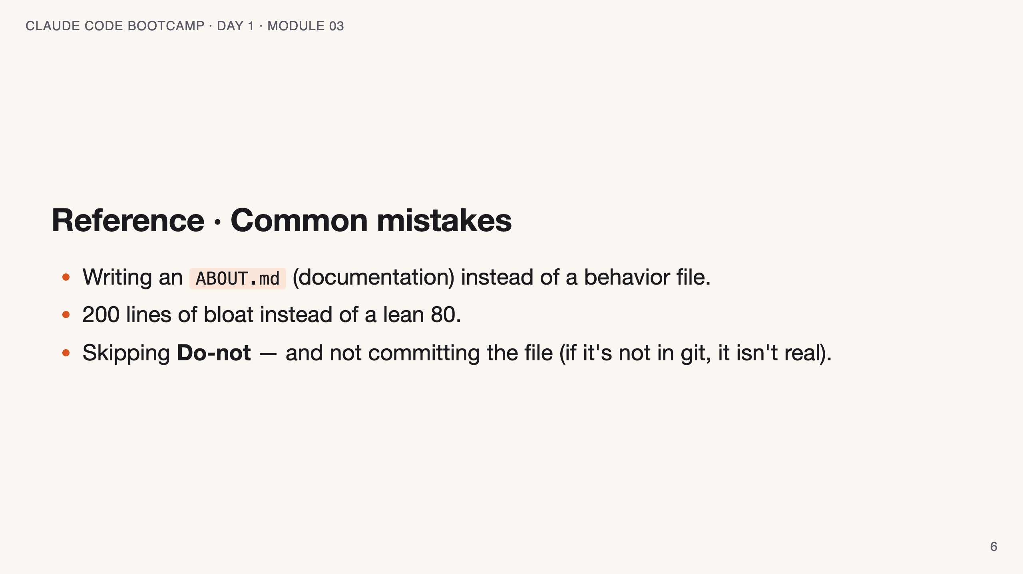
Notes:
SPEAKER NOTES — slide 5 (common mistakes, 30 sec) Instructor cues: - Run the trim test live: delete a section, re-prompt, watch the drift.

Slide 7
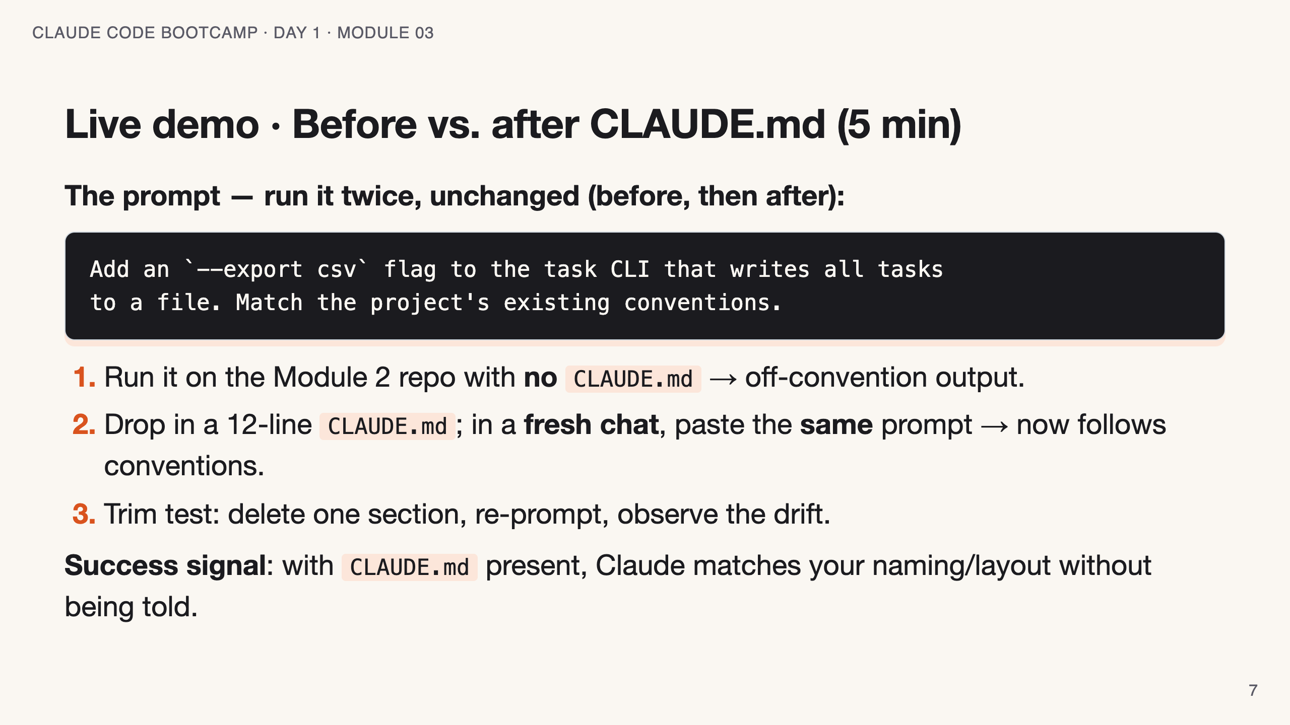
Notes:
SPEAKER NOTES — slide 6 (demo, 5 min) - Fresh chat matters — show that the file, not the chat history, carries the rules.

Slide 8
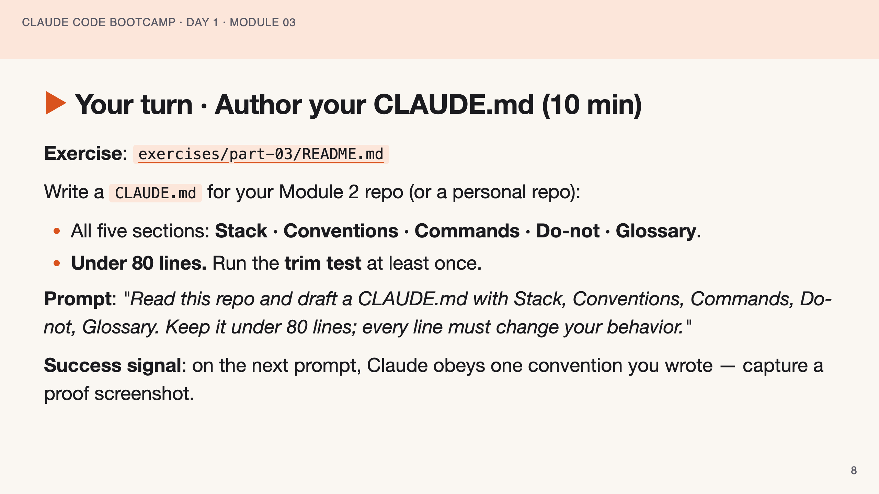
Notes:
SPEAKER NOTES — slide 7 (hands-on, 10 min) - Catch students pasting README prose. Ask: "does this line change Claude's output?" If no, cut it.

Slide 9
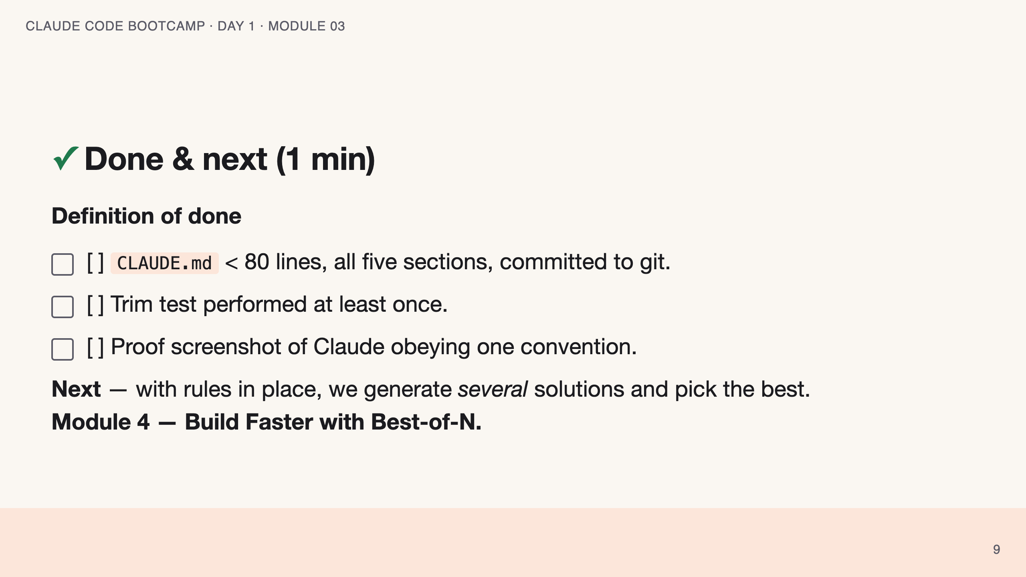
Notes:
SPEAKER NOTES — slide 8 (wrap, 1 min) polish-log 2026-05-28 · lean instructor-pacing shape (matches Module 1 pilot). cover -> theory (behavior file) -> reference (sample · mistakes) -> live demo -> your turn -> done.

