Slide 1
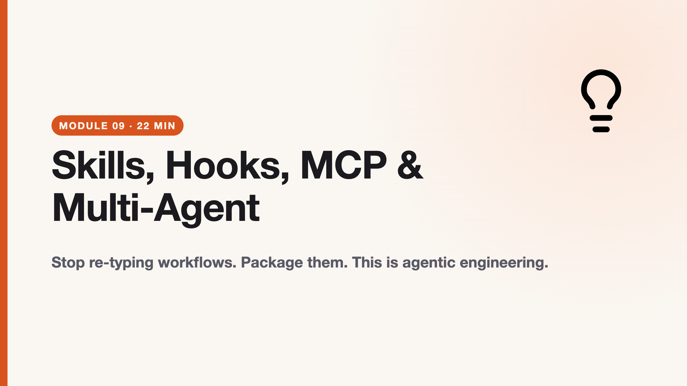
Notes:
duration: 22 min SPEAKER NOTES — slide 1 (hook, 60 sec) - One line: "Today's habits become reusable tools you carry into Monday's repo."

Slide 2
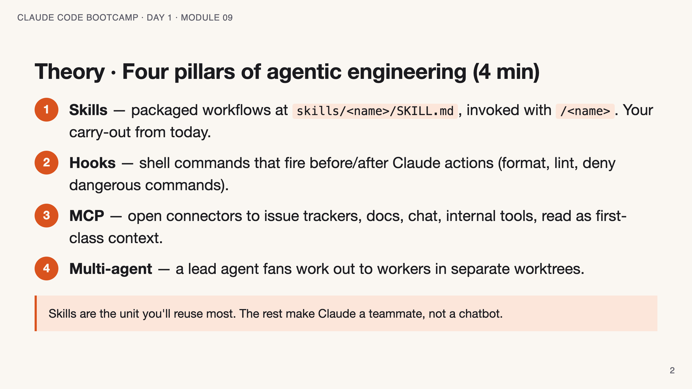
Notes:
SPEAKER NOTES — slide 2 (theory, 4 min) - Most students will author a Skill in the lab. Hooks/MCP/multi-agent are awareness + stretch.

Slide 3
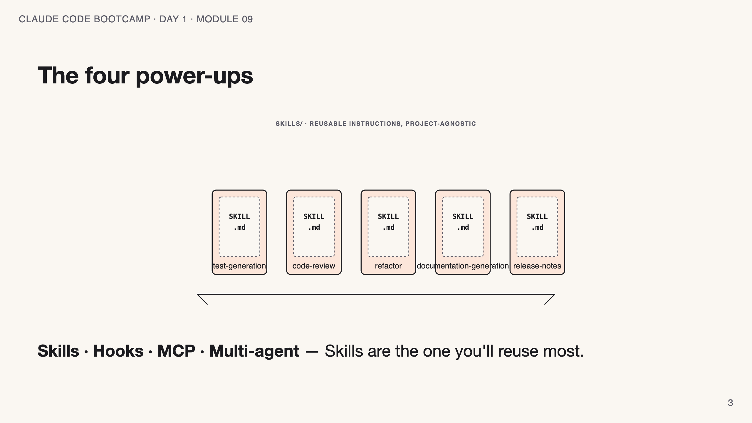
Notes:
SPEAKER NOTES — slide 3 (diagram, 1 min) - Point at Skills first; the rest turn Claude from chatbot into teammate.

Slide 4
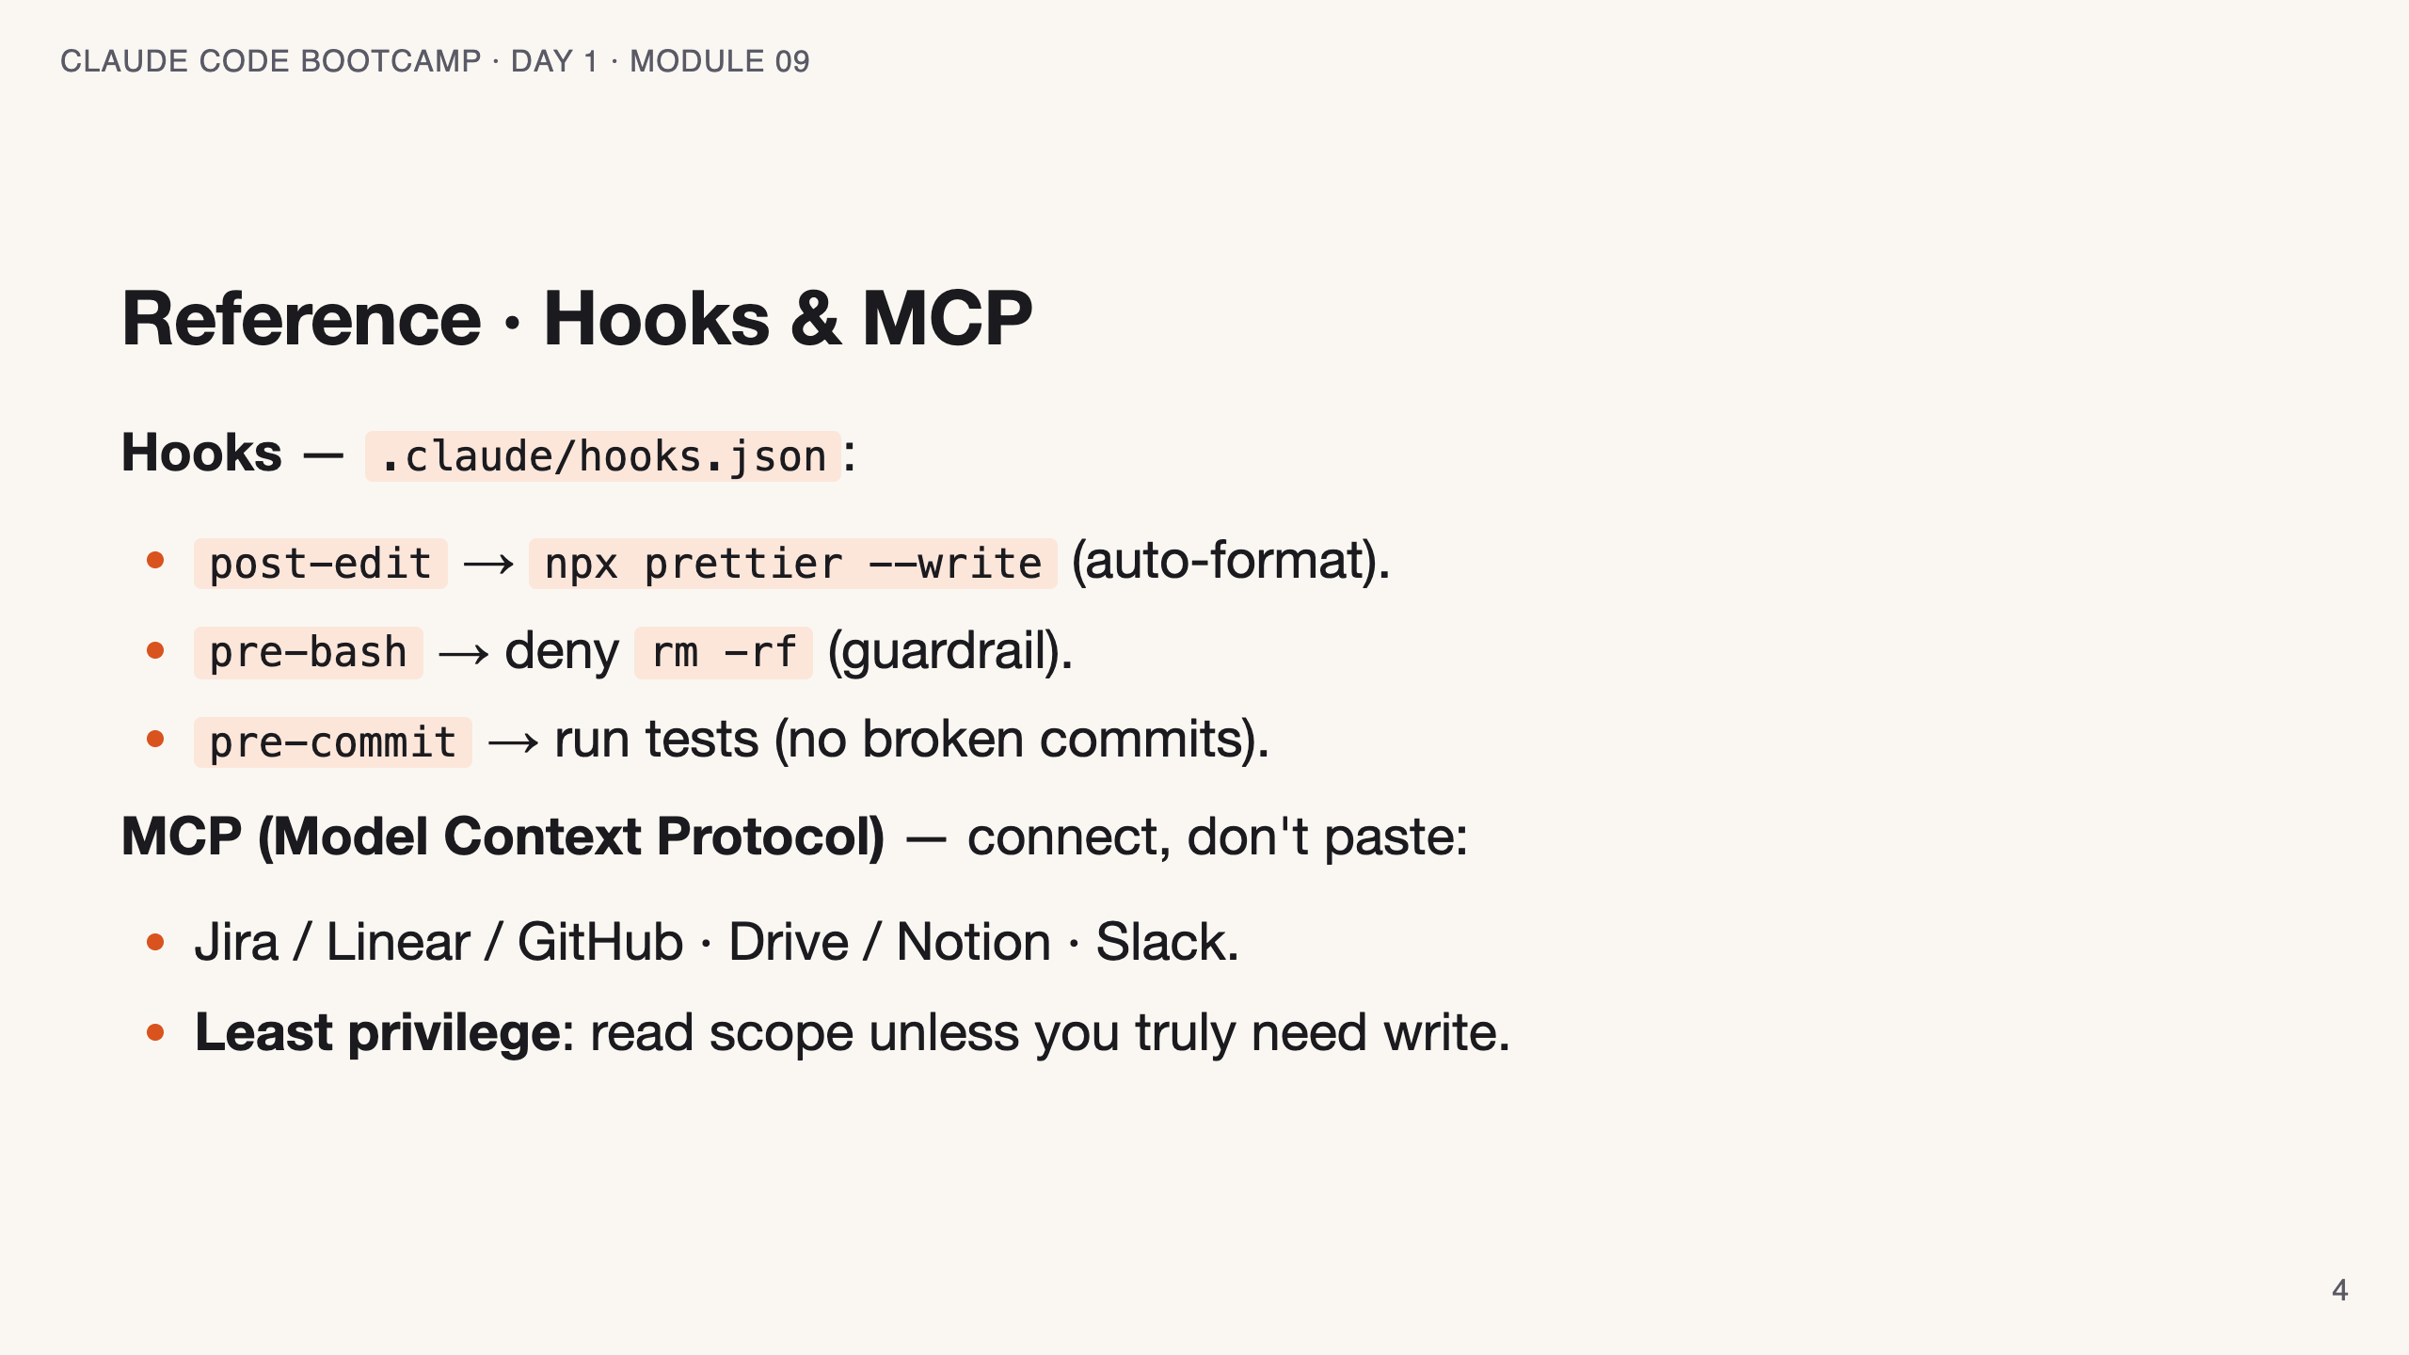
Notes:
SPEAKER NOTES — slide 3 (reference, 1 min) - Hooks that swallow exit codes are a trap — call it out.

Slide 5
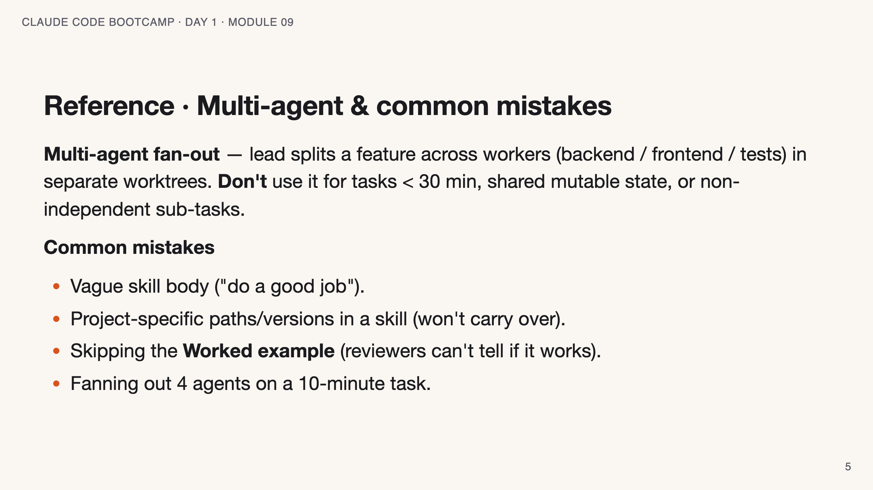
Notes:
SPEAKER NOTES — slide 4 (mistakes/cues, 30 sec)

Slide 6
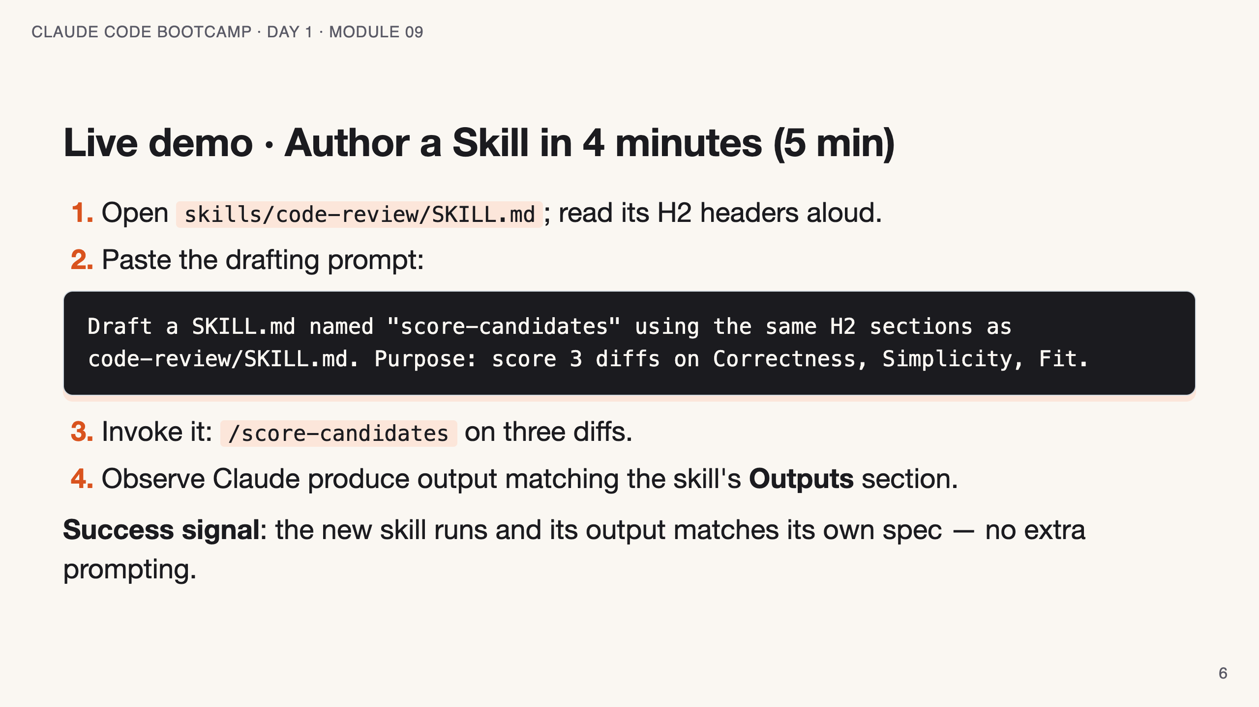
Notes:
SPEAKER NOTES — slide 5 (demo, 5 min) - Keep it to 4 minutes of drafting. The shape is the lesson, not the wording.

Slide 7
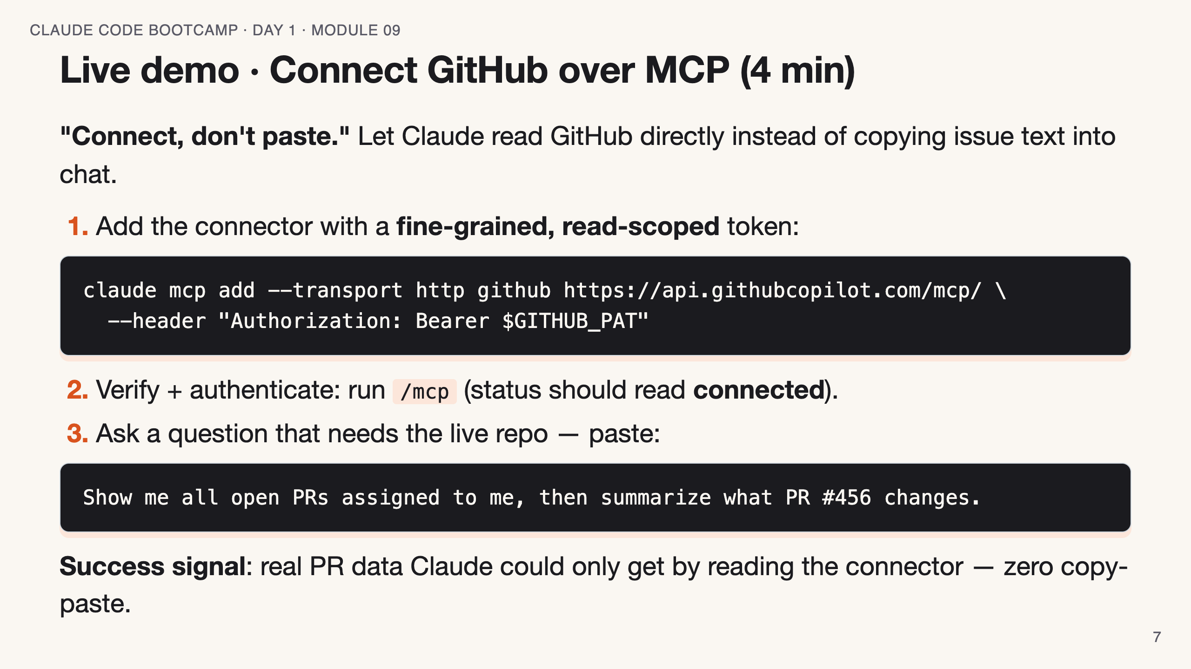
Notes:
SPEAKER NOTES — slide 6 (demo, 4 min) - Least privilege: fine-grained PAT scoped to ONLY the demo repo — never a classic all-repo token. - /mcp also runs the OAuth login flow for servers that need it. - Offline fallback: `claude mcp add --transport http sentry https://mcp.sentry.dev/mcp`, /mcp to auth, then ask "most common errors in the last 24h". - Trust gate: only connect servers you trust — external content can carry prompt injection.

Slide 8
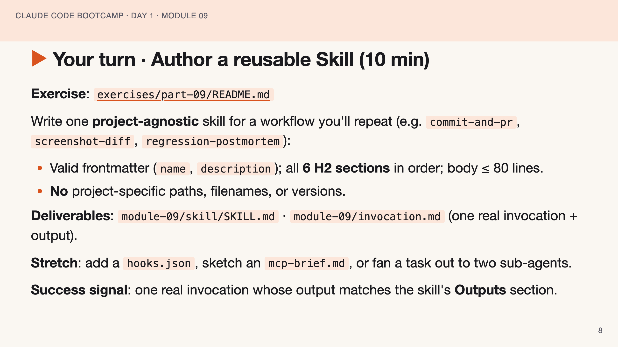
Notes:
SPEAKER NOTES — slide 6 (hands-on, 10 min) - Catch project-specific paths — that's what kills carry-over. 3-min warning.

Slide 9
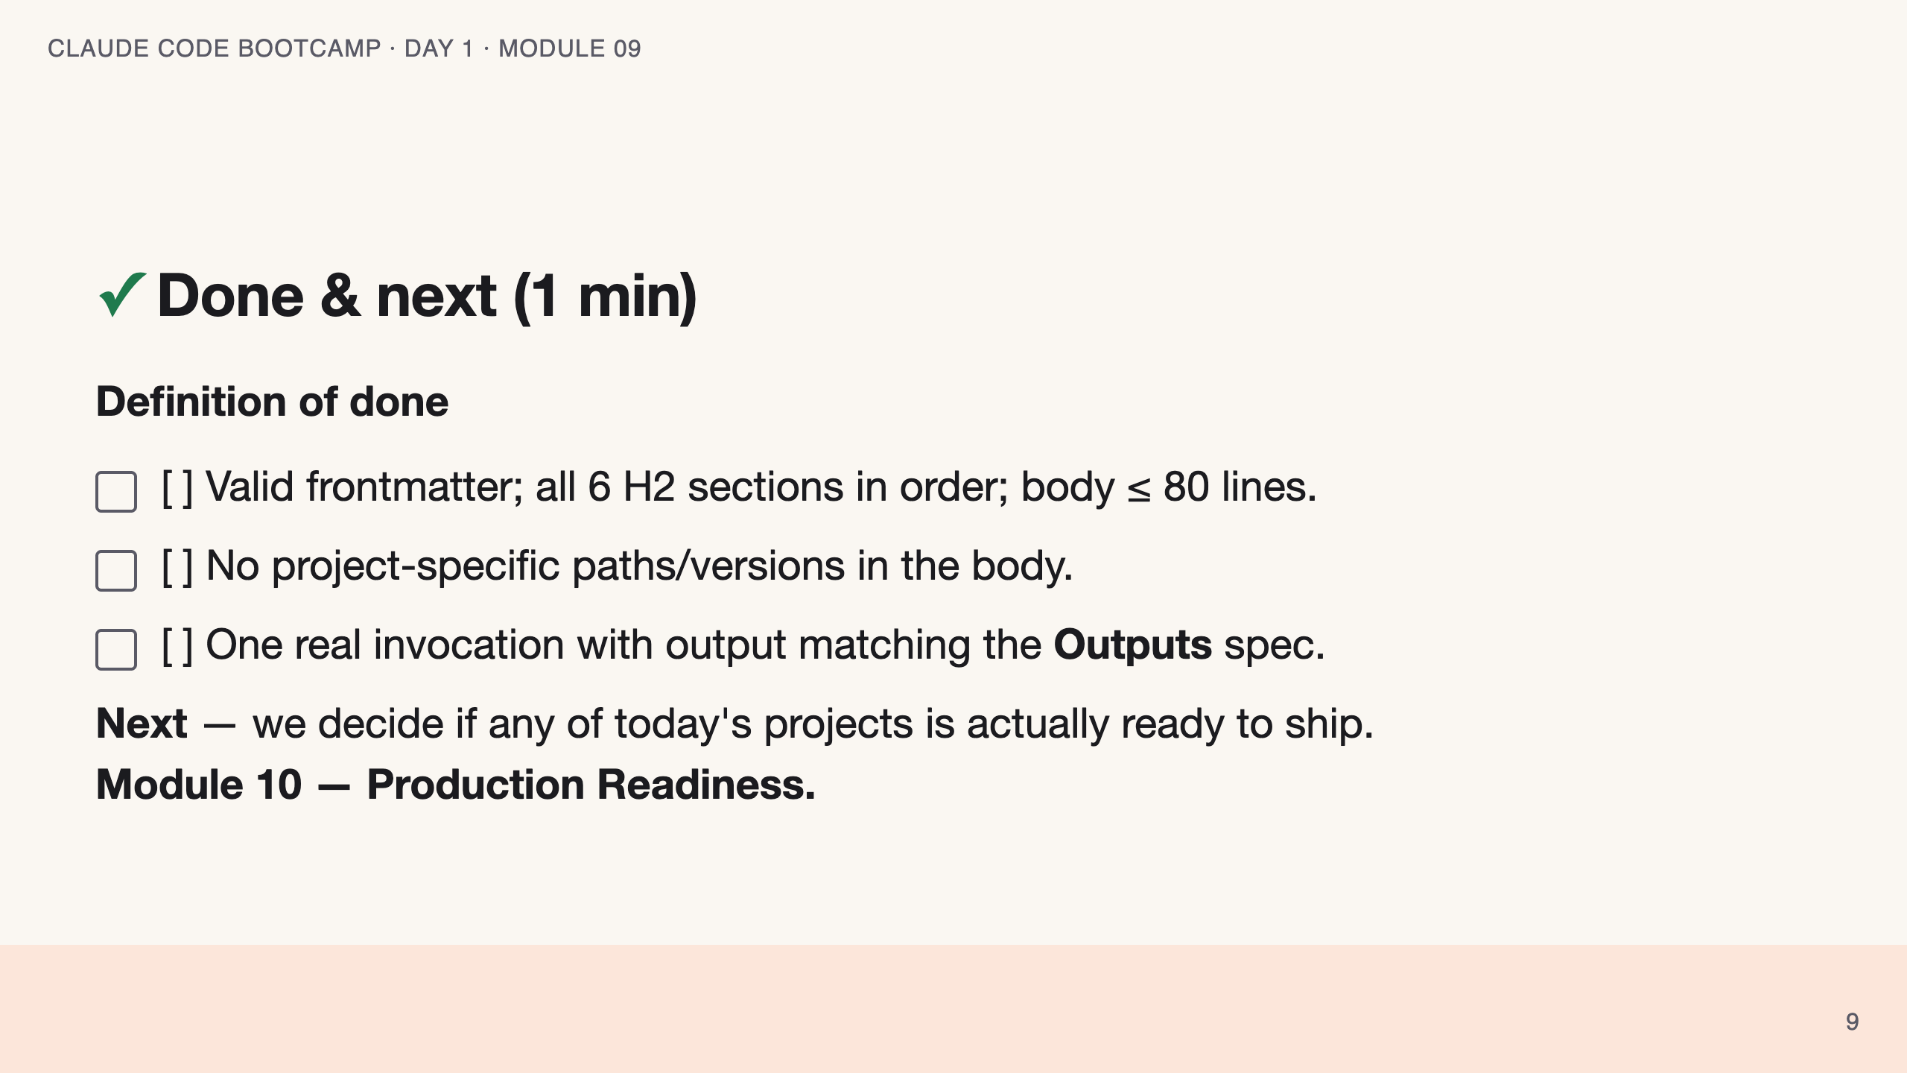
Notes:
SPEAKER NOTES — slide 7 (wrap, 1 min) polish-log 2026-05-28 · lean instructor-pacing shape (matches Module 1 pilot). cover -> theory (4 pillars) -> reference (hooks/MCP · multi-agent/mistakes) -> live demo -> your turn -> done.

