Slide 1

A CASE STUDY ON DUOLINGO
(Based on big data analytics)
Submitted by,
POORNIMA K R
MSC CS(DA) 22
This Photo by Unknown Author is licensed under CC BY

Slide 2
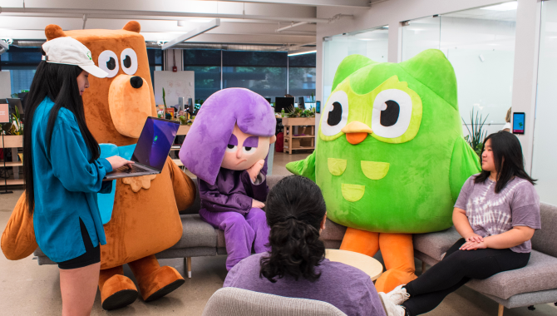
INTRODUCTION
Duolingo is a learning platform that provides free language education through mobile apps and a website. With around 40 million users active on the platform each month, Duolingo may well possess the largest language learning dataset of any company or research institution. Duolingo harnesses big data to transform language learning by collecting extensive data from user interactions, such as lesson completions, practice sessions, and feedback. This data is processed and analyzed using advanced big data technologies, enabling Duolingo to personalize learning experiences, adapt content in real-time, and continuously improve course effectiveness. By leveraging big data, Duolingo ensures a more engaging, efficient, and effective learning journey for millions of users worldwide.

Slide 3

Operational
workflow
2.Data Ingestion
4.Data Analysis
1.Data collection
3.Data storage
Notes:
It's not just the type or amount of data that's important, it's what organizations do with the data that matters.

Slide 4
Duolingo collects data through various user interactions on its platform. Here’s how:
User Profiles: Information provided by users when they sign up, such as age, language preferences, and learning goals
Lesson Interactions: Data from completed lessons, including the time taken, answers given, and mistakes made.
Practice Sessions: Tracking how often users practice and which exercises they choose.
Engagement Metrics: Monitoring daily activity, streaks, and usage patterns.
Feedback and Surveys: Collecting user feedback through in-app surveys and feedback forms.
Device Data: Information about the devices used, including operating system and app version.
Social Interactions: Data from social features like friend competitions and leaderboards.
Data Collection

Slide 5
Apache Kafka: Used for high-throughput, low-latency data streaming. Duolingo can ingest large volumes of user interaction data, such as practice sessions and quiz results, in real-time. Kafka’s fault-tolerant and distributed architecture ensures that data is reliably processed even if there are system failures.
AWS Kinesis: Provides similar real-time streaming capabilities with the added benefit of seamless integration with other AWS services. Duolingo can capture and process user interactions quickly and scale processing as needed.
Both Kafka and Kinesis allow Duolingo to perform real-time analytics on user data. This means that data can be analyzed as it's generated, enabling immediate insights into user behavior, app performance, and engagement metrics.
By analyzing real-time data from Kafka or Kinesis, Duolingo can adjust the user experience on the fly. For example, it can provide personalized content, suggest specific exercises based on user progress, or adapt the difficulty level dynamically.
Data Ingestion and processing
“Data ingestion is the process of collecting and importing data from various sources into a system for storage and analysis”.

Slide 6
Duolingo uses several big data technologies for data storage, each contributing to managing and optimizing their massive volumes of user data:
Apache Hadoop:
Distributed Storage: Hadoop's Hadoop Distributed File System (HDFS) allows Duolingo to store large datasets across multiple machines. This distributed approach ensures that data is not stored on a single point of failure, enhancing reliability and availability.
Scalability: Hadoop can scale horizontally, meaning Duolingo can add more nodes to the cluster as data volume grows, accommodating increasing storage needs without significant changes to the existing infrastructure.
Data Redundancy: HDFS automatically replicates data across different nodes in the cluster, providing fault tolerance and ensuring data durability even in the case of hardware failures.
Data Storage

Slide 7
2.Amazon S3 (Simple Storage Service):
Scalable Storage
Durability and Availability: S3 provides high durability (99.999999999% durability) and availability. Data is automatically replicated across multiple geographic locations, ensuring that Duolingo’s data is both safe and accessible.
Integration: S3 integrates seamlessly with other AWS services used by Duolingo, such as AWS Lambda for processing and Amazon Redshift for data warehousing. This integration streamlines data workflows and supports advanced analytics.
Data Storage
3.Amazon Redshift:
Data Warehousing: Redshift is used for scalable data warehousing, allowing Duolingo to run complex queries and analytics on large datasets. It stores data in columnar format, which is optimized for read-heavy operations typical in analytics workloads.
Performance and Scalability
4.Apache Cassandra:
NoSQL Database: Cassandra is a NoSQL database used for managing large volumes of data across distributed nodes.

Slide 8
How does Duolingo handle data handling challenges?
scalability
Real-Time Processing
Data Analysis And Complexity
Cloud Infrastructure: Duolingo leverages cloud platforms like AWS to scale its storage and computing resources dynamically. Distributed Systems: By using distributed data systems like Apache Kafka and Apache Cassandra.
Stream Processing: Technologies like Apache Kafka and AWS Kinesis enable real-time data ingestion and processing, allowing Duolingo to quickly analyze and act on user data with minimal latency
Advanced Analytics Tools: Utilizing tools like Amazon Redshift and Apache Spark allows for efficient processing of large datasets and complex queries.

Slide 9
Duolingo’s upcoming plans with big data technologies
Data Vault
Predictive Analytics
Augmented and Virtual Reality (AR/VR)
Gamification Enhancements
Notes:
Gamification Enhancements

Slide 10
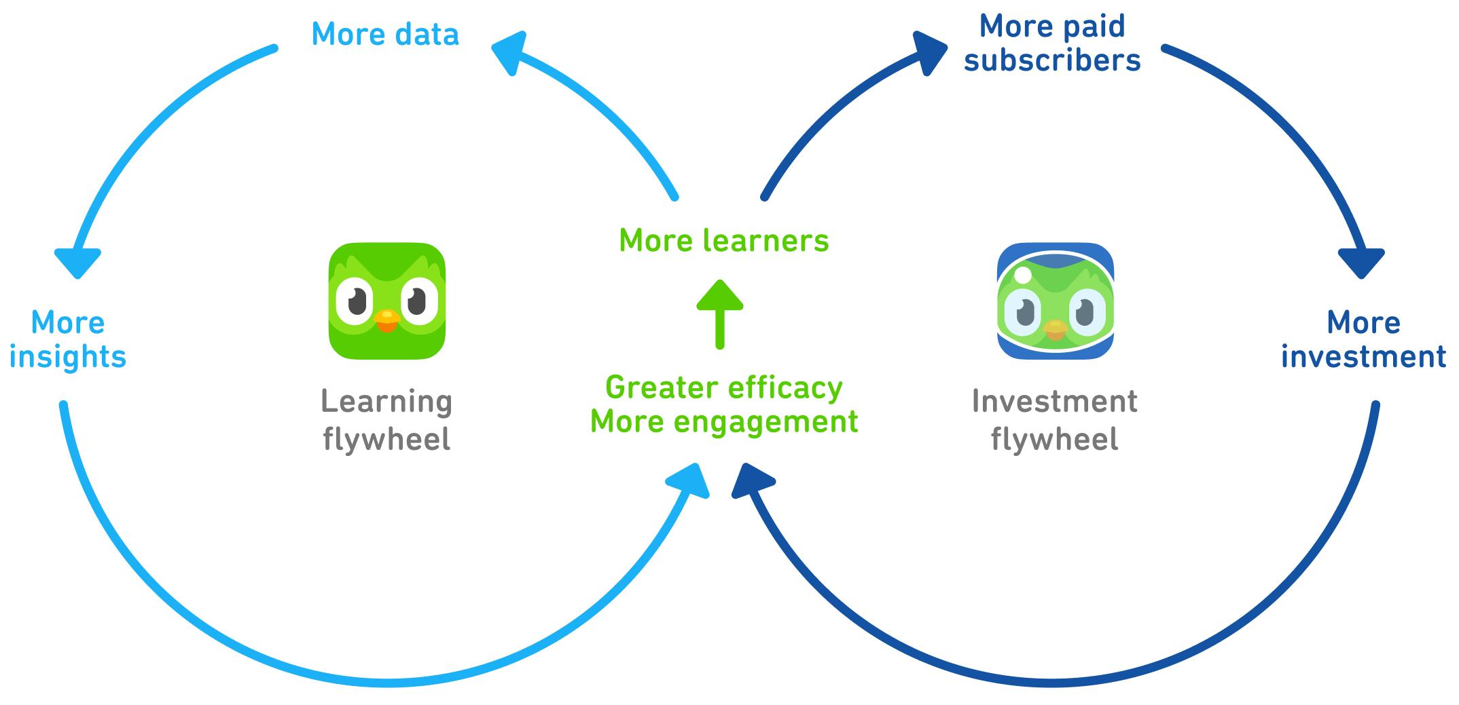
How does more data helps in Duolingo's success?
This Photo by Unknown Author is licensed under CC BY-NC
Notes:
It's not just the type or amount of data that's important, it's what organizations do with the data that matters.

