Slide 1
K.POORNIMA 2021506063
Final Project
3/21/2024 Annual Review

Slide 2
Plagiarism-checker-Python-master
3/21/2024 Annual Review

Slide 3


AGENDA
The agenda of the project would be to create a tool that:
Detects instances of plagiarism by comparing submitted documents against a database of existing texts or against each other.
Provides a measure of similarity between documents.
Outputs a report highlighting sections of the submitted documents that may be plagiarized and indicating the potential source(s).
3/21/2024 Annual Review

Slide 4

PROBLEM STATEMENT
Develop a plagiarism detection tool to identify instances of plagiarism in text documents. Plagiarism is the act of using someone else's work, ideas, or expressions without properly acknowledging the source.
3/21/2024 Annual Review

Slide 5
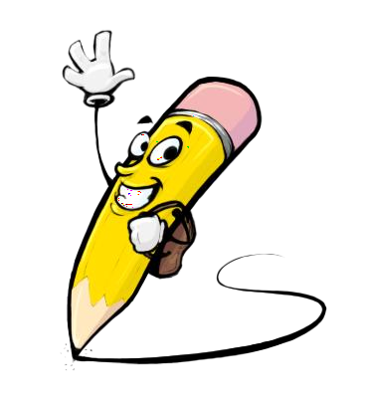
PROJECT OVERVIEW
1. Data Collection:
Gather a dataset of text documents that will serve as the corpus for comparison.
This dataset could include academic papers, articles, essays, or any other relevant text sources.
2. Preprocessing:
Clean and preprocess the text data to remove noise, such as punctuation, special characters, and stop words..
3. Similarity Measurement:
Implement algorithms to calculate the similarity between documents.
Common techniques include vector space models (e.g., TF-IDF), cosine similarity, and machine learning approaches like Siamese networks.
4. Plagiarism Detection:
Compare submitted documents against the corpus to identify sections that closely match existing texts.
Set a threshold for similarity scores to determine instances of potential plagiarism.
3/21/2024 Annual Review

Slide 6

WHO ARE THE END USERS?
Students and Academics: Ensure originality of assignments and research papers.
Educational Institutions: Enforce academic integrity policies.
Publishing Industry: Verify manuscript uniqueness before publication.
Content Creators: Ensure originality of articles and blog posts.
Legal Professionals: Verify originality of legal documents.
Software Developers: Integrate plagiarism detection into applications.
Quality Assurance Teams: Ensure originality of documentation.
General Users: Verify content originality for various purposes.
3/21/2024 Annual Review

Slide 7

YOUR SOLUTION AND ITS VALUE PROPOSITION
Our solution offers a robust plagiarism detection tool equipped with advanced algorithms for accurate analysis, providing users with detailed reports to maintain integrity and originality in their written work, all presented through an intuitive and user-friendly interface.
3/21/2024 Annual Review

Slide 8

THE WOW IN YOUR SOLUTION
Scalability and Performance: Designing the system to handle large volumes of documents and users concurrently while maintaining high performance and responsiveness.
Customization and Flexibility: Allowing users to customize the plagiarism detection settings and parameters based on their specific requirements and preferences.
Integration with AI Technologies: Leveraging artificial intelligence (AI) and machine learning (ML) techniques to enhance plagiarism detection accuracy and adaptability over time.
Comprehensive Reporting: Generating detailed and informative reports that not only highlight instances of plagiarism but also provide insights and recommendations for improving originality.
3/21/2024 Annual Review
8

Slide 9
MODELLING
Teams cam add wireframes
Modeling:
Design robust backend models for storing user data, documents, and analysis results.
Utilize efficient algorithms for similarity measurement and plagiarism detection.
Implement data preprocessing techniques to clean and prepare text data for analysis.
Wireframe:
Create intuitive user interface wireframes with clear navigation and functionality.
Design user-friendly input forms for uploading documents and setting analysis preferences.
Visualize plagiarism reports with highlighted plagiarized sections and source references.
3/21/2024 Annual Review
9

Slide 10
RESULTS
The result is a plagiarism detection tool providing accurate analysis of text documents, generating detailed reports highlighting instances of potential plagiarism, all within a user-friendly interface.
In my project I have included 3 text files(juma.txt,john.txt,fatma.txt) and my project finds the degree of plagiarism between the files
Demo_link
3/21/2024 Annual Review
10

