Slide 1
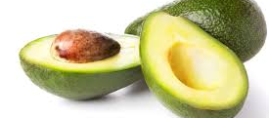
Avocado Price Analysis
By: Poornima Prakash

Slide 2
Introduction
This dataset represents weekly retail scan data for National retail volume (units) and price. Thus has Historical data on avocado prices and sales volume in multiple US markets starting from 2013 to current year.
Data has been collected from IRI / FreshLook Marketing Multi-Outlet (MULO) retail scan data. Multi-Outlet (MULO) reporting reflects retail scan sales across the following channels: grocery, mass, club, drug, dollar and military
The Average Price (of avocados) in the table reflects a per unit (per avocado) cost, even when multiple units (avocados) are sold in bags.

Slide 3
Cont…
Dataset contains 18249 rows and 14 columns.
Below is the table showing names of all the columns and their description.
Column Name | Description
Date | The date of the observation
AveragePrice | The average price of a single avocado
type | Conventional or organic
year | The year
Region | The city or region of the observation
Total Volume | Total number of avocados sold
4046 | Total number of avocados with PLU 4046 sold
4225 | Total number of avocados with PLU 4225 sold
4770 | Total number of avocados with PLU 4770 sold
Date | The date of the observation

Slide 4
Initial Observations
Summary of data types in this dataset:
Object_Columns: type column
Numeric_Columns : Everything else
There are no Nan or missing values in the dataset.

Slide 5
Data Normalization
Standardized all the column headers to lower case to avoid any typo errors.
Convert Date column to pandas readable Datetime type
Remove the column 'Unnamed: 0', as it is just an index column
Do below listed Non-numerical data conversions for easy data analysis and model building for prediction.
Convert ‘type’ column into dummies by separating it into 2 other columns: organic and conventional.
Convert ‘region’ column into a categorical variable, as the data among 54 regions are pretty even.
Convert ‘Date’ column to the right scale to be used in the model.

Slide 6
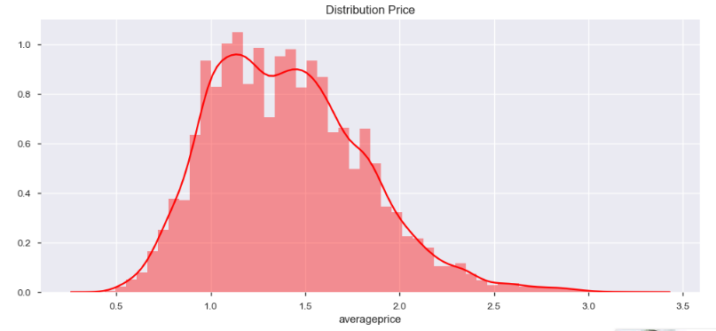
Objectives & Graphs
Distribution of average price of Avocado:
Average Price of avocado is normal with the values mostly between 1.0 and 2.0.

Slide 7
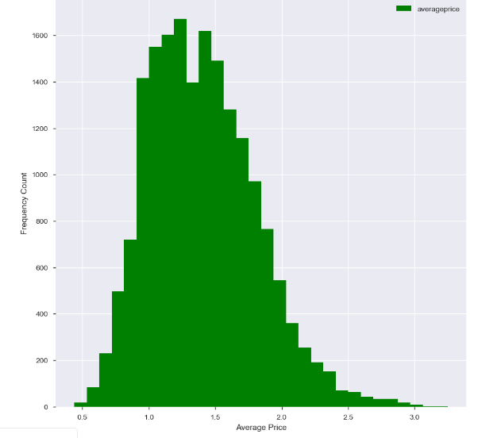
Objectives & Graphs
Frequency distribution of Avocado prices:
The price distribution for both types of Avocado is relatively normal.
The avocado price hovers between $1.00 and $1.80.

Slide 8
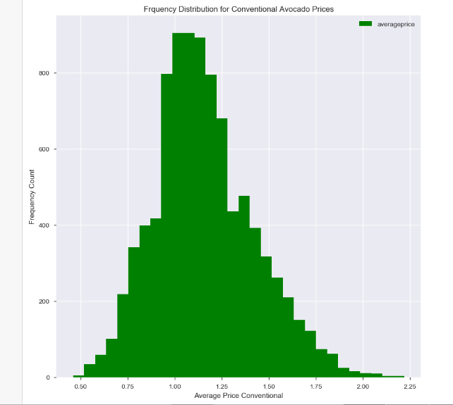
Objectives & Graphs
Frequency Distribution for Conventional Avocado Prices :
For conventional avocado's we see the price distribution is relatively normal. The conventional avocado price hovers around $1.00.

Slide 9
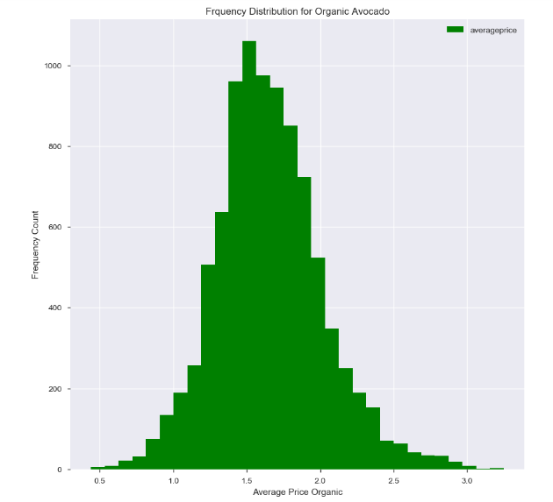
Objectives & Graphs
Frequency Distribution for Organic Avocado Prices :
For Organic avocado's we see the price distribution is relatively normal. The Organic avocado price hovers around $1.50.

Slide 10
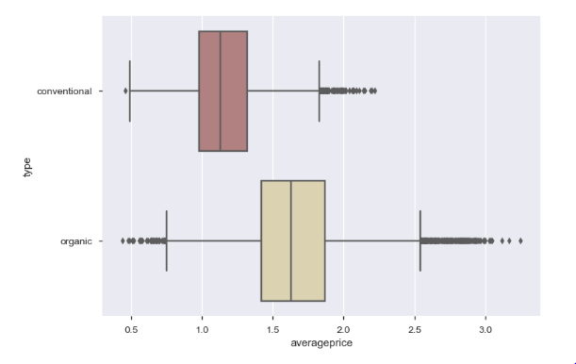
Objectives & Graphs
Average Price Vs Avocado type:
Organic avocados are a little more expensive than conventional types of avocados. On average the price difference between Organic and Conventional Avocados is roughly .50 cents.

Slide 11
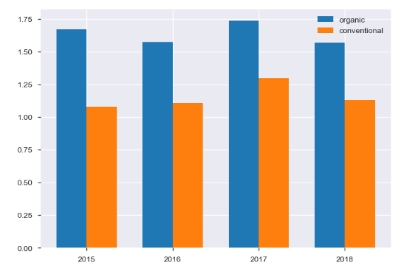
Objectives & Graphs
Price Vs Type and Year:
Average price of organic avocados has been always greater than the conventional ones. Year 2017 records the highest price for both types of the avocados.

Slide 12
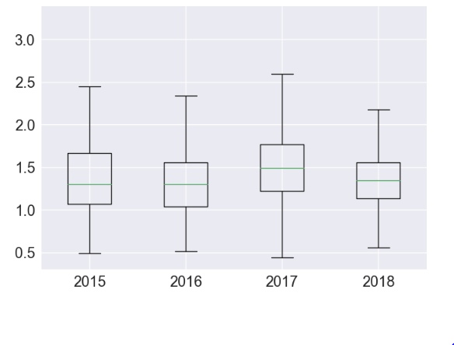
Objectives & Graphs
Price Vs Year:
Avocados prices have suffered a price spikes in 2017, but the prices have dropped comparatively in 2018.

Slide 13
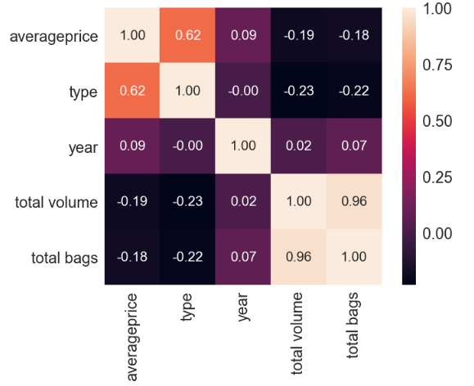
Objectives & Graphs
Correlation Heat Map:
The price of avocado is influenced by the column 'type'. Also, there is a strong correlation between the features: "Total Bags" and "Total Volume". features Small Bags, Large Bag are also strongly correlated.

Slide 14
Model Creation and Evaluation
Regression Model with all features:
MAE: 0.23252019140625357
MSE: 0.09060791128181109
RMSE: 0.30101148031563696
Regression Model with selected features:
MAE: 0.23713058607891768 MSE: 0.09344406705311693 RMSE: 0.30568622319809724

Slide 15
Model Creation and Evaluation
Decision Tree Model :
MAE: 0.22030215504594303 MSE: 0.08270529518903273 RMSE: 0.28758528333180183
Random Forest Model:
MAE: 0.22038662152182664 MSE: 0.0827833196690666 RMSE: 0.2877209058602913

Slide 16
Model Creation and Evaluation
Regression Model with XGBoost :
MAE: 0.09359595147929634
MSE: 0.01771736615336724
RMSE: 0.13310659695660162
R^2 of XGBoost: 0.8909105096208638
The RMSE value from the XGBoost regression model is 0.133, obviously lowest compared to the previous models. Also, the model also has the higher R square value. Hence, we chose the XGBoost regression model as our solution.

Slide 17
Conclusion
The Average Price of both organic and conventional avocados was getting more expensive from 2015 to 2018. Also the price varies from region to region.
Organic avocados are more expensive than conventional ones.
The Average Price of avocados is affected by years, regions, types.
On evaluating different models to predict the avocado prices, found that the XGBoost regression model gave the best results with least RMSE(0.13) value.

