Slide 1

Car Sales – EDA
By: Poornima Prakash &
Ravi Sahu

Slide 2
Introduction
This Car_Sales dataset was collected by Anton Bobanev from car sale advertisements for study/practice purposes in 2016
This dataset contains data for more than 9.5K cars sale in Ukraine.
Most of them are used cars so it opens the possibility to analyze features related to car operation. Thus, can be used to compare car sales pattern in Ukrainian market

Slide 3
Cont…
Dataset contains 9576 rows and 10 columns.
Below is the table showing names of all the columns and their description.
Column Name | Description
car | manufacturer brand
price | seller’s price in advertisement (in USD)
body | car body type
mileage | as mentioned in advertisement (‘000 Km)
engV | rounded engine volume (‘000 cubic cm)
engType | type of fuel (“Other” in this case should be treated as NA)
registration | whether car registered in Ukraine or not
year | year of production
model | specific model name
drive | drive type

Slide 4
Initial Observations
Summary of data types in this dataset:
Numeric_Columns: price (Float),Mileage (integer), engV (Float), Year (integer)
Object_Columns: Everything else
price & mileage columns have some values 0, that are too low to be real price.
The following variables have null values that needs to be addressed.
drive: There are 511 missing values.
engV: There are 434 missing values.

Slide 5
Data Normalization
Standardized all the column headers to lower case to avoid any typo errors.
Replaced missing entries of Drive and Engine Volume (engV) columns with the median values.
Replaced the outliners (0) of Price and Mileage columns with the median values.
Added new column- ‘Mileage_Level’ with values ‘Low Mileage’ if corresponding mileage column value is less than the average value. Otherwise has the value ‘High Mileage’.

Slide 6
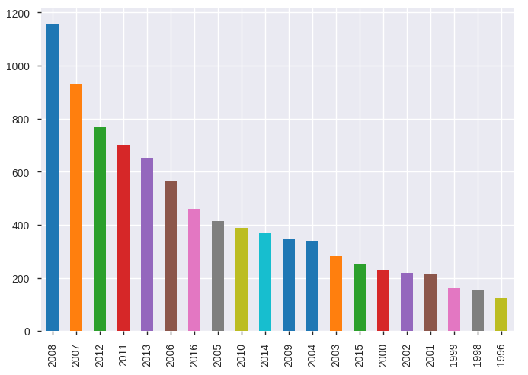
Objectives & Graphs
Comparison of car sales over few years :
The bar graph clearly shows the sale of cars was highest in the year 2008.
Now the sales of car has reduced drastically by more than 50% in the recent years.

Slide 7
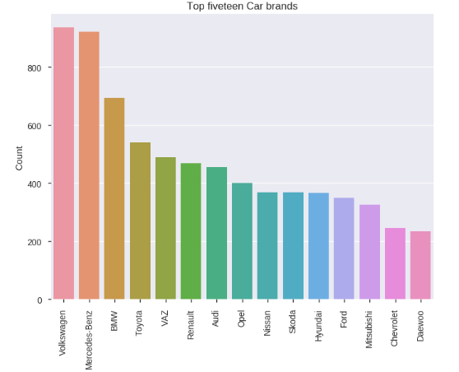
Objectives & Graphs
Top 15 Car brands:
Volkswagen and Mercedes-Benz cars are the most popular car brands in Ukraine. Followed by car brands like BMW, Toyota etc

Slide 8
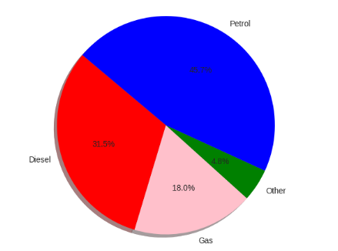
Objectives & Graphs
Preferred Fuel types:
Petrol cars are the most widely sold Engine Type. Followed by Diesel car. Gas and Other fuels are not so commonly used

Slide 9
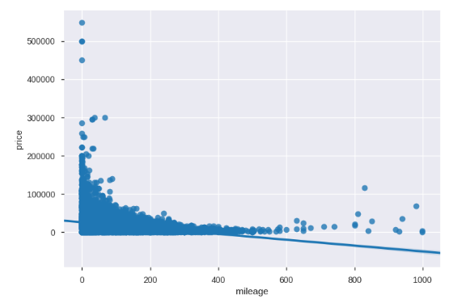
Objectives & Graphs
Price Vs Mileage:
Mileage and price are indirectly related. High priced cars give very low mileage and visa-versa.

Slide 10
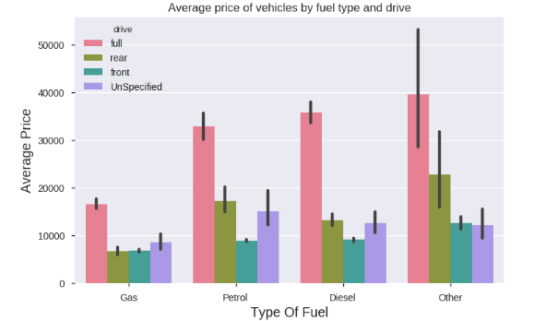
Objectives & Graphs
Price Vs Fuel Type and Drive:
Full drive cars of all engine fuel type cars are high priced compared to other drive cars. In Petrol and Diesel all types of car drives are almost equally priced.

Slide 11
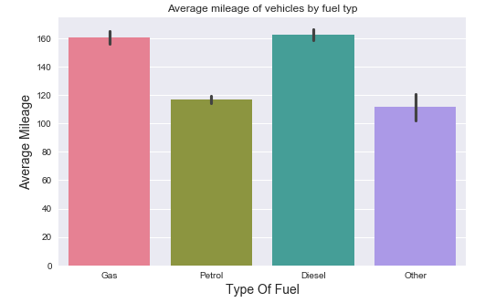
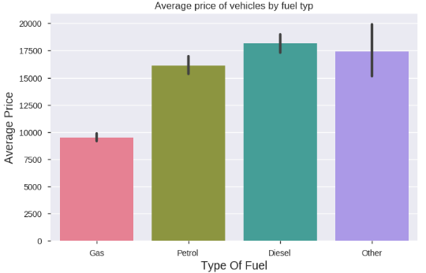
Objectives & Graphs
Price Vs Fuel Type and Drive:
Diesel cars give high mileage and thus highly priced. On the other hand Gas cars priced less, but give equivalent mileage as Diesel.

Slide 12
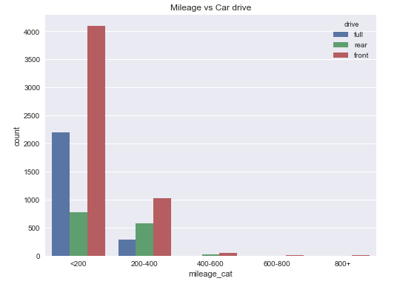
Objectives & Graphs
Mileage Vs Drive:
Front drive cars are most preferred because of the high mileage they provide. Followed by the full drive cars in the low mileage category(<200).

Slide 13
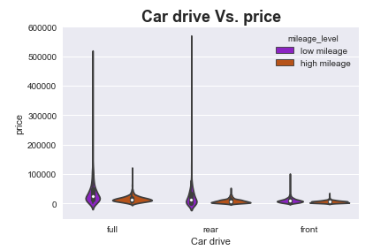
Objectives & Graphs
Price Vs Car Drive and Mileage:
In all the car drive types, low mileage car are highly priced. where as the high mileage cars are priced low.

Slide 14
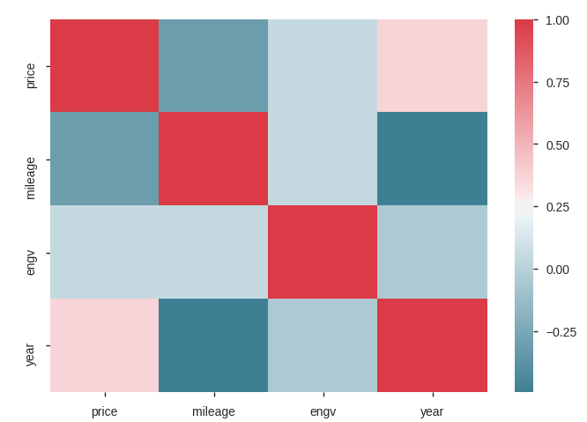
Objectives & Graphs
Correlation Heat Map:
Heat map clearly signifies Mileage-Year & Mileage-Price are highly correlated.

Slide 15
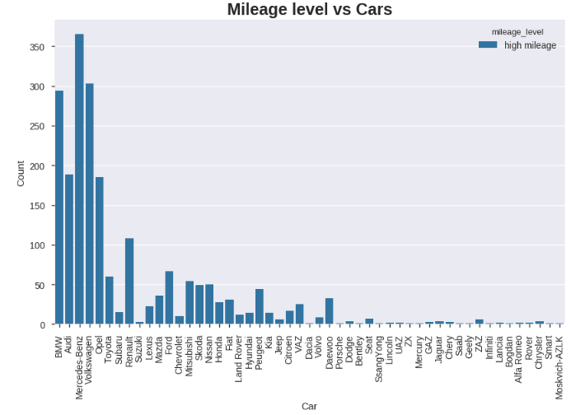
Objectives & Graphs
Car brand Vs Mileage:
Volkswagen and Mercedes-Benz cars provide highest mileage and thus highly preferred.

Slide 16
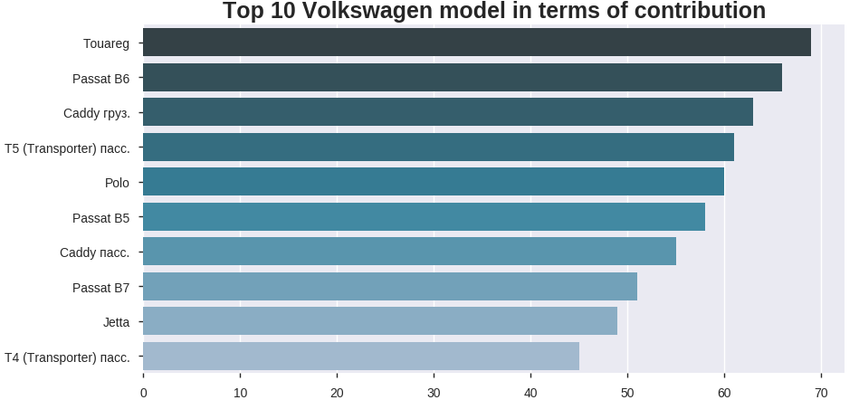
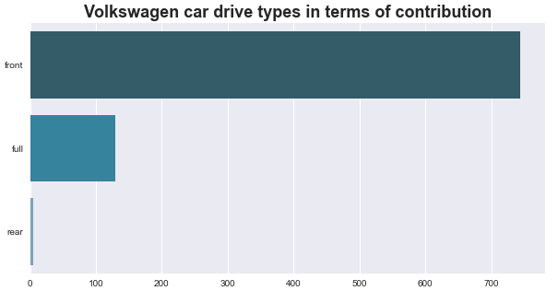
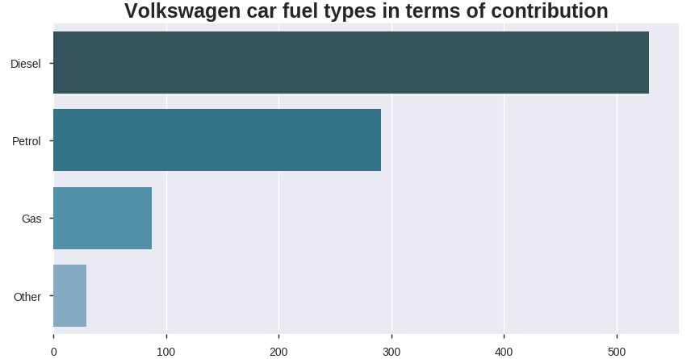
Objectives & Graphs
Top one selling car brand (Volkswagen) features:
Front drive diesel cars are preferred in the Volkswagen car brand. Top 10 selling Volkswagen models are as listed in the graph.

Slide 17
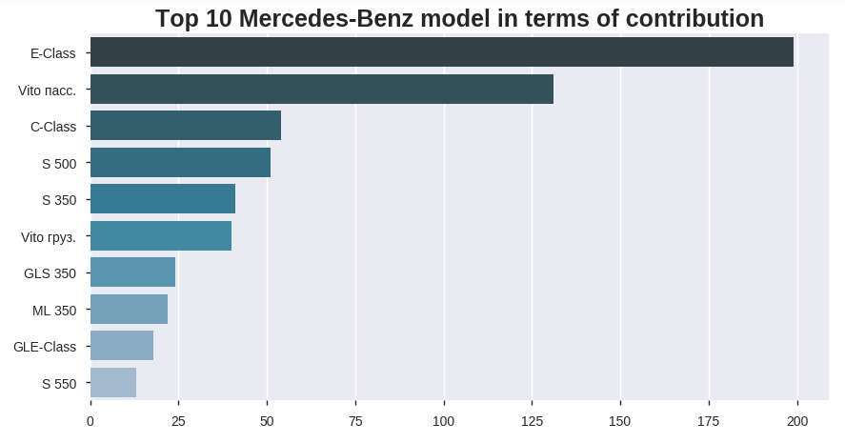
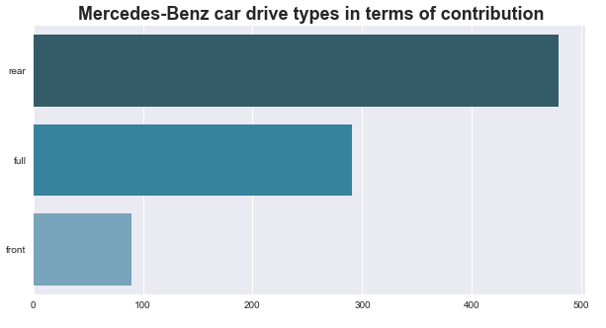
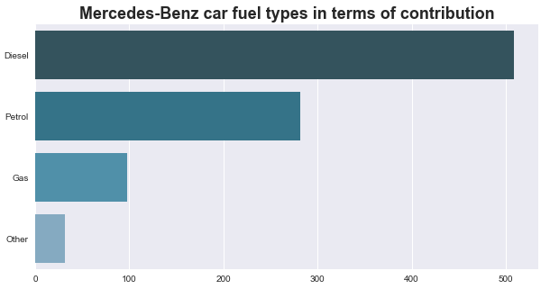
Objectives & Graphs
Top second selling car brand (Mercedes-Benz) features:
Rear drive diesel cars are preferred in the Mercedes-Benz car brand. Top 10 selling Mercedes-Benz models are as listed in the graph.

Slide 18
Conclusion
The Car sales Survey being conducted helps us to know the most preferred car brand and features affecting it.
Diesels cars provide high mileage are highly priced. But Gas cars provide equally high mileage but are priced low.
In Front drive cars low mileage cars are highly priced.
From the analysis, it was concluded that Volkswagen front drive Diesel cars are most preferred. Followed by Mercedes-Benz rear drive Diesel cars due to their features.

